Slide 1
Church matters
1 Corinthians 2:15-3:9

Slide 2
Notes:
How’s your sabbathing?

Slide 3
Church matters
1 Corinthians 2:15-3:9

Slide 4
1 Corinthians 2:15-3:9 ESV
¹⁵ The spiritual person judges all things, but is himself to be judged by no one. ¹⁶ “For who has understood the mind of the Lord so as to instruct him?” But we have the mind of Christ.
3 But I, brothers,^{[a]} could not address you as spiritual people, but as people of the flesh, as infants in Christ. ² I fed you with milk, not solid food, for you were not ready for it. And even now you are not yet ready, ³ for you are still of the flesh. For while there is jealousy and strife among you, are you not of the flesh and behaving only in a human way?

Slide 5
1 Corinthians 2:15-3:9 ESV
4 For when one says, “I follow Paul,” and another, “I follow Apollos,” are you not being merely human?
5 What then is Apollos? What is Paul? Servants through whom you believed, as the Lord assigned to each. 6 I planted, Apollos watered, but God gave the growth. 7 So neither he who plants nor he who waters is anything, but only God who gives the growth. 8 He who plants and he who waters are one, and each will receive his wages according to his labor. 9 For we are God's fellow workers. You are God's field, God's building.

Slide 6
Salvation
Development
Prayer

Slide 7
1 Corinthians 2:15-3:9 ESV
¹⁵ The spiritual person judges all things, but is himself to be judged by no one. ¹⁶ “For who has understood the mind of the Lord so as to instruct him?” But we have the mind of Christ.
3 But I, brothers,^{[a]} could not address you as spiritual people,
Notes:
the implication is that the spiritual person has the ability to weigh and make decisions righteously and yet lives in a way that cannot be judged as being outside the expectations of a devoted follower of Christ…as a whole, the Corinthian church m embers were not there

Slide 8
1 Corinthians 2:15-3:9 ESV
but as people of the flesh,
as infants in Christ.
^{Acts 18 & 19}
² I fed you with milk, not solid food, for you were
not ready for it.
Notes:
according to GD Fee, this doesn’t mean living a lost, lustful life, but instead of being motivated by the things of God or His indwelling spirit, they are living merely by human-based drives of belonging to someone, the daily grind, living in this physical world. Really no different than their unsaved neighbors and coworkers.
This “infant-ism” indicates a couple of things: 1. Their salvation is true and real 2. Their salvation is still in early phases, holistically. Reviewing Acts 18, Paul meets Priscilla and Aquilla and the 3 of them plant a church in Corinth. He lived with them and joined their family business, tent making. Titius Justus hosted the early church Titius is not of jewish decent, but a follower of God, enammered by the jewish beliefs in a world of human sufficiency and pursuits; Paul’s buddies Timothy and Barnabus joined in. Crispus, the ruler of the Jewish synagogue heard Paul, a fellow Jew and joined in, creating a church of Jews and Gentiles. Paul lived with the new church for 18 months. Then, Priscila and Aquilla traveled with Paul to Ephesus. Paul moved on P &A stayed put and met a passionate, articulate preacher named Apollos. His theology around baptism was a little off, so P&A taught him, he humbly adjusted and continued the work, apparently moving on to Corinth with P&A to help the church. While Apollos was in Corinth, Paul circled back to Ephesus and met some pre-P&A disciples of Apollos, corrected their idea of baptism, and they became filled with the holy spirit, teaching and presumably growing the Ephesian church. So significant time has passed, after lots of investment from the early church leaders, and Corinth has not moved measurably. Reflecting back to his 18 months in Corinth, Paul states.
This mixed church of gentiles and Jews had to be brought together under one truth of the Gospel of Jesus without erasing the importance of the Jewish old testament heritage and welcoming the people the Law would state were “not chosen.” So a difficult mix, and justly requiring someone like Paul, and Turkish Jew with roman citizenship and Timothy, the child of gentile and jewish families to come in, level set the story of God and man, the coming of Messiah, and the change from a chosen nation to salvation for all.

Slide 9
1 Corinthians 2:15-3:9 ESV
And even now you are not yet ready,
³ for you are still of the flesh.
For while there is jealousy and strife among you, are you not of the flesh and behaving only in a human way?
Notes:
and at least 2 years later, their church still hasn’t moved on…failure to thrive puts the church at risk for death because of not consuming enough of the right kind of spiritual calories. Whether it was form or heritage, the factioning in the church interfered with each person’s ability to grow in Christ and the church to grow in unity and influence.
So while most assuredly saved for eternal glory, heaven bound, this church’s membership are still living according to the daily drivers of any other person. They are an ineffective church. How would their church answer this question: How is your gathering of good people to help each other as well as non-members any different than other non-profits? That should be a question any of us ask when doing temperature checks of Darby Creek. If church is just a social club of sorts, count me out.
Oh the power of needing to be right! Following Paul or apollos could be racist; culturist, styling, even agist. Now before we go one, this jealously and strife happened to be the symptom of this church, of this group of Christians. Later in the letter, Paul calls out other symptoms, some are really wild, others could be flushed out here. “Behaving in a human way” really means ignoring or being unaware of how the Bible teaches us to handle the pressures of life, empowered by the Holy Spirit. The stressors on a “carnal church” are not always a point of self indulgence or gain or style preferences of members, but sometimes a cause of fear or frustration or failure. When the going gets tough, what happens…is it a bootstrap church filled with bootstrap Christians? Ambulance story – great person doing great things, momentarily forgetting that grace overcomes our human frailities, and that grace gives the holy spirit to do extraordinary things.

Slide 10
1 Corinthians 2:15-3:9 ESV
4 For when one says, “I follow Paul,”
and another, “I follow Apollos,”
are you not being merely human?
.
Notes:
Paul, born in Turkey around 4 bc, grew up in the educational system of the jewish leadership, the law; he was a zealous religious person, he was the last Apostle….listen to Greg’s teahing for the meaning there…he was the first one to Corinth
Appolos was from Egypt, born after Paul, he was eloquent and bold, Paul admittedly not so much, from a different culture, probably educated more in the mix of religion and Greek and oriental philosophy, medicine, sciences, being from Alexandria. He was mighty in the scriptures, but doesn’t appear to have been instructed in the hierarchy and governmental ways of the Sanhedrin.
The preference factor….we have personality and taste, God-given gifts. But preference isn’t at the core of the church’s growth and any Christian’s devotion. We must become students of the truth, God’s word

Slide 11
1 Corinthians 2:15-3:9 ESV
5 What then is Apollos? What is Paul?
Servants through whom you believed,
as the Lord assigned to each.
Notes:
What…not who. “What” indicates less than a human personality, life, instead a tool of God…
Believed, again reaffirming that the whole of the church truly are saints of God
God assigned the role to each leader, overcoming and leveraging their differences, set in God’s timing of their experience with each church

Slide 12
1 Corinthians 2:15-3:9 ESV
6 I planted, Apollos watered, but God gave the growth.
7 So neither he who plants nor he who waters is anything, but only God who gives the growth.
8 He who plants and he who waters are one, and each will receive his wages according to his labor.
Notes:
In Ephesus, it appears the roles were reversed, at least with some of the saints, as Apollos planted with his P&A-corrected teachings and Paul came and watered …. Regardless the reality is no church leader can cause or make the church to grow, it is the unencumbered spirit of God working within the community of the church – it is the leaderships’ role to be used by God, malleable and available to His working in the needs of the members.
The implication is something else is retarding the growth of the church at Corinth. He is releasing himself and Apollos (and the other planters) and squarely placing the condition of the church today on the immature members of the church and their behaviors and beliefs that block the indwelling and influence of the Spirit of God. This is important because free will doesn’t stop at the moment of conversion, but is a daily decision, even momentary decision by each member of big C church … the health and growth of Darby Creek Church, or the American Church, or the Church united around the world is impacted by my walk and development in Christ
Paul, in a sense gives himself an out for the condition of the Corinthian church…he taught and invested as he was destined to do…Paul and Apollos did their job, united in God. but as an ongoing laborer and having truly invested his heart and soul into this potentially mighty, mixed church of God, he still reaches back to build unity through personal devotion in Christ.

Slide 13
1 Corinthians 2:15-3:9 ESV
9 For we are God's fellow workers. You are God's field, God's building.
Notes:
You” here is the Corinthian church. Not Paul’s. not Apollos’, not Turkish, not African. Not Sanhedrin officer, not philosophical STEM student…God’s field, God’s building, God’s “project”
So for church unity, these three things are a must:
1. Majority of the attendees have their flesh, their humanness overcome with the salvation of Jesus Christ becoming Lord of their life. They are true believers. All are welcomed, growth is from God.
2. They are moving on from the elementary ideas of I am a sinner saved by grace to I am a “what,” a tool of God to be used to build the body of the church. My investment of gifts, talents, abilities, availabilities to fill a gap in this church are bigger than my desire for satisfaction, excitement, interest, or even beliefs. To do this, I must:
Study his word, spend time with him, be rested in him so I know what I am
Spend time with his people, the church he has placed me in, today. How does your “what-ness” fit with other’s “what-ness” are those pieces fitting better over time, or is the pressure pushing them together benefiting the edges, creating a ridge . who needs to move? Are your main things the plain things and the minor things, minor things? Do you know how to relate and respond, spiritually, or do I rely on a fleshly, comfortable ways?
3. Pray. Pray for others in your church, for their growth, their care…how do you know how to pray, get to know them! Pray for your own fleshliness to fall away and your spirit would become more discerning of your motivations, beliefs and drives. Are they aligned with the Spirit who is from God.

Slide 14
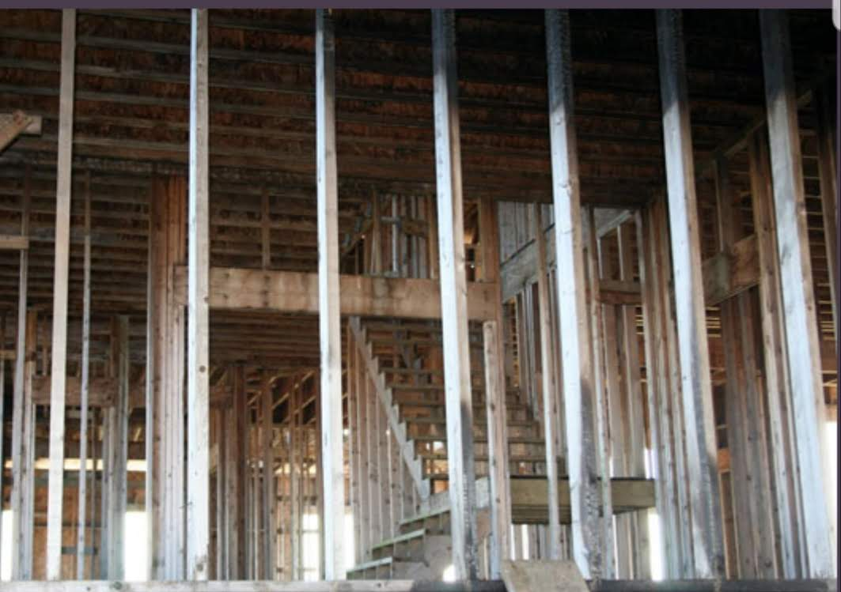
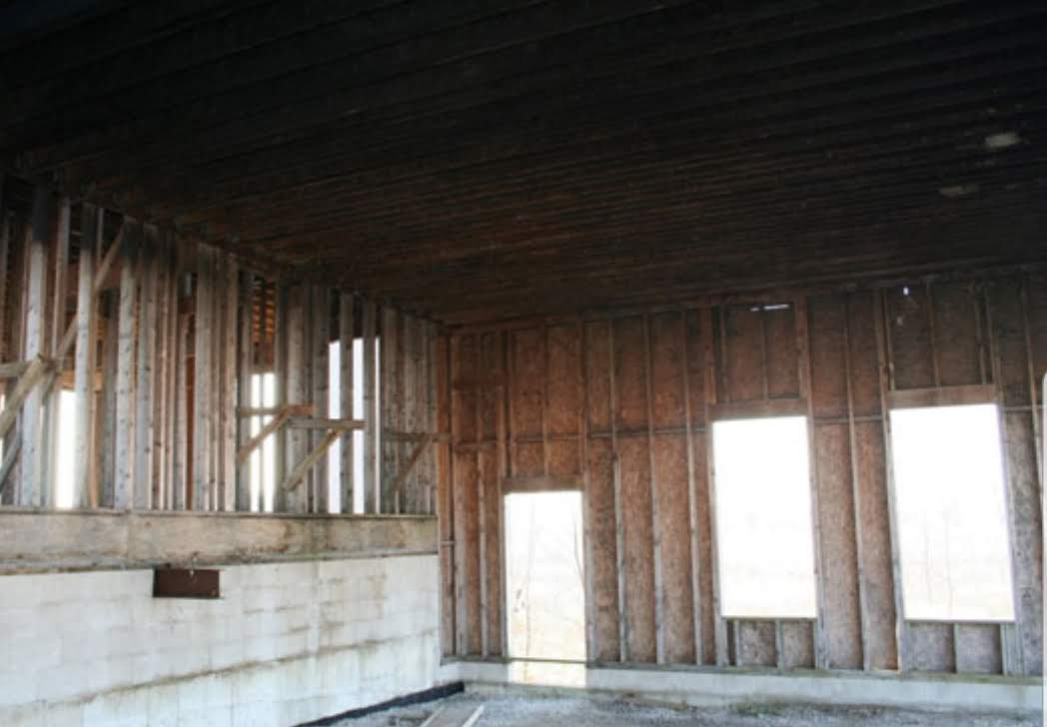
Notes:
We discussed the field and farming of God’s church this morning. But at the end of verse 9, Paul starts the idea of the church as a building. When we look at this new-house build, we see appropriate use of concrete, 16 inch on center studs, risers going to substantial platforms, headers built substantially, double plates in the right places on weight-bearing structures. It is well designed and executed. This house is 20 years old

Slide 15
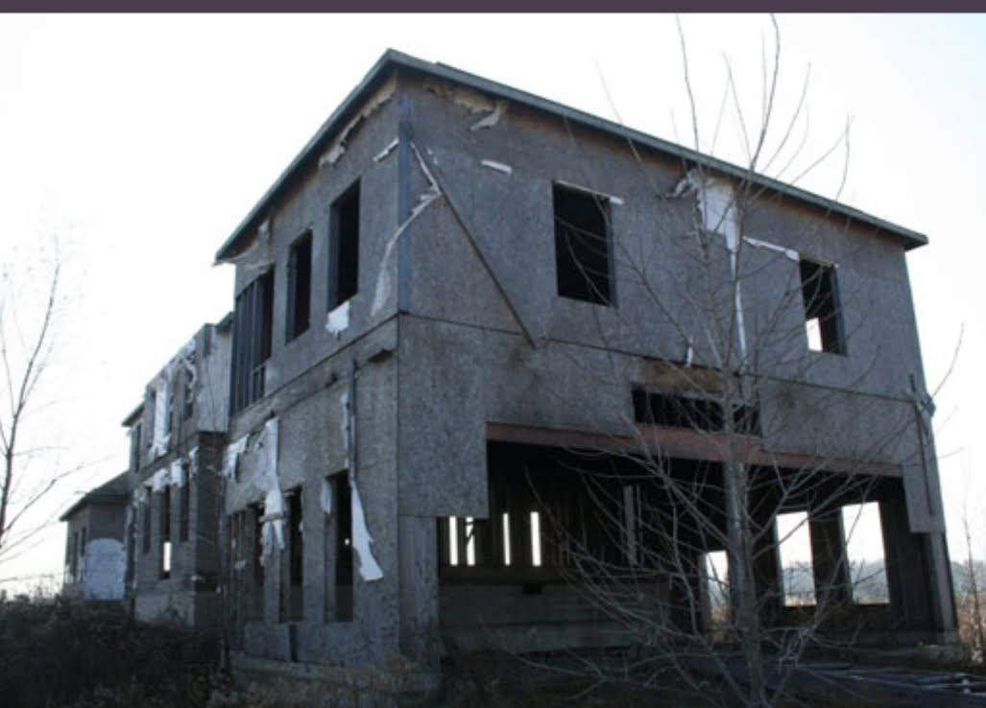
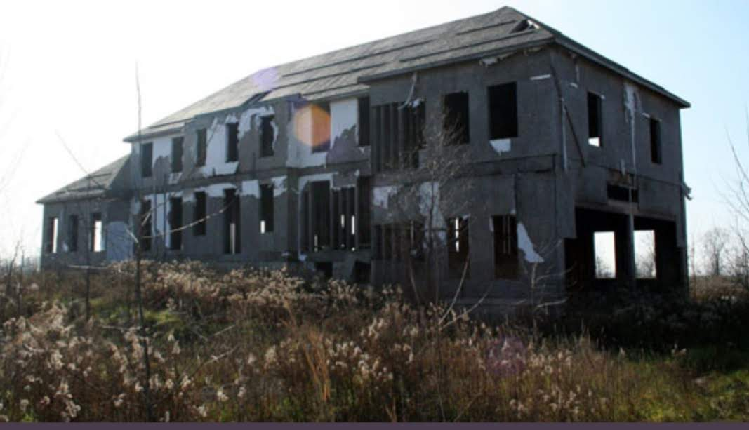
Notes:
I drove past this house for about 15 years, up route 23 in Michigan. You can see how grand and substantial it’s plans and structure meant for it to be.Love the 4-car garage! But it didn’t get finished. The foundation was laid, structure confirmed, but when it came time for the people who were going to live in it to start investing all work came to a hault. No money to be invested; no decisions on the brick, the wall coverings, the doors. The perfectly well intended and designed house has since collapsed in a strong storm, largely because of disinterest from others outside the core leadership of the project. It could have been funded further. Others could’ve gotten a whale of a deal and finished the dicsions and directions. But it’s gone.
God’s work will continue and continue to go where people move from milk to to meat, to unity in Christ. We blame the weakening of the American church on outside forces including the fade of culture. But where the church members continue their personal growth, the welcoming and investing of others into the life, the church remains an important influence, the salt of the earth.

Slide 16
Church matters
1 Corinthians 3:1-9

