Slide 1
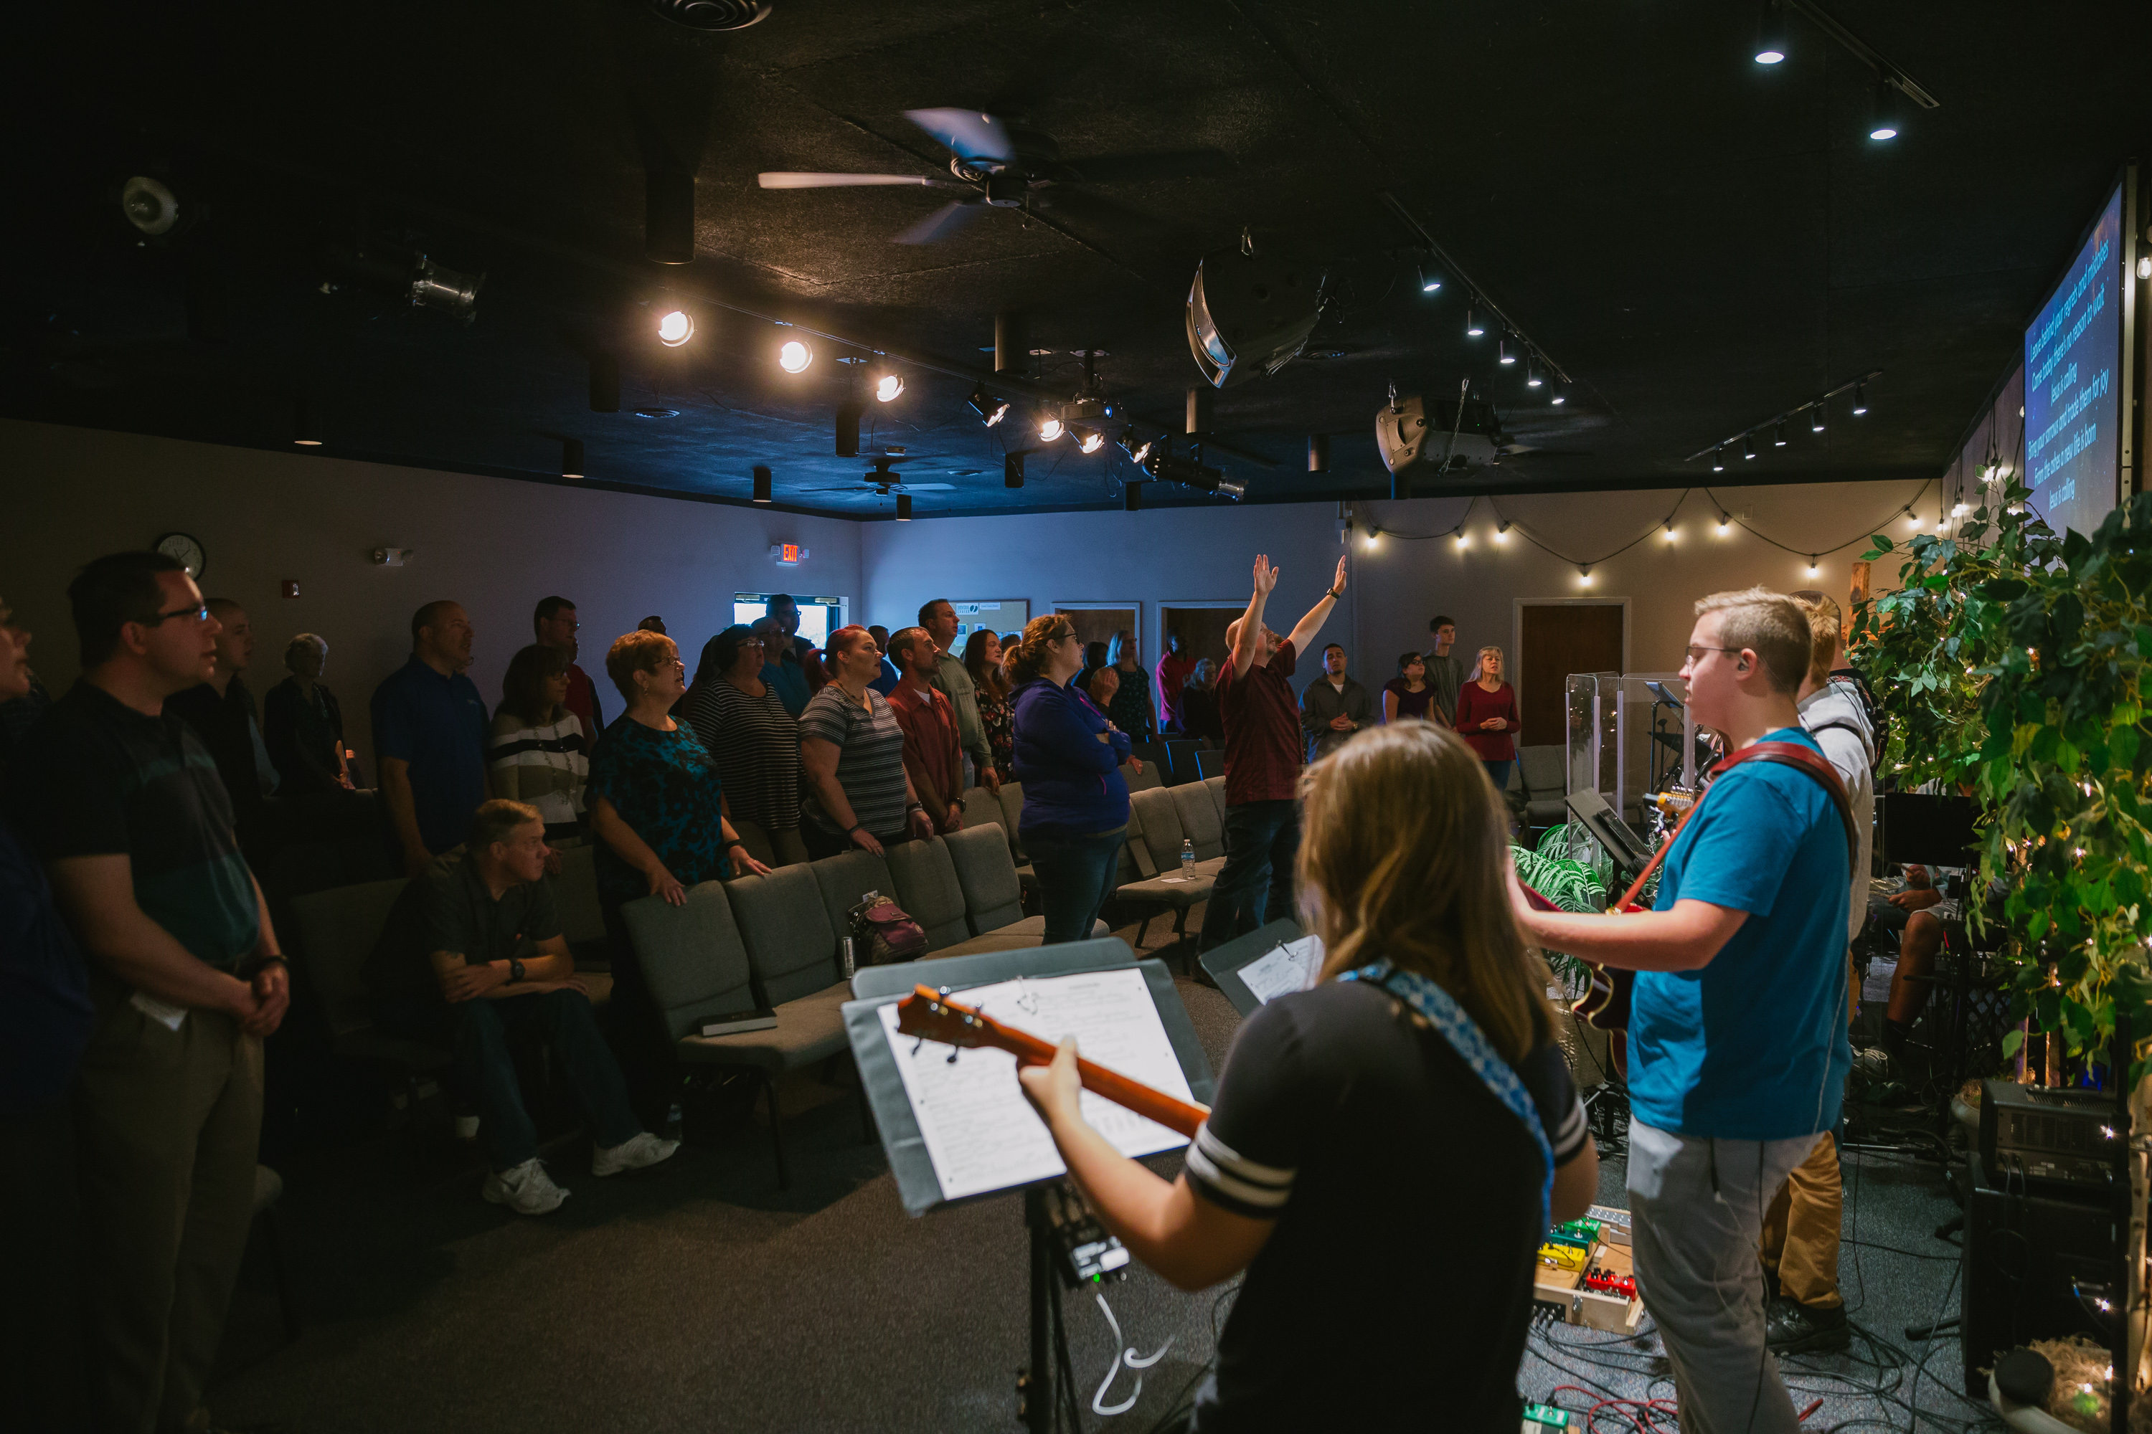
Church-Wide Meeting – TODAY!
Following the Service in the Sanctuary
You will hear about…
Events that are planned for 2019-2020
Our church focus / theme for the year
How you can pray and participate
** Child care is not provided during this meeting, but parents are welcome to have their children with them

Slide 2
GO Sunday is Sept 29
SignUp on Our Website

Slide 3

Our Kids Ministry Needs You!
KICK (K-5th Grade)
Clubhouse (Preschool)
Need 2 Teachers
Contact Beth Shimer
Need 1 Teacher
Need 1 Helper
Contact Lex Bennett
Contact these Ministry Leaders directly or fill out an INFO card
(in the seat backs) and put it in a Donation / Response Box

Slide 4

Watch Over Your Heart
1 Kings 11

Slide 5
1 Kings 11:1-13 (ESV)
1 Now King Solomon loved many foreign women, along with the daughter of Pharaoh: Moabite, Ammonite, Edomite, Sidonian, and Hittite women,
2 from the nations concerning which the Lord had said to the people of Israel, “You shall not enter into marriage with them, neither shall they with you, for surely they will turn away your heart after their gods.” Solomon clung to these in love.
3 He had 700 wives, who were princesses, and 300 concubines. And his wives turned away his heart.
4 For when Solomon was old his wives turned away his heart after other gods, and his heart was not wholly true to the Lord his God, as was the heart of David his father.

Slide 6
1 Kings 11:1-13 (ESV)
5 For Solomon went after Ashtoreth the goddess of the Sidonians, and after Milcom the abomination of the Ammonites.
6 So Solomon did what was evil in the sight of the Lord and did not wholly follow the Lord, as David his father had done.
7 Then Solomon built a high place for Chemosh the abomination of Moab, and for Molech the abomination of the Ammonites, on the mountain east of Jerusalem.
8 And so he did for all his foreign wives, who made offerings and sacrificed to their gods.
9 And the Lord was angry with Solomon, because his heart had turned away from the Lord, the God of Israel, who had appeared to him twice

Slide 7
1 Kings 11:1-13 (ESV)
10 and had commanded him concerning this thing, that he should not go after other gods. But he did not keep what the Lord commanded.
11 Therefore the Lord said to Solomon, “Since this has been your practice and you have not kept my covenant and my statutes that I have commanded you, I will surely tear the kingdom from you and will give it to your servant.
12 Yet for the sake of David your father I will not do it in your days, but I will tear it out of the hand of your son.
13 However, I will not tear away all the kingdom, but I will give one tribe to your son, for the sake of David my servant and for the sake of Jerusalem that I have chosen.”

Slide 8
Watch Over Your Heart
1 Kings 11

Slide 9

Observations about Solomon’s Fall
1: The Little, Daily Choices Make a Big Difference

Slide 10
Observations about Solomon’s Fall
2: Sin is a Heart Problem

Slide 11
Watch Over Your Heart

Slide 12
Proverbs 4:20-27 (ESV)
20 My son, be attentive to my words;
incline your ear to my sayings.
21 Let them not escape from your sight;
keep them within your heart.
22 For they are life to those who find them,
and healing to all their flesh.
23 Keep your heart with all vigilance,
for from it flow the springs of life.
24 Put away from you crooked speech,
and put devious talk far from you.

Slide 13
Proverbs 4:20-27 (ESV)
25 Let your eyes look directly forward,
and your gaze be straight before you.
26 Ponder the path of your feet;
then all your ways will be sure.
27 Do not swerve to the right or to the left;
turn your foot away from evil.

Slide 14
Watch Over Your Heart
1: Understand the Heart is Something to be Treasured

Slide 15
Watch Over Your Heart
2: Make Guarding Your Heart a Priority

Slide 16
Watch Over Your Heart
3: Listen Closely to God’s Word

Slide 17
Watch Over Your Heart
4: Cut Down on the Trash (Garbage In, Garbage Out)

Slide 18
Watch Over Your Heart
1 Kings 11

