Slide 1
GO Sunday is NEXT SUNDAY
Arrive Here at 9:30am!!
SignUp on Our Website

Slide 2
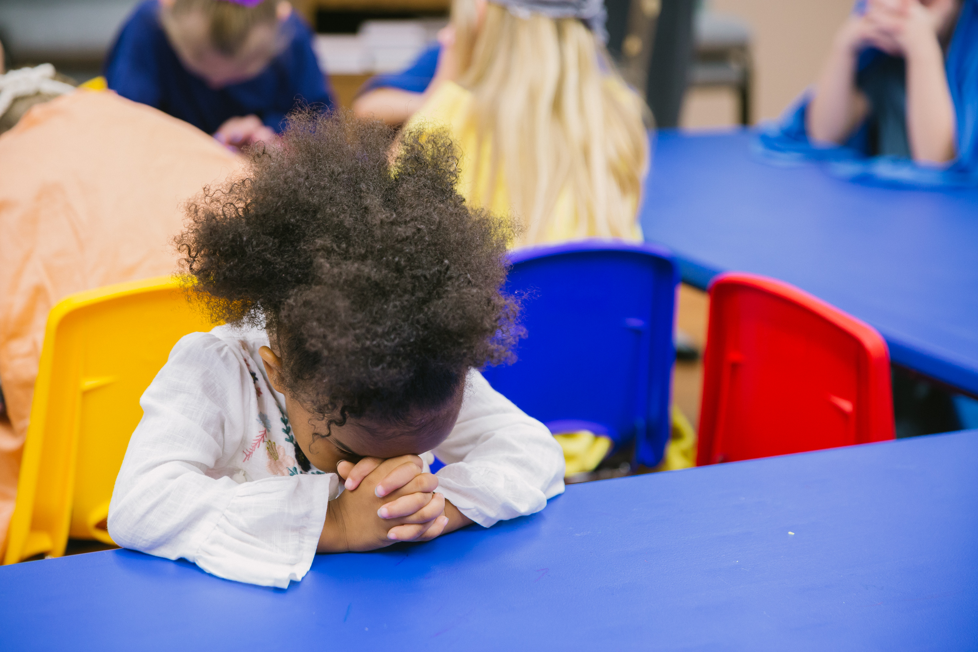
Our Kids Ministry Needs You!
KICK (K-5th Grade)
Clubhouse (Preschool)
Need 2 Teachers
Contact Beth Shimer
Need 1 Teacher
Contact Lex Bennett
Contact these Ministry Leaders directly or fill out an INFO card
(in the seat backs) and put it in a Donation / Response Box

Slide 3
9am to Noon
November 2, 2019

Slide 4

Operation 5:16
Set for July 12-18

Slide 5
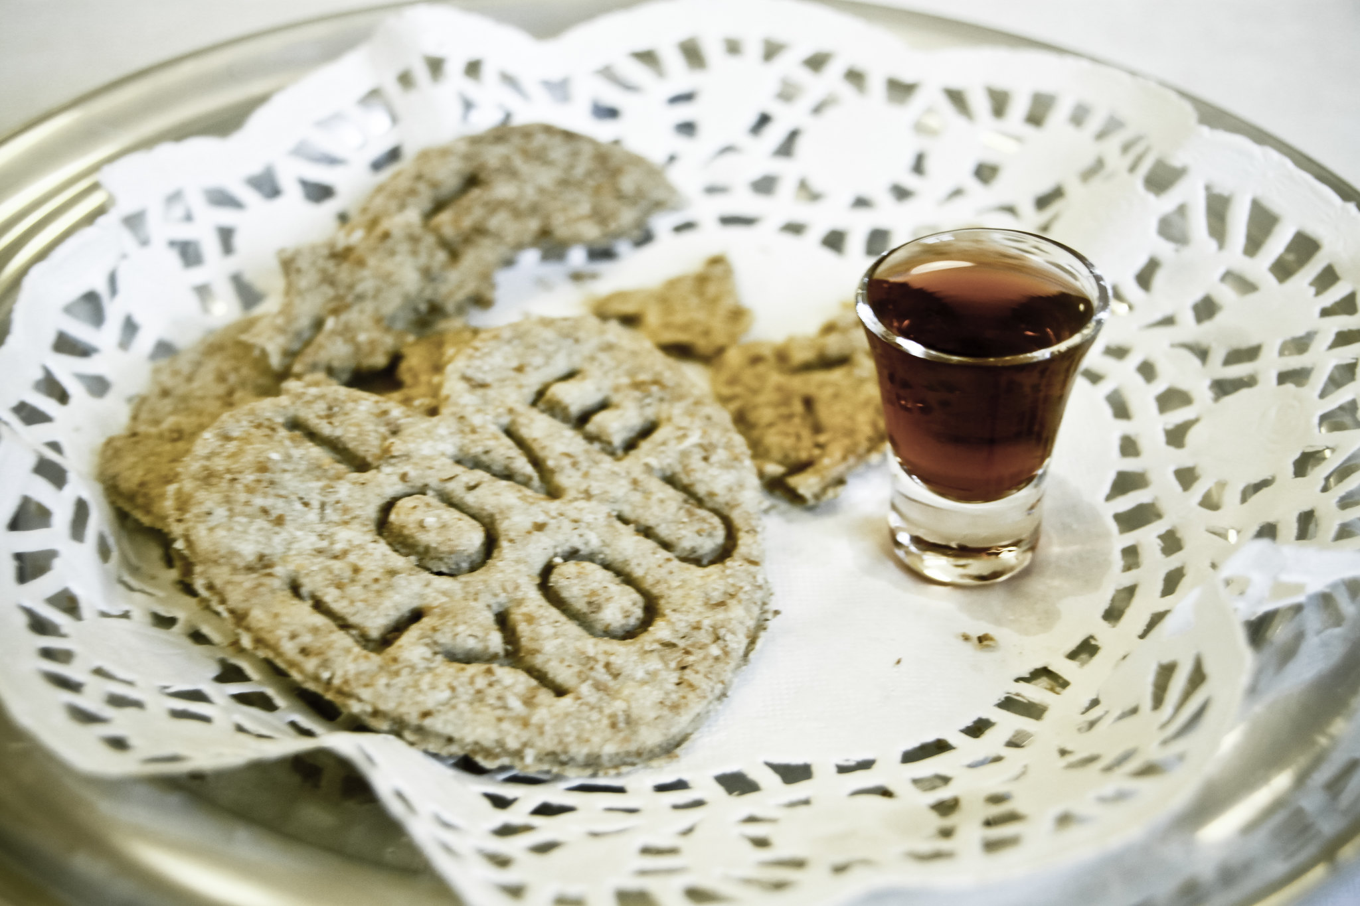
Jesus suffered and died for the forgiveness of our sins
Matthew 26:28

Slide 6


Slide 7


The Gift of the Sabbath

Slide 8
Genesis 2:1-3 (ESV)
1 Thus the heavens and the earth were finished, and all the host of them.
2 And on the seventh day God finished his work that he had done, and he rested on the seventh day from all his work that he had done.
3 So God blessed the seventh day and made it holy, because on it God rested from all his work that he had done in creation.

Slide 9
Exodus 16:22-31 (ESV)
22 On the sixth day they gathered twice as much bread, two omers each. And when all the leaders of the congregation came and told Moses,
23 he said to them, “This is what the Lord has commanded: ‘Tomorrow is a day of solemn rest, a holy Sabbath to the Lord; bake what you will bake and boil what you will boil, and all that is left over lay aside to be kept till the morning.’”
24 So they laid it aside till the morning, as Moses commanded them, and it did not stink, and there were no worms in it.
25 Moses said, “Eat it today, for today is a Sabbath to the Lord; today you will not find it in the field.
with honey.

Slide 10
Exodus 16:22-31 (ESV)
26 Six days you shall gather it, but on the seventh day, which is a Sabbath, there will be none.”
27 On the seventh day some of the people went out to gather, but they found none.
28 And the Lord said to Moses, “How long will you refuse to keep my commandments and my laws?
29 See! The Lord has given you the Sabbath; therefore on the sixth day he gives you bread for two days. Remain each of you in his place; let no one go out of his place on the seventh day.”
30 So the people rested on the seventh day.
31 Now the house of Israel called its name manna. It was like coriander seed, white, and the taste of it was like wafers made.

Slide 11
Exodus 20:8-11 (ESV)
8 “Remember the Sabbath day, to keep it holy.
9 Six days you shall labor, and do all your work,
10 but the seventh day is a Sabbath to the Lord your God. On it you shall not do any work, you, or your son, or your daughter, your male servant, or your female servant, or your livestock, or the sojourner who is within your gates.
11 For in six days the Lord made heaven and earth, the sea, and all that is in them, and rested on the seventh day. Therefore the Lord blessed the Sabbath day and made it holy.

Slide 12
Mark 2:23-28 (ESV)
23 One Sabbath he was going through the grainfields, and as they made their way, his disciples began to pluck heads of grain.
24 And the Pharisees were saying to him, “Look, why are they doing what is not lawful on the Sabbath?”
25 And he said to them, “Have you never read what David did, when he was in need and was hungry, he and those who were with him:
26 how he entered the house of God, in the time of Abiathar the high priest, and ate the bread of the Presence, which it is not lawful for any but the priests to eat, and also gave it to those who were with him?”
27 And he said to them, “The Sabbath was made for man, not man for the Sabbath.
28 So the Son of Man is lord even of the Sabbath.”

Slide 13
Embrace the Sabbath as a GIFT from God that He wants to use to Bless you
13 “If you turn back your foot from the Sabbath,
from doing your pleasure on my holy day, and call the Sabbath a delight
and the holy day of the Lord honorable;
if you honor it, not going your own ways,
or seeking your own pleasure, or talking idly;
14 then you shall take delight in the Lord,
and I will make you ride on the heights of the earth; I will feed you with the heritage of Jacob your father, for the mouth of the Lord has spoken.” (Isaiah 58)

Slide 14
When I receive the gift of the Sabbath…
1: I am refusing to bow to the idols of success and productivity

Slide 15
When I receive the gift of the Sabbath…
2: I am remembering my identity comes from being God’s daughter / son, and not from what I DO

Slide 16
When I receive the gift of the Sabbath…
3: I am trusting that what God “gives me” on the Sabbath will make it so I can get done what needs to get done the other 6 days.

Slide 17
Take Action
1: Decide on a day that will be your day of resting from work

Slide 18
Take Action
2: Decide what you will do to spend some extra focused time with God

Slide 19
Take Action
3: Make plans to do something that will “refuel your tanks”

Slide 20
Take Action
4: Decide what you won’t do

Slide 21
The Gift of the Sabbath

