Slide 1
GO Sunday is Sept 29
SignUp on Our Website

Slide 2
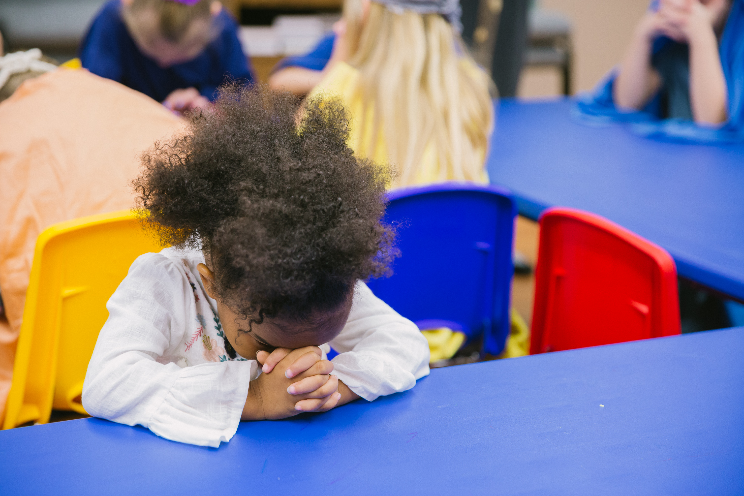
Our Kids Ministry Needs You!
KICK (K-5th Grade)
Clubhouse (Preschool)
Need 2 Teachers
Contact Beth Shimer
Need 1 Teacher
Contact Lex Bennett
Contact these Ministry Leaders directly or fill out an INFO card
(in the seat backs) and put it in a Donation / Response Box

Slide 3
Operation 5:16
Set for July 12-18

Slide 5
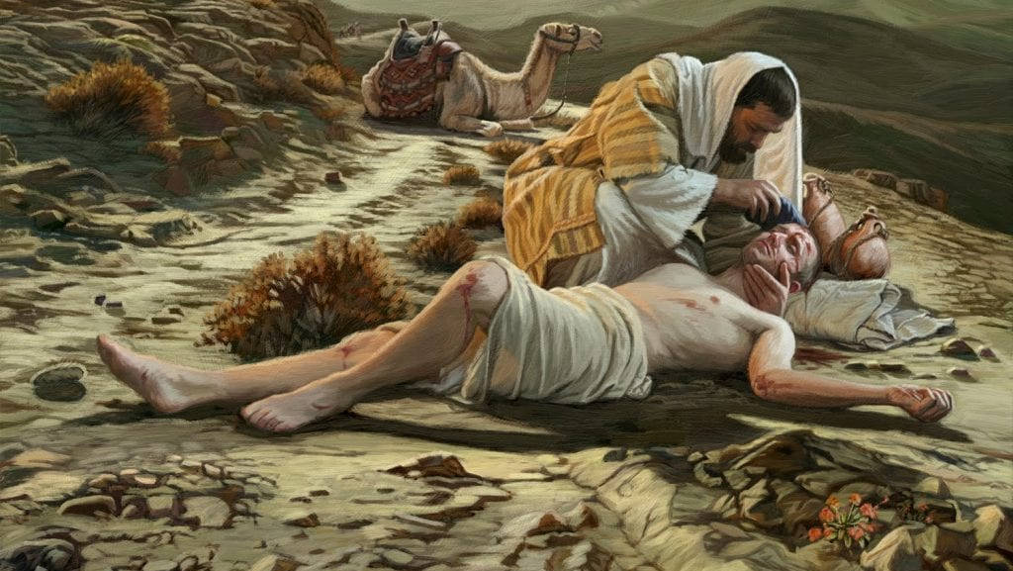
The Good Samaritan
Luke 10:25-37

Slide 6
Luke 10:25-37 (ESV)
25 And behold, a lawyer stood up to put him to the test, saying, “Teacher, what shall I do to inherit eternal life?”
26 He said to him, “What is written in the Law? How do you read it?”
27 And he answered, “You shall love the Lord your God with all your heart and with all your soul and with all your strength and with all your mind, and your neighbor as yourself.”
28 And he said to him, “You have answered correctly; do this, and you will live.”
29 But he, desiring to justify himself, said to Jesus, “And who is my neighbor?”

Slide 7
Luke 10:25-37 (ESV)
30 Jesus replied, “A man was going down from Jerusalem to Jericho, and he fell among robbers, who stripped him and beat him and departed, leaving him half dead.
31 Now by chance a priest was going down that road, and when he saw him he passed by on the other side.
32 So likewise a Levite, when he came to the place and saw him, passed by on the other side.
33 But a Samaritan, as he journeyed, came to where he was, and when he saw him, he had compassion.

Slide 8
Luke 10:25-37 (ESV)
34 He went to him and bound up his wounds, pouring on oil and wine. Then he set him on his own animal and brought him to an inn and took care of him.
35 And the next day he took out two denarii and gave them to the innkeeper, saying, ‘Take care of him, and whatever more you spend, I will repay you when I come back.’
36 Which of these three, do you think, proved to be a neighbor to the man who fell among the robbers?”
37 He said, “The one who showed him mercy.” And Jesus said to him, “You go, and do likewise.”

Slide 9
What We Observe in The Parable of the Good Samaritan
1: The brokenness of this sinful world
10:30 Jesus replied, “A man was going down from Jerusalem to Jericho, and he fell among robbers, who stripped him and beat him and departed, leaving him half dead.

Slide 10
What We Observe in The Parable of the Good Samaritan
2: The emptiness of religion without love
10:31 Now by chance a priest was going down that road, and when he saw him he passed by on the other side.
10:32 So likewise a Levite, when he came to the place and saw him, passed by on the other side.

Slide 11
What We Observe in The Parable of the Good Samaritan
3: Racism and prejudice
10:33 But a Samaritan, as he journeyed, came to where he was, and when he saw him, he had compassion.

Slide 12
What We Observe in The Parable of the Good Samaritan
4: Being a Christ-like neighbor requires sacrifice and risk
34 He went to him and bound up his wounds, pouring on oil and wine. Then he set him on his own animal and brought him to an inn and took care of him.
35 And the next day he took out two denarii and gave them to the innkeeper, saying, ‘Take care of him, and whatever more you spend, I will repay you when I come back.’

Slide 14
These observations are true, but let’s not miss what is really happening here…
Jesus is primarily trying to show this person that there is no way he can keep the law perfectly! (and neither can we!! We need Jesus!)

Slide 15
Jesus does everything the Samaritan did and MORE!
1: Jesus sees our brokenness in sin and comes to us with compassion
2: Jesus demonstrated God’s love for us
3: Jesus makes a way for racism to end
4: Jesus paid the price for our salvation with His own blood
5: Jesus is coming again to receive us into eternal life

Slide 16
Take Action
1: Recognize your inability to meet the requirements of God’s moral law and that you are in need of grace and mercy that is only available through faith in Jesus and what He did.

Slide 17
Take Action
2: Show yourself to be a true neighbor and “go and do” like the Samaritan did!

Slide 18
The Good Samaritan
Luke 10:25-37

