Slide 1
GO Sunday is Sept 29
SignUp on Our Website

Slide 2
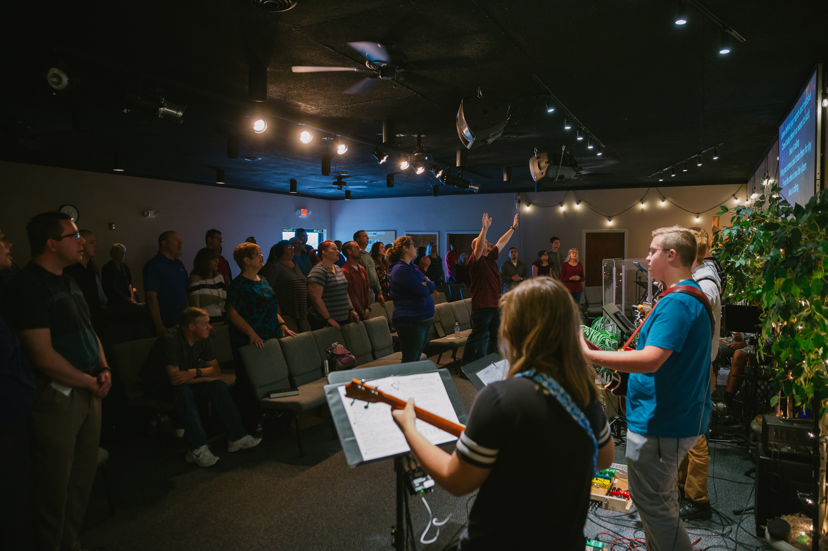
Church-Wide Meeting – NEXT SUNDAY
Following the Service in the Sanctuary
You will hear about…
Events that are planned for 2019-2020
Our church focus / theme for the year
How you can pray and participate
** Child care is not provided during this meeting, but parents are welcome to have their children with them

Slide 3
Our Kids Ministry Needs You!
KICK (K-5th Grade)
Clubhouse (Preschool)
Need 2 Teachers
Contact Beth Shimer
Need 1 Teacher
Need 3 Helpers
Contact Lex Bennett
Infant Room
Need 1 Helper
Contact Julie Cornelius
or Linda Charlton
Contact these Ministry Leaders directly or fill out an INFO card
(in the seat backs) and put it in a Donation / Response Box

Slide 4
Responding to Jesus
1 Kings 10

Slide 5
1 Kings 10:1-13 (ESV)
1 Now when the queen of Sheba heard of the fame of Solomon concerning the name of the Lord, she came to test him with hard questions.
2 She came to Jerusalem with a very great retinue, with camels bearing spices and very much gold and precious stones. And when she came to Solomon, she told him all that was on her mind.
3 And Solomon answered all her questions; there was nothing hidden from the king that he could not explain to her.
4 And when the queen of Sheba had seen all the wisdom of Solomon, the house that he had built,

Slide 6
1 Kings 10:1-13 (ESV)
5 the food of his table, the seating of his officials, and the attendance of his servants, their clothing, his cupbearers, and his burnt offerings that he offered at the house of the Lord, there was no more breath in her.
6 And she said to the king, “The report was true that I heard in my own land of your words and of your wisdom,
7 but I did not believe the reports until I came and my own eyes had seen it. And behold, the half was not told me. Your wisdom and prosperity surpass the report that I heard.
8 Happy are your men! Happy are your servants, who continually stand before you and hear your wisdom!

Slide 7
1 Kings 10:1-13 (ESV)
9 Blessed be the Lord your God, who has delighted in you and set you on the throne of Israel! Because the Lord loved Israel forever, he has made you king, that you may execute justice and righteousness.”
10 Then she gave the king 120 talents of gold, and a very great quantity of spices and precious stones. Never again came such an abundance of spices as these that the queen of Sheba gave to King Solomon.
11 Moreover, the fleet of Hiram, which brought gold from Ophir, brought from Ophir a very great amount of almug wood and precious stones.

Slide 8
1 Kings 10:1-13 (ESV)
12 And the king made of the almug wood supports for the house of the Lord and for the king's house, also lyres and harps for the singers. No such almug wood has come or been seen to this day.
13 And King Solomon gave to the queen of Sheba all that she desired, whatever she asked besides what was given her by the bounty of King Solomon. So she turned and went back to her own land with her servants.

Slide 9
Responding to Jesus
1 Kings 10

Slide 10
Remember Solomon is a
“type” of Christ
Solomon reveals a pattern of salvation that God later provided for us in Jesus Christ
So the queen’s response to Solomon points to our response to Jesus Christ

Slide 11
Responding to Jesus
#1: Seek the Truth about Jesus (vs 1)

Slide 12
Where to go to learn more about Jesus
The Gospels in the Bible (Matthew, Mark, Luke, and John) are like biographies of Jesus

Slide 13
Where to go to learn more about Jesus
The Case for Christ movie on Netflix or Amazon video

Slide 14
Responding to Jesus
#2: Honor Jesus’ Wisdom (vss 6-8)

Slide 15
How to honor Jesus’ wisdom
Read, think about, and act on what Jesus said
Trust what He is doing in your life right now

Slide 16
Responding to Jesus
#3: Thank God for Giving Us Jesus (vs 9)

Slide 17
Responding to Jesus
#4: Recognize Everything We Have Comes from Him and is for Him (vs 10)

Slide 18
Responding to Jesus
1 Kings 10

