Slide 1
Church Meeting
September 8, 2019

Slide 2
Annual Finance Update

Slide 3
Bank Accounts Aug 31, 2019
Operating Checking: $56,750
Building Checking: $3,737
Building Savings: $46,625
Needs Checking: $3,900
If you are interested, you can request a copy of our Profit & Loss Statement by contacting the church office.

Slide 4
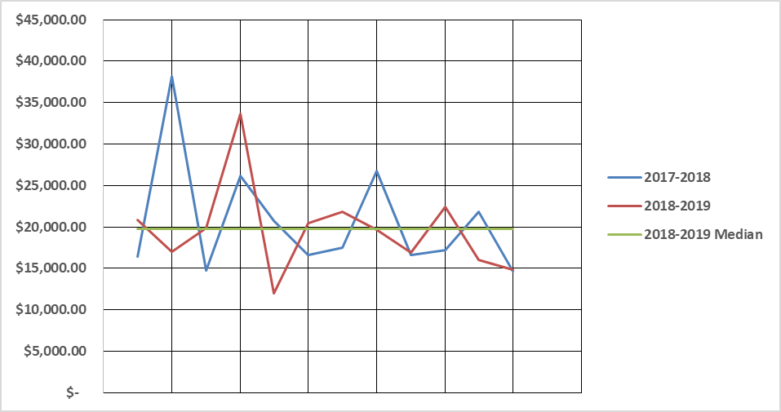
Monthly Giving

Slide 5
2018-2019 Year End Profit & Loss
 | Actual | Budgeted
Books/Merch. Sales & Donations | 0.00 | 5.00
GCC Rebate | 12,048.03 | 11,460.00
Offerings/Giving | 235,394.70 | 229,200.00
Total Income | 247,442.73 | 240,665.00
Total Expenses | 236,821.48 | 235,608.72
Net Income | 10,621.25 | 5,056.28
Please contact Andrea if you would like a copy of the P&L Statement

Slide 6
Ministry Year Theme

Slide 7
Theme for 2019-2020
Love Your Neighbor!
Matthew 22:35-40 (ESV)

Slide 8
Matthew 22:35-40
One of them, a lawyer, asked him a question to test him. “Teacher, which is the great commandment in the Law?” And he said to him, “You shall love the Lord your God with all your heart and with all your soul and with all your mind. This is the great and first commandment. And a second is like it: You shall love your neighbor as yourself. On these two commandments depend all the Law and the Prophets.”

Slide 9
Go Sunday!
Yard Projects
Serving 1st Responders
Police Departments
Fire Departments
Emergency Room Staff
Visiting Nursing Homes
Prayer Team

Slide 10
Operation 5:16
Letting our light shine
Week long mission trip to our community
Serving people and sowing good news

Slide 11
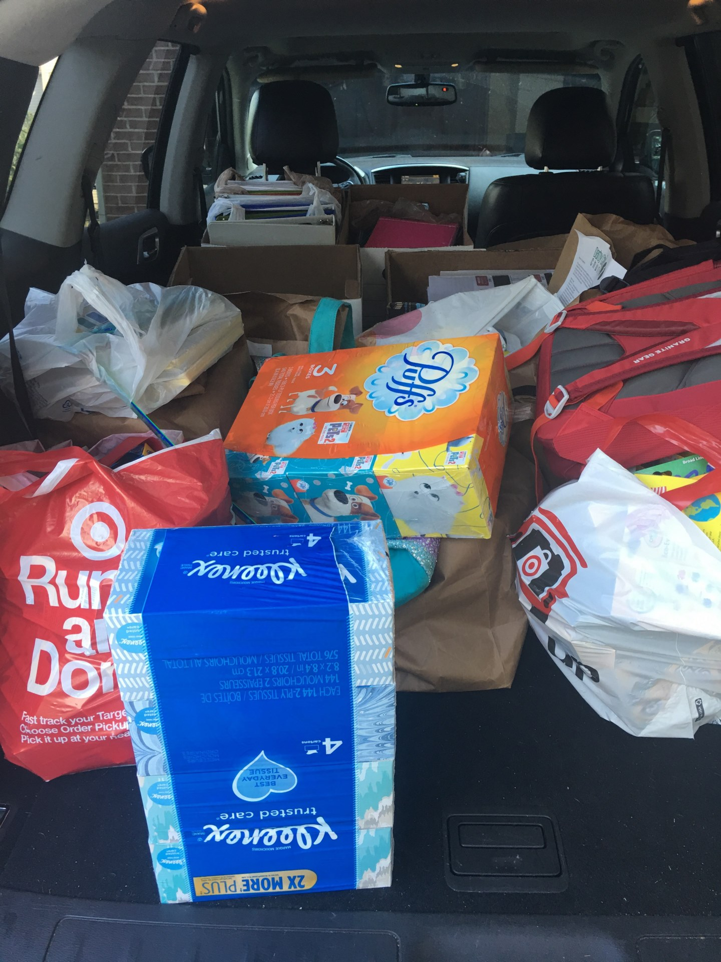
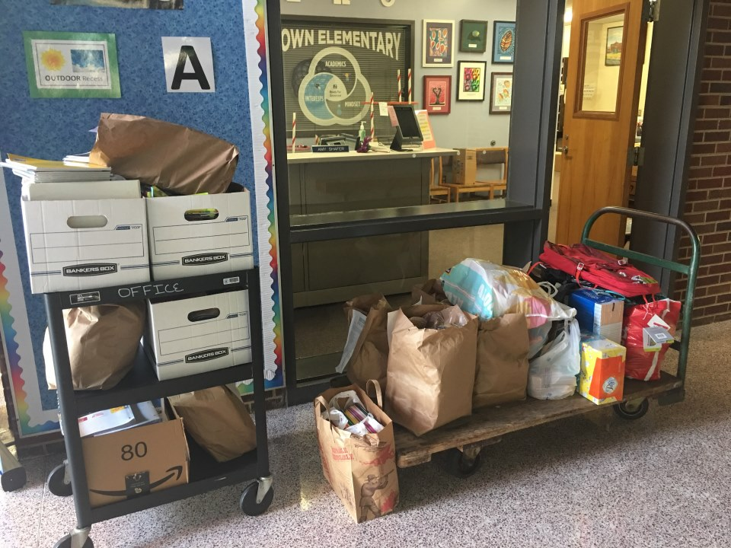
School Supply Outreach

Slide 12
Elder Community Research and Connection
Elder board will be inviting local community leaders in to discuss the needs that they see in our community.
How can Darby Creek help?

Slide 13
Small Groups
Studying the topic of Loving Your Neighbor
Finding practical applications

Slide 14
More Ideas Welcome!
These plans and events are not an exclusive list
Please let us know your ideas on loving our neighbors

Slide 15
Operation 5:16

Slide 16
Operation 5:16 Survey
What week in July 2020 is preferred for any participation in Operation 5:16?
July 5 – 11
July 12 – 18
July 19 – 25
July 26 – August 1
Either use QR code, click on button on DarbyCreek.org or text your answer to
614-719-9066

Slide 17
Small Groups
Loving Your Neighbor

Slide 18
Small Group Studies
All groups will be covering at least one of these two studies this ministry year

Slide 19
Small Groups Get Involved

