Slide 1
Last day to bring in school supplies
is NEXT Sunday (August 18)
We also need a few people
To be here on Sat, Aug 17
from 12 noon to 2pm to
receive the school supply bags
our neighbors will drop off.
Want to make / bring refreshments
for the reception on Aug 17?
We need a couple people to do this.
Contact Pastor Charley (614-499-1162)
Or Pam Hook (PamBr3@aol.com)
to volunteer.

Slide 2
Picnic TODAY! Hot Dogs and Bottled Water Provided.
After service until 1:30p

Slide 3
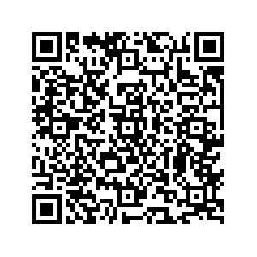
Ministry Sign Ups – SignUp Today
Scan QR Code located
Located near Donation Boxes
Complete the Form
Or pickup a green Ministry Interest Form in the back,
complete it, and put it in a Donation / Response Box

Slide 4
GO Sunday is Sept 29
SignUp on Our Website

Slide 6
Building of Solomon’s Temple
*Preparation for Construction – 1 Kings 5
*Construction – 1 Kings 6 & 7
*Temple Dedication – 1 Kings 8
+Ark containing the 2 stone tablets
with 10 commandments written
brought to the temple
+Glory of God fills the temple
+Solomon’s prayer of dedication

Slide 7
Praying Like Solomon
1 Kings 8

Slide 8
1 Kings 8 (ESV)
28 Yet have regard to the prayer of your servant and to his plea, O Lord my God, listening to the cry and to the prayer that your servant prays before you this day,
29 that your eyes may be open night and day toward this house, the place of which you have said, ‘My name shall be there,’ that you may listen to the prayer that your servant offers toward this place.
30 And listen to the plea of your servant and of your people Israel, when they pray toward this place. And listen in heaven your dwelling place, and when you hear, forgive.

Slide 9
James 5:16-18 (ESV)
16 Therefore, confess your sins to one another and pray for one another, that you may be healed. The prayer of a righteous person has great power as it is working.
17 Elijah was a man with a nature like ours, and he prayed fervently that it might not rain, and for three years and six months it did not rain on the earth.
18 Then he prayed again, and heaven gave rain, and the earth bore its fruit.

Slide 10
1 Kings 8 (ESV) – searching “hear in heaven”

Slide 11
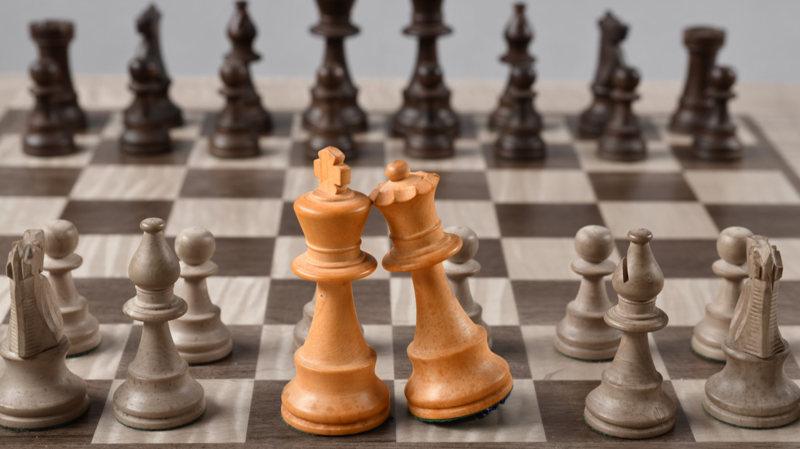
7 Things for Your Prayer List
#1: Pray for Justice (8:31-32)

Slide 12
7 Things for Your Prayer List
#2: Pray for the Prodigal (8:33-34)

Slide 13
7 Things for Your Prayer List
#3: Pray for God’s Provision & Blessing (8:35-36)

Slide 14
7 Things for Your Prayer List
#4: Pray for Deliverance (8:37-40)

Slide 15
7 Things for Your Prayer List
#5: Pray for those who don’t have a
relationship with God (8:41-43)

Slide 16
7 Things for Your Prayer List
#6: Pray for victory in the spiritual battle (8:44-45)

Slide 17
7 Things for Your Prayer List
#7: Confess your sin and ask for forgiveness
(8:46-50)

Slide 18
Praying Like Solomon
1 Kings 8

