Slide 1
Women’s Prayer Group
Thursday’s 10-11:30am
@ Roy’s Home (Hilliard)
Contact Julie Roys
Text to (614) 209-3402 or
Email jroys86@gmail.com

Slide 2
Total Health Clinic – Fund Raising Results
We are so happy to announce that the equipment that Dr. Walter Bonilla needs for the Total Health Clinic in Managua, Nicaragua has been fully funded...and then some! To date, $1,750 has been raised which exceeds the goal of $1,014.93 needed for the equipment. We will be sending the money to Total Health (https://totalhealth.org/) on Monday, July 8th.
We will continue take donations for this project through TODAY. Funds
that exceed the amount needed to purchase the equipment will help support the
clinic and keep it running. If you are still interested in giving toward this you can just
send your check, cash, or online gift the way you would normally give to Darby Creek
Church BUT put “Total Health Clinic” in the memo description or on the giving
envelop.

Slide 3
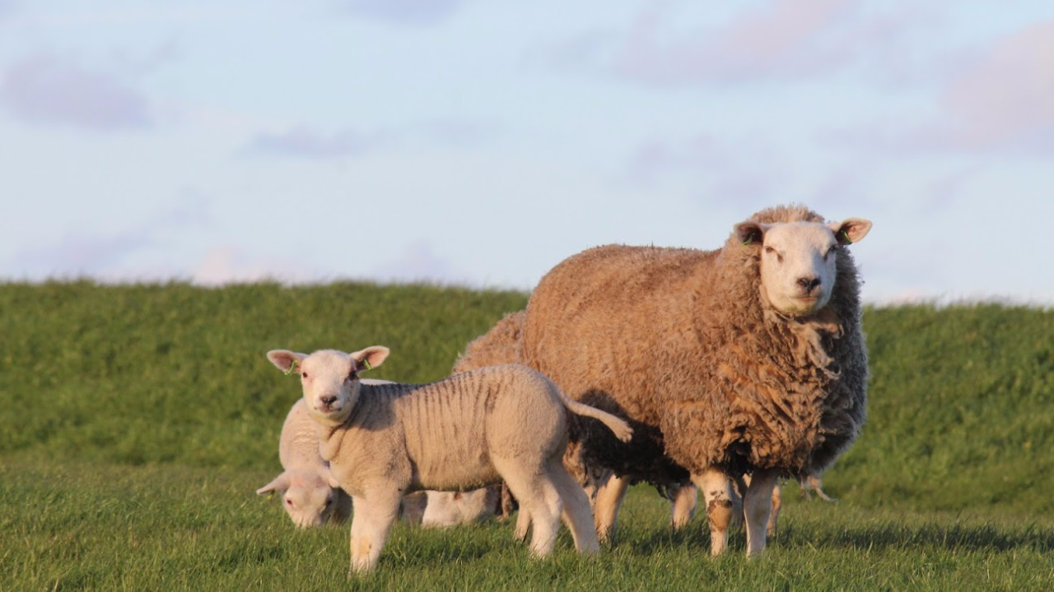
Jesus is the Shepherd Who Restores
Psalm 23:3

Slide 4
Psalm 23: 1-6 (ESV)
1 The Lord is my shepherd; I shall not want.
2 He makes me lie down in green pastures.
He leads me beside still waters.
3 He restores my soul.
He leads me in paths of righteousness for his name's sake.
4 Even though I walk through the valley of the shadow of death, I will fear no evil, for you are with me; your rod and your staff, they comfort me.

Slide 5
Psalm 23: 1-6 (ESV)
5 You prepare a table before me in the presence of my enemies;
you anoint my head with oil; my cup overflows.
6 Surely goodness and mercy shall follow me all the days of my life,
and I shall dwell in the house of the Lord forever.

Slide 6
Jesus is the Shepherd Who Restores
Psalm 23:3

Slide 7
“Restore” in verse 3 could be ...
Helping heal a weak sheep
(giving renewed strength)
2. Restoring a wayward sheep back to the fold

Slide 8
Jesus Restores Us When We are Weak and Weary:
Causes:
1: Serving
2: Suffering

Slide 9
Jesus Restores Us When We are Weak and Weary:
Ways God Restores the Weary / Weak:
1: Rest
2: A Word from His Word
Serving others, we can get depleted
1 Kings 19:5-18; Is 40:31; 57:15

Slide 10
Jesus Restores Us When We are Weak and Weary:
Ways God Restores the Weary / Weak:
1: Daily Renewal
2: Eternal Perspective
Suffering, we may become
depressed or discouraged
2 Cor 4:7-18; Lam 3:22-23

Slide 11
Jesus Restores Us When We are Wayward and Wandering:
Causes:
1: Led astray by others
2: Caught in sin
Wandering / Wayward

Slide 12
Matthew 18:10-14(ESV)
10 “See that you do not despise one of these little ones. For I tell you that in heaven their angels always see the face of my Father who is in heaven.
12 What do you think? If a man has a hundred sheep, and one of them has gone astray, does he not leave the ninety-nine on the mountains and go in search of the one that went astray?
13 And if he finds it, truly, I say to you, he rejoices over it more than over the ninety-nine that never went astray.
14 So it is not the will of my Father who is in heaven that one of these little ones should perish.
Some manuscripts add verse 11: “For the Son of Man came to save the lost”

Slide 13
In this parable:
We see the faithful love of God (the Shepherd)
We see the importance of EVERY believer (the “one”)

Slide 14
Jesus Restores Us When We are Wayward and Wandering:
Ways God Restores the Wayward:
1: Uses other people
2: He disciplines
Wandering / Wayward
Galatians 6:1; Ps 51:12; Ps 119:67; Heb 12:5-11

Slide 15
Jesus is the Shepherd Who Restores
Psalm 23:3

