Slide 2
Bring Your Own Lunch Picnic TODAY! After service until 1:30p

Slide 3
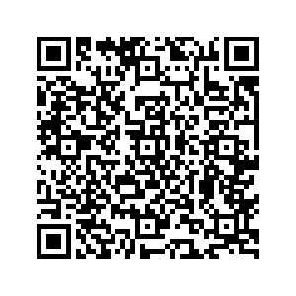
Ministry Sign Ups Start Today!!
Scan QR Code located
Located near Donation Boxes
Complete the Form
Or pickup a green Ministry Interest Form in the back,
complete it, and put it in a Donation / Response Box

Slide 4
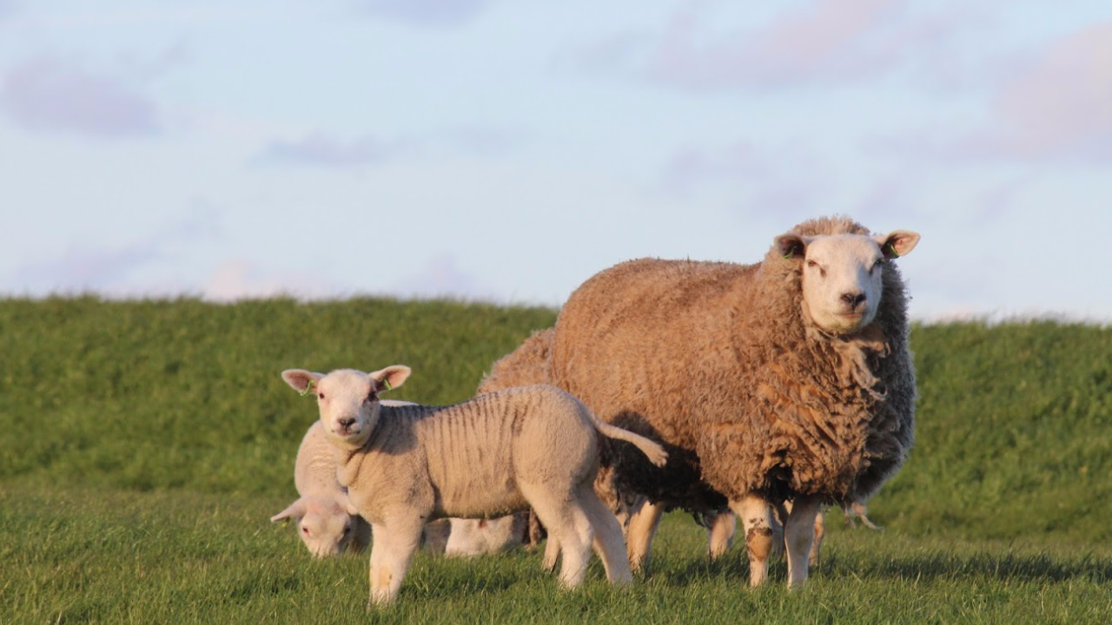
Jesus is the Ultimate Host
Psalm 23:5-6

Slide 5
Psalm 23: 1-6 (ESV)
1 The Lord is my shepherd; I shall not want.
2 He makes me lie down in green pastures.
He leads me beside still waters.
3 He restores my soul.
He leads me in paths of righteousness for his name's sake.
4 Even though I walk through the valley of the shadow of death, I will fear no evil, for you are with me; your rod and your staff, they comfort me.

Slide 6
Psalm 23: 1-6 (ESV)
5 You prepare a table before me in the presence of my enemies;
you anoint my head with oil; my cup overflows.
6 Surely goodness and mercy shall follow me all the days of my life,
and I shall dwell in the house of the Lord forever.

Slide 7
Jesus is the Ultimate Host
Psalm 23:5-6

Slide 8
Psalm 23: 5-6 (ESV)
5 You prepare a table before me in the presence of my enemies;
you anoint my head with oil; my cup overflows.
6 Surely goodness and mercy shall follow me all the days of my life,
and I shall dwell in the house of the Lord forever.

Slide 9
The “Big Picture” of the Message Today:
The Metaphor Changes:
From Shepherd to Host
1: A Table to which We
are Invited
2: A Cup that Overflows
3: A Home to Never Leave

Slide 10
Table
Cup
Home

Slide 11
1: A Table to which We are Invited
5a You prepare a table before me in the presence of my enemies;

Slide 12
Rev 3:20
Behold, I stand at the door and knock. If anyone hears my voice and opens the door, I will come in to him and eat with him, and he with me.

Slide 13
John 15:14-15
14 You are my friends if you do what I command you.
15 No longer do I call you servants, for the servant does not know what his master is doing; but I have called you friends, for all that I have heard from my Father I have made known to you.

Slide 14
2: A Cup that Overflows
5 You prepare a table before me in the presence of my enemies;
you anoint my head with oil; my cup overflows.

Slide 15
Ephesians 1:3
Blessed be the God and Father of our Lord Jesus Christ, who has blessed us in Christ with every spiritual blessing in the heavenly places,

Slide 16
Ephesians 1:7-8
7 In him we have redemption through his blood, the forgiveness of our trespasses, according to the riches of his grace,
8 which he lavished upon us, in all wisdom and insight

Slide 17
Luke 6:38
give, and it will be given to you. Good measure, pressed down, shaken together, running over, will be put into your lap. For with the measure you use it will be measured back to you.”

Slide 18
3: A Home to Never Leave
6 Surely goodness and mercy shall follow me all the days of my life, and I shall dwell in the house of the Lord forever.

Slide 19
Lamentations 3:22-23
22 The steadfast love of the Lord never ceases;
his mercies never come to an end;
23 they are new every morning;
great is your faithfulness.

Slide 20
John 14:1-3
1 “Let not your hearts be troubled. Believe in God; believe also in me.
2 In my Father's house are many rooms. If it were not so, would I have told you that I go to prepare a place for you?
3 And if I go and prepare a place for you, I will come again and will take you to myself, that where I am you may be also.

Slide 21
The “Big Picture” of the Message Today:
1: A Table to which We
are Invited
2: A Cup that Overflows
3: A Home to Never Leave

Slide 22
Jesus is the Ultimate Host
Psalm 23:5-6

