Slide 1
Women’s Prayer Group
Thursday’s 10-11:30am
@ Roy’s Home (Hilliard)
Contact Julie Roys
Text to (614) 209-3402 or
Email jroys86@gmail.com

Slide 2
Bring Your Own Lunch Picnic Next Sunday! After service until 1:30p

Slide 3
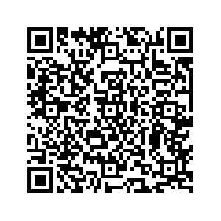
Ministry Sign Ups Start Today!!
Scan QR Code located
Located near Donation Boxes
Complete the Form
Or pickup a green Ministry Interest Form in the back,
complete it, and put it in a Donation / Response Box

Slide 5
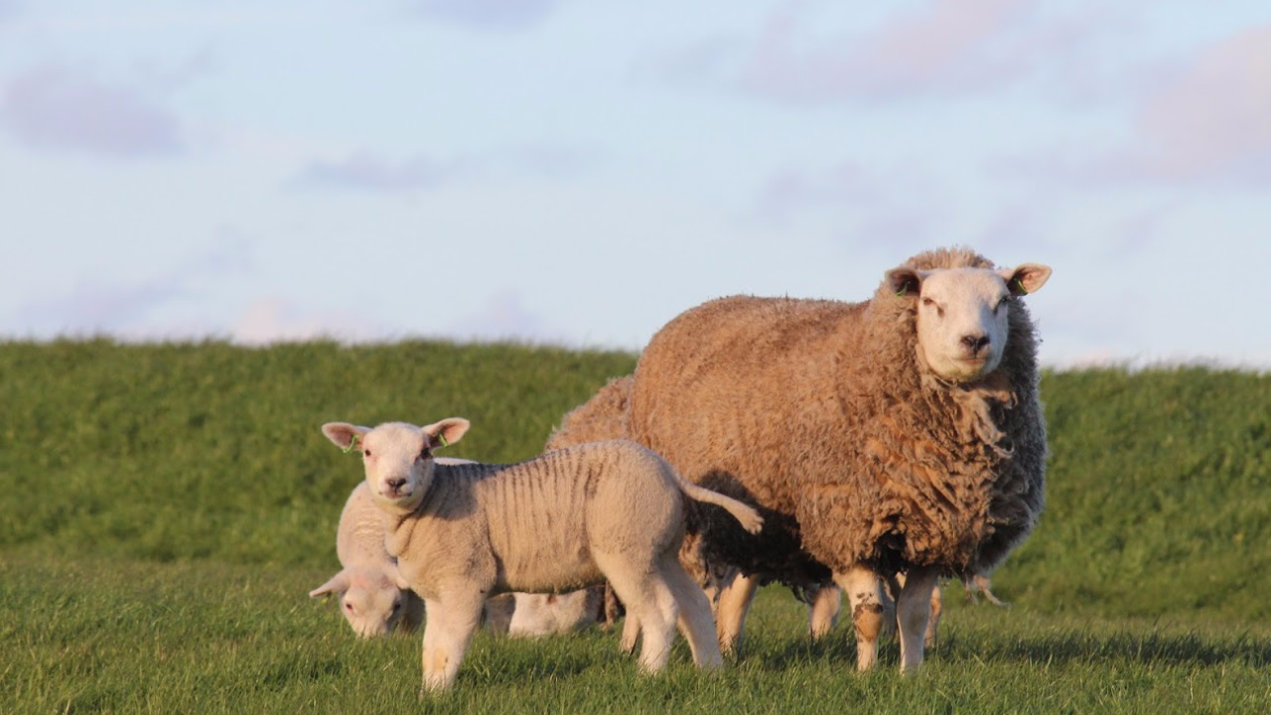
Jesus is the Shepherd Who is with Us
in the Valley
Psalm 23:4

Slide 6
Mountains in the USA

Slide 7
Valleys in the USA

Slide 8
Psalm 23: 1-6 (ESV)
1 The Lord is my shepherd; I shall not want.
2 He makes me lie down in green pastures.
He leads me beside still waters.
3 He restores my soul.
He leads me in paths of righteousness for his name's sake.
4 Even though I walk through the valley of the shadow of death, I will fear no evil, for you are with me; your rod and your staff, they comfort me.

Slide 9
Psalm 23: 1-6 (ESV)
5 You prepare a table before me in the presence of my enemies;
you anoint my head with oil; my cup overflows.
6 Surely goodness and mercy shall follow me all the days of my life,
and I shall dwell in the house of the Lord forever.

Slide 10
Jesus is the Shepherd Who is with Us
in the Valley
Psalm 23:4

Slide 11
Psalm 23: 4 (ESV)
Even though I walk through the valley of the shadow of death, I will fear no evil, for you are with me; your rod and your staff, they comfort me.

Slide 12
The “Big Picture” of the Message Today:
1: The Shepherd leads us into and through life’s valleys
2: The valleys of our lives are intended to be places of spiritual growth
3: In the valley, we are promised the Shepherd’s presence and protection

Slide 13
The Shepherd leads us into and through
life’s valleys

Slide 14
Psalm 23: 3b (ESV)
He leads me in paths of righteousness for his name's sake.

Slide 15
The valleys of our lives are intended to be places of spiritual growth

Slide 16
James 1:2-4 (ESV)
2 Count it all joy, my brothers, when you meet trials of various kinds,
3 for you know that the testing of your faith produces steadfastness.
4 And let steadfastness have its full effect, that you may be perfect and complete, lacking in nothing.

Slide 17
1 Timothy 4:8 (NLT)
“Physical training is good, but training for godliness is much better, promising benefits in this life and in the life to come.”

Slide 18
The Christian’s Comfort when Facing Death:
1: Jesus Knows the Way

Slide 19
2 Timothy 2:11 (ESV)
The saying is trustworthy, for:
If we have died with him, we will also live with him;

Slide 20
The Christian’s Comfort when Facing Death:
1: Jesus Knows the Way
2: To be absent from the body is to be present with the Lord

Slide 21
2 Corinthians 5:6-9 (ESV)
6 So we are always of good courage. We know that while we are at home in the body we are away from the Lord,
7 for we walk by faith, not by sight.
8 Yes, we are of good courage, and we would rather be away from the body and at home with the Lord.
9 So whether we are at home or away, we make it our aim to please him.

Slide 22
The Christian’s Comfort when Facing Death:
1: Jesus Knows the Way
2: To be absent from the body is to be present with the Lord
3: Jesus took our punishment

Slide 23
Romans 8:1 (ESV)
There is therefore now no condemnation for those who are in Christ Jesus.

Slide 24
In the valley, we are promised the Shepherd’s presence and protection

Slide 25
Psalm 23:4 (ESV)
Even though I walk through the valley of the shadow of death, I will fear no evil, for you are with me; your rod and your staff, they comfort me.

Slide 26
Psalm 23: 1-6 (ESV)
As we go through valleys, there is a
deeper intimacy and nearness with
the Lord we experience
1 The Lord is my shepherd; I shall not want.
2 He makes me lie down in green pastures.
He leads me beside still waters.
3 He restores my soul.
He leads me in paths of righteousness for his name's sake.
4 Even though I walk through the valley of the shadow of death, I will fear no evil, for you are with me; your rod and your staff, they comfort me.

Slide 27
Isaiah 43:1-2 (ESV)
1 But now thus says the Lord,
he who created you, O Jacob,
he who formed you, O Israel:
“Fear not, for I have redeemed you;
I have called you by name, you are mine.
2 When you pass through the waters, I will be with you;
and through the rivers, they shall not overwhelm you;
when you walk through fire you shall not be burned,
and the flame shall not consume you.

Slide 28
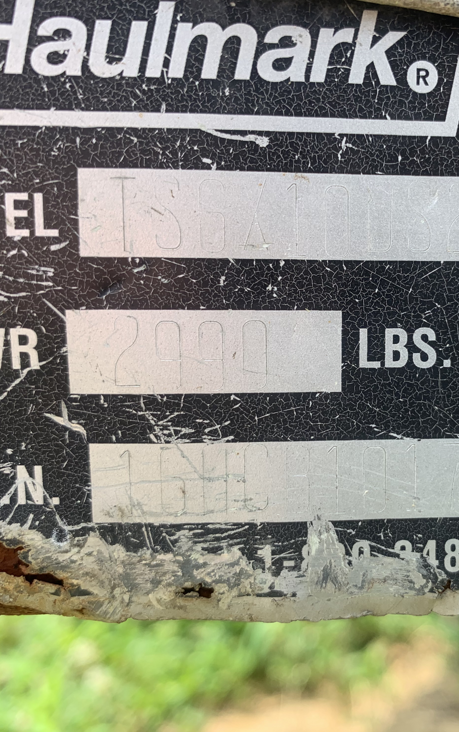

Slide 30
Psalm 56:3-4 (ESV)
3 When I am afraid,
I put my trust in you.
4 In God, whose word I praise,
in God I trust; I shall not be afraid.
What can flesh do to me?

Slide 31
Jesus is the Shepherd Who is with Us
in the Valley
Psalm 23:4

