Slide 1
Women’s Prayer Group
Thursday’s 10-11:30am
@ Roy’s Home (Hilliard)
Contact Julie Roys
Text to (614) 209-3402 or
Email jroys86@gmail.com

Slide 2
FYI – On August 11 at the church picnic, the church will providing hot dogs and bottled water.
Bring Your Own Lunch Picnic Today! After service until 1:30p

Slide 3
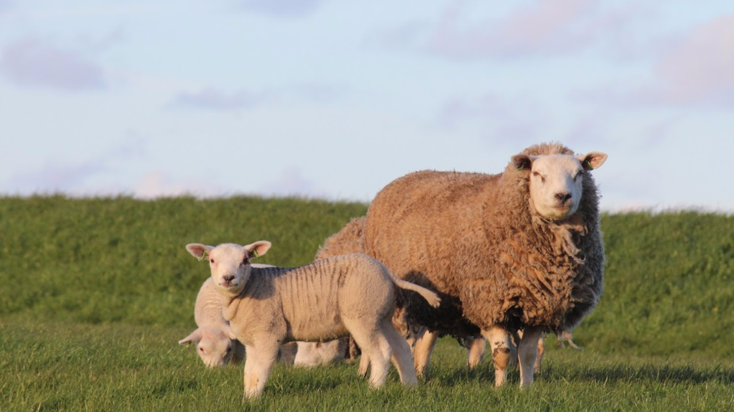
Jesus is the Shepherd Who Guides Us
Psalm 23:3

Slide 4
Psalm 23: 1-6 (ESV)
1 The Lord is my shepherd; I shall not want.
2 He makes me lie down in green pastures.
He leads me beside still waters.
3 He restores my soul.
He leads me in paths of righteousness for his name's sake.
4 Even though I walk through the valley of the shadow of death, I will fear no evil, for you are with me; your rod and your staff, they comfort me.

Slide 5
Psalm 23: 1-6 (ESV)
5 You prepare a table before me in the presence of my enemies;
you anoint my head with oil; my cup overflows.
6 Surely goodness and mercy shall follow me all the days of my life,
and I shall dwell in the house of the Lord forever.

Slide 6
Jesus is the Shepherd Who Guides Us
Psalm 23:3

Slide 7
Psalm 23: 3 (ESV)
3 He restores my soul.
He leads me in paths of righteousness for his name's sake.

Slide 8
The “Big Picture” of the Message Today:
Two Observations in Psalm 23:3b
1: Jesus the Good Shepherd guides His sheep
2: The Good Shepherd always guides us with a purpose in mind

Slide 9
Some caution when looking for guidance
1: Don’t let your feelings be your guide

Slide 10
Proverbs 14:12 (ESV)
There is a way that seems right to a man,
but its end is the way to death.

Slide 11
Some caution when looking for guidance
2: Don’t let your circumstances be your guide

Slide 12
Acts 27:9-14 (ESV)
9 Since much time had passed, and the voyage was now dangerous because even the Fast was already over, Paul advised them,
10 saying, “Sirs, I perceive that the voyage will be with injury and much loss, not only of the cargo and the ship, but also of our lives.”
11 But the centurion paid more attention to the pilot and to the owner of the ship than to what Paul said.
12 And because the harbor was not suitable to spend the winter in, the majority decided to put out to sea from there, on the chance that somehow they could reach Phoenix, a harbor of Crete, facing both southwest and northwest, and spend the winter there.

Slide 13
Acts 27:9-14 (ESV)
13 Now when the south wind blew gently, supposing that they had obtained their purpose, they weighed anchor and sailed along Crete, close to the shore.
14 But soon a tempestuous wind, called the northeaster, struck down from the land.

Slide 14
How to be Led by God
1) Know His Ways

Slide 15
How to Know His Ways...
a) Humbly Ask God for Guidance

Slide 16
Psalm 25:4,5,9 (ESV)
4 Make me to know your ways, O Lord;
teach me your paths.
5 Lead me in your truth and teach me,
for you are the God of my salvation;
for you I wait all the day long.
9 He leads the humble in what is right,
and teaches the humble his way.

Slide 17
How to Know His Ways…
b) Be willing to do what He shows you

Slide 18
Psalm 25:12 (ESV)
12 Who is the man who fears the Lord?
Him will he instruct in the way that he should choose.

Slide 19
How to Know His Ways…
c) Study God’s Word and Apply It

Slide 20
Psalm 119:9, 105 (ESV)
9 How can a young man keep his way pure?
By guarding it according to your word.
105 Your word is a lamp to my feet
and a light to my path.

Slide 21
Hebrews 5:12-14 (ESV)
12 For though by this time you ought to be teachers, you need someone to teach you again the basic principles of the oracles of
God. You need milk, not solid food,
13 for everyone who lives on milk is unskilled in the word of
righteousness, since he is a child.
14 But solid food is for the mature, for those who have their powers of discernment trained by constant practice to distinguish good from evil.

Slide 22
How to be Led by God
2) Be Filled with the Spirit

Slide 23
Romans 8:14 (ESV)
For all who are led by the Spirit of God are sons of God.

Slide 24
How to be Led by God
3) Remember He is always guiding us for His Purposes and His Glory

Slide 25
Psalm 23: 3 (ESV)
3 He restores my soul.
He leads me in paths of righteousness for his name's sake.

Slide 26
Romans 11:36 (ESV)
For from him and through him and to him are all things. To him be glory forever. Amen.

Slide 27
Jesus is the Shepherd Who Guides Us
Psalm 23:3

