Slide 1
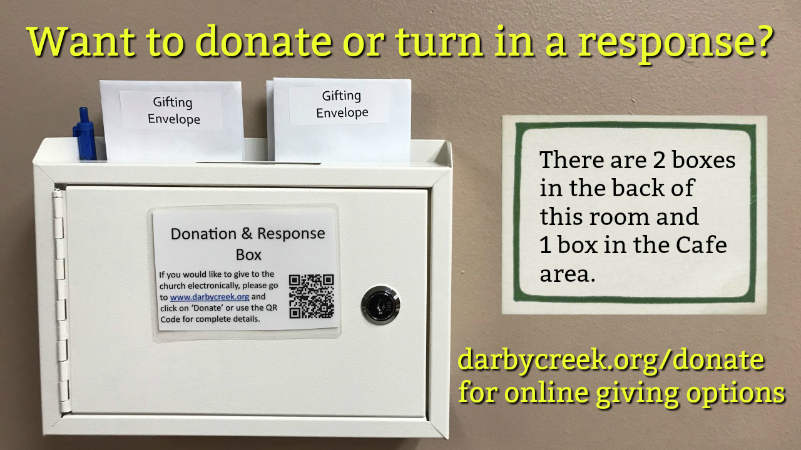

Slide 3
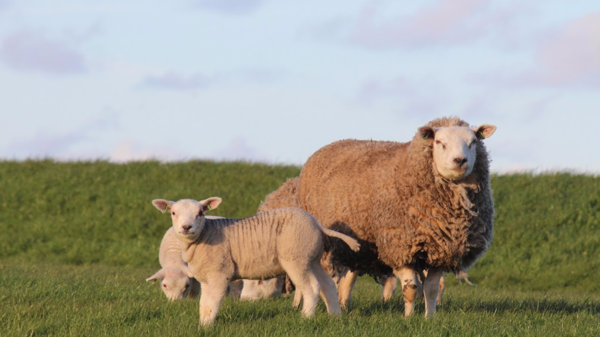
Jesus is the Shepherd Who Satisfies
Psalm 23:1-2

Slide 4
Psalm 23: 1-6 (ESV)
1 The Lord is my shepherd; I shall not want.
2 He makes me lie down in green pastures.
He leads me beside still waters.
3 He restores my soul.
He leads me in paths of righteousness for his name's sake.
4 Even though I walk through the valley of the shadow of death, I will fear no evil, for you are with me; your rod and your staff, they comfort me.

Slide 5
Psalm 23: 1-6 (ESV)
5 You prepare a table before me in the presence of my enemies;
you anoint my head with oil; my cup overflows.
6 Surely goodness and mercy shall follow me all the days of my life,
and I shall dwell in the house of the Lord forever.

Slide 6
Jesus is the Shepherd Who Satisfies
Psalm 23:1-2

Slide 7
Contentment and Satisfaction Come from Our Relationship with Jesus (Our Shepherd)

Slide 8
“The Lord is My Shepherd” ….or is He?

Slide 9
“The Lord is My Shepherd: I Shall Not Want”
I will only find true satisfaction and contentment
as I look to Jesus

Slide 10
What Sheep Need in Order to be at Rest and Lie Down:
The Presence of the Shepherd Meets These Needs

Slide 11
What Sheep Need in Order to be at Rest and Lie Down
1: Safety / Security
Free from Fear

Slide 12
What Sheep Need in Order to be at Rest and Lie Down
2: Harmony
Free from Fighting

Slide 13
What Sheep Need in Order to be at Rest and Lie Down
3: Tranquility
Free from Pests

Slide 14
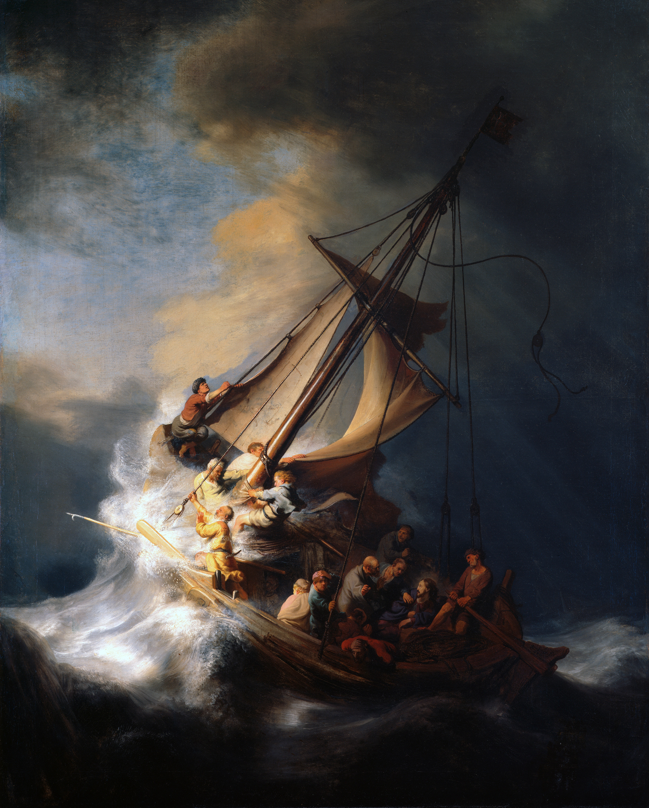
Rembrandt
“Storm on the Sea of Galilee”

Slide 15
What Sheep Need in Order to be at Rest and Lie Down
4: Fullness
Free from Hunger

Slide 16
Jesus is the Shepherd Who Satisfies
Psalm 23:1-2

