Slide 1
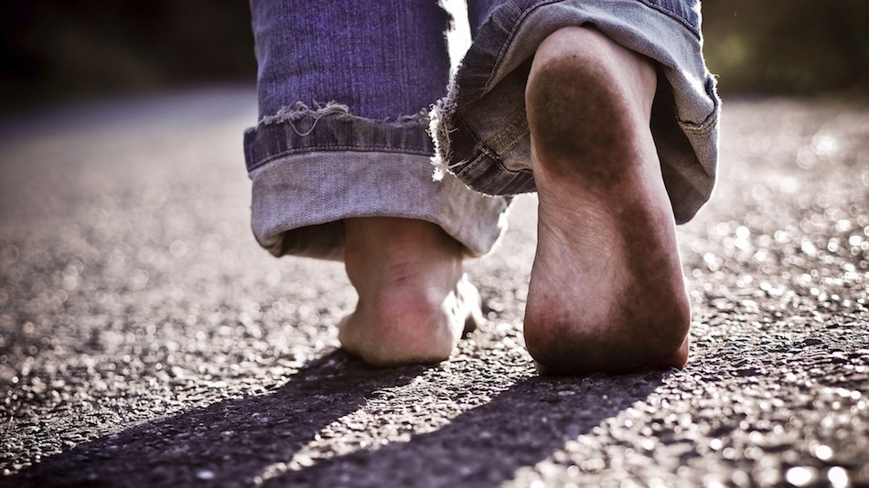

Slide 2
FAILURE OR FOLLOWER?

Slide 3
FAILURE OR FOLLOWER?
Simon Peter and another disciple were following Jesus. Because this disciple was known to the high priest, he went with Jesus into the high priest’s courtyard, but Peter had to wait outside at the door. The other disciple, who was known to the high priest, came back, spoke to the servant girl on duty there and brought Peter in. “You aren’t one of this man’s disciples too, are you?” she asked Peter. He replied, “I am not.” It was cold, and the servants and officials stood around a fire they had made to keep warm. Peter also was standing with them, warming himself.
John 18:15-18

Slide 4
FAILURE OR FOLLOWER?
Meanwhile, Simon Peter was still standing there warming himself. So they asked him, “You aren’t one of his disciples too, are you?” He denied it, saying, “I am not.” One of the high priest’s servants, a relative of the man whose ear Peter had cut off, challenged him, “Didn’t I see you with him in the garden?”
Again Peter denied it, and at that moment a rooster began to crow.
John 18:25-27

Slide 5
FAILURE OR FOLLOWER?
The Lord turned and looked straight at Peter. Then Peter remembered the word the Lord had spoken to him: “Before the rooster crows today, you will disown me three times.”
Luke 22:61

Slide 6
FAILURE OR FOLLOWER?
What went through Peter’s mind when he remembered…
Met
John 1:40-42

Slide 7
FAILURE OR FOLLOWER?
What went through Peter’s mind when he remembered…
Met
John 1:40-42
Declared
Matthew 16:16–18

Slide 8
FAILURE OR FOLLOWER?
What went through Peter’s mind when he remembered…
Met
John 1:40-42
Declared
Matthew 16:16–18
Learned
John 13:6-8

Slide 9
FAILURE OR FOLLOWER?
What went through Peter’s mind when he remembered…
Met
John 1:40-42
Declared
Matthew 16:16–18
Promised
John 13:36-38
Learned
John 13:6-8

Slide 10
FAILURE OR FOLLOWER?
What went through Peter’s mind when he remembered…
Met
John 1:40-42
Declared
Matthew 16:16–18
Promised
John 13:36-38
Slept
Mark 14:37
Learned
John 13:6-8

Slide 11
FAILURE OR FOLLOWER?
What went through Peter’s mind when he remembered…
Met
John 1:40-42
Declared
Matthew 16:16–18
Promised
John 13:36-38
Defended
John 18:10-11
Slept
Mark 14:37
Learned
John 13:6-8

Slide 12
FAILURE OR FOLLOWER?
What went through Peter’s mind when he remembered…
Met
John 1:40-42
Denied
John 18:15-18; 25-27
Declared
Matthew 16:16–18
Promised
John 13:36-38
Defended
John 18:10-11
Slept
Mark 14:37
Learned
John 13:6-8

Slide 13
FAILURE OR FOLLOWER?
What went through Peter’s mind when he remembered…
Met
John 1:40-42
Denied
John 18:15-18; 25-27
Declared
Matthew 16:16–18
Promised
John 13:36-38
FAILURE
Defended
John 18:10-11
Slept
Mark 14:37
Learned
John 13:6-8

Slide 14
FAILURE OR FOLLOWER?
Jesus was not done with Peter:
“But go, tell his disciples and Peter, ‘He is going ahead of you into Galilee. There you will see him, just as he told you.’ ”
Mark 16:7

Slide 15
FAILURE OR FOLLOWER?
He received the grace of Christ:
Jesus said, “Feed my sheep.” and “Follow me!”
John 21:17–19

Slide 16
FAILURE OR FOLLOWER?
He received the grace of Christ:
Jesus said, “Feed my sheep.” and “Follow me!”
John 21:17–19
He passed along the grace of Christ:
But in your hearts, revere Christ as Lord. Always be prepared to give an answer to everyone who asks you to give the reason for the hope that you have.
1 Peter 3:15

Slide 17
FAILURE OR FOLLOWER?
What went through Peter’s mind when he remembered…
Met
John 1:40-42
Denied
John 18:15-18; 25-27
Declared
Matthew 16:16–18
Promised
John 13:36-38
FOLLOWER
Defended
John 18:10-11
Slept
Mark 14:37
Learned
John 13:6-8

