Slide 2
Starts
June 9
Summer Sunday Picnics
2nd and 4th Sundays
June, July, August
Bring a sack lunch or hit the fast food drive thru after church

Slide 3
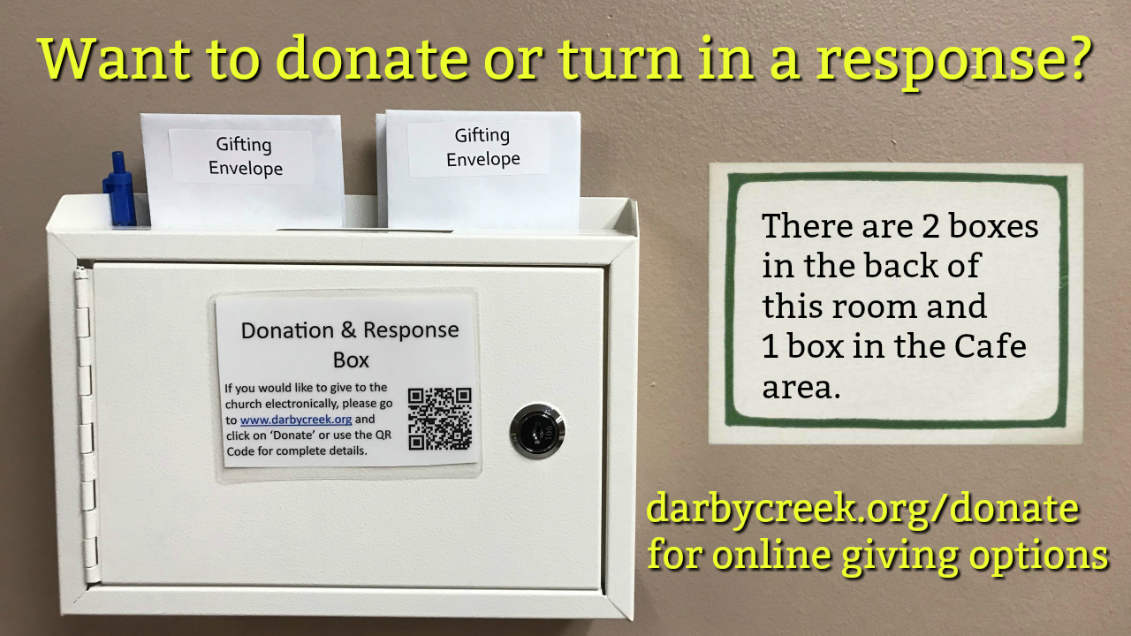

Slide 4
Successful Kingdom Living in God’s Eyes
1 Kings 2

Slide 5
The Kingdom of God and the Church
What is the relationship of the church to the kingdom? On the one hand, the church is a “pilot plant” of the kingdom of God. It is not simply a collection of individuals who are forgiven. It is a “royal nation” (1 Peter 2:9), in other words, a counterculture.
The church is to be a new society in which the world can see what family dynamics, business practices, race relations, and all of life can be under the kingship of Jesus Christ. God is out to heal all the effects of sin: psychological, social, and physical.4 The young woman was very beautiful, and she was of service to the king and attended to him, but the king knew her not.
https://www.thegospelcoalition.org/blogs/justin-taylor/the-kingdom-and-the-church/

Slide 6
The Kingdom of God and the Church
On the other hand, the church is to be an agent of the kingdom. It is not only to model the healing of God’s rule but it is to spread it. “You are . . . a royal priesthood, a holy nation . . . that you may declare the praises of him who called you out of darkness into his wonderful light” (1 Peter 2:9). Christians go into the world as witnesses of the kingdom (Acts 1:6-8).
To spread the kingdom of God is more than simply winning people to Christ. It is also working for the healing of persons, families, relationships, and nations; it is doing deeds of mercy and seeking justice. It is ordering lives and relationships and institutions and communities according to God’s authority to bring in the blessedness of the kingdom.
https://www.thegospelcoalition.org/blogs/justin-taylor/the-kingdom-and-the-church/

Slide 7
1 Kings 2:1-12 (ESV)
1 When David's time to die drew near, he commanded Solomon his son, saying,
2 “I am about to go the way of all the earth. Be strong, and show yourself a man,
3 and keep the charge of the Lord your God, walking in his ways and keeping his statutes, his commandments, his rules, and his testimonies, as it is written in the Law of Moses, that you may prosper in all that you do and wherever you turn,

Slide 8
1 Kings 2:1-12 (ESV)
4 that the Lord may establish his word that he spoke concerning me, saying, ‘If your sons pay close attention to their way, to walk before me in faithfulness with all their heart and with all their soul, you shall not lack a man on the throne of Israel.’
5 “Moreover, you also know what Joab the son of Zeruiah did to me, how he dealt with the two commanders of the armies of Israel, Abner the son of Ner, and Amasa the son of Jether, whom he killed, avenging in time of peace for blood that had been shed in war, and putting the blood of war on the belt around his waist and on the sandals on his feet.
6 Act therefore according to your wisdom, but do not let his gray head go down to Sheol in peace.

Slide 9
1 Kings 2:1-12 (ESV)
7 But deal loyally with the sons of Barzillai the Gileadite, and let them be among those who eat at your table, for with such loyalty they met me when I fled from Absalom your brother.
8 And there is also with you Shimei the son of Gera, the Benjaminite from Bahurim, who cursed me with a grievous curse on the day when I went to Mahanaim. But when he came down to meet me at the Jordan, I swore to him by the Lord, saying, ‘I will not put you to death with the sword.’
9 Now therefore do not hold him guiltless, for you are a wise man. You will know what you ought to do to him, and you shall bring his gray head down with blood to Sheol.”

Slide 10
1 Kings 2:1-12 (ESV)
10 Then David slept with his fathers and was buried in the city of David.
11 And the time that David reigned over Israel was forty years. He reigned seven years in Hebron and thirty-three years in Jerusalem.
12 So Solomon sat on the throne of David his father, and his kingdom was firmly established.

Slide 11
Becoming a Kingdom Citizen
Adonijah, Joab, and Shimei all refused to submit to God’s anointed king and they suffered the consequences

Slide 12
Becoming a Kingdom Citizen
So, we too, when we don’t accept God’s anointed King (Jesus Christ) and give Him the rightful place in our lives we suffer the consequences.

Slide 13
Becoming a Kingdom Citizen
So, we too, when we don’t accept God’s anointed King (Jesus Christ) and give Him the rightful place in our lives we suffer the consequences.

Slide 14
What is Successful Kingdom Living in God’s Eyes?
(David’s Last Words to Solomon)
Live by God’s Word and Walk in His ways

Slide 15
What is Successful Kingdom Living in God’s Eyes?
(David’s Last Words to Solomon)
The Christian life boils down to “Seek First the Kingdom of God” (Matthew 6:33)

Slide 16
How do we practically seek the Kingdom of God?

Slide 17
Successful Kingdom Living in God’s Eyes
1 Kings 2

