Slide 1
Starts
June 9
Summer Sunday Picnics
2nd and 4th Sundays
June, July, August
Bring a sack lunch or hit the fast food drive thru after church

Slide 2
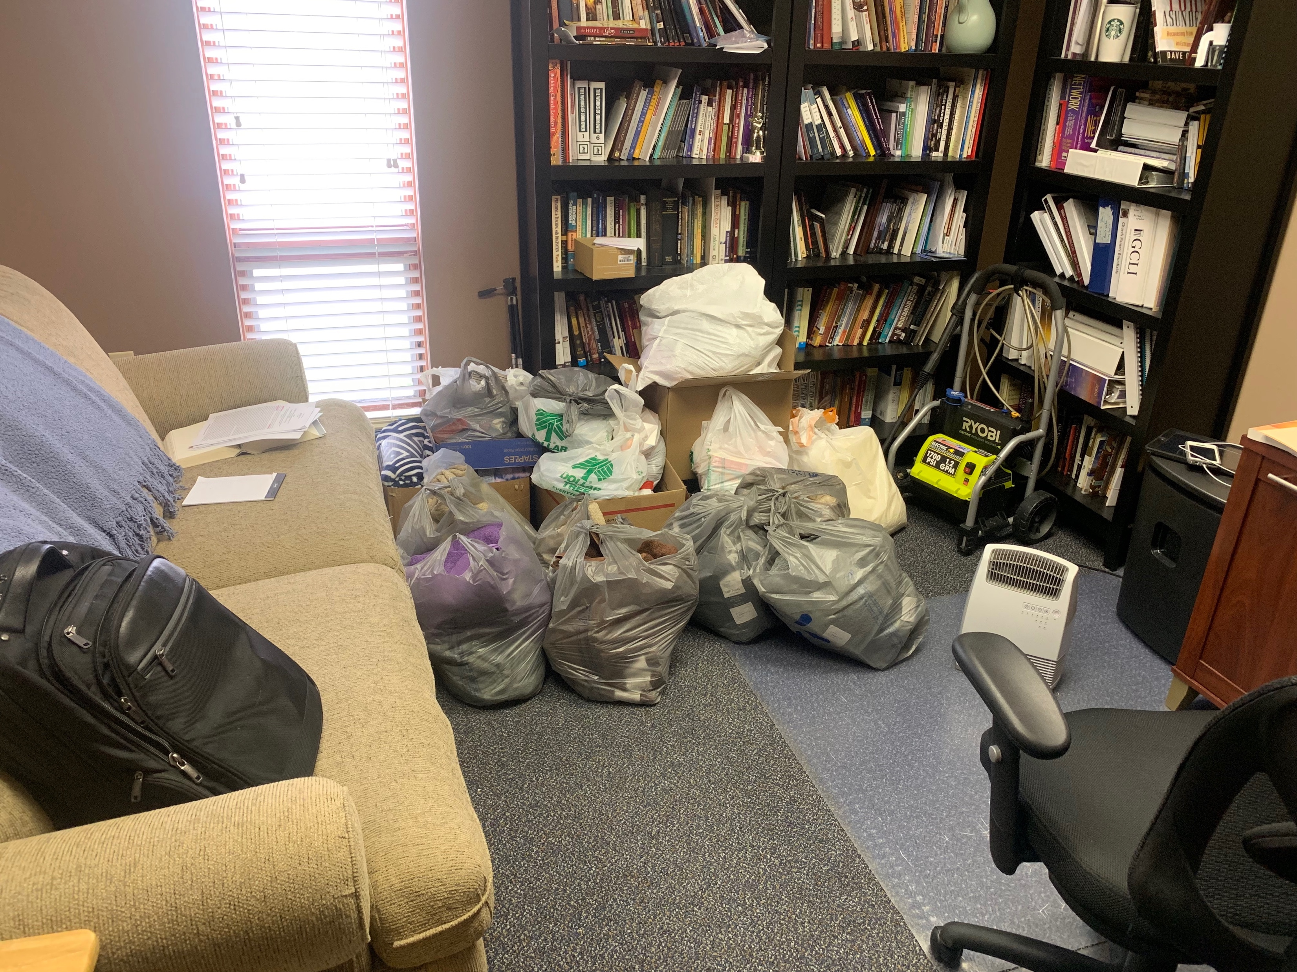
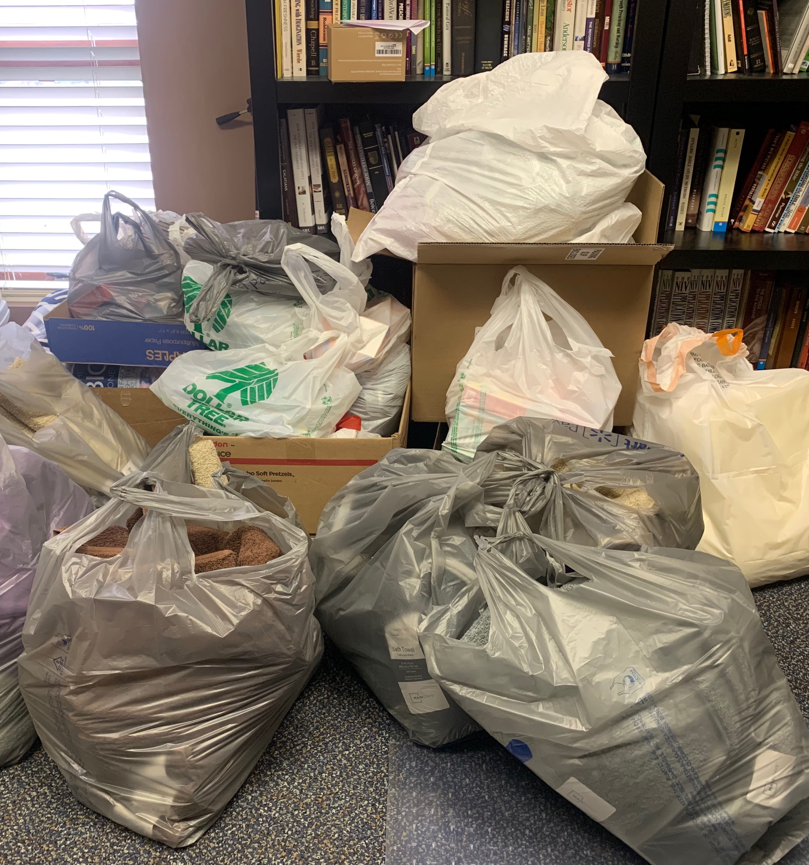
Missions Trip Donations

Slide 3
King Me!
1 Kings 1

Slide 4
The Forest and the Trees

Slide 5
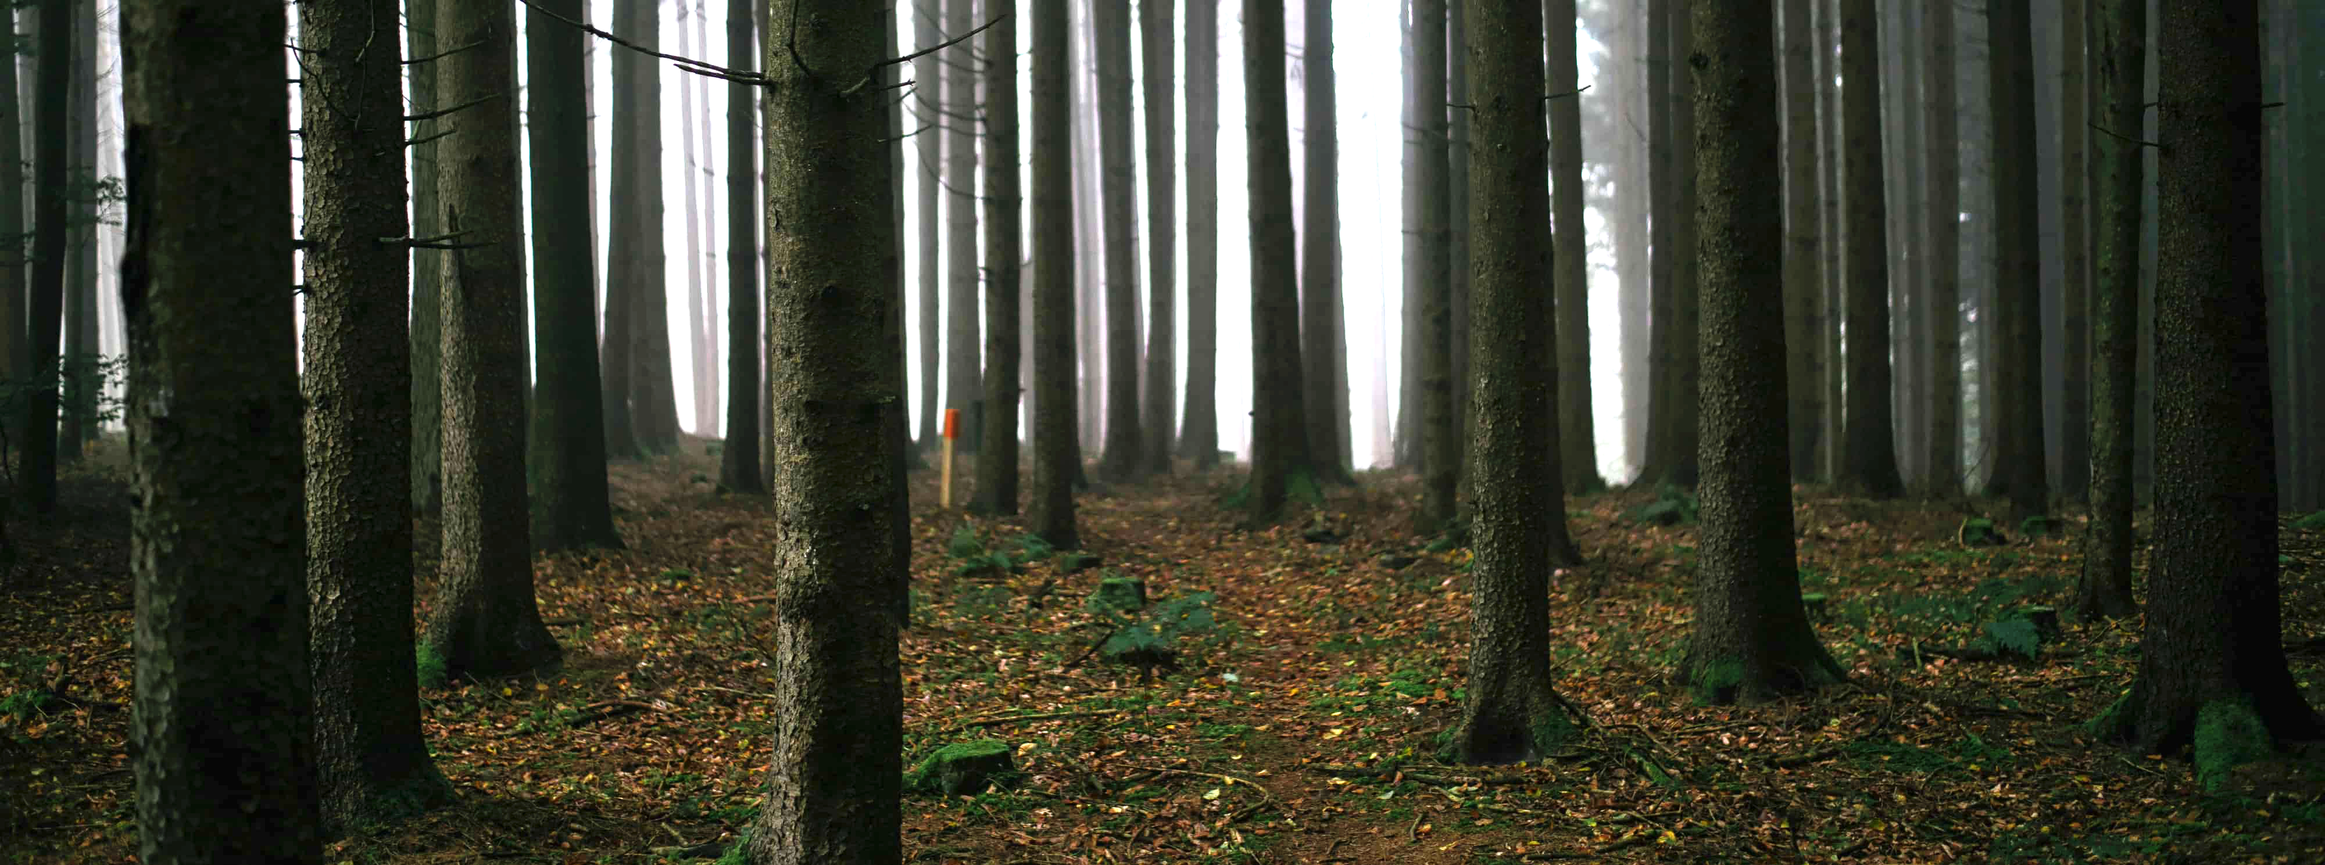
The Trees:
This Story and Character Lessons

Slide 6
1 Kings 1:1-10 (ESV)
1 Now King David was old and advanced in years. And although they covered him with clothes, he could not get warm.
2 Therefore his servants said to him, “Let a young woman be sought for my lord the king, and let her wait on the king and be in his service. Let her lie in your arms, that my lord the king may be warm.”
3 So they sought for a beautiful young woman throughout all the territory of Israel, and found Abishag the Shunammite, and brought her to the king.
4 The young woman was very beautiful, and she was of service to the king and attended to him, but the king knew her not.

Slide 7
1 Kings 1:1-10 (ESV)
5 Now Adonijah the son of Haggith exalted himself, saying, “I will be king.” And he prepared for himself chariots and horsemen, and fifty men to run before him.
6 His father had never at any time displeased him by asking, “Why have you done thus and so?” He was also a very handsome man, and he was born next after Absalom.
7 He conferred with Joab the son of Zeruiah and with Abiathar the priest. And they followed Adonijah and helped him.
8 But Zadok the priest and Benaiah the son of Jehoiada and Nathan the prophet and Shimei and Rei and David's mighty men were not with Adonijah.

Slide 8
1 Kings 1:1-10 (ESV)
9 Adonijah sacrificed sheep, oxen, and fattened cattle by the Serpent's Stone, which is beside En-rogel, and he invited all his brothers, the king's sons, and all the royal officials of Judah,
10 but he did not invite Nathan the prophet or Benaiah or the mighty men or Solomon his brother.

Slide 9
Don’t Drop the Leadership Ball
Not protecting the throne (succession plan; next generation)
Lack of parental discipline is now bearing fruit (did not confront his children)
David

Slide 10
Guard Against Adonijah’s Pride
Our chief purpose is to glorify God, not ourselves
Submit to God’s will
Know the Word and submitting to it
Get Godly Counsel (not just “yes men/women”)
Adonijah

Slide 11
We All Need a Nathan
(& to be Like Him)
A Loyal Friend (sticks by you; defends you)
A Truth-Telling Friend (tough love)
Nathan

Slide 12
The Forest:
How this Story Fits within the Larger Story

Slide 13
God Keeps His Word!
Someone from David’s family would sit on the throne forever (Jesus – the ultimate fulfillment of that promise).
God promised David that Solomon would be his successor

Slide 14
King Me!
1 Kings 1

