Slide 1
Summer Sunday Picnics
2nd and 4th Sundays
June, July, August
Bring a sack lunch or hit the fast food drive thru after church

Slide 2
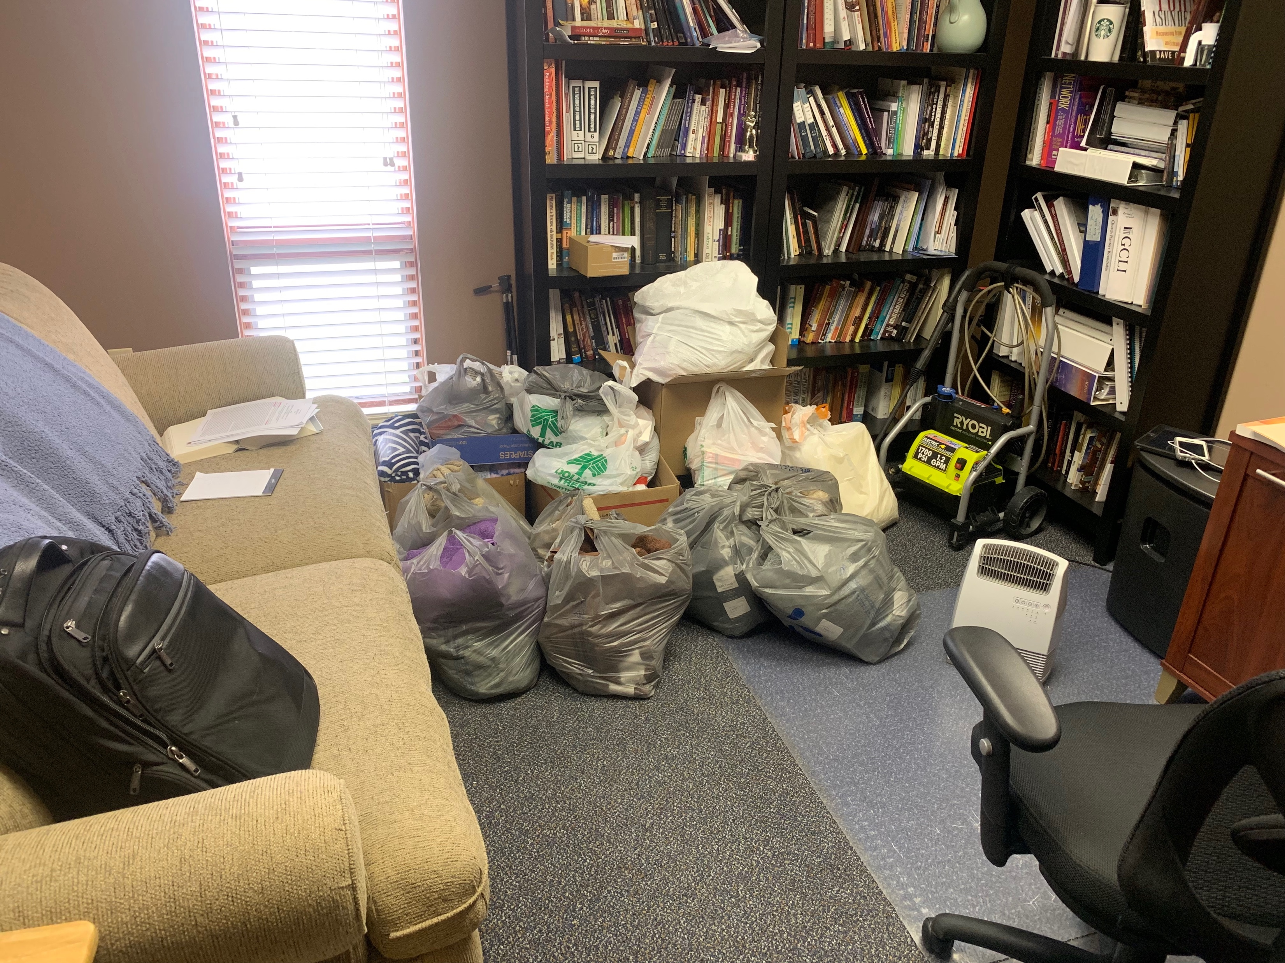
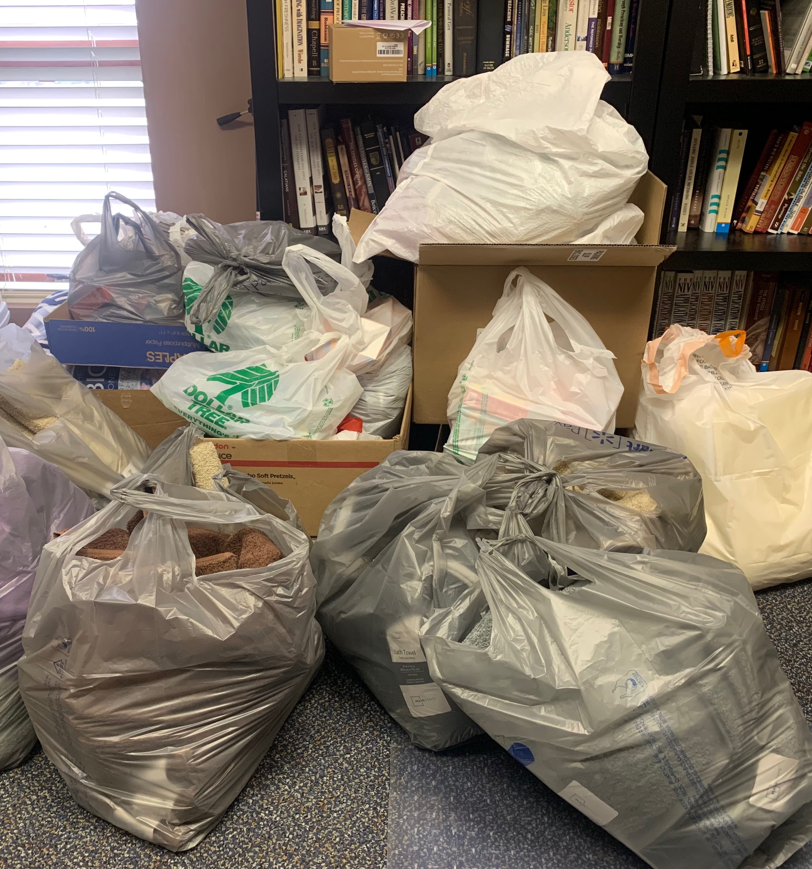
Missions Trip Donations

Slide 5
Mark 7 (ESV)
14 And he called the people to him again and said to them, “Hear me, all of you, and understand:
15 There is nothing outside a person that by going into him can defile him, but the things that come out of a person are what defile him.”
17 And when he had entered the house and left the people, his disciples asked him about the parable.
18 And he said to them, “Then are you also without understanding? Do you not see that whatever goes into a person from outside cannot defile him,
19 since it enters not his heart but his stomach, and is expelled?” (Thus he declared all foods clean.)

Slide 6
Mark 7 (ESV)
20 And he said, “What comes out of a person is what defiles him.
21 For from within, out of the heart of man, come evil thoughts, sexual immorality, theft, murder, adultery,
22 coveting, wickedness, deceit, sensuality, envy, slander, pride, foolishness.
23 All these evil things come from within, and they defile a person.”

Slide 7
Ezekiel 36 (ESV)
24 I will take you from the nations and gather you from all the countries and bring you into your own land. 25 I will sprinkle clean water on you, and you shall be clean from all your uncleannesses, and from all your idols I will cleanse you. 26 And I will give you a new heart, and a new spirit I will put within you. And I will remove the heart of stone from your flesh and give you a heart of flesh. 27 And I will put my Spirit within you, and cause you to walk in my statutes and be careful to obey my rules.
Romans 6 (ESV)
We were buried therefore with him by baptism into death, in order that, just as Christ was raised from the dead by the glory of the Father, we too might walk in newness of life.

Slide 10
The Book of 1 Kings
Chapters 1-11: Rise and Fall of King Solomon
Chapters 12-14: A Divided Kingdom
Chapters 15-16: Northern Kingdom’s Decline
Chapters 17-22: Elijah; Good Kings / Bad Kings

Slide 11
The Where & When of
1 Kings
970 to 848 B.C.

Slide 12
Our focus in this message series…
Chapters 1-11: Rise and Fall of King Solomon

Slide 13
What Can We Learn from 1 Kings?
We learn about the character and work of God in history

Slide 14
What Can We Learn from 1 Kings?
We learn that idolatry is a big deal to God

Slide 15
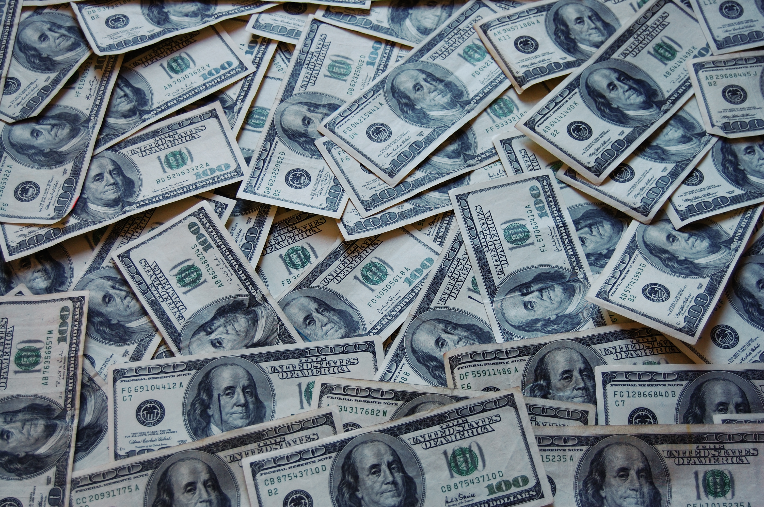
I Don’t Have Any Idols….Do I?
Sex

Slide 16
I Don’t Have Any Idols….Do I?
What Can’t I Live Without?
What Will I Risk Everything For?
What Gives My Life Meaning?
What Do I Trust In?
1 John 5:21 ESV
Little children, keep yourselves from idols.

Slide 17
What Can We Learn from 1 Kings?
We can see glimpses of Jesus in this book of the Bible

Slide 18
Solomon; A Christ-like Figure
Matthew 12:42
The queen of the South will rise up at the judgment with this generation and condemn it, for she came from the ends of the earth to hear the wisdom of Solomon, and behold, something greater than Solomon is here.

Slide 19
One Major Take Away from 1 Kings
Two Words: Spiritual Decline

Slide 20
One Major Take Away from 1 Kings
Two Words: Spiritual Decline
A small deviation from your trajectory can make a BIG difference in your destination

Slide 21
One Major Take Away from 1 Kings
Two Words: Spiritual Decline
Solomon’s numerous marriages and extensive harem led to his wandering faith in later years.

Slide 22
One Major Take Away from 1 Kings
Two Words: Spiritual Decline
Like King Solomon, eventually compromise after compromise will lead us to places we never intended to be in our lives. And these compromises can have unintended consequences.

