Slide 1
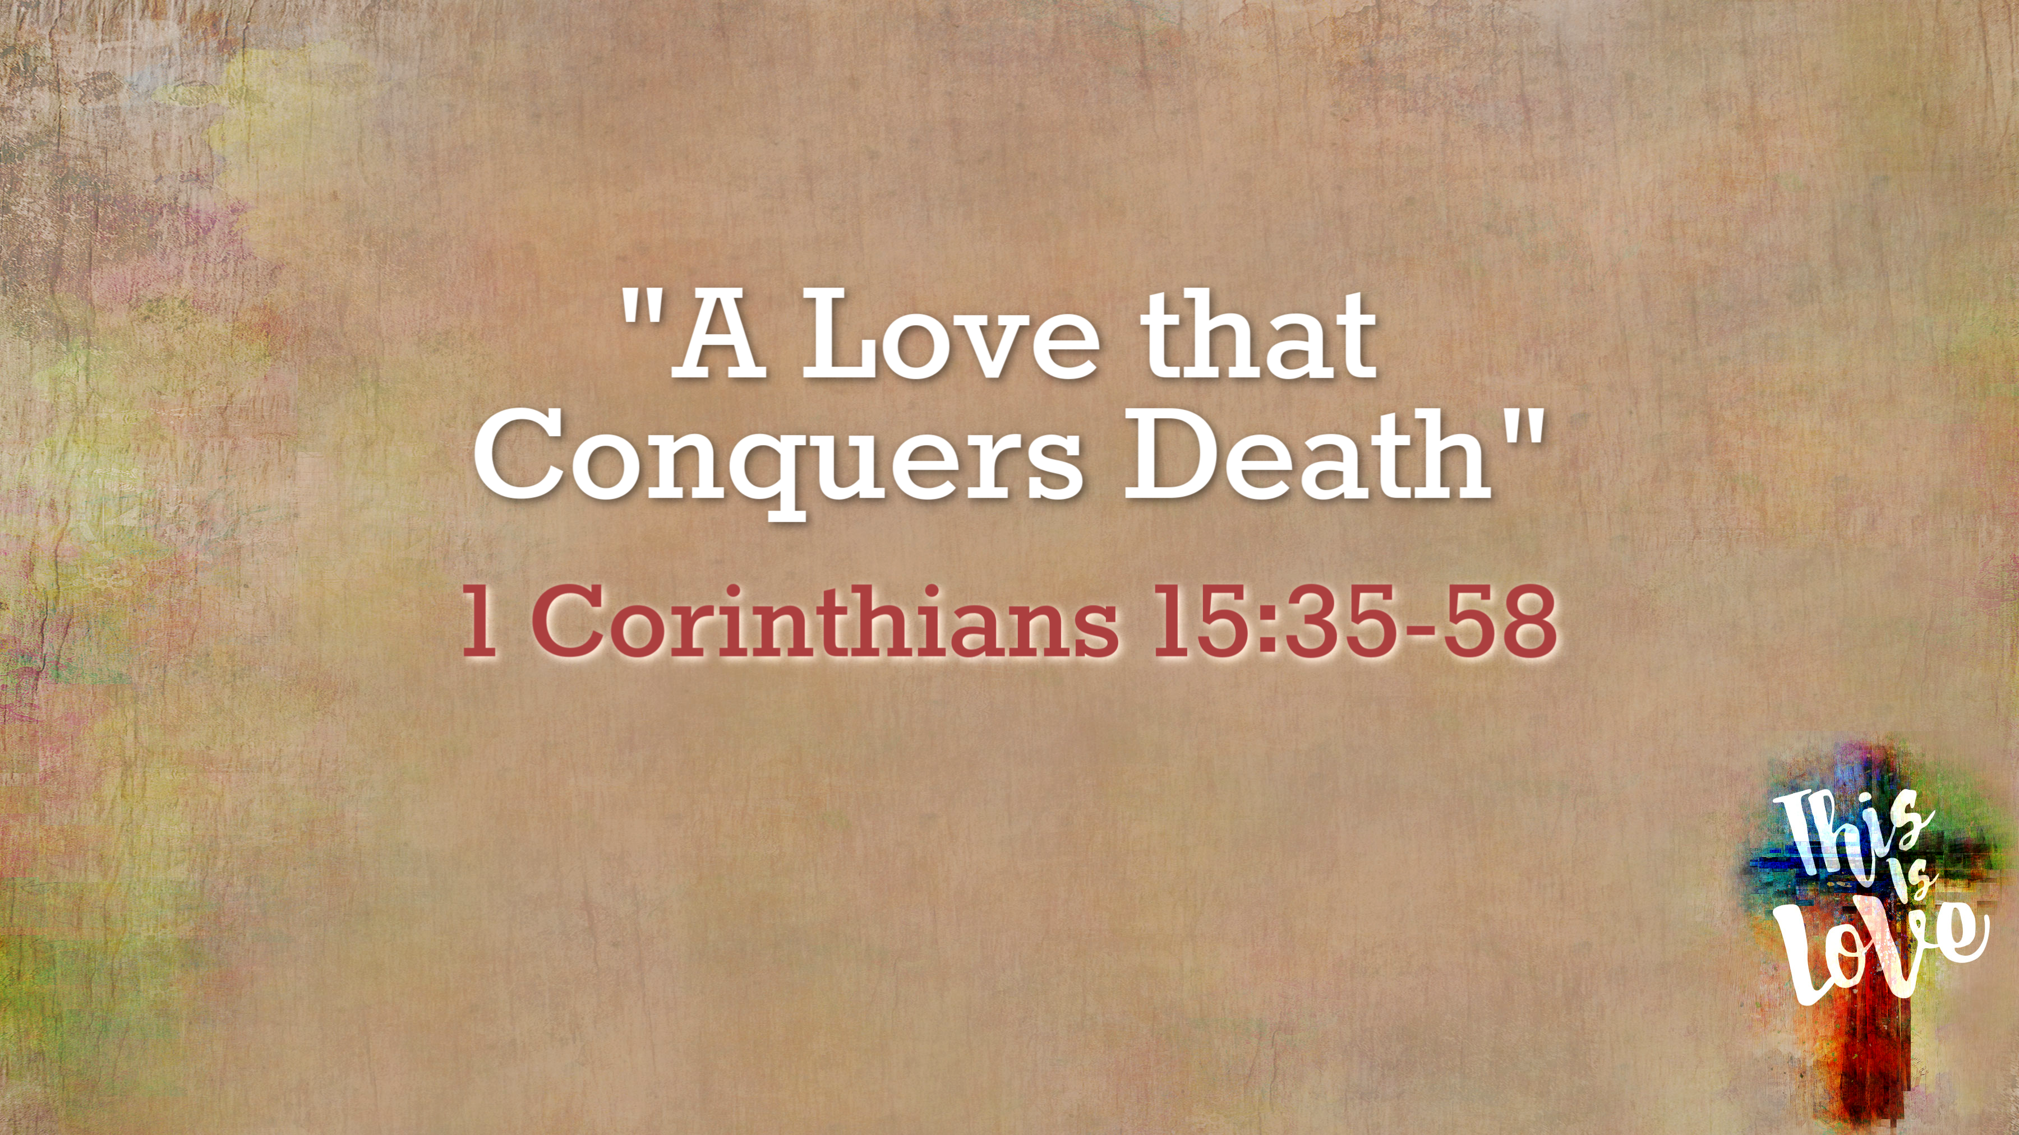

Slide 2
1 Corinthians 15:1-4 English Standard Version
1 Now I would remind you, brothers, of the gospel I preached to you, which you received, in which you stand,
2 and by which you are being saved, if you hold fast to the word I preached to you—unless you believed in vain.
3 For I delivered to you as of first importance what I also received: that Christ died for our sins in accordance with the Scriptures,
4 that he was buried, that he was raised on the third day in accordance with the Scriptures,

Slide 3

1: This is the gospel. It includes the resurrection.
Behold, your king is coming to you
Christ died for our sins
He was buried
He was raised on the third day
Matthew 21:1-11

Slide 4
1 Corinthians 15:10 English Standard Version
10 But by the grace of God I am what I am, and his grace toward me was not in vain. On the contrary, I worked harder than any of them, though it was not I, but the grace of God that is with me.

Slide 5
Behold, your king is coming to you
2: This is a gospel of grace
Matthew 21:1-11

Slide 6
1 Corinthians 15:12-13, 17-19 English Standard Version
12 Now if Christ is proclaimed as raised from the dead, how can some of you say that there is no resurrection of the dead?
13 But if there is no resurrection of the dead, then not even Christ has been raised.
17 And if Christ has not been raised, your faith is futile and you are still in your sins.
18 Then those also who have fallen asleep in Christ have perished.
19 If in Christ we have hope in this life only, we are of all people most to be pitied.

Slide 7
3: The resurrection of the dead is critical.
Behold, your king is coming to you
Matthew 21:1-11

Slide 8
1 Corinthians 15:20, 23-26 English Standard Version
20 But in fact Christ has been raised from the dead, the firstfruits of those who have fallen asleep.
23 But each in his own order: Christ the firstfruits, then at his coming those who belong to Christ.
24 Then comes the end, when he delivers the kingdom to God the Father after destroying every rule and every authority and power.
25 For he must reign until he has put all his enemies under his feet.
26 The last enemy to be destroyed is death.

Slide 9
1 Corinthians 15:35-37, 40 English Standard Version
35 But someone will ask, “How are the dead raised? With what kind of body do they come?”
36 You foolish person! What you sow does not come to life unless it dies.
37 And what you sow is not the body that is to be, but a bare kernel, perhaps of wheat or of some other grain.
40 There are heavenly bodies and earthly bodies, but the glory of the heavenly is of one kind, and the glory of the earthly is of another.

Slide 10
4: Our resurrected body will be similar to our earthly one but much better
Behold, your king is coming to you
Matthew 21:1-11

Slide 11
1 Corinthians 15:40-43 English Standard Version
41 There is one glory of the sun, and another glory of the moon, and another glory of the stars; for star differs from star in glory.
42 So is it with the resurrection of the dead. What is sown is perishable; what is raised is imperishable.
43 It is sown in dishonor; it is raised in glory. It is sown in weakness; it is raised in power.

Slide 12
Philippians 3:20-21 English Standard Version
20 But our citizenship is in heaven, and from it we await a Savior, the Lord Jesus Christ,
21 who will transform our lowly body to be like his glorious body, by the power that enables him even to subject all things to himself.

Slide 13
1 Corinthians 15:50-53 English Standard Version
50 I tell you this, brothers: flesh and blood cannot inherit the kingdom of God, nor does the perishable inherit the imperishable.
51 Behold! I tell you a mystery. We shall not all sleep, but we shall all be changed,
52 in a moment, in the twinkling of an eye, at the last trumpet. For the trumpet will sound, and the dead will be raised imperishable, and we shall be changed.
53 For this perishable body must put on the imperishable, and this mortal body must put on immortality.

Slide 14
1 Corinthians 15:54-57 English Standard Version
54 When the perishable puts on the imperishable, and the mortal puts on immortality, then shall come to pass the saying that is written:
“Death is swallowed up in victory.”
55 “O death, where is your victory?
O death, where is your sting?”
56 The sting of death is sin, and the power of sin is the law.
57 But thanks be to God, who gives us the victory through our Lord Jesus Christ.

Slide 15
1 Corinthians 15:35-58 English Standard Version
58 Therefore, my beloved brothers, be steadfast, immovable, always abounding in the work of the Lord, knowing that in the Lord your labor is not in vain.

Slide 16
An Epitaph on a Tomb:
Pause Stranger, when you pass me by,
As you are now, so once was I.
As I am now, so you will be,
So prepare for death and follow me.
Behold, your king is coming to you
Scratched below that someone wrote:
To follow you I’m not content,
Until I know which way you went.
Matthew 21:1-11

Slide 17
John 5:28-29 English Standard Version
28 Do not marvel at this, for an hour is coming when all who are in the tombs will hear his voice
29 and come out, those who have done good to the resurrection of life, and those who have done evil to the resurrection of judgment.

Slide 18
Romans 10:9-10 English Standard Version
9 because, if you confess with your mouth that Jesus is Lord and believe in your heart that God raised him from the dead, you will be saved.
10 For with the heart one believes and is justified, and with the mouth one confesses and is saved.

