Slide 2
April and May: We need these items for our missions trip
to Managua, Nicaragua!
New or gently used blankets
New or gently used towels
Pencils and pens
Colored pencils with pencil sharpener
Children's coloring books for various ages
Soccer balls
Small air pump (to pump up soccer balls)
Baseballs
Baseball glove (various sizes)
Toys for the church preschool and toddler room
Gently used clothing (all clothing for all ages)
Tooth brushes for children and adults
Small tooth paste tubes
Bars of soap (no liquid soap please)
Bandages / Band-aids

Slide 3
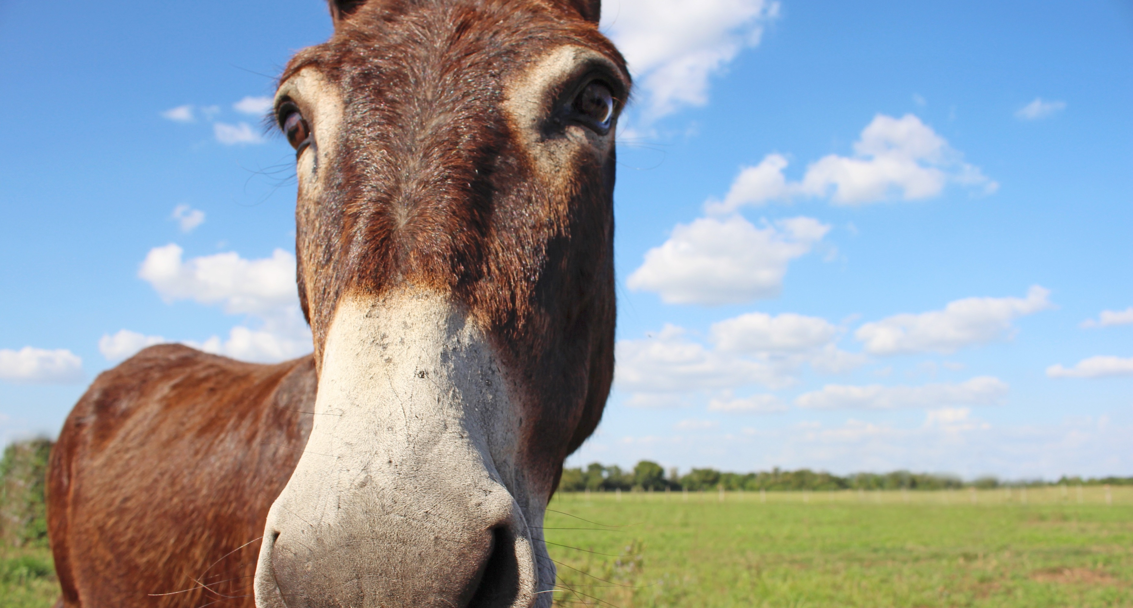
Behold, your king is coming to you
Matthew 21:1-11

Slide 4
Matthew 21:1-11 English Standard Version
1 Now when they drew near to Jerusalem and came to Bethphage, to the Mount of Olives, then Jesus sent two disciples,
2 saying to them, “Go into the village in front of you, and immediately you will find a donkey tied, and a colt with her. Untie them and bring them to me.
3 If anyone says anything to you, you shall say, ‘The Lord needs them,’ and he will send them at once.”
4 This took place to fulfill what was spoken by the prophet, saying,

Slide 5
Matthew 21:1-11 English Standard Version
5 “Say to the daughter of Zion,
‘Behold, your king is coming to you,
humble, and mounted on a donkey,
on a colt, the foal of a beast of burden.’”
6 The disciples went and did as Jesus had directed them.
7 They brought the donkey and the colt and put on them their cloaks, and he sat on them.
8 Most of the crowd spread their cloaks on the road, and others cut branches from the trees and spread them on the road.

Slide 6
Matthew 21:1-11 English Standard Version
9 And the crowds that went before him and that followed him were shouting, “Hosanna to the Son of David! Blessed is he who comes in the name of the Lord! Hosanna in the highest!”
10 And when he entered Jerusalem, the whole city was stirred up, saying, “Who is this?”
11 And the crowds said, “This is the prophet Jesus, from Nazareth of Galilee.”

Slide 7
Behold, your king is coming to you
Matthew 21:1-11

Slide 8
The Identity Jigsaw Puzzle
Who Is
Jesus?

Slide 9
The Identity Jigsaw Puzzle
Piece #1
The Donkey

Slide 10
1 Kings 1:38-40 English Standard Version
38 So Zadok the priest, Nathan the prophet, and Benaiah the son of Jehoiada, and the Cherethites and the Pelethites went down and had Solomon ride on King David's mule and brought him to Gihon.
39 There Zadok the priest took the horn of oil from the tent and anointed Solomon. Then they blew the trumpet, and all the people said, “Long live King Solomon!”
40 And all the people went up after him, playing on pipes, and rejoicing with great joy, so that the earth was split by their noise.

Slide 11
The Identity Jigsaw Puzzle
Piece #2
The Cloaks

Slide 12
2 Kings 9:11-13 English Standard Version
11 When Jehu came out to the servants of his master, they said to him, “Is all well? Why did this mad fellow come to you?” And he said to them, “You know the fellow and his talk.”
12 And they said, “That is not true; tell us now.” And he said, “Thus and so he spoke to me, saying, ‘Thus says the Lord, I anoint you king over Israel.’”
13 Then in haste every man of them took his garment and put it under him on the bare steps, and they blew the trumpet and proclaimed, “Jehu is king.”

Slide 13
The Identity Jigsaw Puzzle
Piece #3
The Praises

Slide 14
Psalm 118:25-26 English Standard Version
25 Save us, we pray, O Lord!
O Lord, we pray, give us success!
26 Blessed is he who comes in the name of the Lord!
We bless you from the house of the Lord.

Slide 15
Observations:
1: God gives us what we need

Slide 16
Observations:
2: Jesus is in Control

Slide 17
Observations:
3: When You Receive Jesus as King, He shakes things up!

Slide 18
Behold, your king is coming to you
Matthew 21:1-11

