Slide 1
Interested in Going on a
Missions Trip to
Managua with Us in
June 2019?
Let us know of your interest TODAY

Slide 2


Slide 3
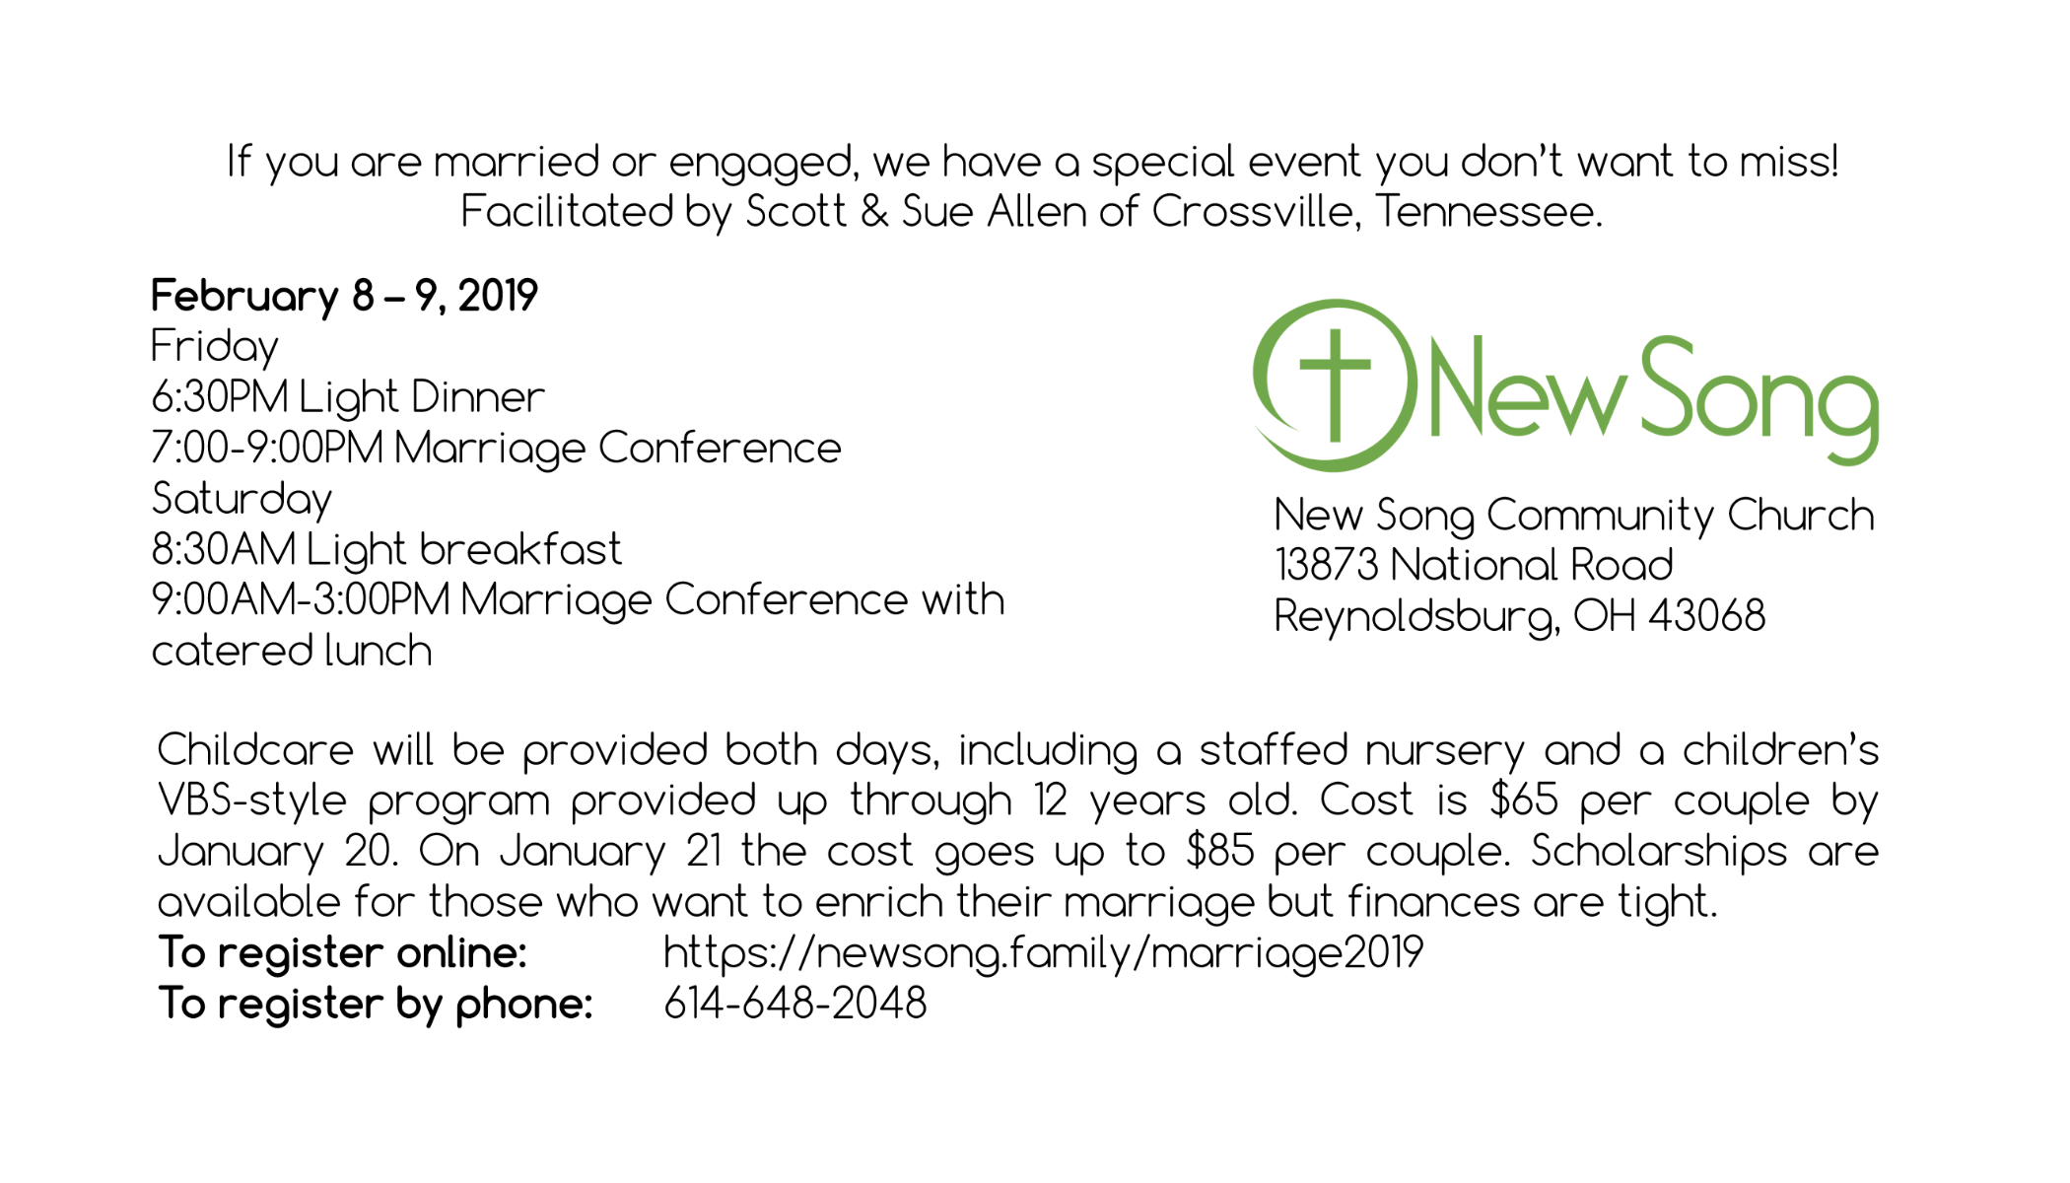

Slide 4

What Should
I Do Now?
Acts 1:12-26

Slide 5
Acts 1:12-26English Standard Version
12 Then they returned to Jerusalem from the mount called Olivet, which is near Jerusalem, a Sabbath day’s journey away.
13 And when they had entered, they went up to the upper room, where they were staying, Peter and John and James and Andrew, Philip and Thomas, Bartholomew and Matthew, James the son of Alphaeus and Simon the Zealot and Judas the son of James.
14 All these with one accord were devoting themselves to prayer, together with the women and Mary the mother of Jesus, and his brothers.

Slide 6
Acts 1:12-26English Standard Version
15 In those days Peter stood up among the brothers (the company of persons was in all about 120) and said,
16 “Brothers, the Scripture had to be fulfilled, which the Holy Spirit spoke beforehand by the mouth of David concerning Judas, who became a guide to those who arrested Jesus.
17 For he was numbered among us and was allotted his share in this ministry.”

Slide 7
Acts 1:12-26English Standard Version
18 (Now this man acquired a field with the reward of his wickedness, and falling headlong he burst open in the middle and all his bowels gushed out.
19 And it became known to all the inhabitants of Jerusalem, so that the field was called in their own language Akeldama, that is, Field of Blood.)
20 “For it is written in the Book of Psalms,
‘May his camp become desolate,
and let there be no one to dwell in it’;
and “ ‘Let another take his office.’

Slide 8
Acts 1:12-26English Standard Version
21 So one of the men who have accompanied us during all the time that the Lord Jesus went in and out among us,
22 beginning from the baptism of John until the day when he was taken up from us—one of these men must become with us a witness to his resurrection.”
23 And they put forward two, Joseph called Barsabbas, who was also called Justus, and Matthias.

Slide 9
Acts 1:12-26English Standard Version
24 And they prayed and said, “You, Lord, who know the hearts of all, show which one of these two you have chosen
25 to take the place in this ministry and apostleship from which Judas turned aside to go to his own place.”
26 And they cast lots for them, and the lot fell on Matthias, and he was numbered with the eleven apostles.

Slide 10
What Should
I Do Now?
Acts 1:12-26

Slide 11
Principles for Making
God-Honoring Decisions
Principle 1: Know and Apply God’s Word

Slide 12
Principles for Making
God-Honoring Decisions
Principle 2: Follow What God Has Clearly Stated as You Seek Wisdom on the Decision Before You

Slide 13
Principles for Making
God-Honoring Decisions
Principle 3: Pray for Wisdom

Slide 14
Principles for Making
God-Honoring Decisions
Principle 4: Seek Godly Input from Others and Apply Common Sense

Slide 15
Principles for Making
God-Honoring Decisions
Principle 5: Consider the Kingdom Impact of the Decision

Slide 16
What Should
I Do Now?
Acts 1:12-26

