Slide 1
Christmas Eve @ Darby Creek
Monday, December 24 from 7-8 pm
Christmas Eve Candlelight Service
Parents: Contact Lex Bennett today if you want your kids to participate in the program

Slide 2
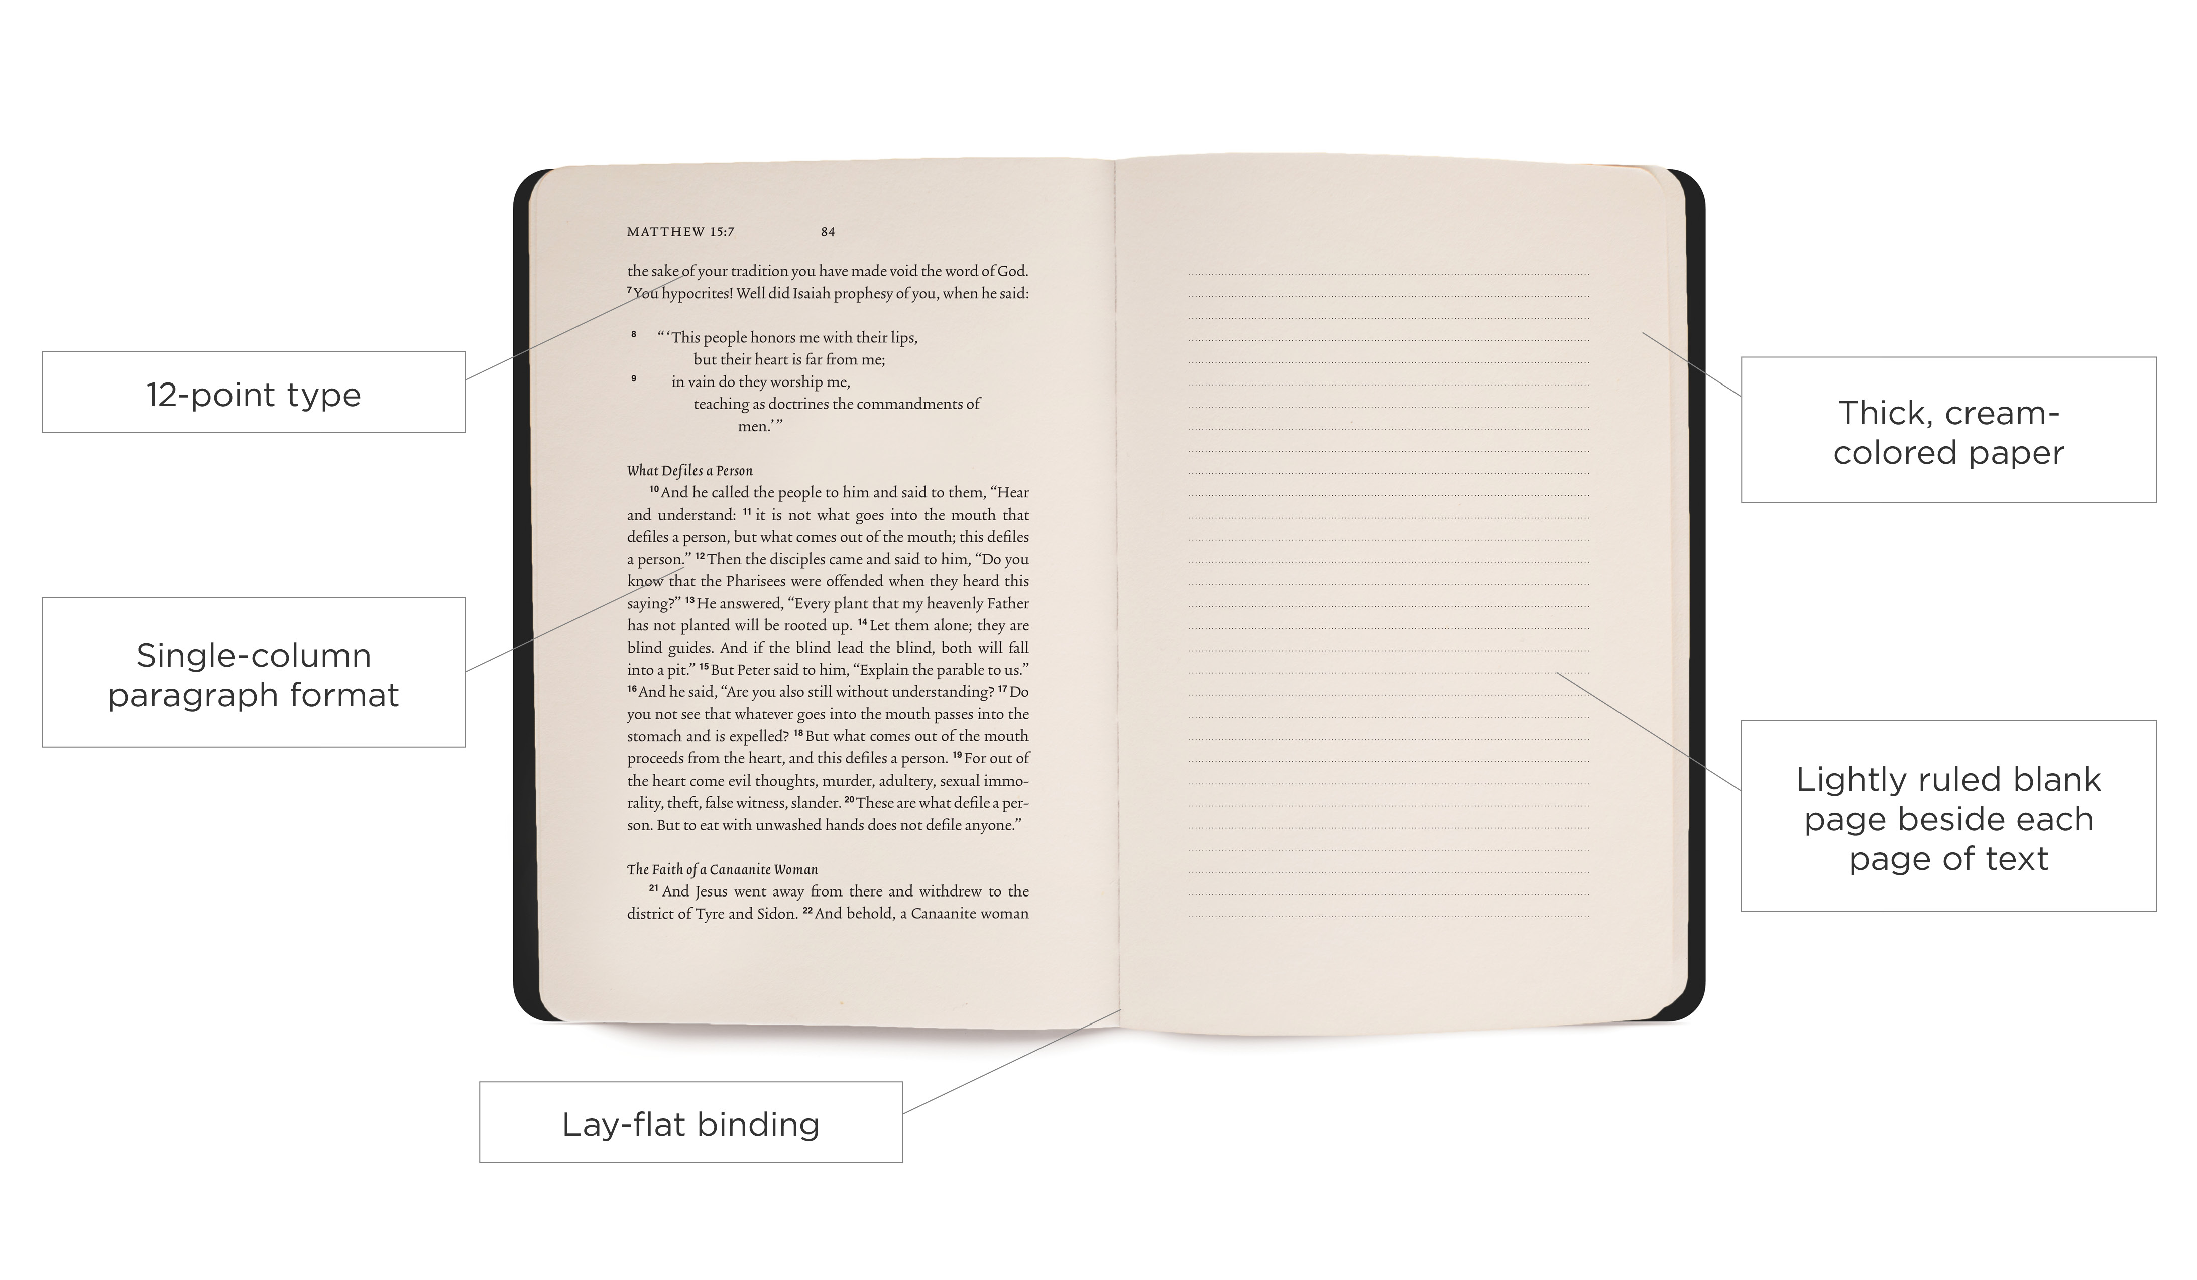
Order Your 50 Days in Acts Reading Plan Materials
(TODAY is order deadline)
DarbyCreek.org/SignUp

Slide 3
Mary’s Surprise and Surrender
Luke 1:26-38
Christmas
According to Luke

Slide 4
Luke 1:26-38 English Standard Version
26 In the sixth month the angel Gabriel was sent from God to a city of Galilee named Nazareth,
27 to a virgin betrothed to a man whose name was Joseph, of the house of David. And the virgin's name was Mary.
28 And he came to her and said, “Greetings, O favored one, the Lord is with you!”
29 But she was greatly troubled at the saying, and tried to discern what sort of greeting this might be.

Slide 5
Luke 1:26-38 English Standard Version
30 And the angel said to her, “Do not be afraid, Mary, for you have found favor with God.
31 And behold, you will conceive in your womb and bear a son, and you shall call his name Jesus.
32 He will be great and will be called the Son of the Most High. And the Lord God will give to him the throne of his father David,
33 and he will reign over the house of Jacob forever, and of his kingdom there will be no end.”

Slide 6
Luke 1:26-38 English Standard Version
34 And Mary said to the angel, “How will this be, since I am a virgin?”
35 And the angel answered her, “The Holy Spirit will come upon you, and the power of the Most High will overshadow you; therefore the child to be born will be called holy—the Son of God.
36 And behold, your relative Elizabeth in her old age has also conceived a son, and this is the sixth month with her who was called barren.

Slide 7
Luke 1:26-38 English Standard Version
37 For nothing will be impossible with God.”
38 And Mary said, “Behold, I am the servant of the Lord; let it be to me according to your word.” And the angel departed from her.

Slide 8
Mary’s Surprise and Surrender
Luke 1:26-38
Christmas
According to Luke

Slide 9
Mary’s Surprise
The Birth Announcement
And behold, you will conceive in your womb and bear a son, and you shall call his name Jesus. V 31
Christmas
According to Luke

Slide 10
Mary’s Surprise
Who is this Child?
32 He will be great and will be called the Son of the Most High. And the Lord God will give to him the throne of his father David,
33 and he will reign over the house of Jacob forever, and of his kingdom there will be no end.” vss 32-33
Christmas
According to Luke

Slide 11
Mary’s Surprise
The Importance of the Virgin Birth
the work of the Holy Spirit in Mary must have prevented not only the transmission of sin from Joseph (for Jesus had no human father) but also, in a miraculous way, the transmission of sin from Mary:
“The Holy Spirit will come upon you … therefore the child to be born will be called holy” (Luke 1:35).
Christmas
According to Luke

Slide 12
Mary’s Surprise
The Importance of the Virgin Birth
Our redemption rests upon Christ’s sinless life
and Him dying in our place. Jesus paid the price for our release from sin and its punishment.
“For our sake he made him to be sin who knew no sin, so that in him we might become the righteousness of God.” 2 Cor 5:21
Christmas
According to Luke

Slide 13
Mary’s Surrender
She surrendered even when
facing certain difficulty
“And Mary said, “Behold, I am the servant of the Lord; let it be to me according to your word.” vs 38
Christmas
According to Luke

Slide 14
Mary’s Surrender
She surrendered without
knowing everything
“And Mary said, “Behold, I am the servant of the Lord; let it be to me according to your word.” vs 38
Christmas
According to Luke

Slide 15
Mary’s Surprise and Surrender
Luke 1:26-38
Christmas
According to Luke

