Slide 1
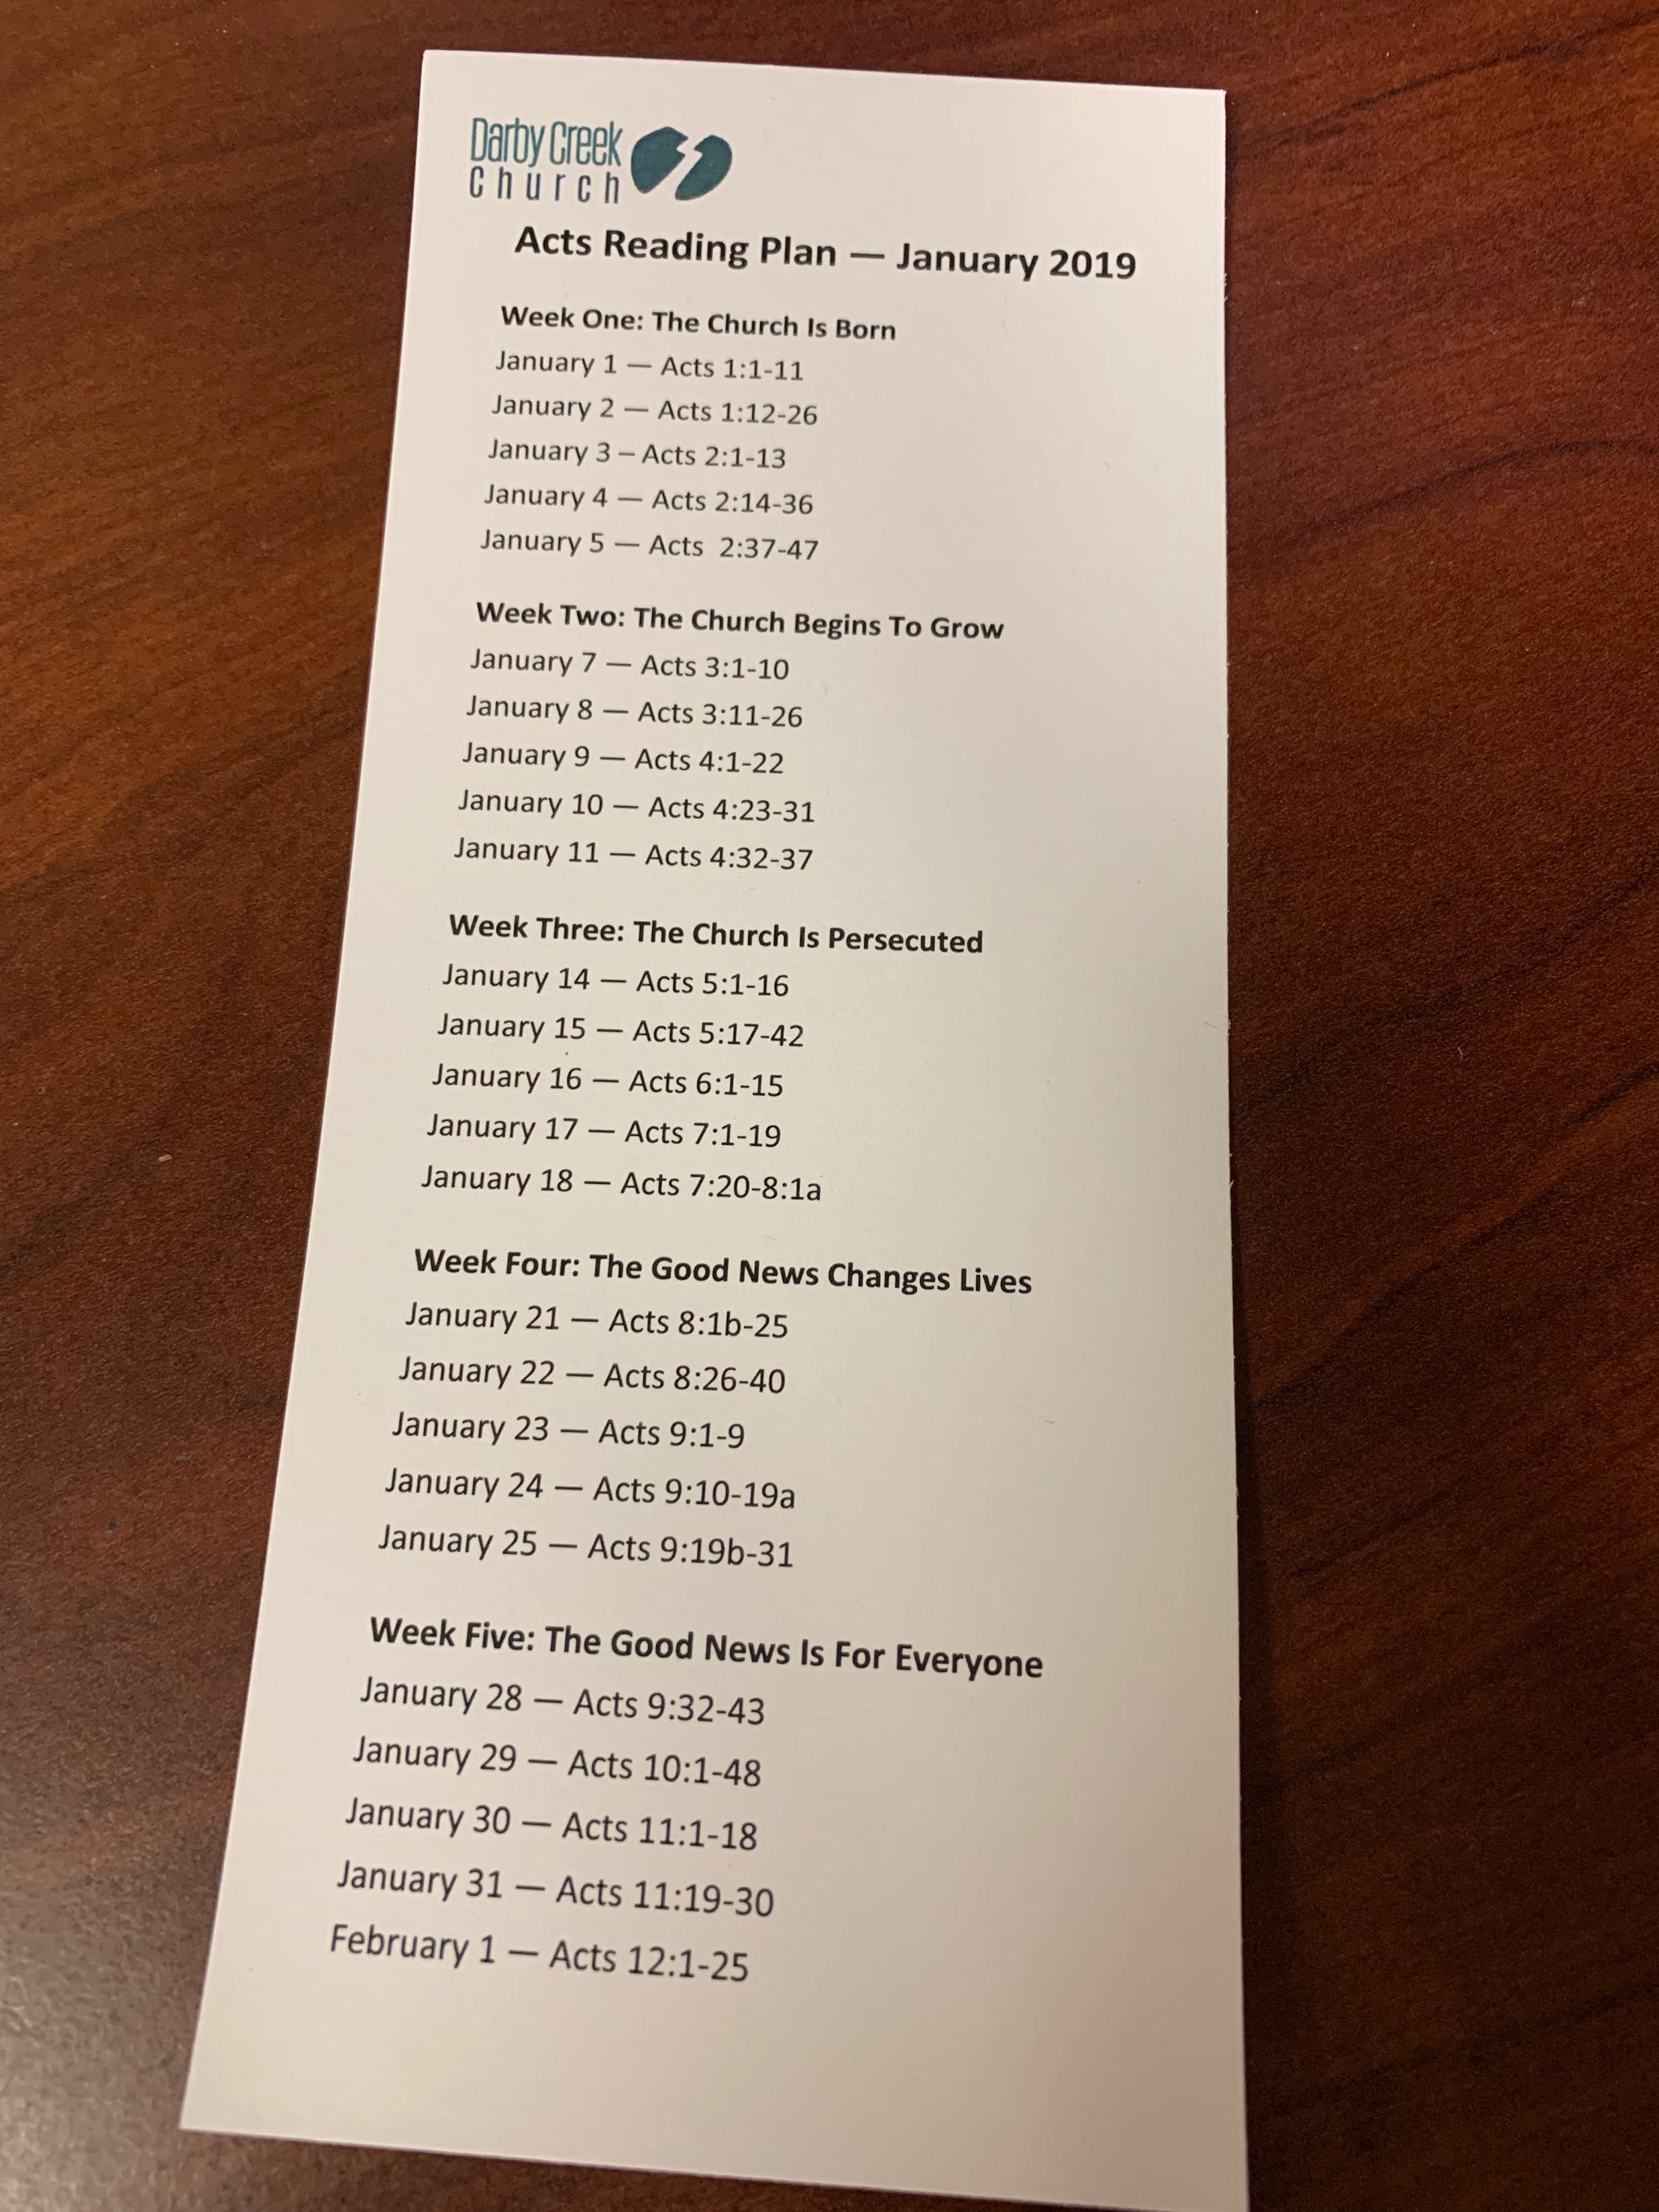
50 Days in Acts Reading Plan
Starts Tuesday!
Pick One Up from the Bulletin Board Area OR the Café Tables

Slide 4
Be Watchful in Prayer &
Watch Your Life
Colossians 4:2-6

Slide 5
Colossians 4:2-6 English Standard Version
2 Continue steadfastly in prayer, being watchful in it with thanksgiving.
3 At the same time, pray also for us, that God may open to us a door for the word, to declare the mystery of Christ, on account of which I am in prison—
4 that I may make it clear, which is how I ought to speak.
5 Walk in wisdom toward outsiders, making the best use of the time.
6 Let your speech always be gracious, seasoned with salt, so that you may know how you ought to answer each person.

Slide 6
1: Prayer is the First Thing to Drop Off Our Spiritual Radar
Colossians 4:2

Slide 8
Things that go together…
Batman &
Robin
Sonny &
Cher
Peanut Butter &
Jelly
Adam &
Eve

Slide 9
2: Prayer and Thanksgiving Go Together
Colossians 4:2

Slide 10
3: Asking for Prayer Support is Critical
Colossians 4:3

Slide 11
John 14:13 ESV
Whatever you ask in my name, this I will do, that the Father may be glorified in the Son.
2 Corinthians 1:11 ESV
You also must help us by prayer, so that many will give thanks on our behalf for the blessing granted us through the prayers of many.

Slide 12
4: Pray for Open Doors to Share Jesus
Colossians 4:3-4

Slide 13
5: Live Carefully and Purposefully before a Watching World
Colossians 4:5-6

Slide 14
Be Watchful in Prayer &
Watch Your Life
Colossians 4:2-6

