Slide 1
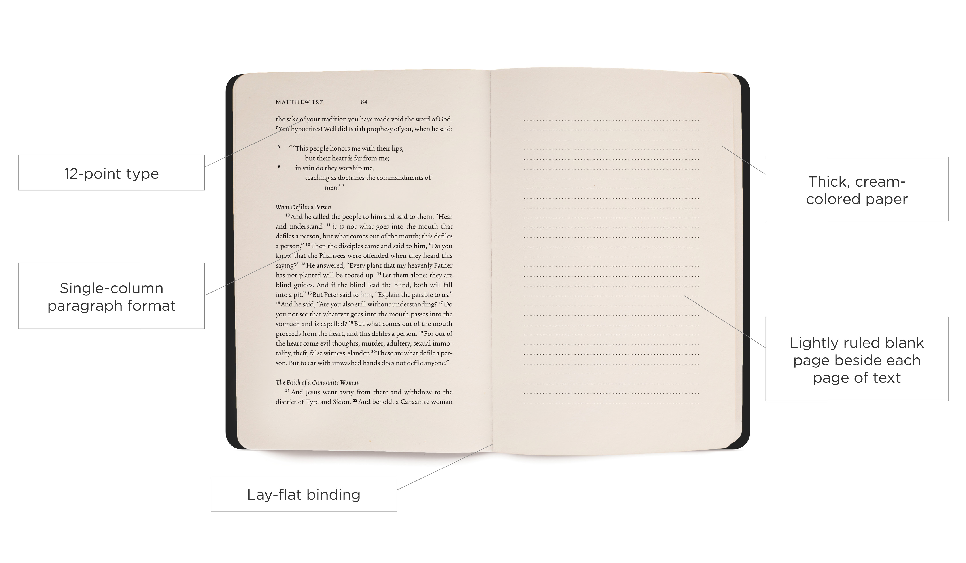
Order Your 50 Days in Acts Reading Plan Materials
(Dec 9 is order deadline)
DarbyCreek.org/SignUp

Slide 2
Thursday, November 29
@ 7pm here at DCC
$1,245 Raised! Still need $755
35 volunteers signed up
and still need 5 more volunteers
to make 8000 meals!!

Slide 3
Communion: Why Did Jesus Die for Us?
He gave his life to free us from every kind of sin, to cleanse us, and to make us his very own people, totally committed to doing good deeds.
– Titus 2:14 New Living Translation

Slide 4
Church
Essentials
Acts 2:42-47

Slide 5
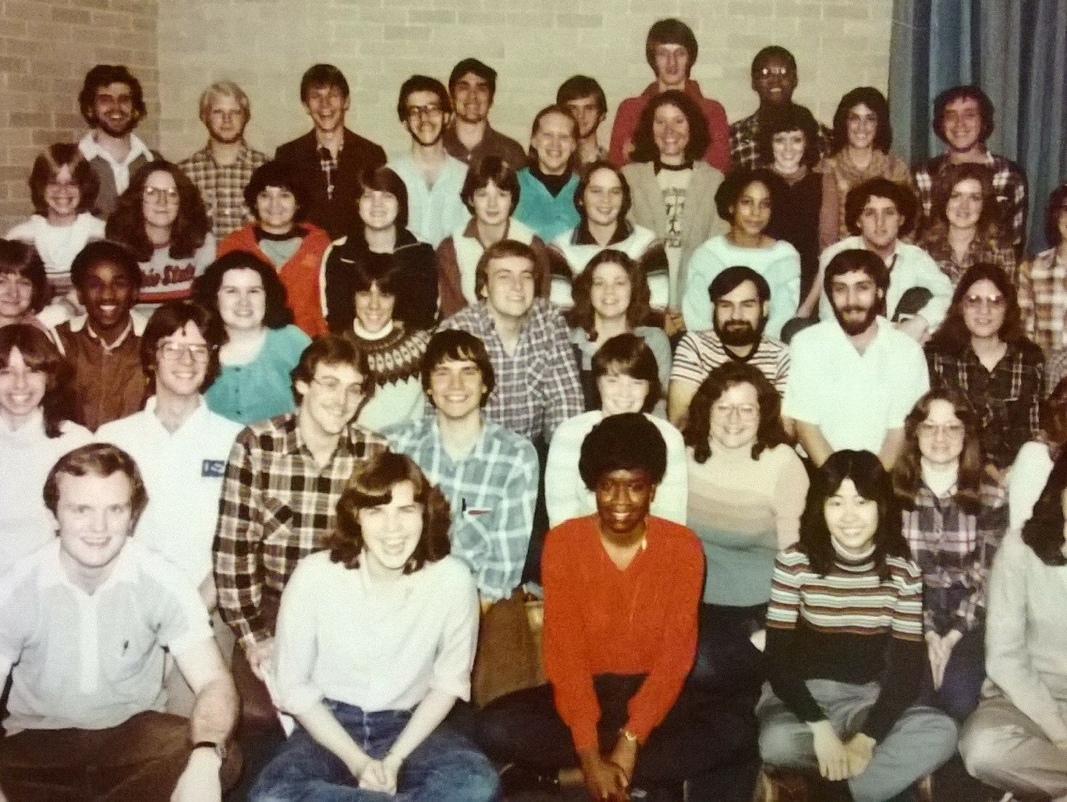
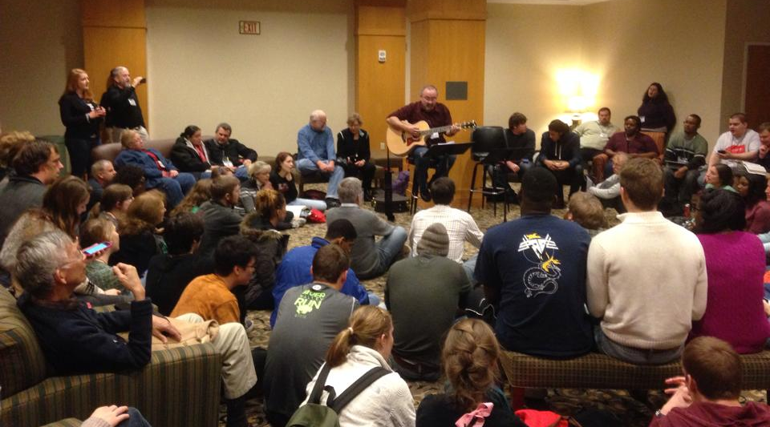
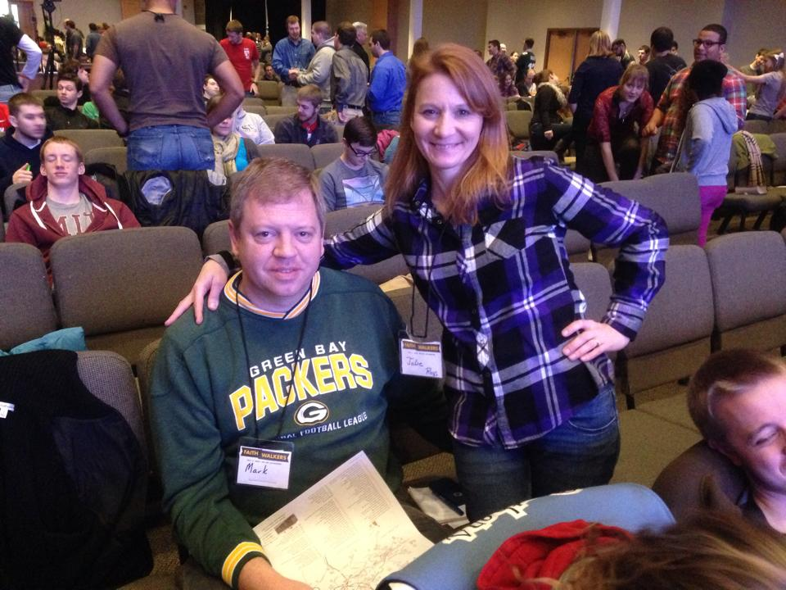

Slide 6
Church
Essentials
Acts 2:42-47

Slide 7
Acts 2:42-47 English Standard Version
42 And they devoted themselves to the apostles' teaching and the fellowship, to the breaking of bread and the prayers.
43 And awe came upon every soul, and many wonders and signs were being done through the apostles.
44 And all who believed were together and had all things in common.

Slide 8
Acts 2:42-47 English Standard Version
45 And they were selling their possessions and belongings and distributing the proceeds to all, as any had need.
46 And day by day, attending the temple together and breaking bread in their homes, they received their food with glad and generous hearts,
47 praising God and having favor with all the people. And the Lord added to their number day by day those who were being saved

Slide 9
Church
Essentials
Acts 2:42-47

Slide 10
A Church Needs to be…
1: A Learning Church (Acts 2:42)
“they devoted themselves to the apostles' teaching”

Slide 11
A Church Needs to be…
2: A Caring Church (Acts 2:42, 44-45)
“And they devoted themselves to … the fellowship”
“And all who believed were together and had all things in common. And they were selling their possessions and belongings and distributing the proceeds to all, as any had need.”

Slide 12
A Church Needs to be…
3: A Worshipping Church (Acts 2:42, 46)
“And they devoted themselves … to the breaking of bread and the prayers. ”
“And day by day, attending the temple together and breaking bread in their homes, they received their food with glad and generous hearts”

Slide 13
A Church Needs to be…
4: A Gospel-Sharing Church (Acts 2:47)
“And the Lord added to their number day by day those who were being saved”

Slide 14
Church
Essentials
Acts 2:42-47

