Slide 1
Prayer for John and Beverly Kinateder
Mission Trip to Peru

Slide 2
Discipling Workshop
Saturday, December 8 from 9am to Noon
$10 Registration (covers cost of the book)
Registration Deadline is November 11
Register by going to
DarbyCreek.org/SignUp
or calling our church office 614-878-6542

Slide 3
Sunday, November 18

Slide 4
Thursday, November 29
@ 7pm here at DCC
Need $2,000 and 40 volunteers
to make 8000 meals!!

Slide 5
The left side of your Bible - Why the old testament matters, today
PART
2

Slide 6
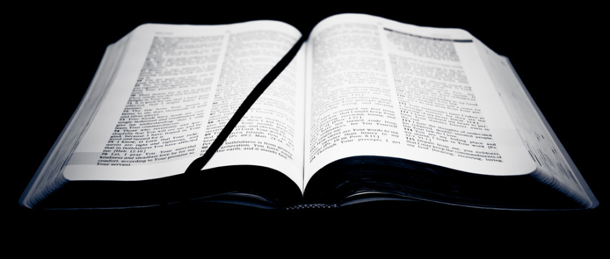
The left side of your Bible - Why the old testament matters, today
-Because it is part of the “All Scripture” - II Tim. 3:14-17
-Because the entire Bible, including the Old Testament is the story of Jesus Christ our Redeemer Lk. 24:25-27
-Because “whatever things were written before were written for our learning, that we through the patience and comfort of the Scriptures might have hope” I Pet. 2:12-13)
-Because the Old Testament is the foundation on which the house of the New Testament is built - Eph. 2:20
-Because the first church was build upon the revealed Scriptures of the Old Testament (Acts 6:2-7; 17:11; 18:11; 28:23).

Slide 7
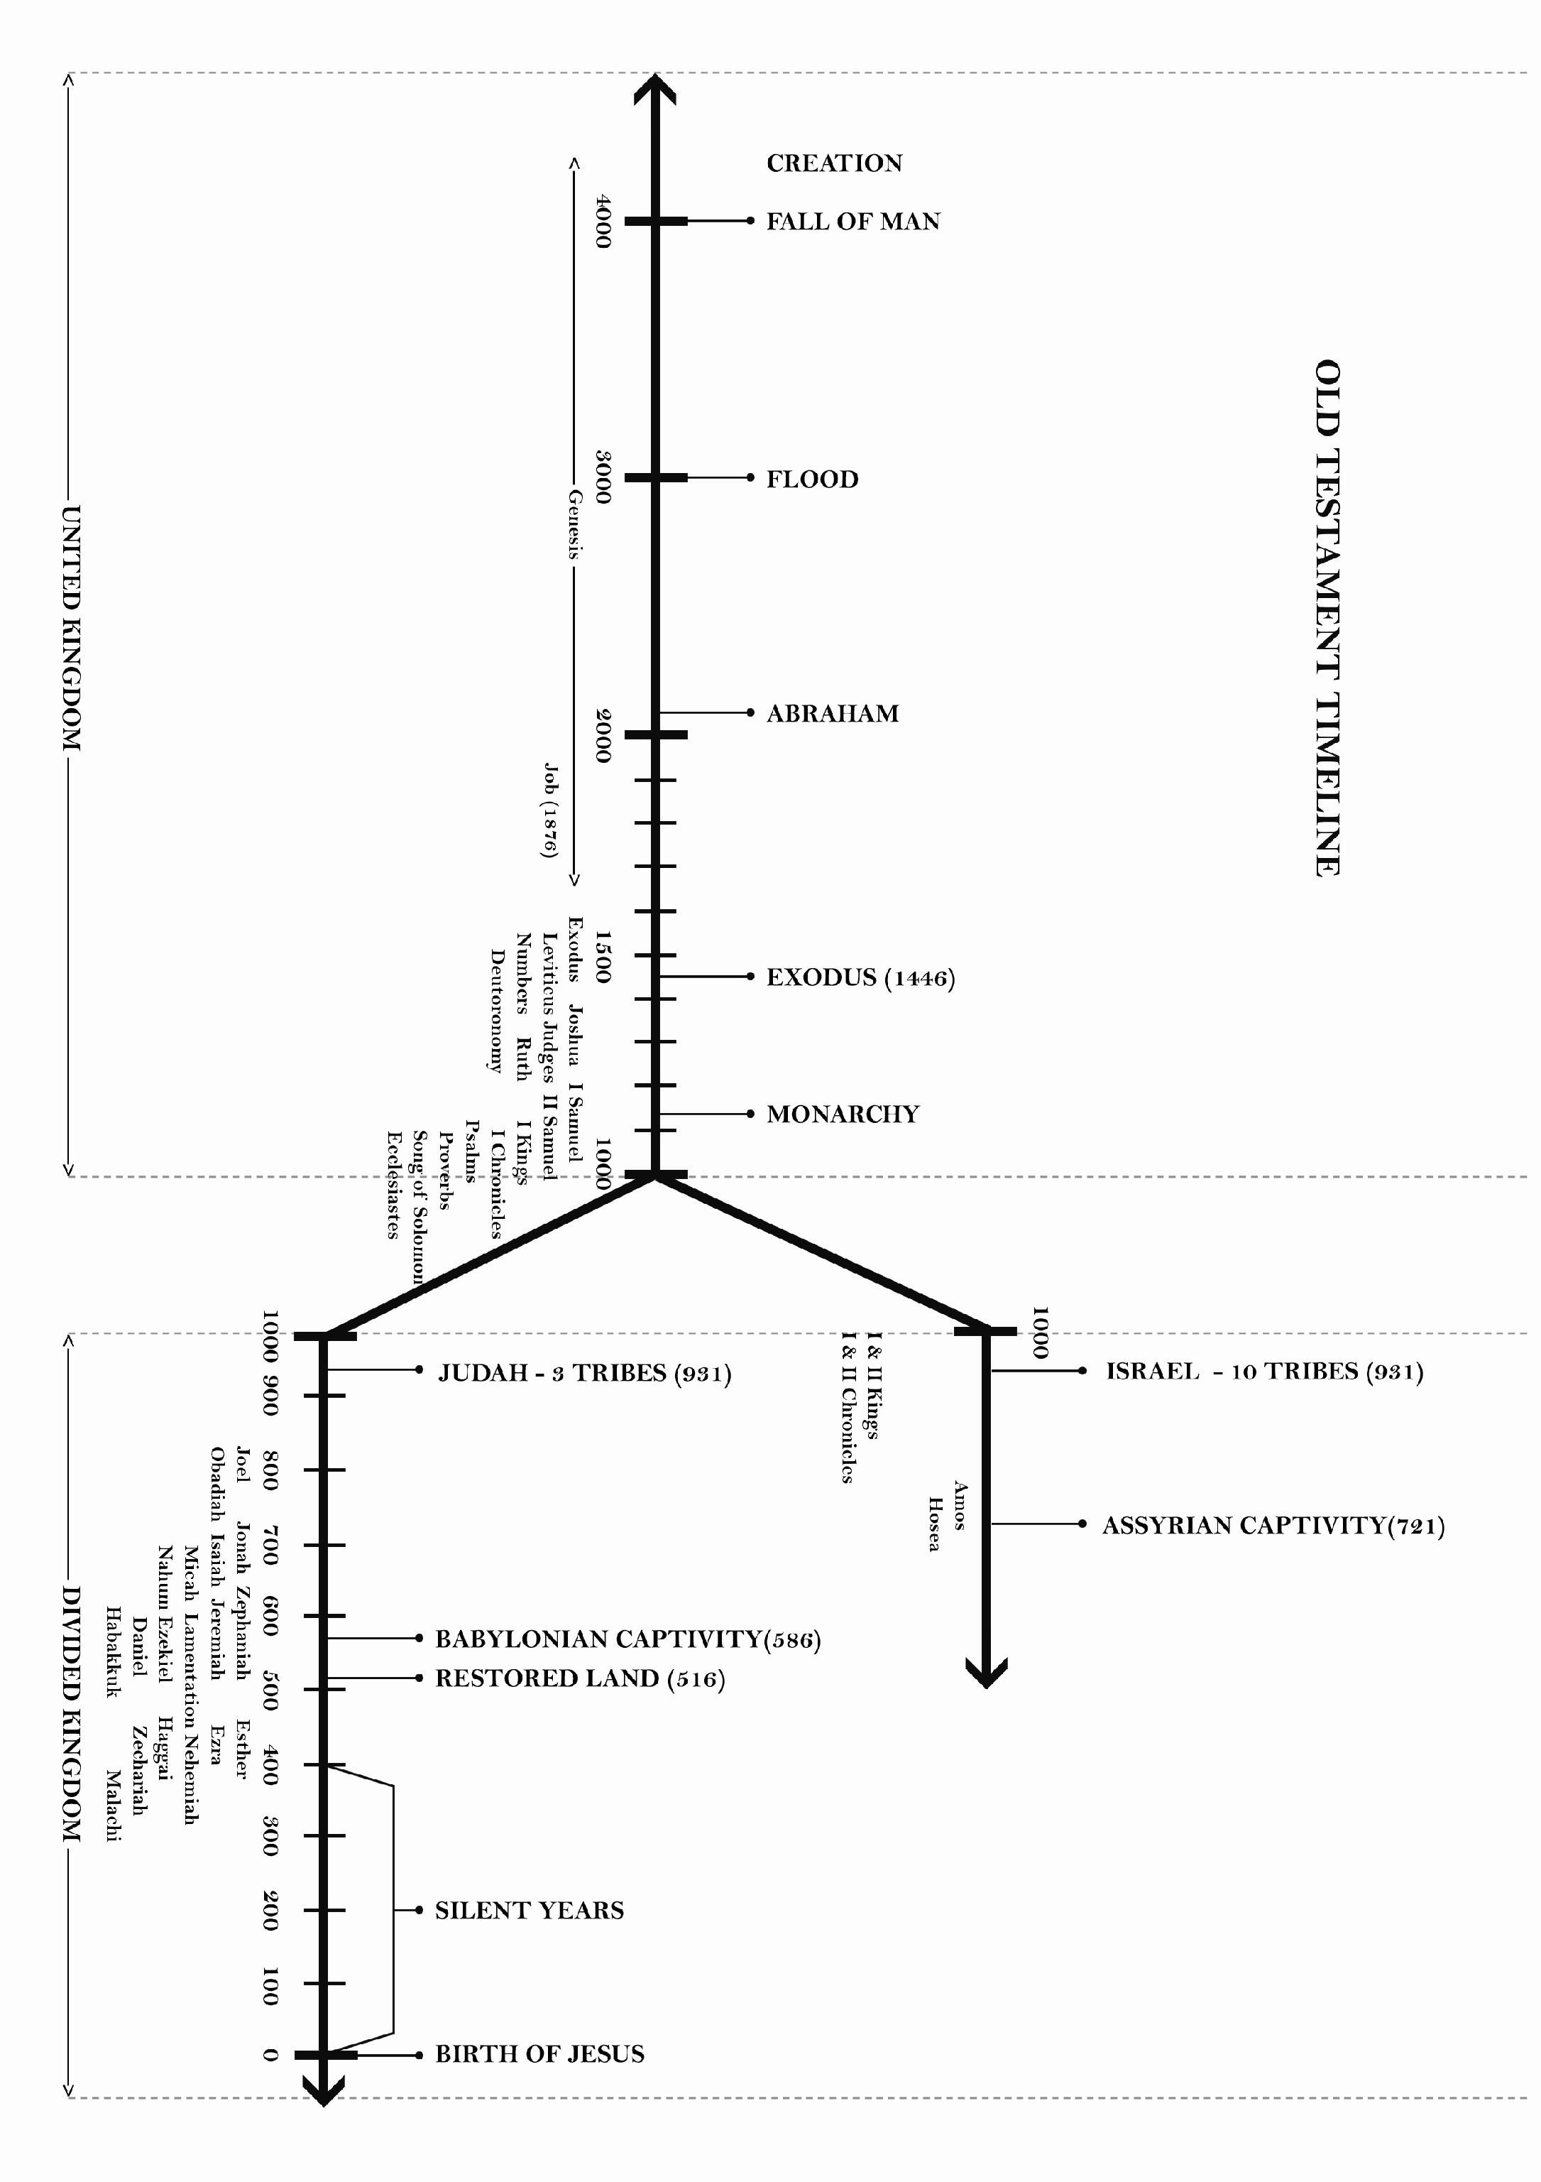

Slide 8
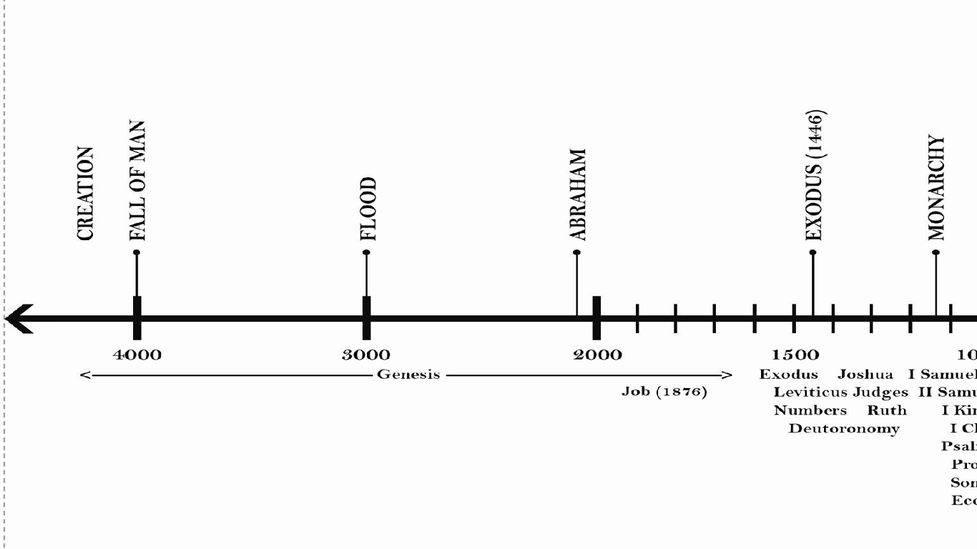
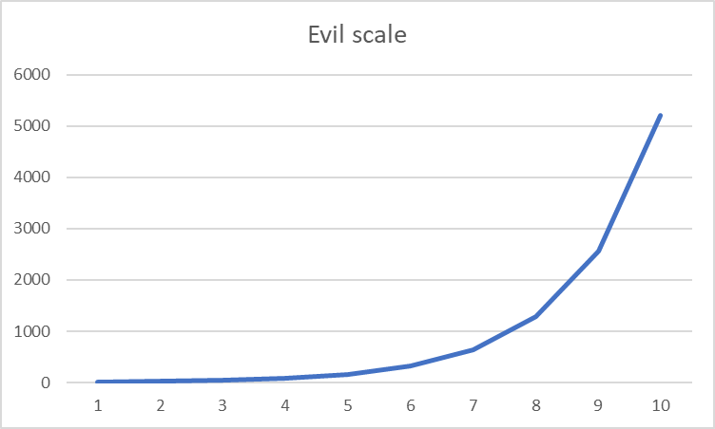
One world, One people, common history
Jacob &
Esau
born
Nimrod founds
Babylon
Isaac
born
Moses
Born
Genesis 6:6
Men and Women
Appear;
Marriage
concept
Tower of Babel
Separation of Nations To Accomplish God’s
will
Abraham
Honors
Melchizedek
12 tribes,
including
Joseph
Born
Humans ranked as having dominion over the creation; work instituted
Notes:
Of interest to me is the relative scale of time in which the new testament happens. Just for this reason, a study of the old testament is warranted to learn more about the behaviors of mankind over a large scale of time, but also regions of geography. To me, adds more power to 1 peter 2:12-13. However, even within the study of mankind, there are differences such as marital customs, type of economy, and types of government
The importance of common history reminds us that the God’s relationship is with people, not a nation or a religion; explains how Moses could author Genesis, including history thousands of years before him

Slide 9
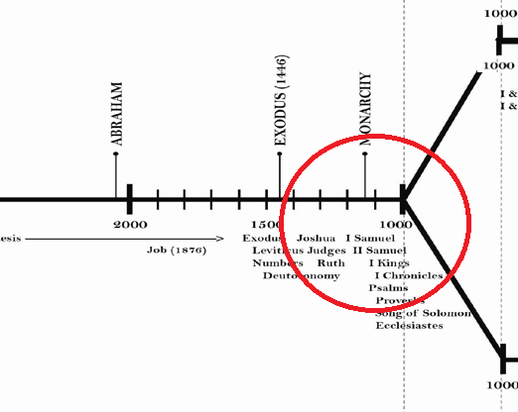

Slide 10
Priests, Judges, Kings, and Prophets
Priest is a derivative of “ to stand” and they stood in the gap between God and the people (Exodus 29:42-46)
Care for the temple; Manifestations of the Divine; Proper execution of sacrifices
Strict interpretation of the law to carry out justice. Diagnose illness, provide care
High Priest had monarch-like control of the people, speaking as the voice of God (Joshua 14:1)
Notes:
The other lamb you shall offer ªat twilight, and shall offer with it a grain offering and its drink offering, as ^{b}in the morning, for a ^{c}pleasing aroma, a food offering to the Lord. 42 It shall be a ^{d}regular burnt offering throughout your generations at the entrance of the tent of meeting before the Lord, ^{e}where I will meet with you, to speak to you there. 43 There I will meet with the people of Israel, and it shall be ^{f}sanctified by my glory. 44 I will consecrate the tent of meeting and the altar. ^{g}Aaron also and his sons I will consecrate to serve me as priests. 45 ^{h}I will dwell among the people of Israel and will be their God. 46 And they shall know that ^{i}I am the Lord their God, who brought them out of the land of Egypt that I might dwell among them. I am the Lord their God
14 These are the inheritances that the people of Israel received in the land of Canaan, which ^{l}Eleazar the priest and Joshua the son of Nun and the heads of the fathers' houses of the tribes of the people of Israel gave them to inherit

Slide 11
Priests, Judges, Kings, and Prophets
Priests started in the desert wanderings, helped the nation cross into Jordan, conquer the land and as settling occurred, nation wanders (Deuteronomy 6:5-12)
Judges arrive (Judges 2:11-23)
Between the time of Joshua and David; Used the code of the Mosaic Law; Led the people in battle ; “Deliverers” (Judges 3:15)
Notable leaders: Ehud, Deborah, Gideon, Jeptha, Samson, and Samuel
Notes:
Deuteronomy 6:5-12 English Standard Version (ESV)
⁵ You shall love the Lord your God with all your heart and with all your soul and with all your might. ⁶ And these words that I command you today shall be on your heart. ⁷ You shall teach them diligently to your children, and shall talk of them when you sit in your house, and when you walk by the way, and when you lie down, and when you rise. ⁸ You shall bind them as a sign on your hand, and they shall be as frontlets between your eyes. ⁹ You shall write them on the doorposts of your house and on your gates.
¹⁰ “And when the Lord your God brings you into the land that he swore to your fathers, to Abraham, to Isaac, and to Jacob, to give you—with great and good cities that you did not build, ¹¹ and houses full of all good things that you did not fill, and cisterns that you did not dig, and vineyards and olive trees that you did not plant—and when you eat and are full, ¹² then take care lest you forget the Lord, who brought you out of the land of Egypt, out of the house of slavery.
Judges 2:11-23 English Standard Version (ESV)
Israel's Unfaithfulness
¹¹ And the people of Israel did what was evil in the sight of the Lord and served the Baals. ¹² And they abandoned the Lord, the God of their fathers, who had brought them out of the land of Egypt. They went after other gods, from among the gods of the peoples who were around them, and bowed down to them. And they provoked the Lord to anger. ¹³ They abandoned the Lord and served the Baals and the Ashtaroth. ¹⁴ So the anger of the Lord was kindled against Israel, and he gave them over to plunderers, who plundered them. And he sold them into the hand of their surrounding enemies, so that they could no longer withstand their enemies. ¹⁵ Whenever they marched out, the hand of the Lord was against them for harm, as the Lord had warned, and as the Lord had sworn to them. And they were in terrible distress.
The Lord Raises Up Judges
¹⁶ Then the Lord raised up judges, who saved them out of the hand of those who plundered them. ¹⁷ Yet they did not listen to their judges, for they whored after other gods and bowed down to them. They soon turned aside from the way in which their fathers had walked, who had obeyed the commandments of the Lord, and they did not do so. ¹⁸ Whenever the Lord raised up judges for them, the Lord was with the judge, and he saved them from the hand of their enemies all the days of the judge. For the Lord was moved to pity by their groaning because of those who afflicted and oppressed them. ¹⁹ But whenever the judge died, they turned back and were more corrupt than their fathers, going after other gods, serving them and bowing down to them. They did not drop any of their practices or their stubborn ways. ²⁰ So the anger of the Lord was kindled against Israel, and he said, “Because this people have transgressed my covenant that I commanded their fathers and have not obeyed my voice, ²¹ I will no longer drive out before them any of the nations that Joshua left when he died, ²² in order to test Israel by them, whether they will take care to walk in the way of the Lord as their fathers did, or not.” ²³ So the Lord left those nations, not driving them out quickly, and he did not give them into the hand of Joshua.
Judges 3:15 English Standard Version (ESV)
¹⁵ Then the people of Israel cried out to the Lord, and the Lord raised up for them a deliverer, Ehud, the son of Gera, the Benjaminite, a left-handed man. The people of Israel sent tribute by him to Eglon the king of Moab.

Slide 12
Priests, Judges, Kings, and Prophets
Monarch, Messiah
Deuteronomy 17:14-20
Commander in chief, Legislator, Supreme Judge, Intercessor among nations
Aligned with priest, promotion of God’s leading (2 Samuel 7:1-17)
Responsible for the obedience of the people in the eyes of God
1 Samuel 12:23-24; 15:26-29
Notes:
Deuteronomy 17:14-20 English Standard Version (ESV)
Laws Concerning Israel's Kings
¹⁴ “When you come to the land that the Lord your God is giving you, and you possess it and dwell in it and then say, ‘I will set a king over me, like all the nations that are around me,’ ¹⁵ you may indeed set a king over you whom the Lord your God will choose. One from among your brothers you shall set as king over you. You may not put a foreigner over you, who is not your brother. ¹⁶ Only he must not acquire many horses for himself or cause the people to return to Egypt in order to acquire many horses, since the Lord has said to you, ‘You shall never return that way again.’ ¹⁷ And he shall not acquire many wives for himself, lest his heart turn away, nor shall he acquire for himself excessive silver and gold.
¹⁸ “And when he sits on the throne of his kingdom, he shall write for himself in a book a copy of this law, approved by^{[a]} the Levitical priests. ¹⁹ And it shall be with him, and he shall read in it all the days of his life, that he may learn to fear the Lord his God by keeping all the words of this law and these statutes, and doing them, ²⁰ that his heart may not be lifted up above his brothers, and that he may not turn aside from the commandment, either to the right hand or to the left, so that he may continue long in his kingdom, he and his children, in Israel.
1 Samuel 12:23-24 English Standard Version (ESV)
²³ Moreover, as for me, far be it from me that I should sin against the Lord by ceasing to pray for you, and I will instruct you in the good and the right way. ²⁴ Only fear the Lord and serve him faithfully with all your heart. For consider what great things he has done for you
1 Samuel 15:26-29 English Standard Version (ESV)
²⁶ And Samuel said to Saul, “I will not return with you. For you have rejected the word of the Lord, and the Lord has rejected you from being king over Israel.” ²⁷ As Samuel turned to go away, Saul seized the skirt of his robe, and it tore. ²⁸ And Samuel said to him, “The Lord has torn the kingdom of Israel from you this day and has given it to a neighbor of yours, who is better than you. ²⁹ And also the Glory of Israel will not lie or have regret, for he is not a man, that he should have regret.”

Slide 13
Priests, Judges, Kings, and Prophets
Commissioned by God for a specific time, and particular people
Prophecy is teaching God’s word where a vacuum of know his truth has developed or predicting future actions
“The word of God came to….”
A call
Common themes:
Repentance & Restoration
Right injustices, spiritual, social, political, and economics (Amos)
Advisors to Kings: Elijah, Elisha, Nathan, Jeremiah, Isaiah, Daniel

Slide 14
Priests, Judges, Kings, and Prophets -> JESUS
Elisha heals Naaman Jesus heals TEN lepers; 1 comes back
Elijah raises dead son Jesus raises Jairus’ Daughter
Elisha prays for blindness Jesus heals Bartameaus
Samson destroys temple Jesus cleanses temple
Gideon’s 300 destroy at night Jesus puts away Peters sword at night
Deborah credited for Barak’s Jesus credits woman for true faith
victory and repentance

Slide 15
Priests, Judges, Kings, and Prophets -> JESUS
Jesus is THE great High Priest – Hebrews 7:22-27
Once and for all
Jesus is THE great, judging King – Matthew 25:31-36
One people, again

Slide 16
The left side of your Bible - Why the old testament matters, today
PART
2

