Slide 1
Sunday, November 18

Slide 2
Thursday, November 29
@ 7pm here at DCC
Need $2,000 and 40 volunteers
to make 8000 meals!!

Slide 3
Discipling Workshop
Saturday, December 8 from 9am to Noon
$10 Registration (covers cost of the book)
Registration Deadline is November 11
Register by going to
DarbyCreek.org/SignUp
or calling our church office 614-878-6542

Slide 4
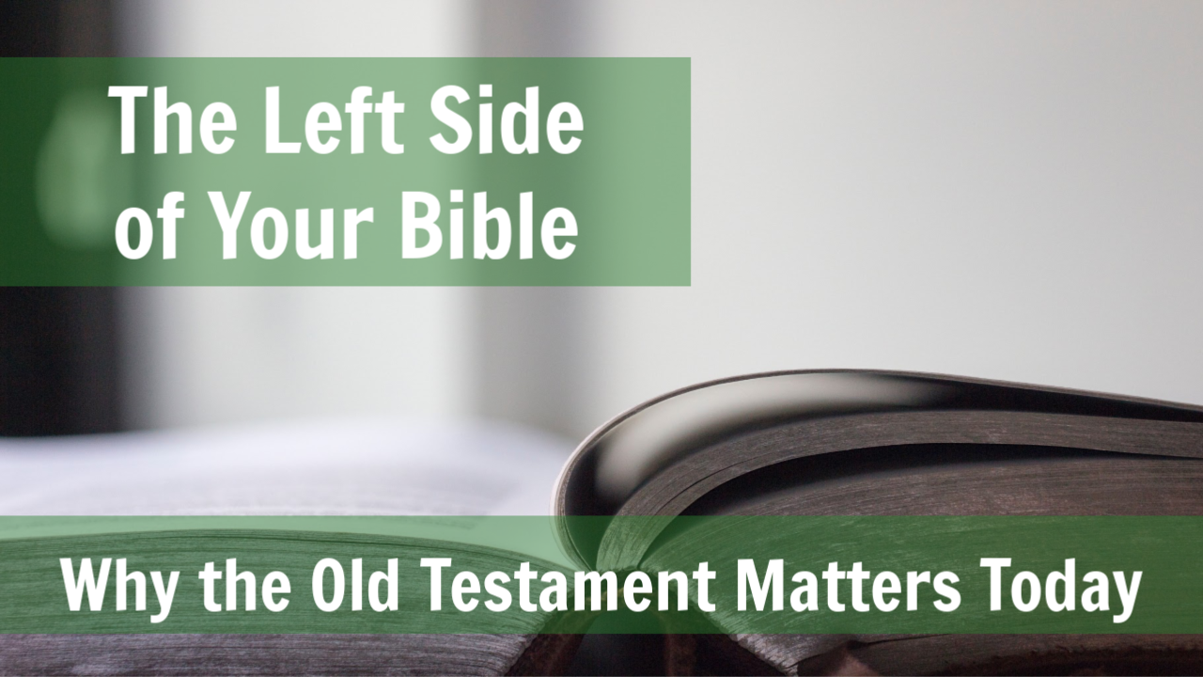
The left side of your Bible - Why the old testament matters, today

Slide 5

Resources
GCLI – Old Testament Survey
Pastor Jonathan Williams
Word of God, Speak Ministries

Slide 6
Resources
Old Testament Survey
Teacher’s Manual
Pastor Bill Scheidler
Church Leadership Resources

Slide 7
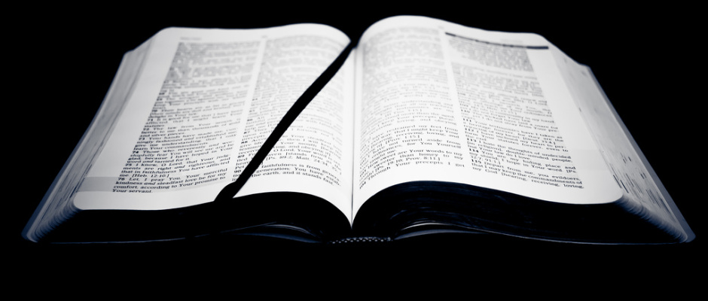
The left side of your Bible - Why the old testament matters, today
-Because it is part of the “All Scripture” - II Timothy 3:14-17
-Because the entire Bible, including the Old Testament is the story of Jesus Christ our Redeemer - Luke 24:25-27
-Because the old testament was written for our learning and give us hope – Romans 15:4
-Because the Old Testament is the foundation on which the house of the New Testament is built - Ephesians 2:20
-Because the first church was build upon the revealed Scriptures of the Old Testament Acts 17:10-11; 28:17-23
Answers so many questions about us:
Origins, purpose, relationships, organization

Slide 8
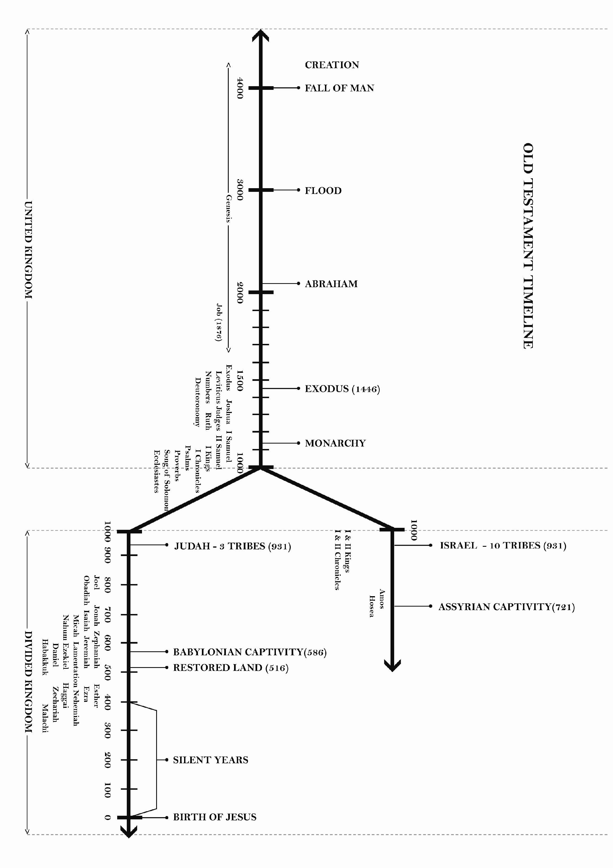

N.T.
time
Jesus Christ

Slide 9
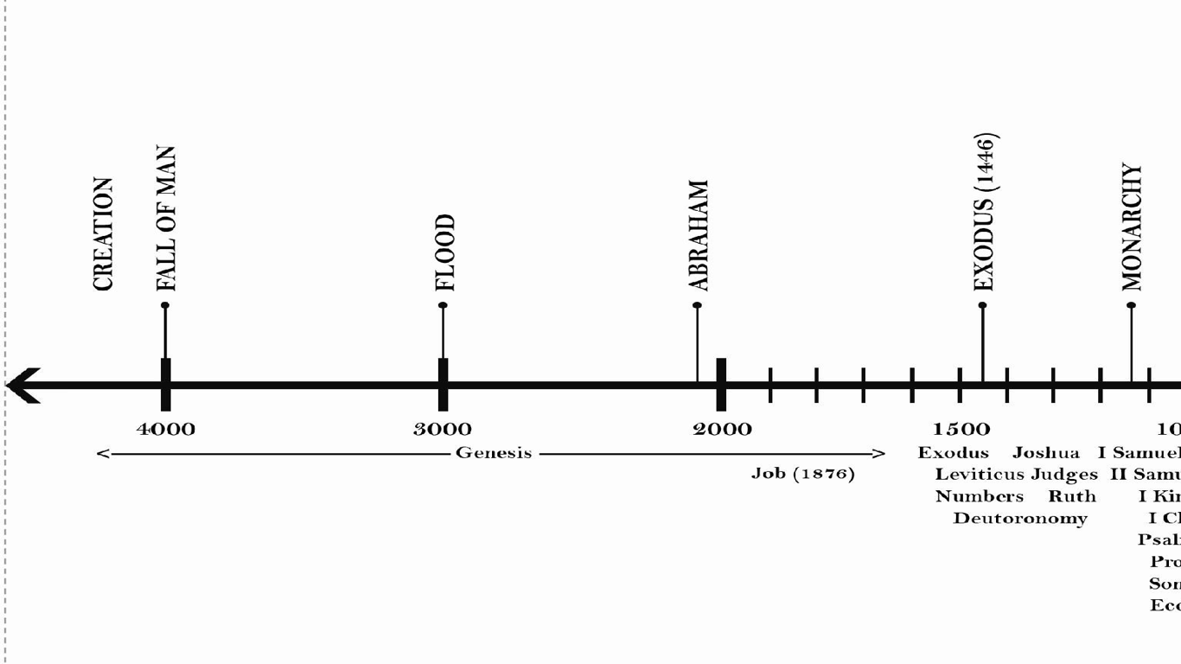
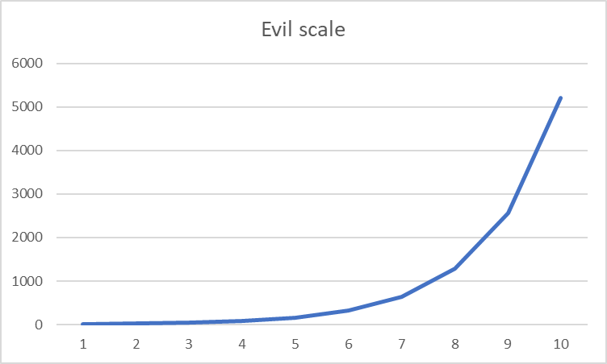
One world, One people, common history
Jacob &
Esau
born
Nimrod founds
Babylon
Isaac
born
Moses
Born
Genesis 6:6
Enoch
Men and Women
Appear;
Marriage
concept
Tower of Babel
Separation of Nations To Accomplish God’s
will
Abraham
Honors
Melchizedek
12 tribes,
including
Joseph
Born
Humans ranked as having dominion over the creation; work instituted
Notes:
Of interest to me is the relative scale of time in which the new testament happens. Just for this reason, a study of the old testament is warranted to learn more about the behaviors of mankind over a large scale of time, but also regions of geography. To me, adds more power to 1 peter 2:12-13. However, even within the study of mankind, there are differences such as marital customs, type of economy, and types of government
The importance of common history reminds us that the God’s relationship is with people, not a nation or a religion; explains how Moses could author Genesis, including history thousands of years before him

Slide 10
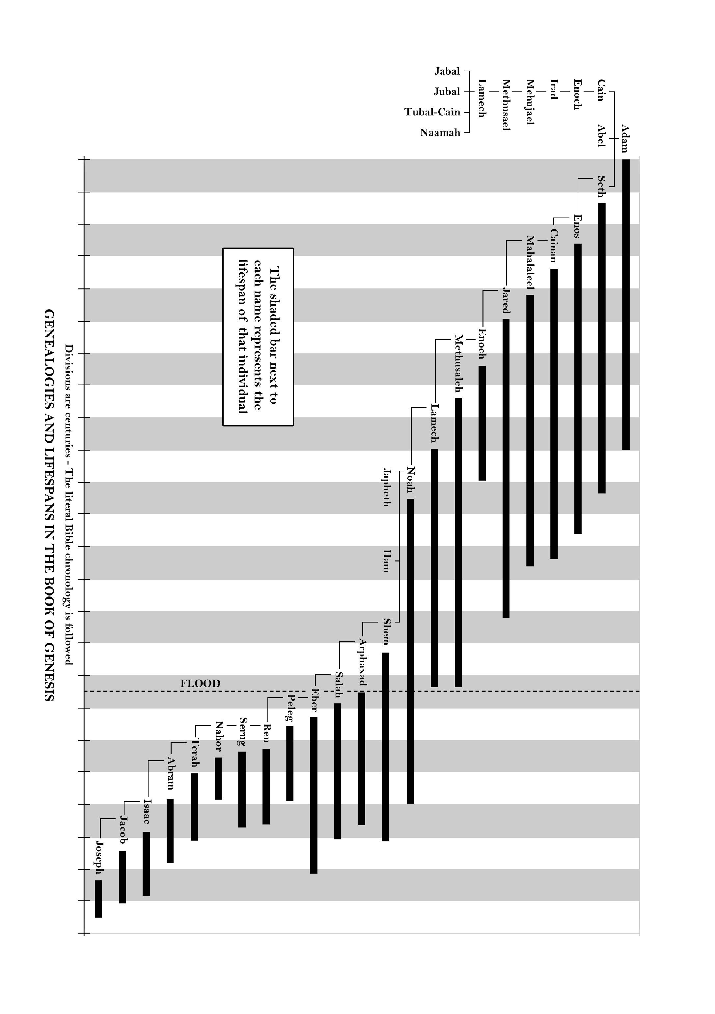
Noah and
Abram overlap
How could Moses
Write Genesis?
150 ish
years

Slide 11
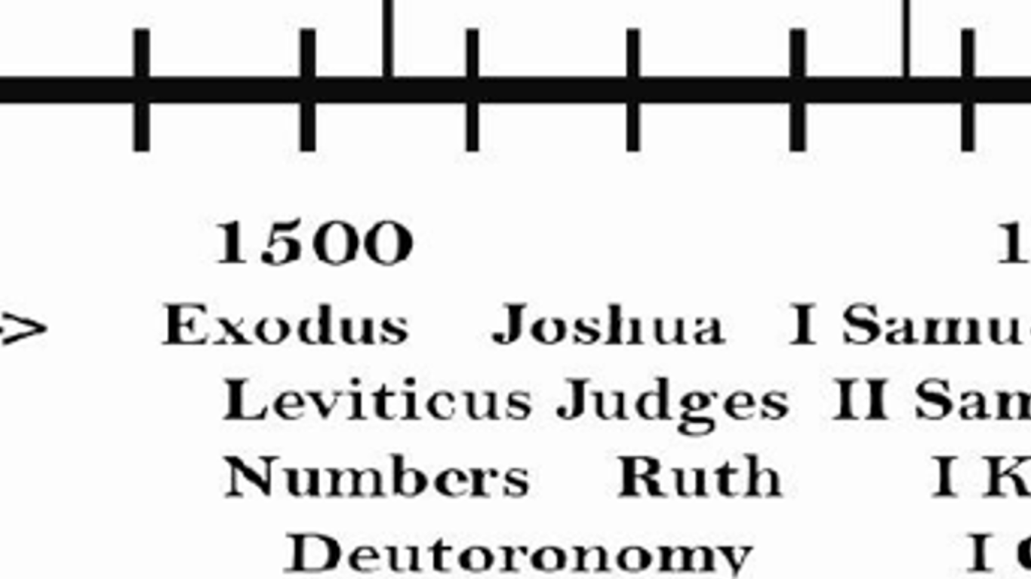

Slide 12
Key Genesis Points
The Book of Genesis details new beginnings.
1) The original creation (Gen. 1-9) that was followed by the fall of mankind, rebellion and ultimately God’s judgment in a worldwide flood.
2) The new beginning with Noah and his family that was followed by the tower of Babel rebellion and ultimately God’s judgment in the confounding of languages (Gen. 10-11).
3) The new beginning with Abram (Gen. 12-50) when God put His hand on a nation and set them apart as His instrument in the earth to fulfill His purposes

Slide 13
Key Exodus Points
1. The Need for Redemption—The People Enslaved (Ex. 1-6)
2. The Strength of the Redeemer—The Plagues on Egypt (Ex. 7-12)
3. The Nature of Redemption—Purchased by Blood (Ex. 12-18)
4. The Relationship of the Redeemed—A Covenant of Obedience with the Lord (Ex. 19-24)
5. Provision Made for Man’s Failure—The Tabernacle of the Meeting (Ex. 25-40)

Slide 14
Key Leviticus Points
1. The Offerings (Chapters 1-7)
2. The Priesthood (Chapters 8-10; 21:1-22:10)
3. The Feasts and Seasons (Chapters 11-27)

Slide 15
Key Numbers Points
1. The evil report of the 10 spies (Num. 13-14)
2. Seven murmurings of the people (throughout book).
3. Moses’ smiting of the rock (Num. 20:1-13)
4. The Bronze Serpent (Num. 21:4)
5. The Talking Donkey (Num. 22:22)
6. Joshua named as Moses’ successor (Num. 27:12)
7. Guidelines for entering the land (Num. 33-35)

Slide 16
Key Deuteronomy Points
1. It is a book of transition. Note the following transitions in Deuteronomy:
2. Transition to a new generation
3. Transition to a new leader—Joshua
4. Transition to a new possession
5. Transition to a new lifestyle (no longer tent dwellers)
Note: Deuteronomy 6:5-9
6. Transition to a new revelation of the love of God.
7. Civil laws in addition to the Levitical law

Slide 17
Why the law?
Is the law then contrary to the promises of God? Certainly not! For if a law had been given that could give life, then righteousness would indeed be by the law. ²² But the Scripture imprisoned everything under sin, so that the promise by faith in Jesus Christ might be given to those who believe.
²³ Now before faith came, we were held captive under the law, imprisoned until the coming faith would be revealed. ²⁴ So then, the law was our guardian until Christ came, in order that we might be justified by faith. ²⁵ But now that faith has come, we are no longer under a guardian – Galatians 3:21-25

Slide 18
In the Law, God put a curse on mankind (Deuteronomy 28:15-19). In the Gospel of Jesus Christ, the Lord Jesus became a curse for mankind (Galatians 3:13)
In the Law, there are 10 commandments for man to do (Exodus 20:1-17). In the gospel of Jesus Christ, there are countless works Jesus Christ has already done (John 21:25)
In the Law, forgiveness came when sheep were sacrificed for the shepherd (Leviticus 1:1-5). In the Gospel of Jesus Christ, forgiveness came when the Shepherd was sacrificed for the sheep (John 10:15)
The Law came about because a mother saved her son's life from death (Exodus 1:22-2:3). The Gospel of Jesus Christ came about because a Father gave up His Son's life unto death (John 3:16)
The Law reveals the sins of the world (Romans 3:20). The Gospel of Jesus Christ reveals how the Lord Jesus took away the sins of the world (John 1:29)
John 1:17 states, "For the law was given though Moses; grace and truth were realized through Jesus Christ."
In the Law, we are called to "Do and live" (Deuteronomy 30:16). In the Gospel of Jesus Christ, we are called to "Live and do" (Ephesians 2:10)
When the Law was given, 3000 were put to death (Exodus 32:28). When the Gospel of Jesus Christ was given, 3000 were made alive (Acts 2:41).

Slide 19
The left side of your Bible - Why the old testament matters, today

