Slide 1


Summer Sunday Picnic July 8 from 11:30a – 1:30p
Pack a lunch or hit the drive thru after service and come back!

Slide 2
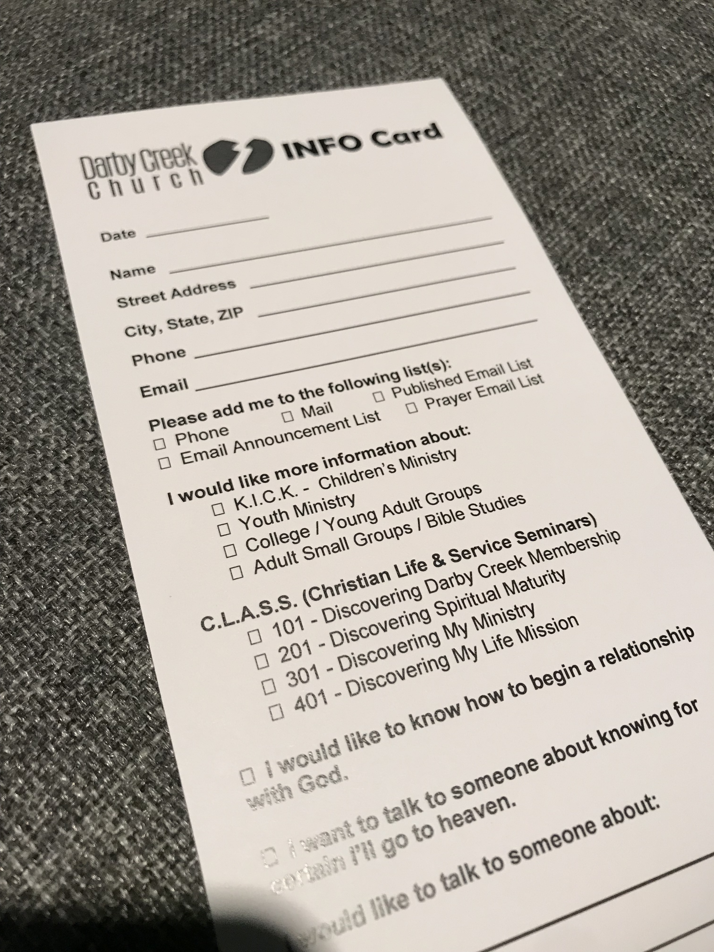
Got Questions?
Want added to email / mailing lists?
Use the INFO Card
in the pocket in the chairs in front of you

Slide 3


Slide 4
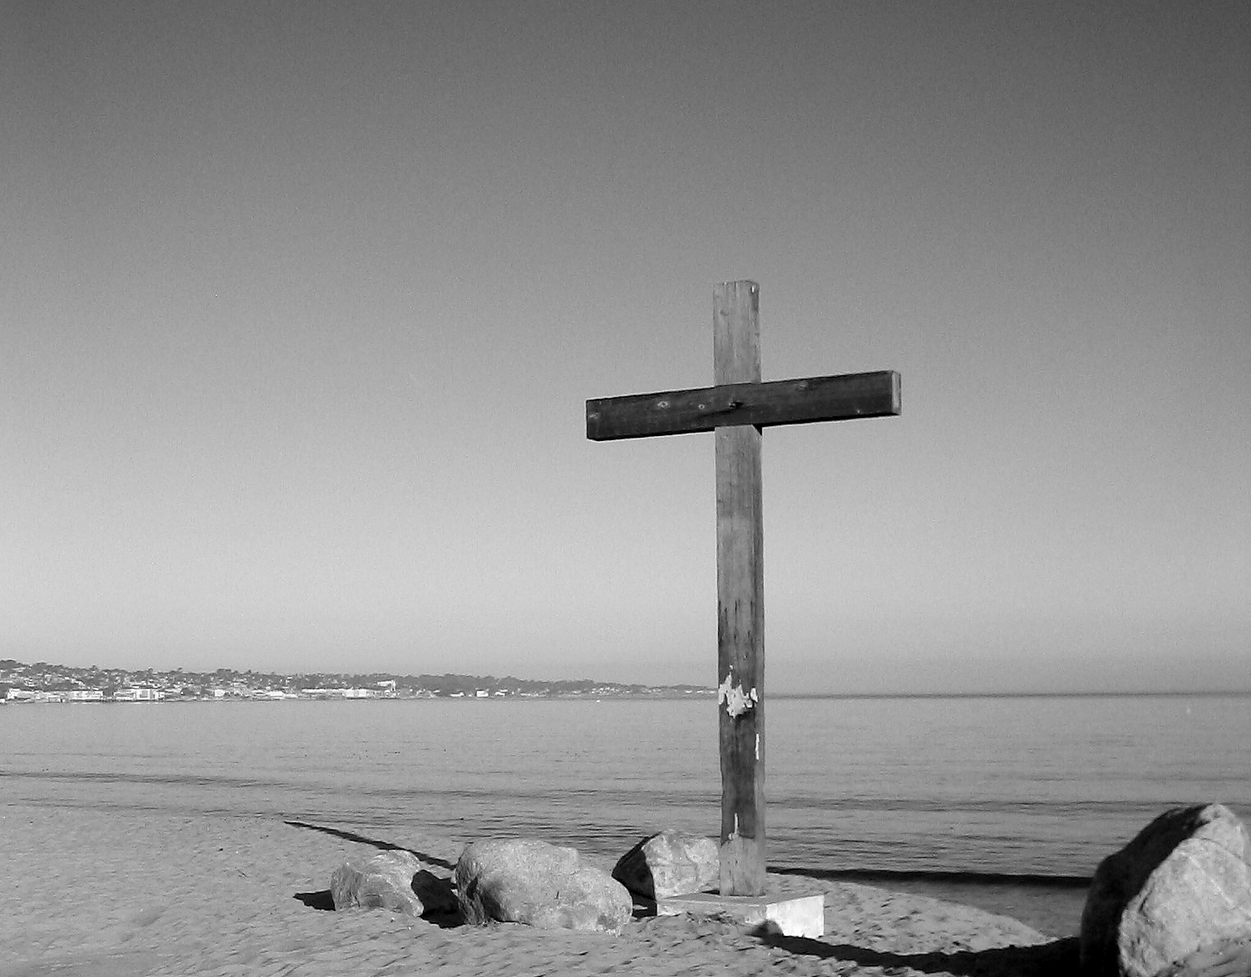

Slide 5
Matthew 27:32-44 ESV
32 As they went out, they found a man of Cyrene, Simon by name. They compelled this man to carry his cross.
33 And when they came to a place called Golgotha (which means Place of a Skull),
34 they offered him wine to drink, mixed with gall, but when he tasted it, he would not drink it.
35 And when they had crucified him, they divided his garments among them by casting lots.
36 Then they sat down and kept watch over him there.

Slide 6
Matthew 27:32-44 ESV
37 And over his head they put the charge against him, which read, “This is Jesus, the King of the Jews.”
38 Then two robbers were crucified with him, one on the right and one on the left.
39 And those who passed by derided him, wagging their heads
40 and saying, “You who would destroy the temple and rebuild it in three days, save yourself! If you are the Son of God, come down from the cross.”

Slide 7
Matthew 27:32-44 ESV
41 So also the chief priests, with the scribes and elders, mocked him, saying,
42 “He saved others; he cannot save himself. He is the King of Israel; let him come down now from the cross, and we will believe in him.
43 He trusts in God; let God deliver him now, if he desires him. For he said, ‘I am the Son of God.’”
44 And the robbers who were crucified with him also reviled him in the same way.

Slide 9

1. On the cross, we see God’s Word come true

Slide 10
Prophecies Fulfilled in this Passage
Wine mixed w/ gall given to Jesus (vs. 34) Psalm 69:21 “…for my thirst they gave me sour wine to drink.
Gambling for Jesus’ clothes (vs 35). Psalm 22:18 “they divide my garments among them, and for my clothing they cast lots.
Passersby shaking their heads at Jesus (vs 39). Psalm 109:25 “I am an object of scorn to my accusers; when they see me, they wag their heads.
Jesus would be counted among the criminals (vs 44). Isaiah 53:12 “he …was numbered with the transgressors; …

Slide 11
2. One the cross, we hear the irony in the mockery

Slide 12
People Mocking Jesus While He was on the Cross
Those who passed by the cross: “You who would destroy the temple and rebuild it in three days, save yourself! If you are the Son of God, come down from the cross.” (vs. 40)
The chief priests, scribes, and elders: “He saved others; he cannot save himself. He is the King of Israel; let him come down now from the cross, and we will believe in him. He trusts in God; let God deliver him now, if he desires him. For he said, ‘I am the Son of God.’”(vs. 42-43)

Slide 13
“To mock God is to pretend to love and serve him when we do not; to act in a false manner, to be insincere and hypocritical in our professions, pretending to obey him, love, serve, and worship him, when we do not. . . . Mocking God grieves the Holy Spirit, and sears the conscience; and thus the bands of sin become stronger and stronger. The heart becomes gradually hardened by such a process.”
- Charles Finney

Slide 14
3. One the cross, we see an innocent King become a curse for us

Slide 15
Responding to the cross of Jesus:
1. Accept Jesus' payment for your sin by turning from sin and believing in what Jesus did on the cross
2. Accept Jesus invitation to "take up your cross" (Luke 9:23)

