Slide 1
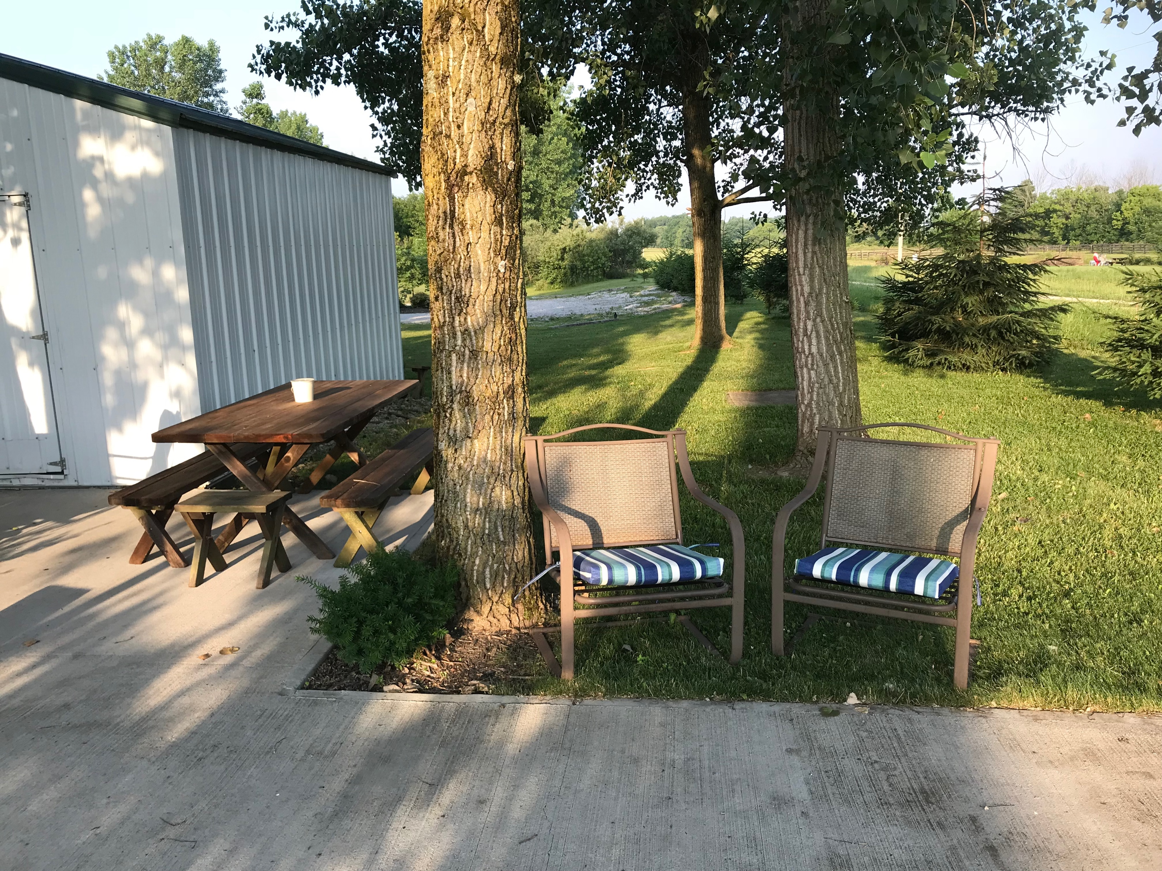
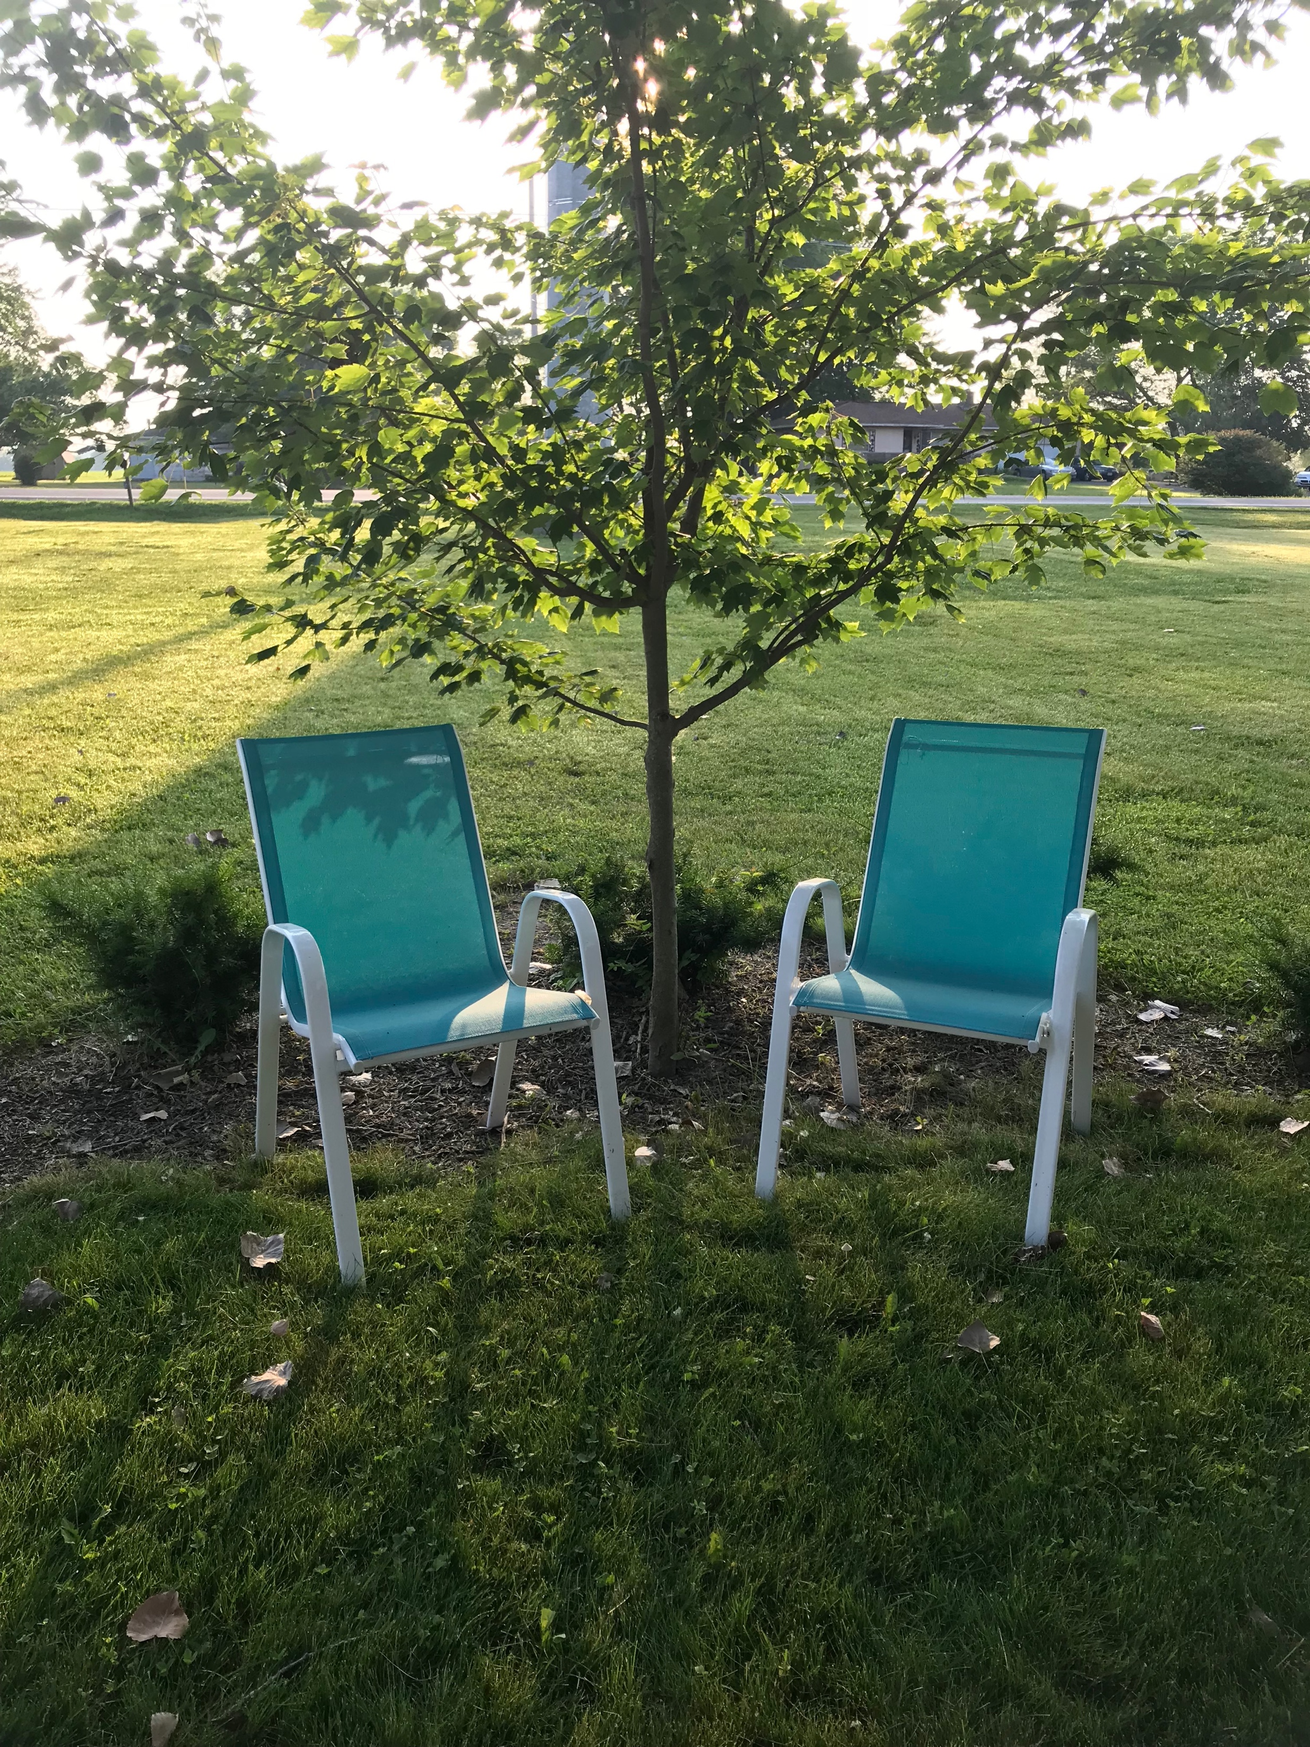
Summer Sunday Picnic June 24 11:30a – 1:30p
Pack a lunch or hit the drive thru after service and come back!

Slide 2
Julie Wheaton – Mission trip to Haiti
Working to Build an Orphanage
Trip Date: 10/9 – 10/16
Fundraising Goal $2,000
https://www.gofundme.com
Search for “Julie Wheaton”

Slide 3


Slide 4
Waiting for Jesus' Return in Matthew 24 and 25
*Explanation what the last days will be like (24:1-35)
*Waiting for Jesus so as not to be surprised (24:36-44)
*Waiting for Jesus as those who must give an account (24:45-51)
*Waiting for Jesus knowing there will be a delay (25:1-13)
*Waiting for Jesus as servants commissioned to improve our masters assets (25:14-30)

Slide 5
Matthew 25:14-30 ESV
14 “For it will be like a man going on a journey, who called his servants and entrusted to them his property.
15 To one he gave five talents, to another two, to another one, to each according to his ability. Then he went away.
16 He who had received the five talents went at once and traded with them, and he made five talents more.
17 So also he who had the two talents made two talents more.
18 But he who had received the one talent went and dug in the ground and hid his master's money.

Slide 6
Matthew 25:14-30 ESV
19 Now after a long time the master of those servants came and settled accounts with them.
20 And he who had received the five talents came forward, bringing five talents more, saying, ‘Master, you delivered to me five talents; here, I have made five talents more.’
21 His master said to him, ‘Well done, good and faithful servant. You have been faithful over a little; I will set you over much. Enter into the joy of your master.’
22 And he also who had the two talents came forward, saying, ‘Master, you delivered to me two talents; here, I have made two talents more.’

Slide 7
Matthew 25:14-30 ESV
23 His master said to him, ‘Well done, good and faithful servant. You have been faithful over a little; I will set you over much. Enter into the joy of your master.’
24 He also who had received the one talent came forward, saying, ‘Master, I knew you to be a hard man, reaping where you did not sow, and gathering where you scattered no seed,
25 so I was afraid, and I went and hid your talent in the ground. Here, you have what is yours.’

Slide 8
Matthew 25:14-30 ESV
26 But his master answered him, ‘You wicked and slothful servant! You knew that I reap where I have not sown and gather where I scattered no seed?
27 Then you ought to have invested my money with the bankers, and at my coming I should have received what was my own with interest.
28 So take the talent from him and give it to him who has the ten talents.

Slide 9
Matthew 25:14-30 ESV
29 For to everyone who has will more be given, and he will have an abundance. But from the one who has not, even what he has will be taken away.
30 And cast the worthless servant into the outer darkness. In that place there will be weeping and gnashing of teeth.’

Slide 11

While we wait for Jesus' return, our task as Christians is to improve our Master’s assets (vs 14)

Slide 12
The Master’s Assets = What Belongs to Him = Everything we have
Improving the assets = Using them for His Kingdom purposes

Slide 13
* Waiting for Jesus' return is
not passive
(1 Corinthians 6:19-20; Galatians 2:20)

Slide 14
* Jesus' true servants joyfully embrace their role to do what Jesus asks
(John 3:6-8)

Slide 15
* When things get tough, it reveals the authenticity of relationship with Jesus (Matthew 13:18-23)

