Slide 1


Slide 2


Slide 3
Matthew 23:1-12 ESV
1 Then Jesus said to the crowds and to his disciples,
2 “The scribes and the Pharisees sit on Moses’ seat,
3 so do and observe whatever they tell you, but not the works they do. For they preach, but do not practice.
4 They tie up heavy burdens, hard to bear, and lay them on people’s shoulders, but they themselves are not willing to move them with their finger.

Slide 4
Matthew 23:1-12 ESV
5 They do all their deeds to be seen by others. For they make their phylacteries broad and their fringes long,
6 and they love the place of honor at feasts and the best seats in the synagogues
7 and greetings in the marketplaces and being called rabbi by others.

Slide 5
Matthew 23:1-12 ESV
8 But you are not to be called rabbi, for you have one teacher, and you are all brothers.
9 And call no man your father on earth, for you have one Father, who is in heaven.
10 Neither be called instructors, for you have one instructor, the Christ.

Slide 6
Matthew 23:1-12 ESV
11 The greatest among you shall be your servant.
12 Whoever exalts himself will be humbled, and whoever humbles himself will be exalted.”

Slide 8

Do we fail to practice what we preach?
(Matthew 23:1-4)

Slide 9
Are we not content with
the approval of God?
(Matthew 23:5-7)

Slide 10
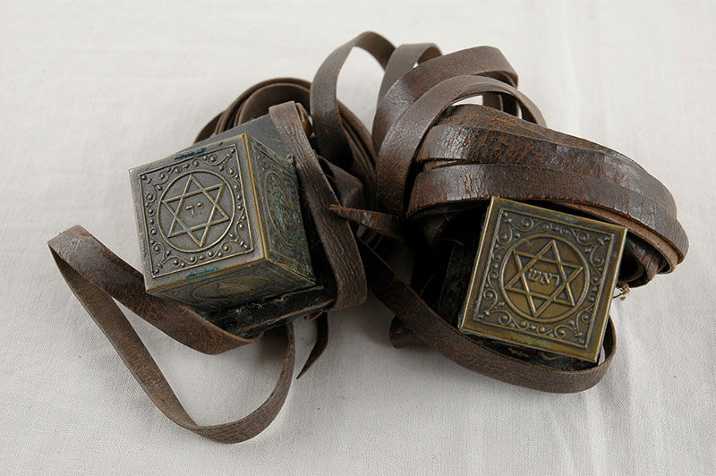
Are we not content with
the approval of God?
(Matthew 23:5-7)

Slide 11
Are we not content with
the approval of God?
(Matthew 23:5-7)

Slide 12
Do we assert our superiority
over others?
(Matthew 23:8-10)

Slide 13
Do we humbly serve others or are we hypocritically centered on ourselves?
(Matthew 23:11-12)

