Slide 1
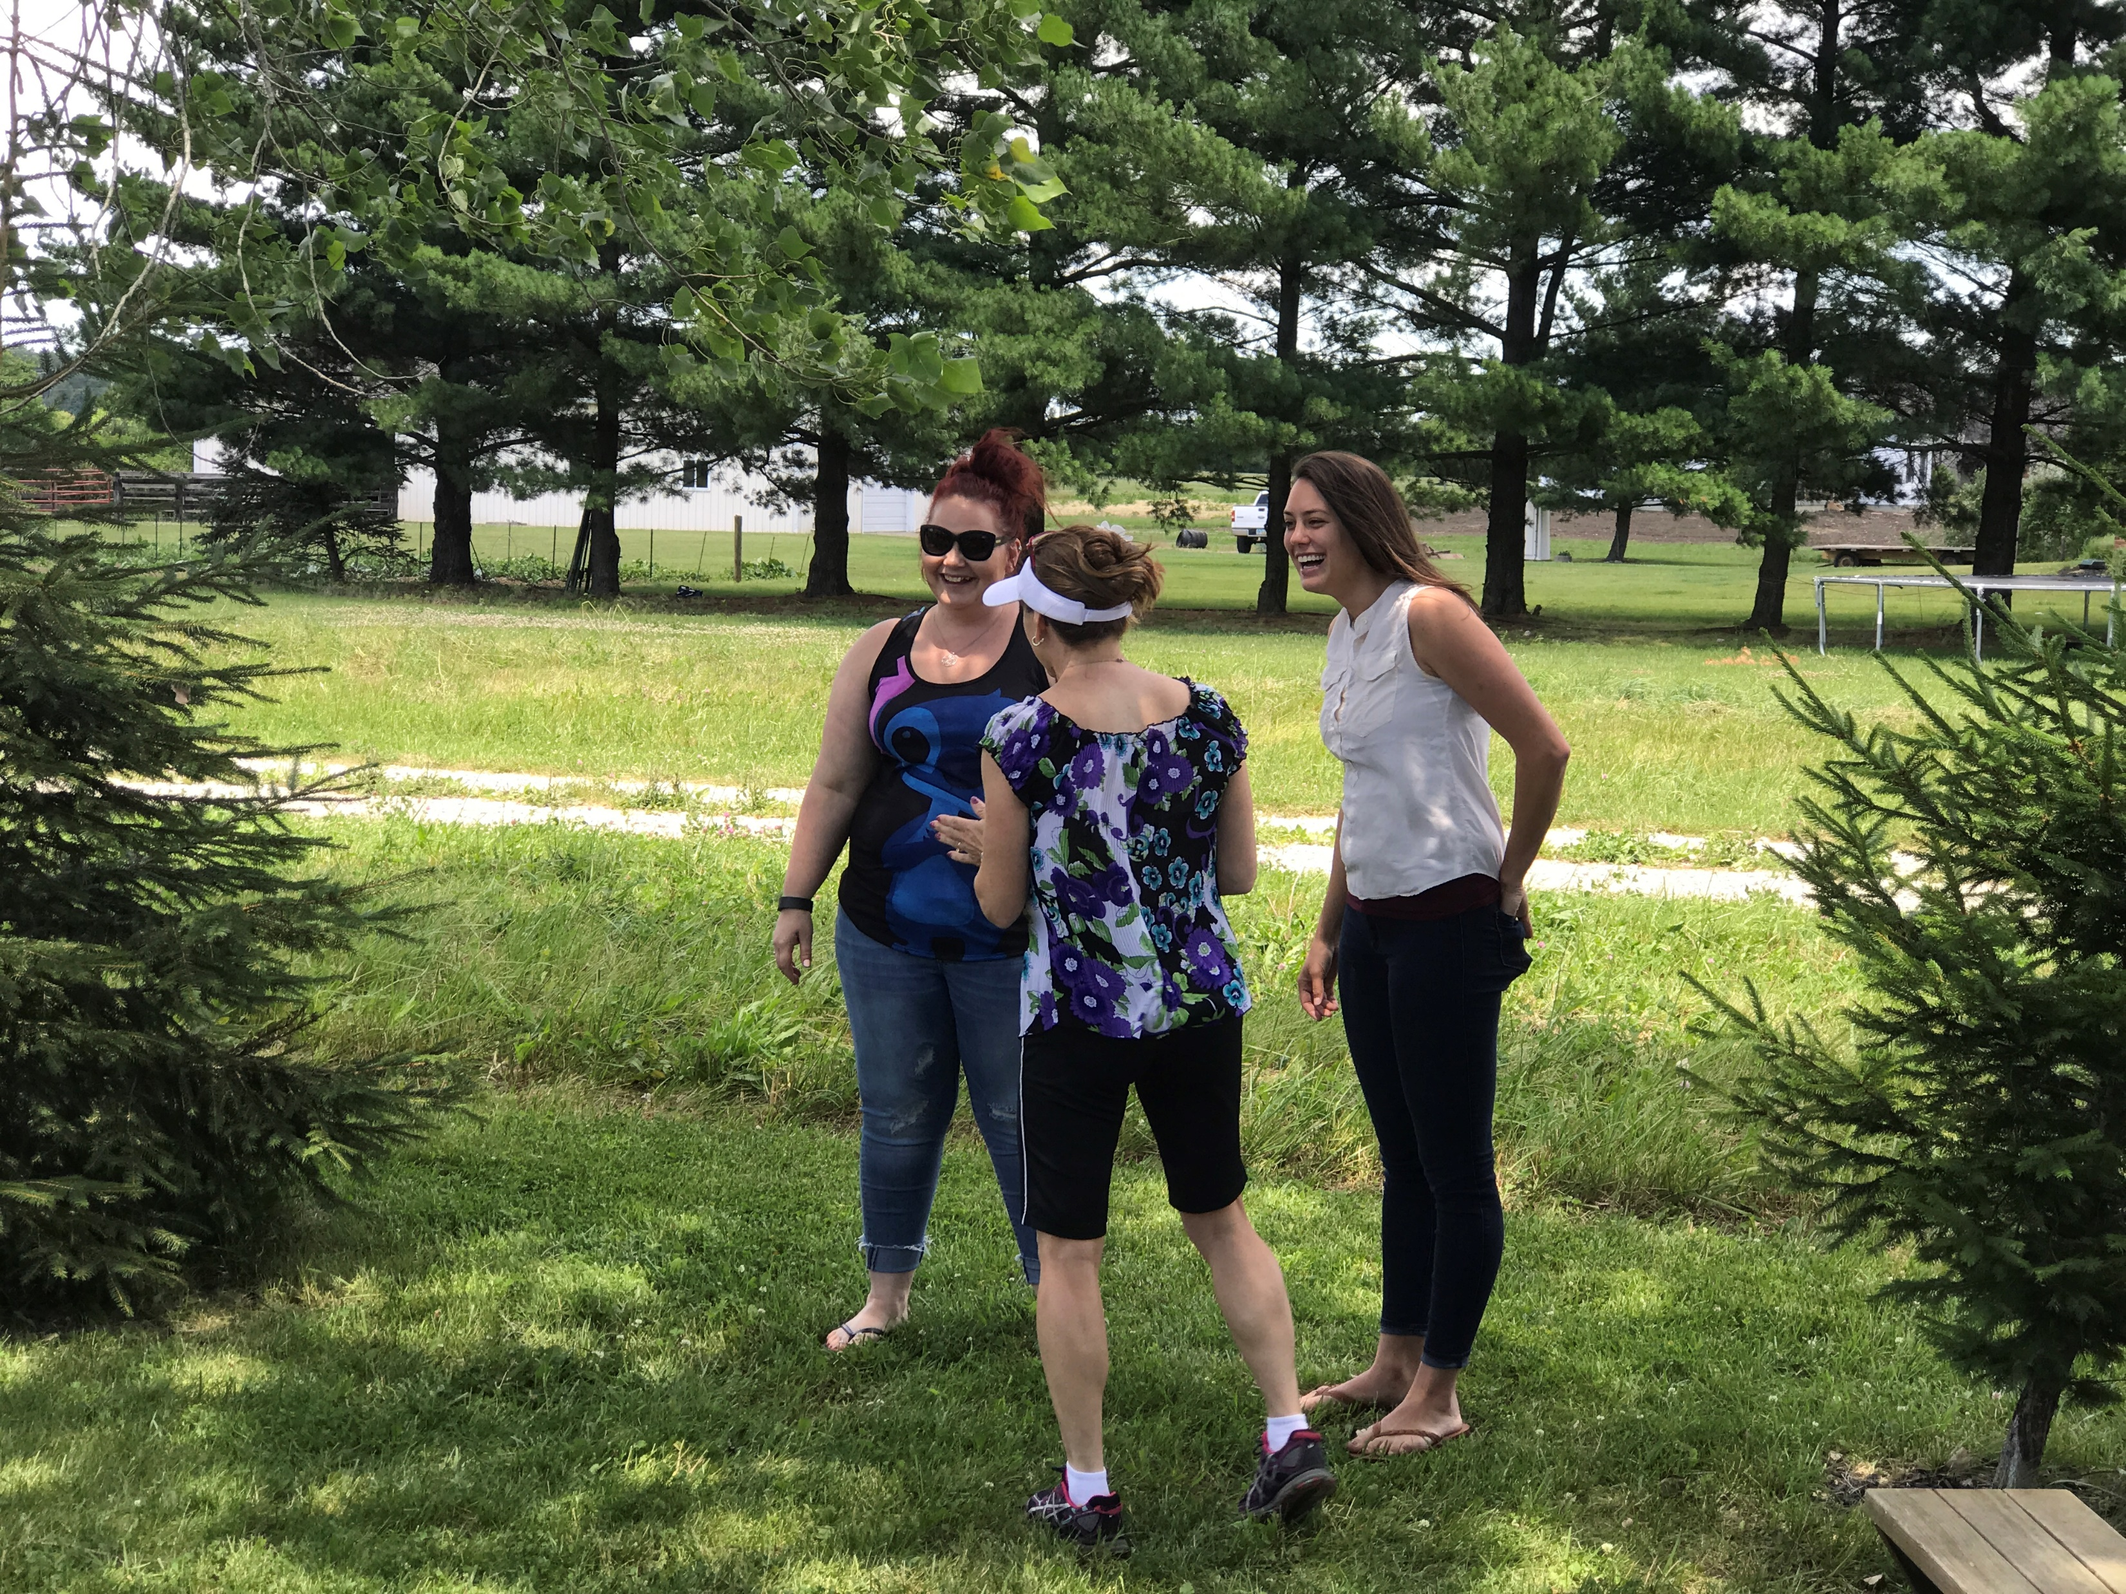
Summer Sunday
Picnic on June 10
11:30a – 1:30p
Pack a lunch or hit the drive thru after service and come back!

Slide 2
Got Questions about Christianity and living the Christian life?
GregB@DarbyCreek.org

Slide 3
Send your DCC pictures to
Pictures@DarbyCreek.org

Slide 5
Matthew 20:17-28 NLT
17 As Jesus was going up to Jerusalem, he took the twelve disciples aside privately and told them what was going to happen to him.
18 “Listen,” he said, “we’re going up to Jerusalem, where the Son of Man will be betrayed to the leading priests and the teachers of religious law. They will sentence him to die.
19 Then they will hand him over to the Romans to be mocked, flogged with a whip, and crucified. But on the third day he will be raised from the dead.”

Slide 6
Matthew 20:17-28 NLT
20 Then the mother of James and John, the sons of Zebedee, came to Jesus with her sons. She knelt respectfully to ask a favor.
21 “What is your request?” he asked. She replied, “In your Kingdom, please let my two sons sit in places of honor next to you, one on your right and the other on your left.”
22 But Jesus answered by saying to them, “You don’t know what you are asking! Are you able to drink from the bitter cup of suffering I am about to drink?” “Oh yes,” they replied, “we are able!”

Slide 7
Matthew 20:17-28 NLT
23 Jesus told them, “You will indeed drink from my bitter cup. But I have no right to say who will sit on my right or my left. My Father has prepared those places for the ones he has chosen.”
24 When the ten other disciples heard what James and John had asked, they were indignant.
25 But Jesus called them together and said, “You know that the rulers in this world lord it over their people, and officials flaunt their authority over those under them.

Slide 8
Matthew 20:17-28 NLT
26 But among you it will be different. Whoever wants to be a leader among you must be your servant,
27 and whoever wants to be first among you must become your slave.
28 For even the Son of Man came not to be served but to serve others and to give his life as a ransom for many.”

Slide 10
The Kingdom values are different from the values of this world (Matthew 20:26-27)

Slide 11
Jesus is the supreme example to us of what servanthood looks like
(Matthew 20:28)

Slide 12
Improving Your Serve…

Slide 13
1. Cultivate selflessness
(1 Corinthians 15:31)

Slide 14
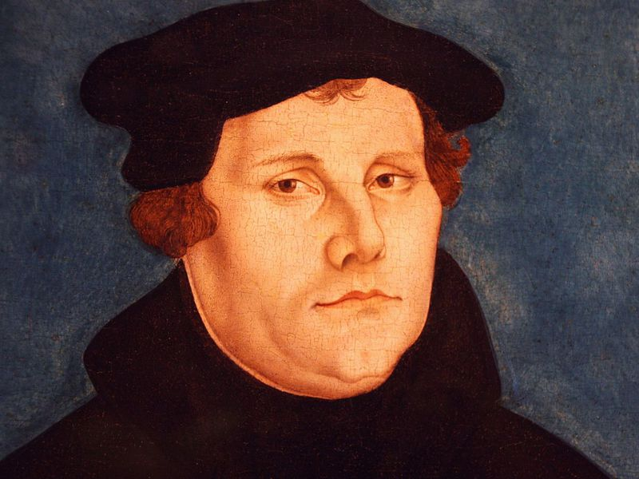
“The original sin in a man is like his beard, which, though shaved off today so that a man is very smooth around his mouth, yet grows again by tomorrow morning. As long as a man lives, such growth of the hair and the beard does not stop. But when the shovel beats the ground on his grave, it stops. Just so original sin remains in us and bestirs itself as long as we live, but we must resist it and always cut off its hair.” - Martin Luther

Slide 15
2. Be sensitive to the needs of those around you
(Luke 10:30-37)

Slide 16
3. Learn to sacrifice
(Matthew 20:28)

Slide 17
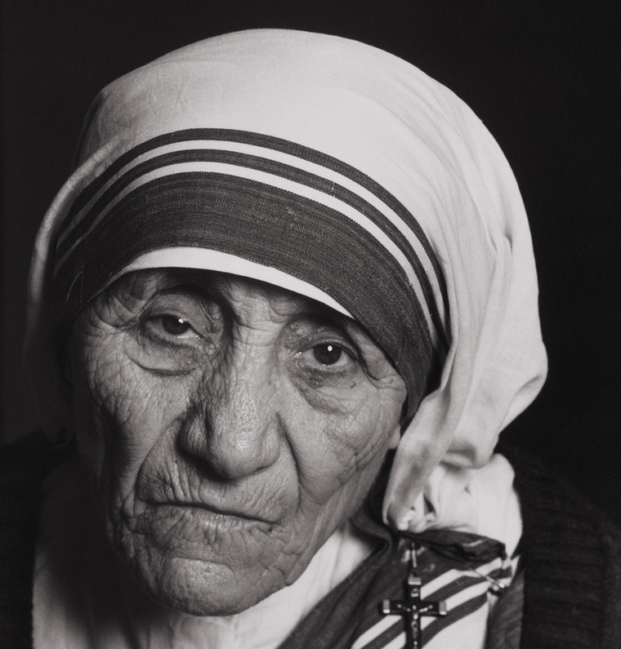
“The original sin in a man is like his beard, which, though shaved off today so that a man is very smooth around his mouth, yet grows again by tomorrow morning. As long as a man lives, such growth of the hair and the beard does not stop. But when the shovel beats the ground on his grave, it stops. Just so original sin remains in us and bestirs itself as long as we live, but we must resist it and always cut off its hair.” - Martin Luther
“If you really love one another, you will not be able to avoid making sacrifices”
- Mother Teresa

Slide 18
4. Keep on pursuing a life of serving others
(1 Corinthians 15:58; Galatians 6:9-10; Ephesians 6:7-8)

