Slide 1
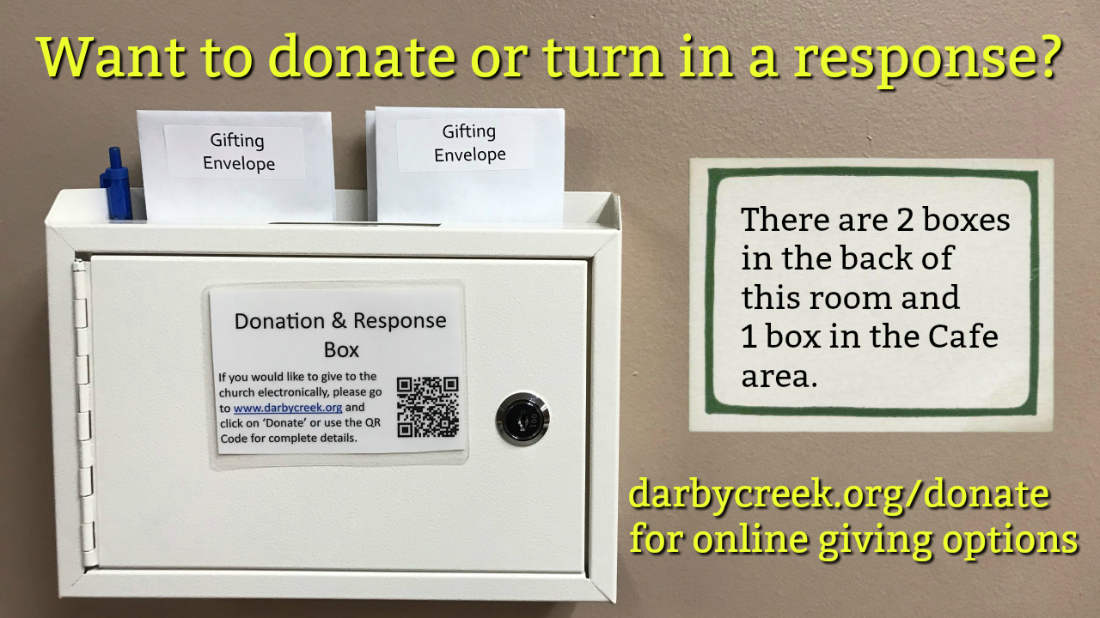

Slide 3
Matthew 18:21-35 ESV
21 Then Peter came up and said to him, "Lord, how often will my brother sin against me, and I forgive him? As many as seven times?"
22 Jesus said to him, "I do not say to you seven times, but seventy-seven times.
23 "Therefore the kingdom of heaven may be compared to a king who wished to settle accounts with his servants.
24 When he began to settle, one was brought to him who owed him ten thousand talents.

Slide 4
Matthew 18:21-35 ESV
25 And since he could not pay, his master ordered him to be sold, with his wife and children and all that he had, and payment to be made.
26 So the servant fell on his knees, imploring him, 'Have patience with me, and I will pay you everything.’
27 And out of pity for him, the master of that servant released him and forgave him the debt.
28 But when that same servant went out, he found one of his fellow servants who owed him a hundred denarii, and seizing him, he began to choke him, saying, 'Pay what you owe.’

Slide 5
Matthew 18:21-35 ESV
29 So his fellow servant fell down and pleaded with him, 'Have patience with me, and I will pay you.’
30 He refused and went and put him in prison until he should pay the debt.
31 When his fellow servants saw what had taken place, they were greatly distressed, and they went and reported to their master all that had taken place.
32 Then his master summoned him and said to him, 'You wicked servant! I forgave you all that debt because you pleaded with me.

Slide 6
Matthew 18:21-35 ESV
33 And should not you have had mercy on your fellow servant, as I had mercy on you?’
34 And in anger his master delivered him to the jailers, until he should pay all his debt.
35 So also my heavenly Father will do to every one of you, if you do not forgive your brother from your heart."

Slide 8
1. There are no limits to forgiving one another
(Matthew 18:21-22)

Slide 9
2. We forgive one another because we have received limitless forgiveness
(Matthew 18:23-27)

Slide 10
3. Extending forgiveness is an indicator you have received God’s grace and forgiveness
(Matthew 18:28-35)

Slide 11
4. Withholding forgiveness puts you
in position to be overtaken by one of
Satan's schemes
(2 Corinthians 2:7-11)

Slide 12
5. Forgiveness DOES NOT equal reconciliation
(Matthew 18:15-17; Romans 12:18-19)

