Slide 2
Matthew 14:13-21 NLT
13 Now when Jesus heard this, he withdrew from there in a boat to a desolate place by himself. But when the crowds heard it, they followed him on foot from the towns.
14 When he went ashore he saw a great crowd, and he had compassion on them and healed their sick.
15 Now when it was evening, the disciples came to him and said, "This is a desolate place, and the day is now over; send the crowds away to go into the villages and buy food for themselves."

Slide 3
Matthew 14:13-21 NLT
16 But Jesus said, "They need not go away; you give them something to eat."
17 They said to him, "We have only five loaves here and two fish."
18 And he said, "Bring them here to me."
19 Then he ordered the crowds to sit down on the grass, and taking the five loaves and the two fish, he looked up to heaven and said a blessing. Then he broke the loaves and gave them to the disciples, and the disciples gave them to the crowds.

Slide 4
Matthew 14:13-21 NLT
20 And they all ate and were satisfied. And they took up twelve baskets full of the broken pieces left over.
21 And those who ate were about five thousand men, besides women and children.

Slide 6
1. Reflect the Compassion of Jesus (Matthew 14:13-14)

Slide 7
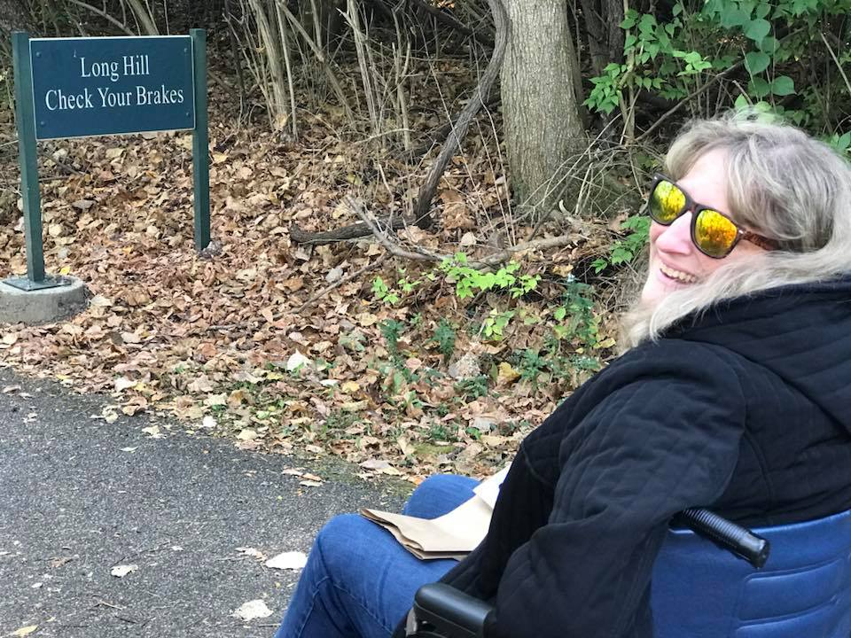

Slide 8
2. Jesus Meets Needs In Us
(Matthew 14:16-21)

Slide 9
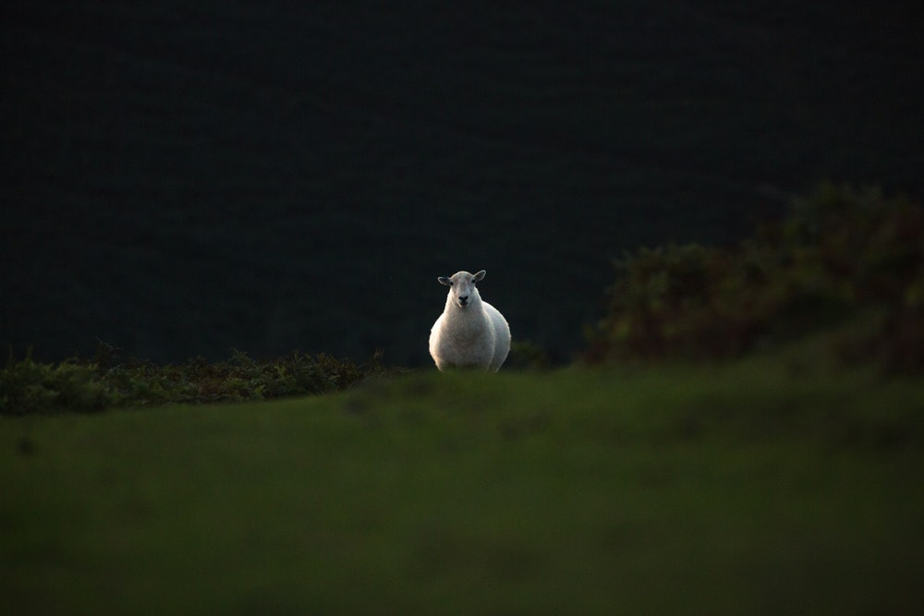

Slide 10
3. Jesus Meets Needs Through Us
(Matthew 14:16-21)

Slide 11
