Slide 2
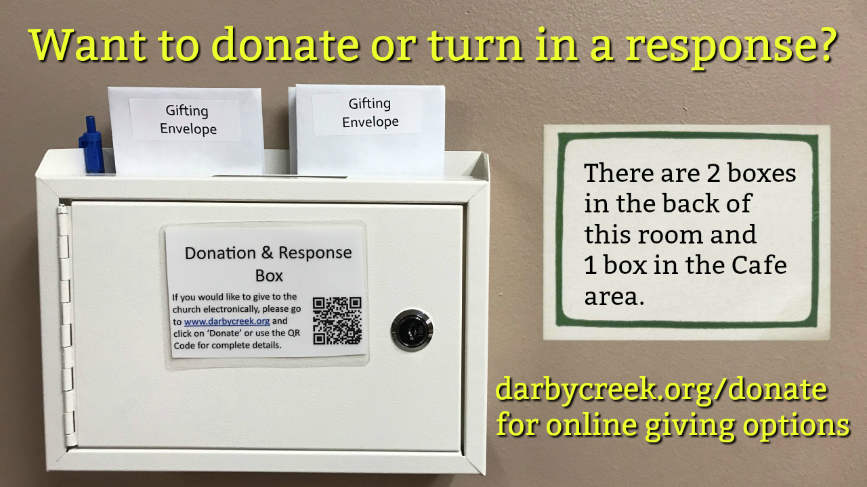

Slide 5
Matthew 14:22-33 NLT
22 Immediately he made the disciples get into the boat and go before him to the other side, while he dismissed the crowds.
23 And after he had dismissed the crowds, he went up on the mountain by himself to pray. When evening came, he was there alone,
24 but the boat by this time was a long way from the land, beaten by the waves, for the wind was against them.
25 And in the fourth watch of the night he came to them, walking on the sea.

Slide 6
Matthew 14:22-33 NLT
26 But when the disciples saw him walking on the sea, they were terrified, and said, "It is a ghost!" and they cried out in fear.
27 But immediately Jesus spoke to them, saying, "Take heart; it is I. Do not be afraid."
28 And Peter answered him, "Lord, if it is you, command me to come to you on the water."
29 He said, "Come." So Peter got out of the boat and walked on the water and came to Jesus.

Slide 7
Matthew 14:22-33 NLT
30 But when he saw the wind, he was afraid, and beginning to sink he cried out, "Lord, save me."
31 Jesus immediately reached out his hand and took hold of him, saying to him, "O you of little faith, why did you doubt?"
32 And when they got into the boat, the wind ceased.
33 And those in the boat worshiped him, saying, "Truly you are the Son of God."

Slide 9
1. Jesus Brought Me Here
(Matthew 14:22)

Slide 10
Romans 8:28 NLT
And we know that God causes everything to work together for the good of those who love God and are called according to his purpose for them.

Slide 11
2. Jesus is Praying for Me
(Matthew 14:23-24)

Slide 12
Romans 8:34 NLT
Who then will condemn us? No one—for Christ Jesus died for us and was raised to life for us, and he is sitting in the place of honor at God’s right hand, pleading for us.
Luke 22:31-32 NLT
31 “Simon, Simon, Satan has asked to sift each of you like wheat.
32 But I have pleaded in prayer for you, Simon, that your faith should not fail. So when you have repented and turned to me again, strengthen your brothers.”

Slide 13
3. Jesus is with Me
(Matthew 14:27)

Slide 14
Isaiah 43:1-2 NLT
1 But now, O Jacob, listen to the Lord who created you.O Israel, the one who formed you says,“Do not be afraid, for I have ransomed you.I have called you by name; you are mine.
2 When you go through deep waters,I will be with you.When you go through rivers of difficulty,you will not drown.When you walk through the fire of oppression,you will not be burned up;the flames will not consume you.

Slide 15
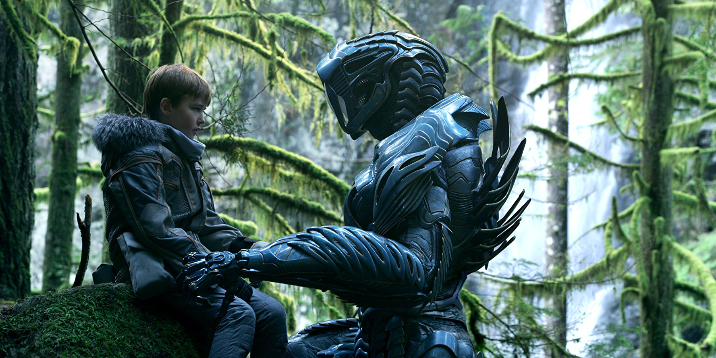

Slide 16
4. Jesus Will See Me Through
(Matthew 14:29-32)

Slide 17
Hebrews 12:1-2 NLT
1 Therefore, since we are surrounded by such a huge crowd of witnesses to the life of faith, let us strip off every weight that slows us down, especially the sin that so easily trips us up. And let us run with endurance the race God has set before us.
2 We do this by keeping our eyes on Jesus, the champion who initiates and perfects our faith. Because of the joy awaiting him, he endured the cross, disregarding its shame. Now he is seated in the place of honor beside God’s throne.

