Slide 2
1 Corinthians 15:1-9, 16-20 NLT
1 Let me now remind you, dear brothers and sisters, of the Good News I preached to you before. You welcomed it then, and you still stand firm in it.
2 It is this Good News that saves you if you continue to believe the message I told you—unless, of course, you believed something that was never true in the first place.
3 I passed on to you what was most important and what had also been passed on to me. Christ died for our sins, just as the Scriptures said.
4 He was buried, and he was raised from the dead on the third day, just as the Scriptures said.

Slide 3
1 Corinthians 15:1-9, 16-20 NLT
5 He was seen by Peter and then by the Twelve.
6 After that, he was seen by more than 500 of his followers at one time, most of whom are still alive, though some have died.
7 Then he was seen by James and later by all the apostles.
8 Last of all, as though I had been born at the wrong time, I also saw him.
9 For I am the least of all the apostles. In fact, I’m not even worthy to be called an apostle after the way I persecuted God’s church.

Slide 4
1 Corinthians 15:1-9, 16-20 NLT
16 And if there is no resurrection of the dead, then Christ has not been raised.
17 And if Christ has not been raised, then your faith is useless and you are still guilty of your sins.
18 In that case, all who have died believing in Christ are lost!
19 And if our hope in Christ is only for this life, we are more to be pitied than anyone in the world.
20 But in fact, Christ has been raised from the dead. He is the first of a great harvest of all who have died.

Slide 5
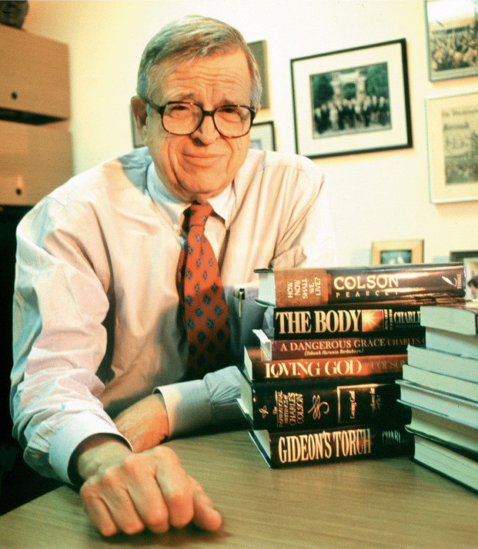
“I know the resurrection is a fact, and Watergate proved it to me. How? Because 12 men testified they had seen Jesus raised from the dead, then they proclaimed that truth for 40 years, never once denying it. Every one was beaten, tortured, stoned and put in prison. They would not have endured that if it weren't true. Watergate embroiled 12 of the most powerful men in the world-and they couldn't keep a lie for three weeks. You're telling me 12 apostles could keep a lie for 40 years? Absolutely impossible.”
-- Charles W. Colson

Slide 6
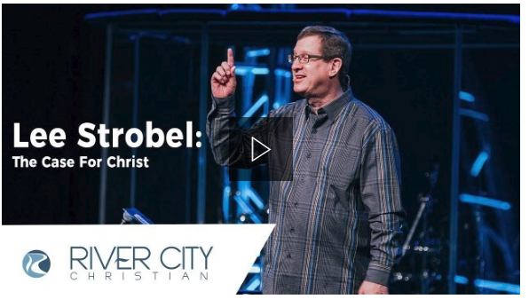

Slide 8
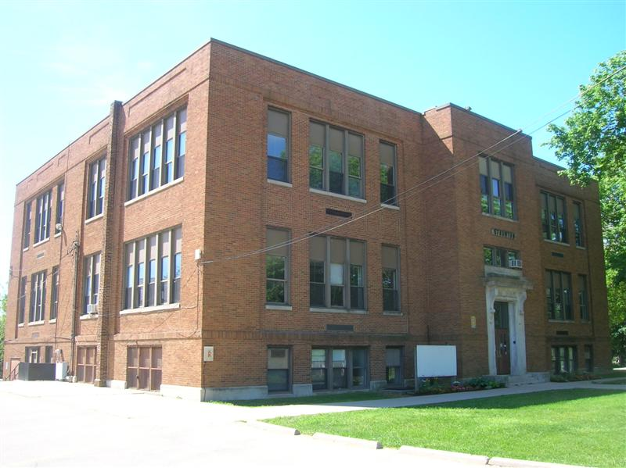
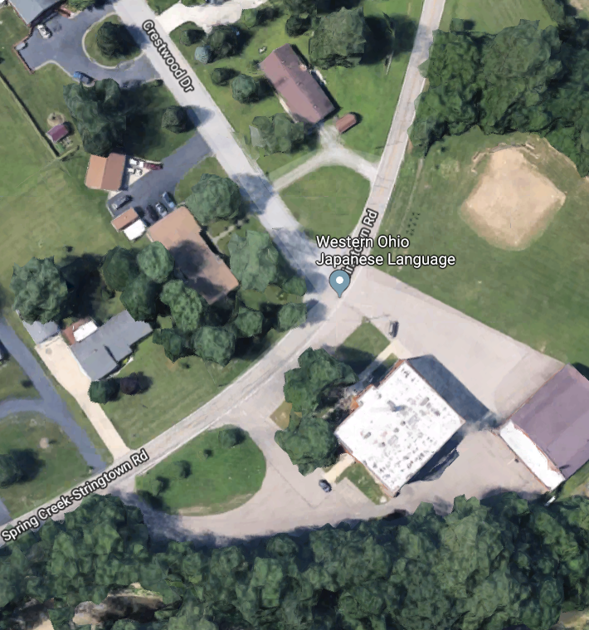

Slide 9
1. The resurrection changes how I relate to my past

Slide 10
I am forgiven and free from the guilt and shame of my past

Slide 11
Ephesians 1:7 NLT
He is so rich in kindness and grace that he purchased our freedom with the blood of his Son and forgave our sins.

Slide 12
Romans 4:25; 8:34 NLT
4:25 He was handed over to die because of our sins, and he was raised to life to make us right with God.
8:34 Who then will condemn us? No one—for Christ Jesus died for us and was raised to life for us, and he is sitting in the place of honor at God’s right hand, pleading for us.

Slide 13
2. The resurrection changes how I live in my present circumstances

Slide 14
God gives me His Holy Spirit and strengthens me to live life no matter what happens

Slide 15
Ephesians 1:13, 19-20 NLT
13 And now you Gentiles have also heard the truth, the Good News that God saves you. And when you believed in Christ, he identified you as his own by giving you the Holy Spirit, whom he promised long ago.
19 I also pray that you will understand the incredible greatness of God’s power for us who believe him. This is the same mighty power
20 that raised Christ from the dead and seated him in the place of honor at God’s right hand in the heavenly realms.

Slide 16
Philippians 4:13 NLT
For I can do everything through Christ, who gives me strength.

Slide 17
I have a purpose to live for

Slide 18
Philippians 1:21 NLT
For to me, living means living for Christ, and dying is even better.

Slide 19
Mark 8:35 NLT
If you try to hang on to your life, you will lose it. But if you give up your life for my sake and for the sake of the Good News, you will save it.

Slide 20
3. The resurrection changes my future

Slide 22
I don't have to be afraid to die because I have a certain future in heaven

Slide 23
1 Peter 1:3-5 NLT
3 All praise to God, the Father of our Lord Jesus Christ. It is by his great mercy that we have been born again, because God raised Jesus Christ from the dead. Now we live with great expectation,
4 and we have a priceless inheritance—an inheritance that is kept in heaven for you, pure and undefiled, beyond the reach of change and decay.
5 And through your faith, God is protecting you by his power until you receive this salvation, which is ready to be revealed on the last day for all to see.

Slide 24
1 John 5:13 NLT
I have written this to you who believe in the name of the Son of God, so that you may know you have eternal life.

