Slide 1


Slide 2
Matthew 9:9-13 NLT
9 As Jesus was walking along, he saw a man named Matthew sitting at his tax collector’s booth. “Follow me and be my disciple,” Jesus said to him. So Matthew got up and followed him.
10 Later, Matthew invited Jesus and his disciples to his home as dinner guests, along with many tax collectors and other disreputable sinners.
11 But when the Pharisees saw this, they asked his disciples, “Why does your teacher eat with such scum?”

Slide 3
Matthew 9:9-13 NLT
12 When Jesus heard this, he said, “Healthy people don’t need a doctor—sick people do.”
13 Then he added, “Now go and learn the meaning of this Scripture: ‘I want you to show mercy, not offer sacrifices.’ For I have come to call not those who think they are righteous, but those who know they are sinners.”

Slide 5

Answer the call to follow Jesus
(Matthew 9:9)

Slide 6
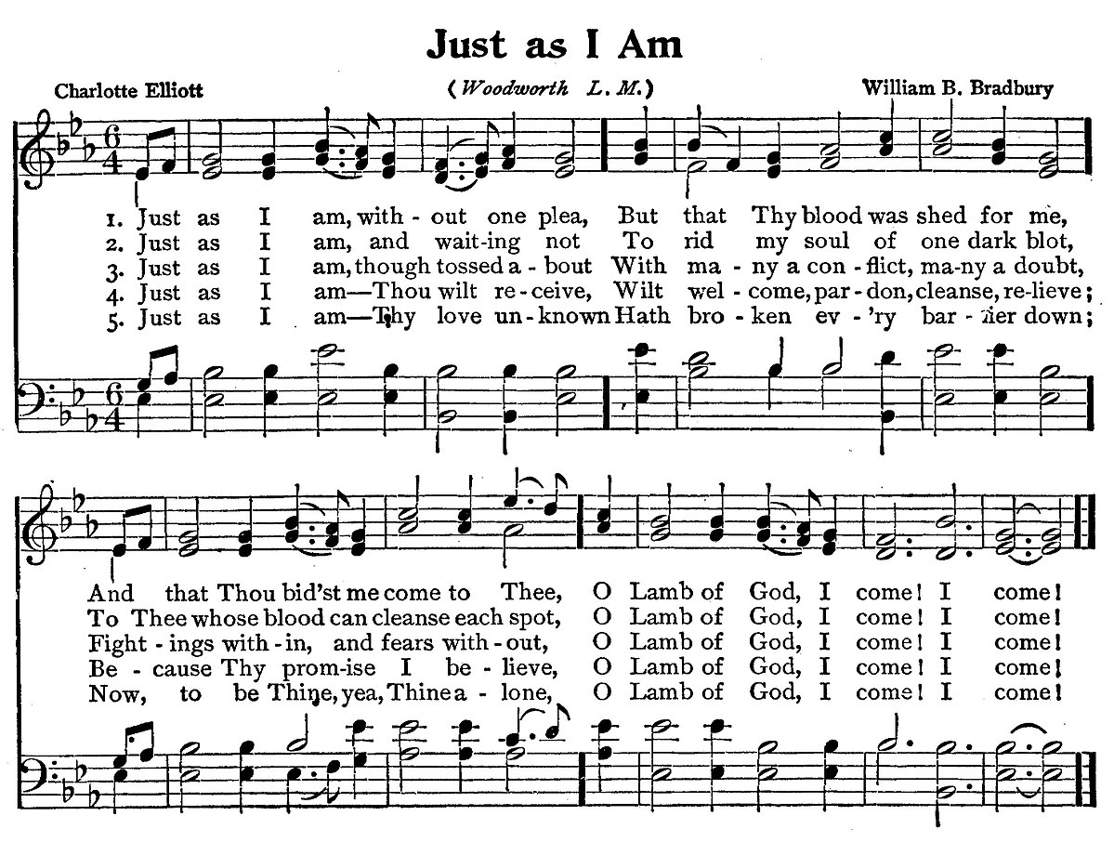
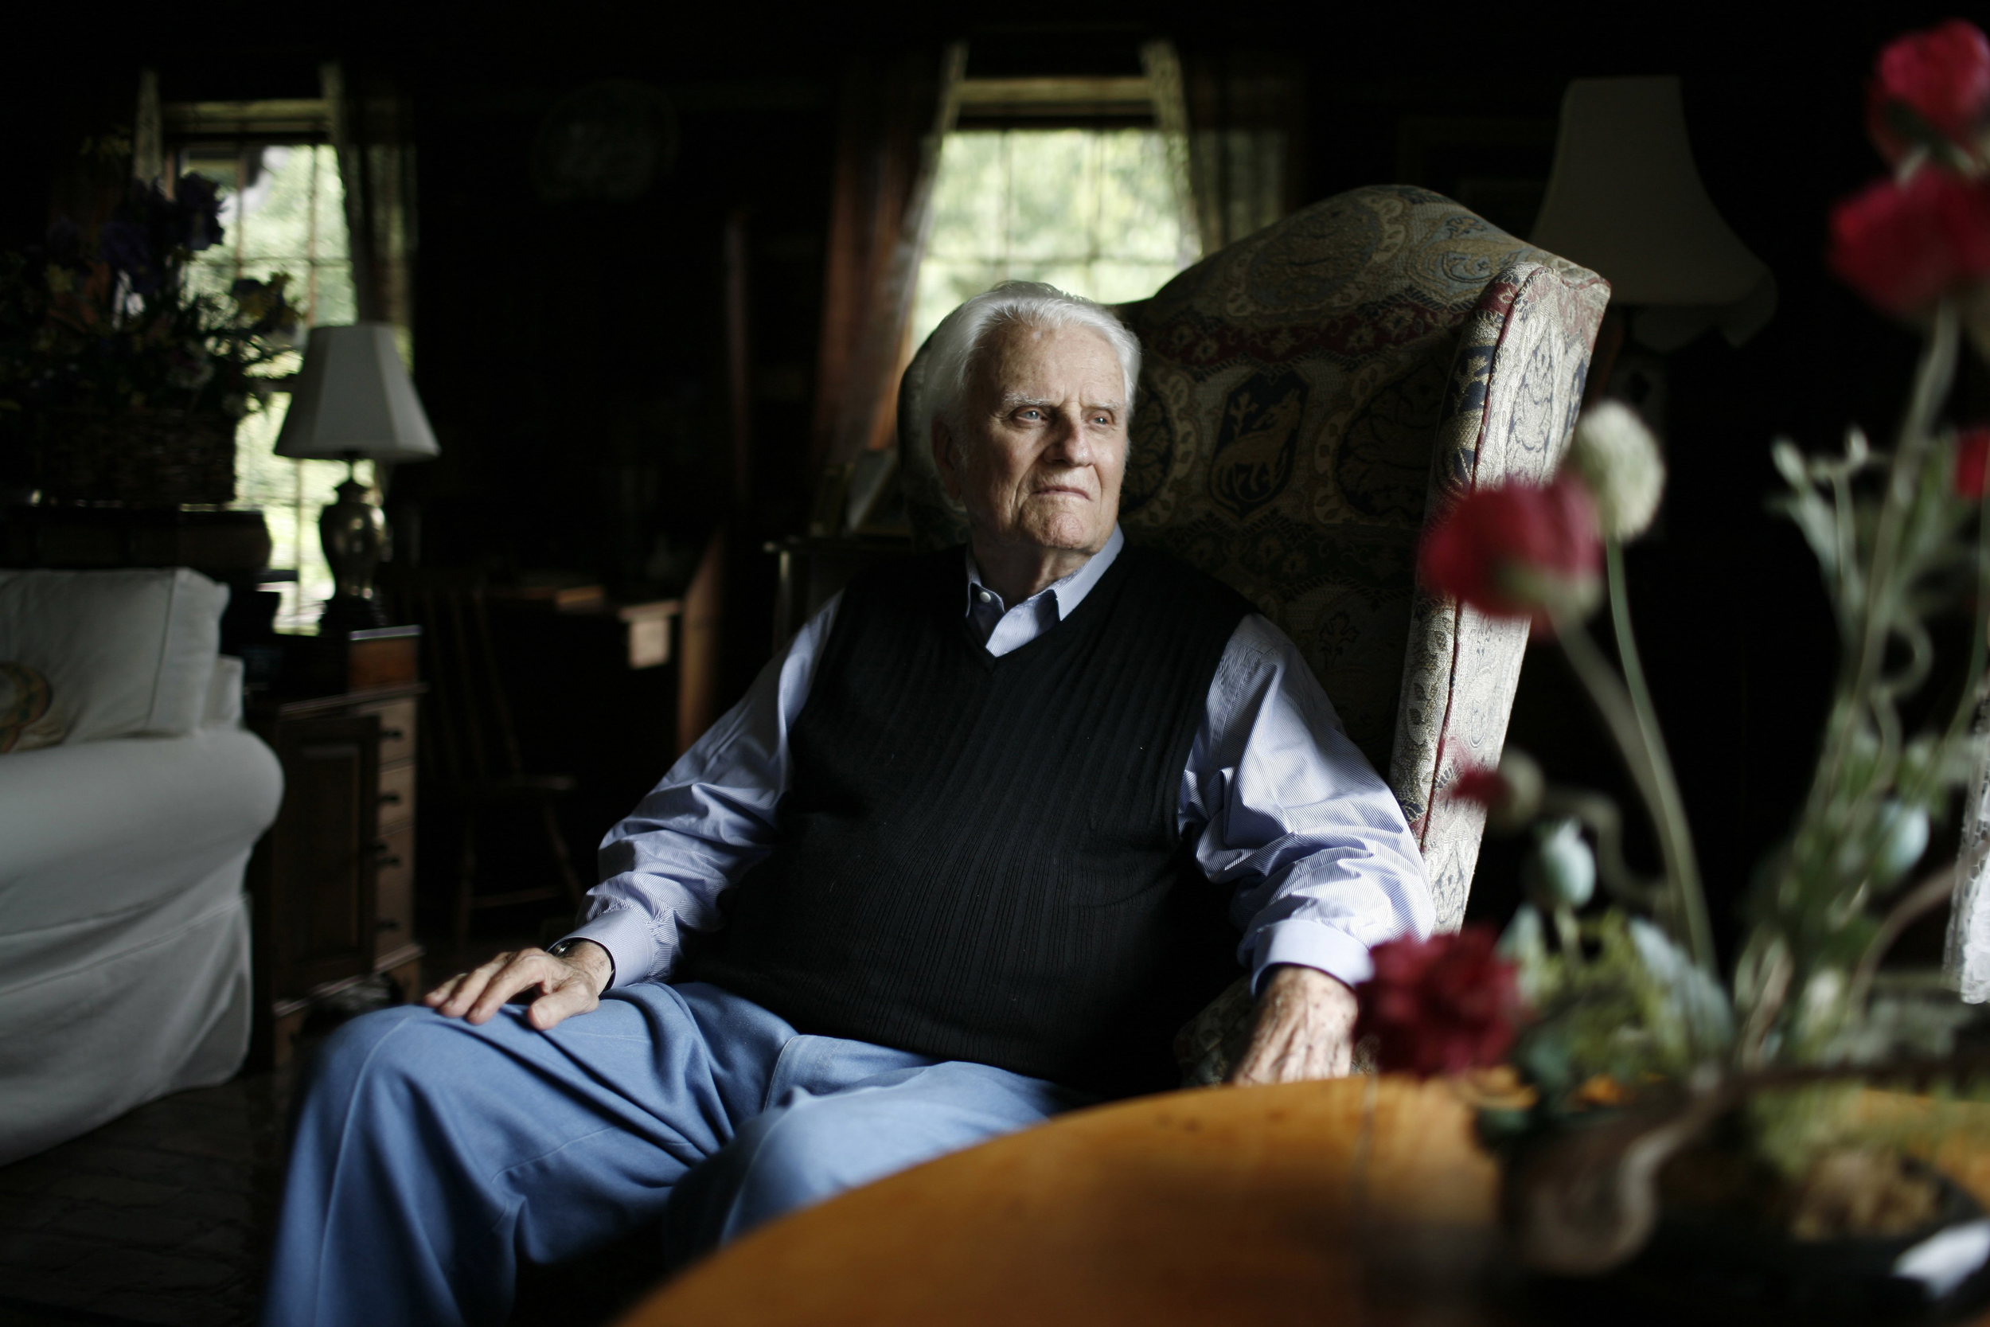

Slide 7
Open your life and home to people far from God
(Matthew 9:10)

Slide 8


Slide 9
Without a loving relationship with God, all religious activity and rituals are not going to help
(Matthew 9:11-13)

