Slide 2
Matthew 11:25-30 NLT
25 At that time Jesus prayed this prayer: “O Father, Lord of heaven and earth, thank you for hiding these things from those who think themselves wise and clever, and for revealing them to the childlike.
26 Yes, Father, it pleased you to do it this way!
27 “My Father has entrusted everything to me. No one truly knows the Son except the Father, and no one truly knows the Father except the Son and those to whom the Son chooses to reveal him.”

Slide 3
Matthew 11:25-30 NLT
28 Then Jesus said, “Come to me, all of you who are weary and carry heavy burdens, and I will give you rest.
29 Take my yoke upon you. Let me teach you, because I am humble and gentle at heart, and you will find rest for your souls.
30 For my yoke is easy to bear, and the burden I give you is light.”

Slide 5
Come: Jesus Invites Us to Come to Him (Matthew 11:28)

Slide 6
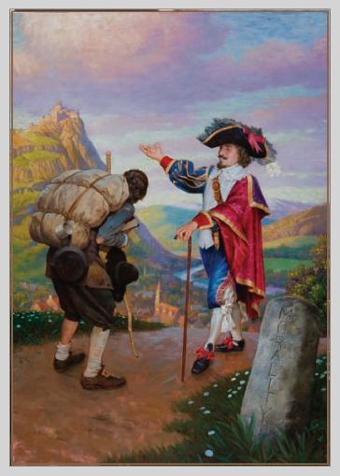
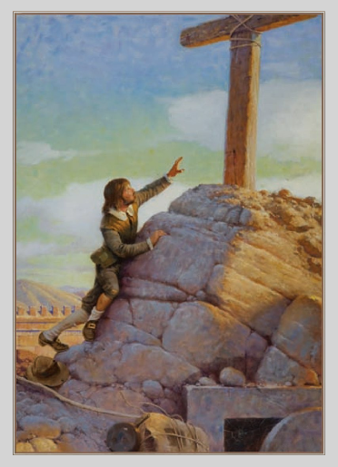
Pilgrim’s Progress by John Bunyan

Slide 7
Take: Jesus Invites Us to Take Up His Yoke (Matthew 11:29)

Slide 8
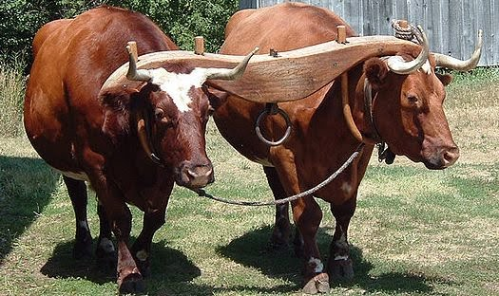
Animals Yoked Together

