Slide 1


Slide 2


Slide 3
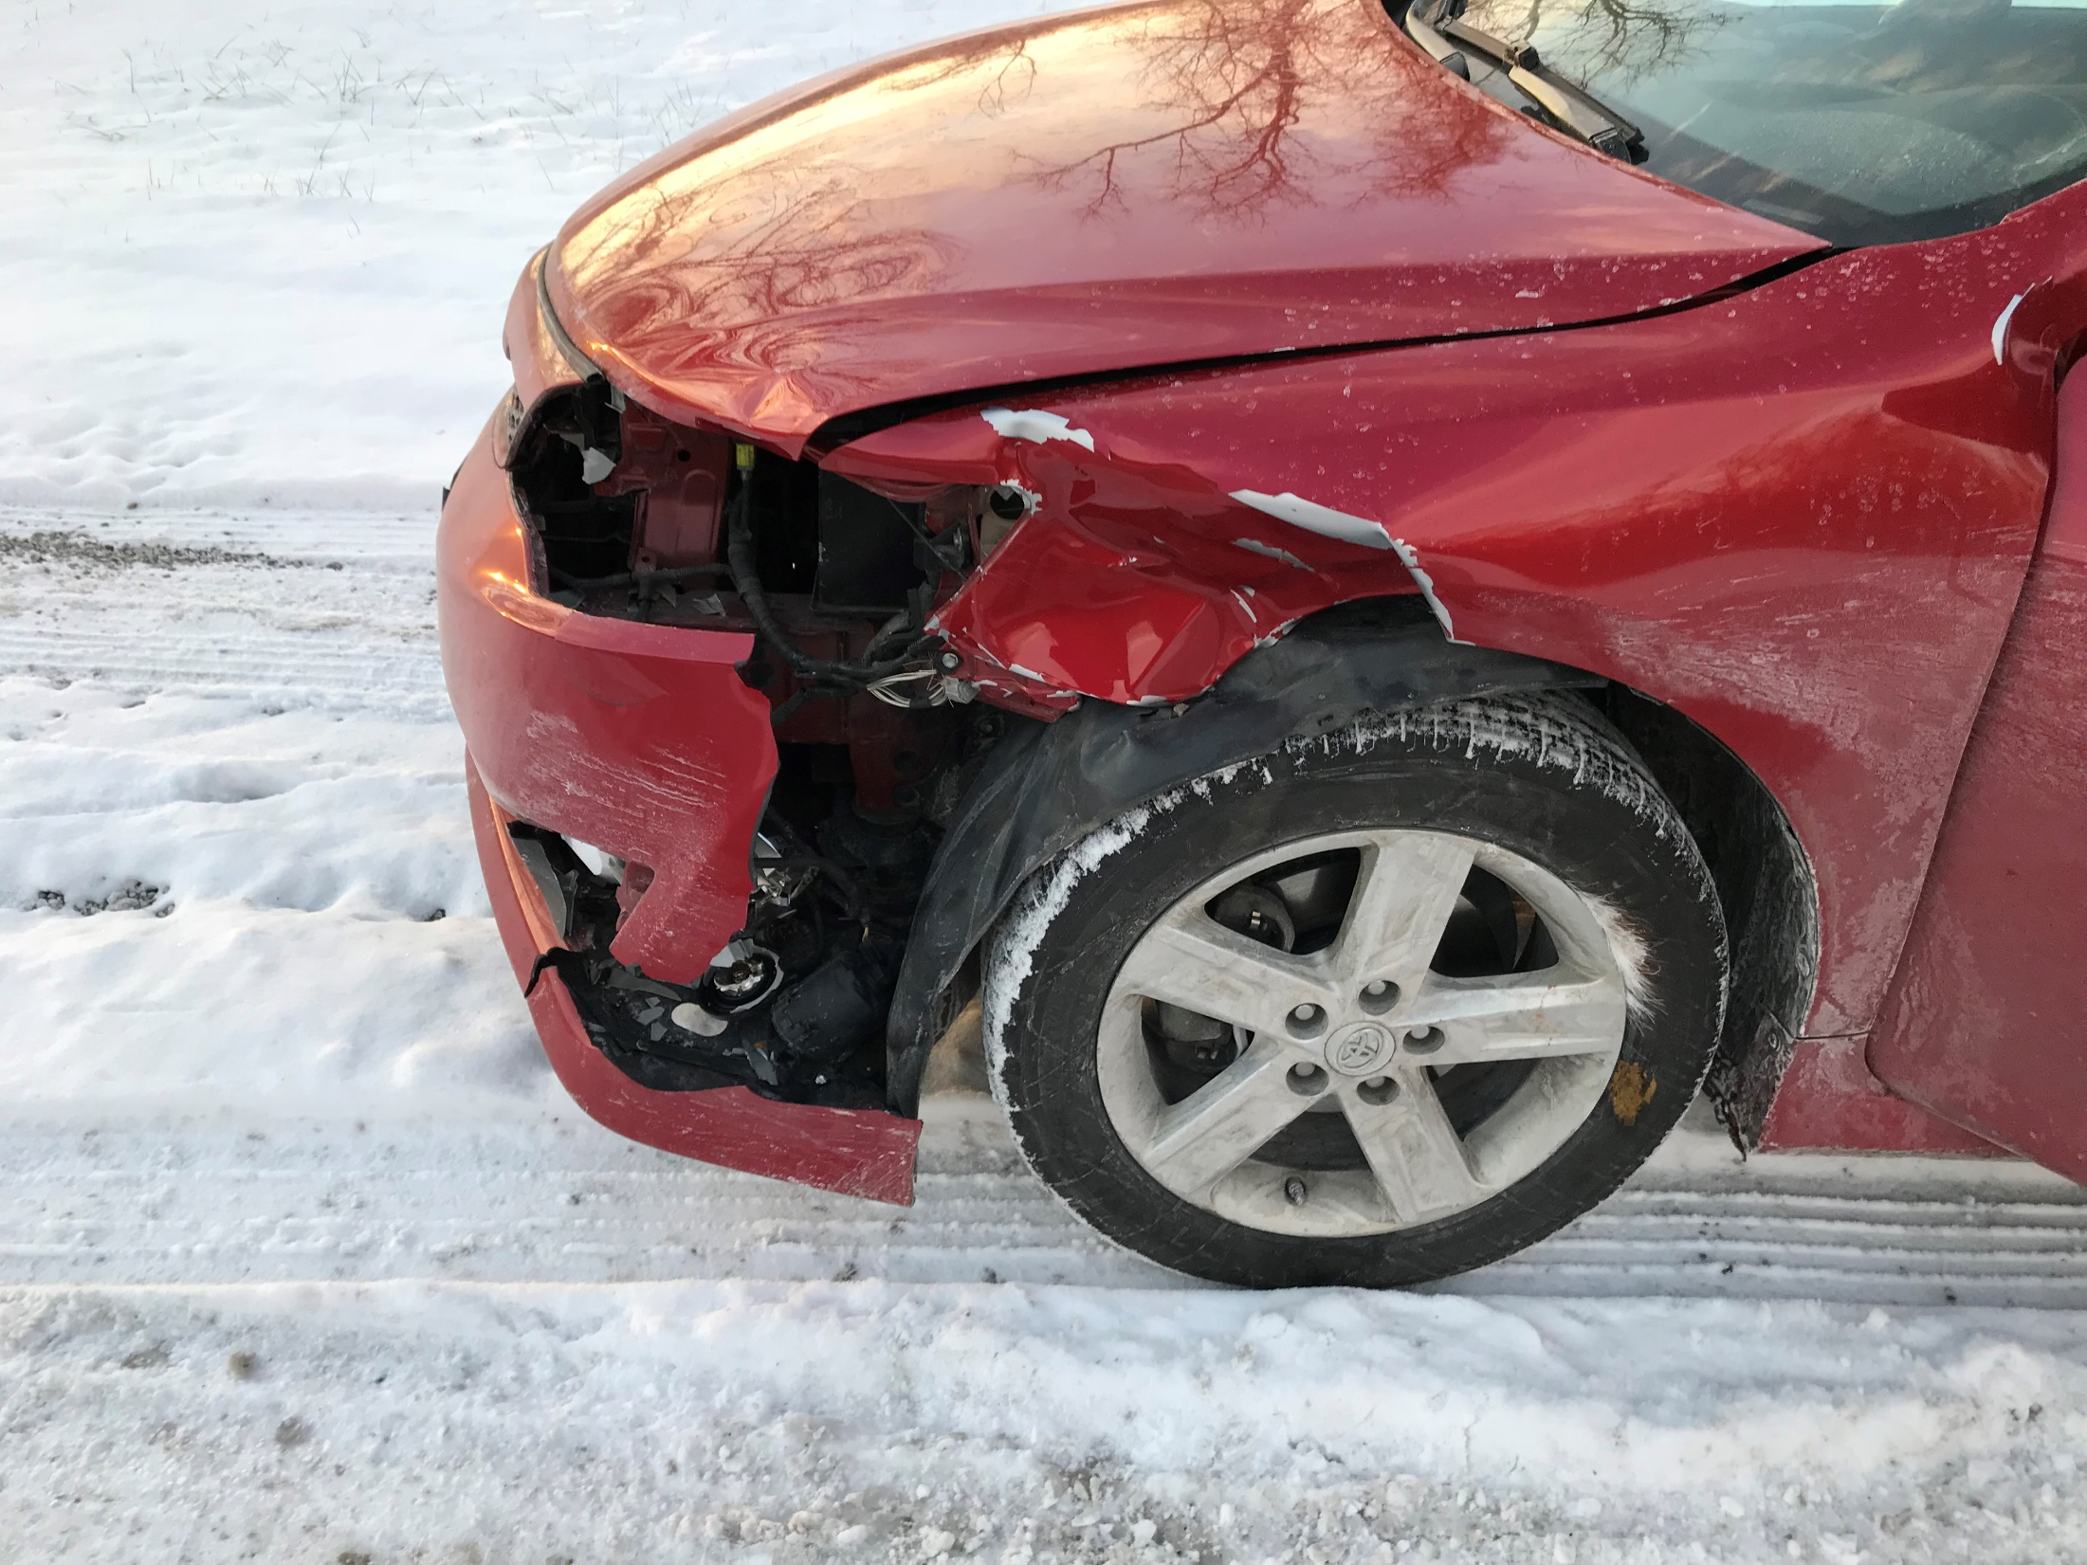

Slide 4
Matthew 10:26-31 HCSB
26 “Therefore, don’t be afraid of them, since there is nothing covered that won’t be uncovered and nothing hidden that won’t be made known.
27 What I tell you in the dark, speak in the light. What you hear in a whisper, proclaim on the housetops.
28 Don’t fear those who kill the body but are not able to kill the soul; rather fear Him who is able to destroy both soul and body in hell.”

Slide 5
Matthew 10:26-31 HCSB
29 “Aren’t two sparrows sold for a penny? Yet not one of them falls to the ground without your Father’s consent.
30 But even the hairs of your head have all been counted.
31 So don’t be afraid therefore; you are worth more than many sparrows.”

Slide 7

Fears that stop us from living authentic Christian lives…
Fear of SLANDER
(Matthew 10:26)

Slide 8
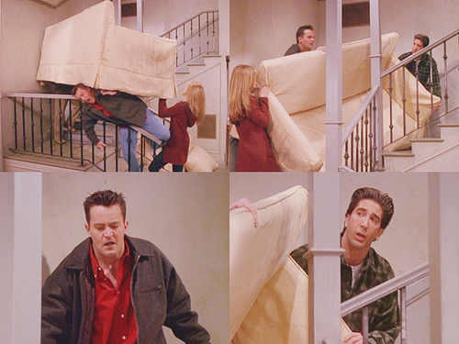

Slide 9
Fears that stop us from living authentic Christian lives…
Fear of VIOLENCE
(Matthew 10:28a)

Slide 10
Fears that stop us from living authentic Christian lives…
Fear of BEING FORGOTTEN
(Matthew 10:29-30)

Slide 11
Rather, FEAR THE KING!
…and nothing else
(Matthew 10:32-39)

