Slide 1
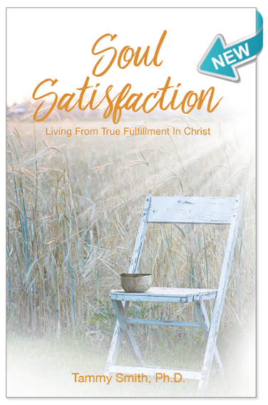
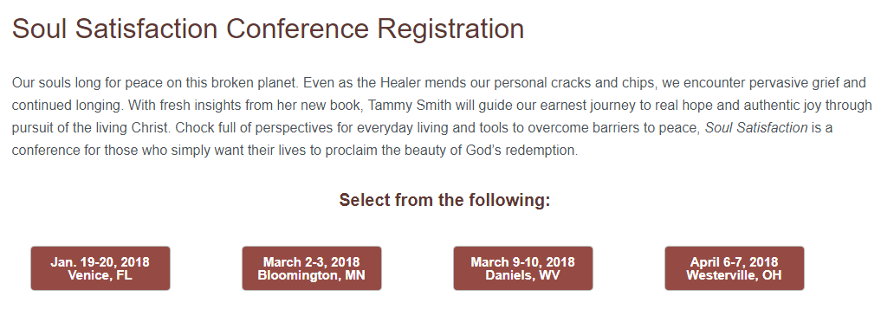
See today’s bulletin insert!

Slide 3
Matthew 5:1-12 ESV
1 Seeing the crowds, he went up on the mountain, and when he sat down, his disciples came to him.
2 And he opened his mouth and taught them, saying:
3 “Blessed are the poor in spirit, for theirs is the kingdom of heaven.
4 “Blessed are those who mourn, for they shall be comforted.
5 “Blessed are the meek, for they shall inherit the earth.
6 “Blessed are those who hunger and thirst for righteousness, for they shall be satisfied.
7 “Blessed are the merciful, for they shall receive mercy.

Slide 4
Matthew 5:1-12 ESV
8 “Blessed are the pure in heart, for they shall see God.
9 “Blessed are the peacemakers, for they shall be called sons of God.
10 “Blessed are those who are persecuted for righteousness' sake, for theirs is the kingdom of heaven.
11 “Blessed are you when others revile you and persecute you and utter all kinds of evil against you falsely on my account. 12 Rejoice and be glad, for your reward is great in heaven, for so they persecuted the prophets who were before you.

Slide 6
•Jesus proclaims the kingdom (4:17)
•Jesus displays the power of the kingdom (4:23-25)
•Now Jesus explains what it means to be a citizen of the kingdom (chapters 5 thru 7)

Slide 7
*You must experience the
grace of the King before you can live the kingdom life Jesus talks about

Slide 8
*The kingdom of God is an
upside-down kingdom

Slide 9
*There is a flow to the beatitudes

Slide 10
•Becoming a citizen of the kingdom (5:3-5)
•Experiencing the transforming nature of the kingdom (5:6-9)
•Conflicting with the kingdom of this world (5:10-12)

