Slide 2
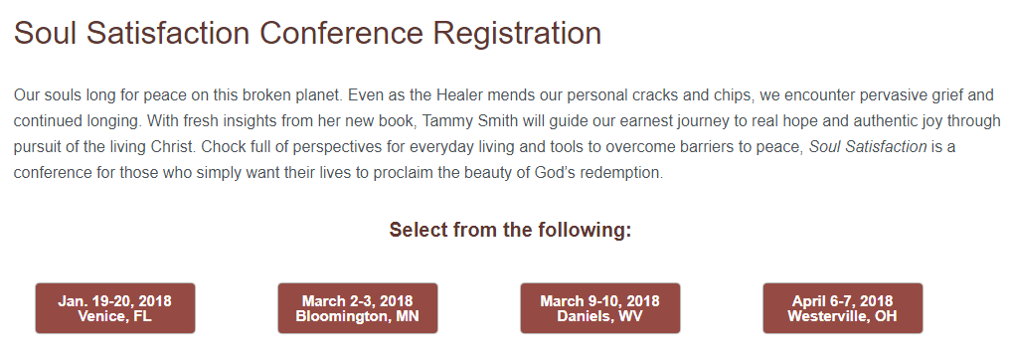
See today’s bulletin insert!

Slide 4
Matthew 6:5-15 ESV
5 “And when you pray, you must not be like the hypocrites. For they love to stand and pray in the synagogues and at the street corners, that they may be seen by others. Truly, I say to you, they have received their reward.
6 But when you pray, go into your room and shut the door and pray to your Father who is in secret. And your Father who sees in secret will reward you.
7 “And when you pray, do not heap up empty phrases as the Gentiles do, for they think that they will be heard for their many words.

Slide 5
Matthew 6:5-15 ESV
8 Do not be like them, for your Father knows what you need before you ask him.
9 Pray then like this:
“Our Father in heaven,
hallowed be your name.
10 Your kingdom come,
your will be done,
on earth as it is in heaven.
11 Give us this day our daily bread,

Slide 6
Matthew 6:5-15 ESV
12 and forgive us our debts,
as we also have forgiven our debtors.
13 And lead us not into temptation,
but deliver us from evil.
14 For if you forgive others their trespasses, your heavenly Father will also forgive you,
15 but if you do not forgive others their trespasses, neither will your Father forgive your trespasses.

Slide 8
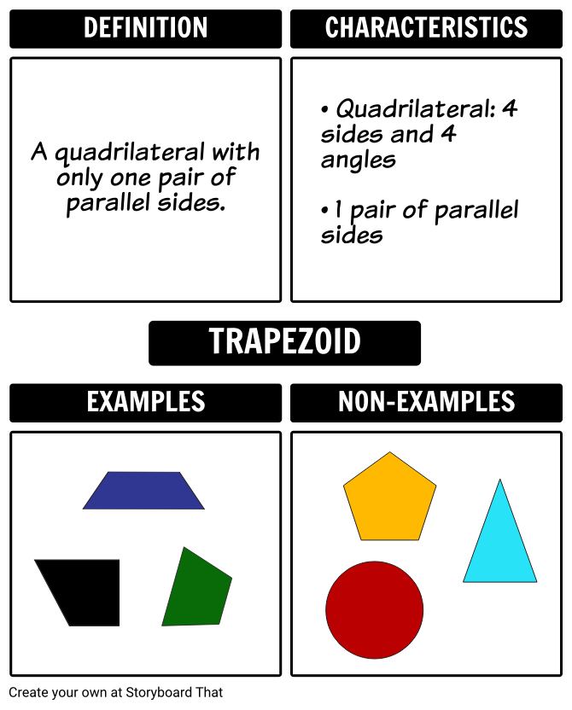
Jesus the master teacher! He shows us good and bad examples of prayer.

Slide 9
How Not to Pray

Slide 10
How to Pray
Remember to Whom you are praying (6:9)

Slide 11
How to Pray
Pray for God to be honored in your life and in those around you (6:9)

Slide 12
How to Pray
Pray for the rule and reign of God to come (6:10a)

Slide 13
How to Pray
Pray with an attitude of letting God have His way in your life (6:10b)

Slide 14
How to Pray
Pray about your needs (6:11)

Slide 15
How to Pray
Confess your sin and extend forgiveness to others (6:12,14-15)

Slide 16
How to Pray
Pray for spiritual protection (6:13)

