Slide 2
Psalm 119:17-24 (English Standard Version – ESV)
17 Deal bountifully with your servant,
that I may live and keep your word.
18 Open my eyes, that I may behold
wondrous things out of your law.
19 I am a sojourner on the earth;
hide not your commandments from me!
20 My soul is consumed with longing
for your rules at all times.

Slide 3
Psalm 119:17-24 (English Standard Version – ESV)
21 You rebuke the insolent, accursed ones,
who wander from your commandments.
22 Take away from me scorn and contempt,
for I have kept your testimonies.
23 Even though princes sit plotting against me,
your servant will meditate on your statutes.
24 Your testimonies are my delight;
they are my counselors.

Slide 5
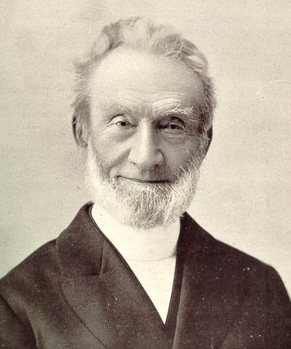
George Muller: Using the Word as a springboard to prayer
“The difference, then, between my former practice and my present one is this: formerly, when I rose, I began to pray as soon as possible, and generally spent all my time till breakfast in prayer, or almost all the time. At all events I almost invariably began with prayer. . . . But what was the result? I often spent a quarter of an hour, or half an hour, or even an hour on my knees before being conscious to myself of having derived comfort, encouragement, humbling of soul, etc.; and often, after having suffered much from wandering of mind for the first ten minutes, or quarter of an hour, or even half an hour, I only then really began to pray. ”
George Mueller: Director of the Ashley Down orphanage in Bristol, England

Slide 6
George Muller: Using the Word as a springboard to prayer
“I scarcely ever suffer now in this way. For my heart being nourished by the truth, being brought into fellowship with God, I speak to my Father and to my Friend about the things that He has brought before me in His precious Word. It often now astonishes me that I did not sooner see this point.”
George Mueller: Director of the Ashley Down orphanage in Bristol, England

Slide 7
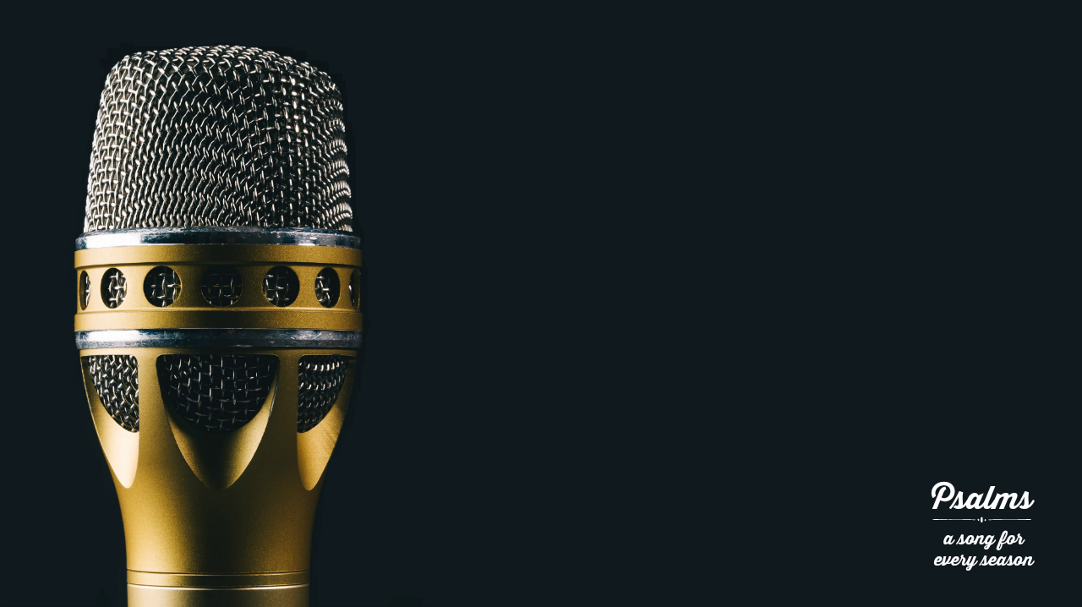
* A Prayer of Commitment to
Keep God’s Word
(Psalm 119:17)

Slide 8
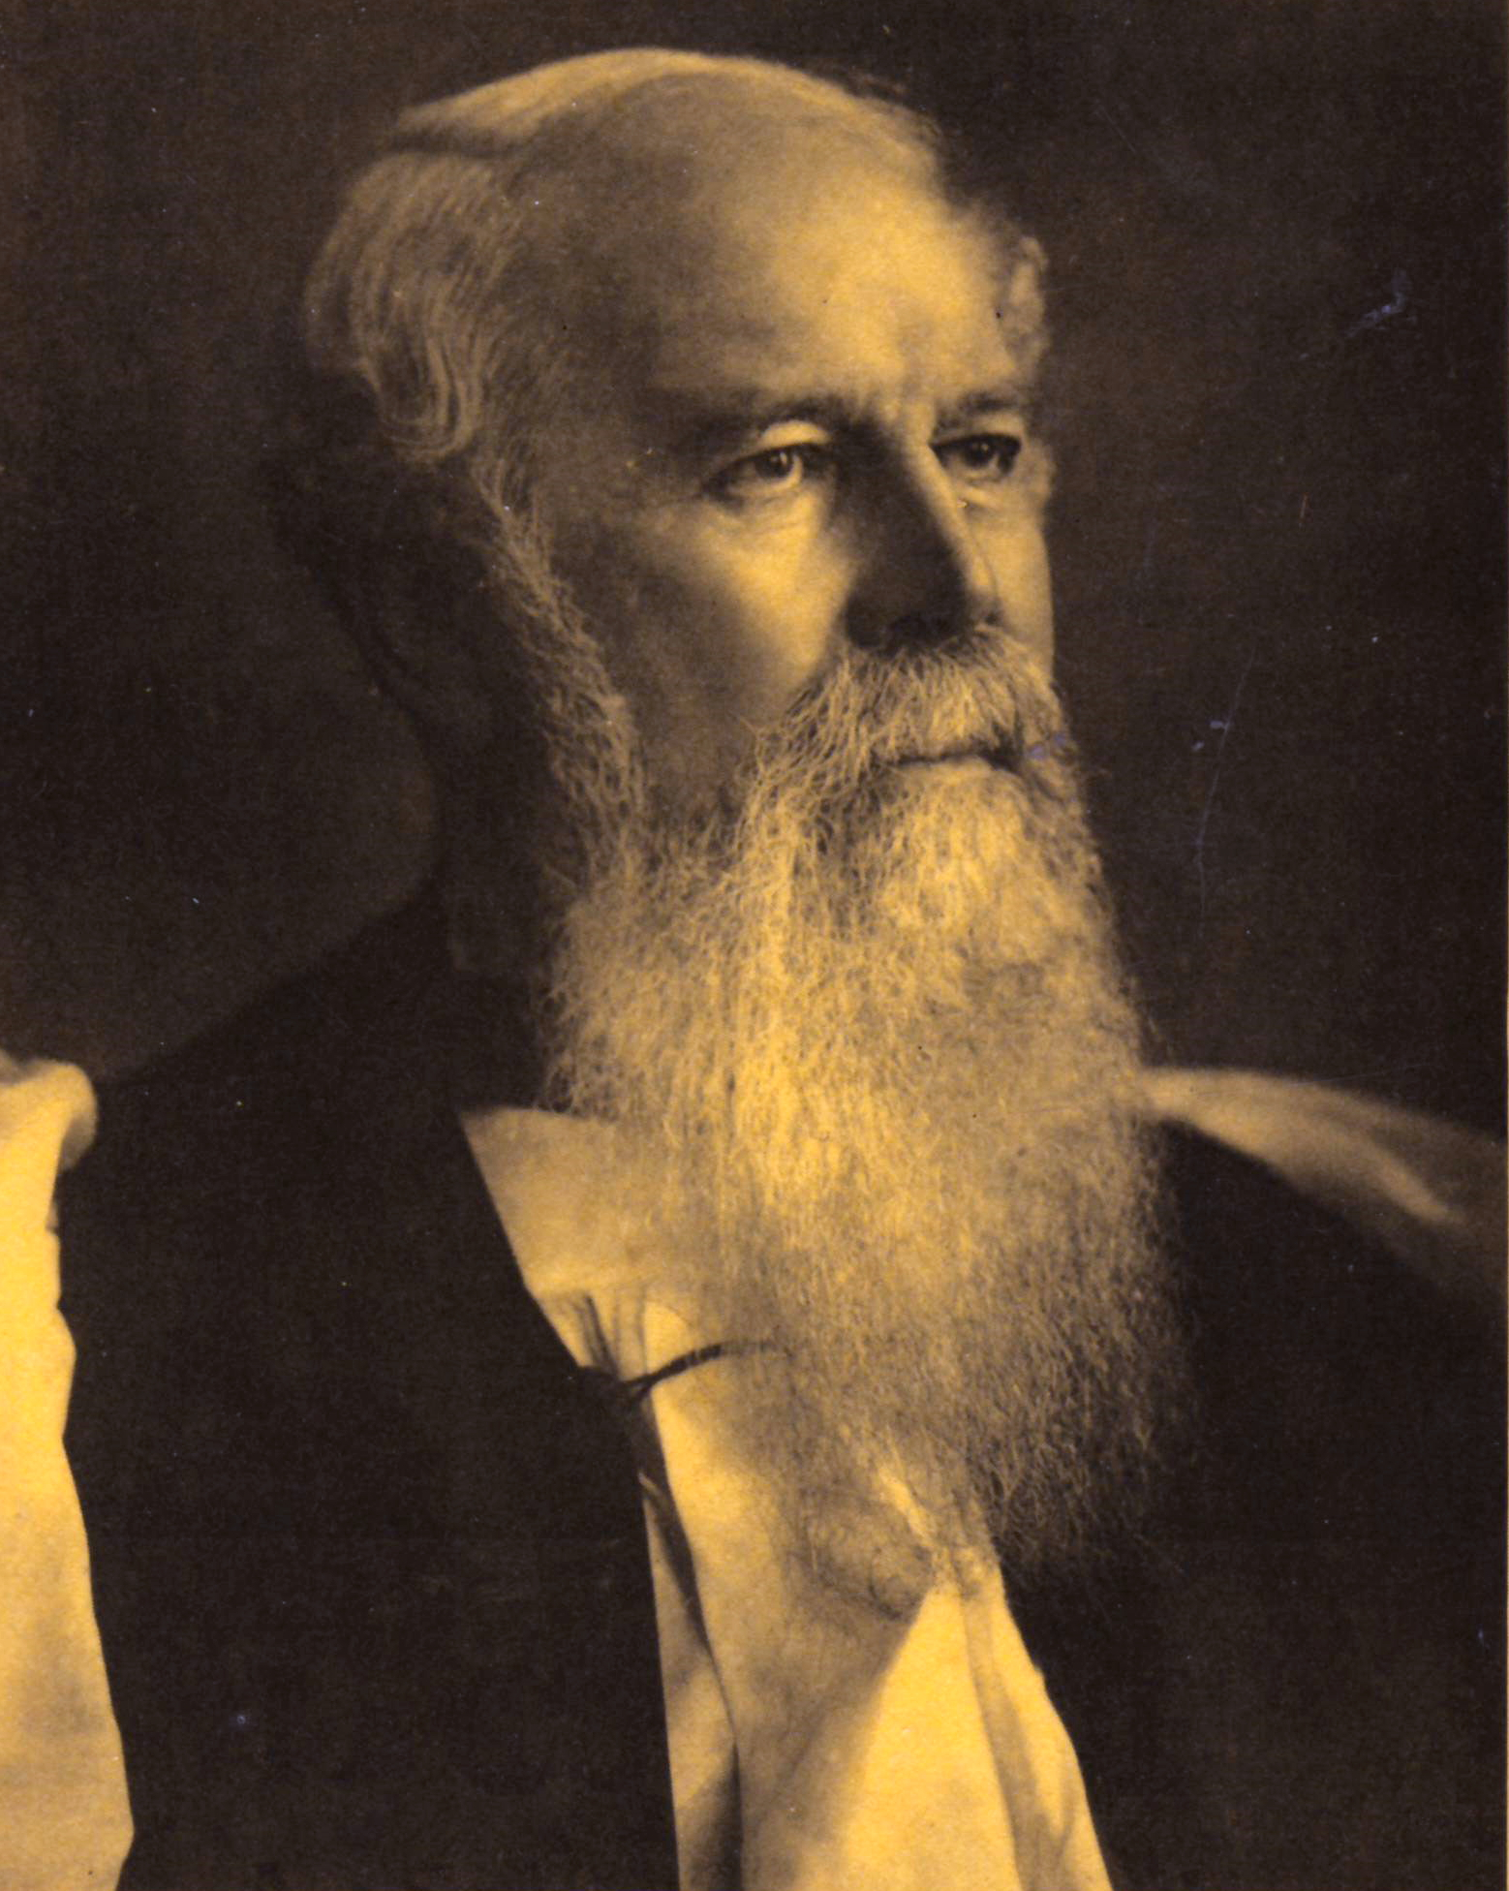
"Obedience is the only reality. It is faith visible, faith acting, and faith manifest. It is the test of real discipleship among the Lord's people."
J.C. Ryle

Slide 9
* A Prayer for
Understanding God’s Word
(Psalm 119:18-19)

Slide 10
* An Expression of a
Passion for God’s Word
(Psalm 119:20)

Slide 11
* A Prayer for Protection as We Carry Out God’s Word
(Psalm 119:21-23)

Slide 12
* An Expression of Receiving Comfort from God’s Word
(Psalm 119:24, 50, 92, 143)

