Slide 2
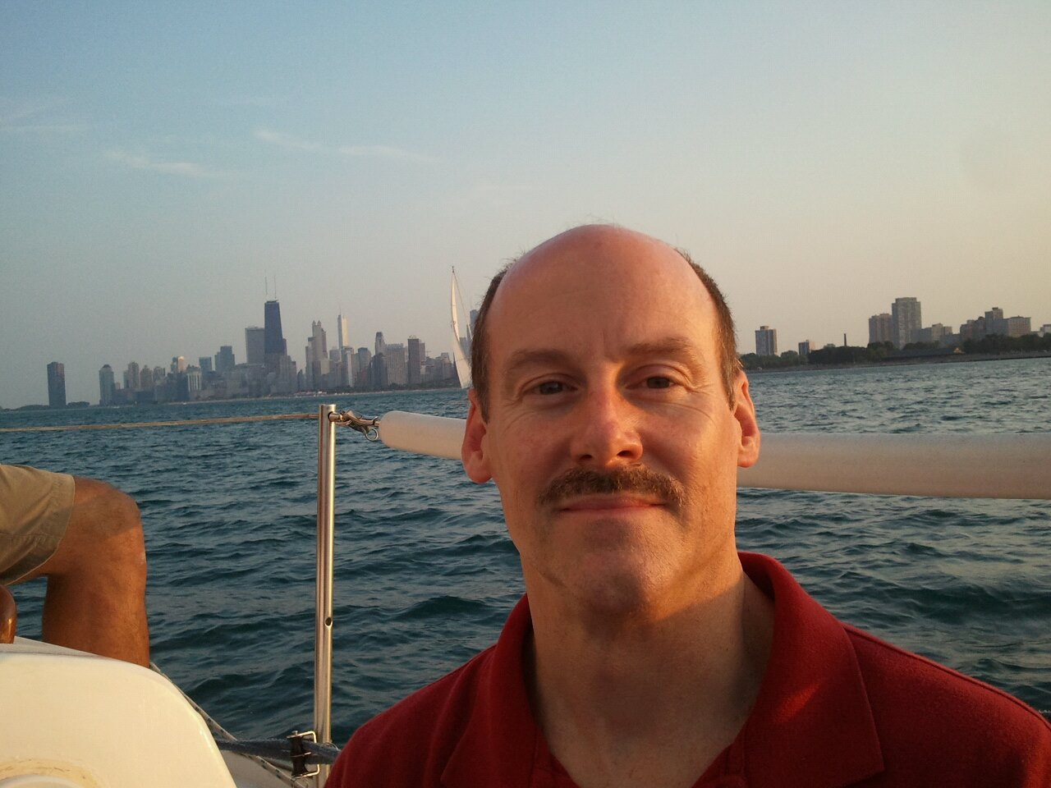
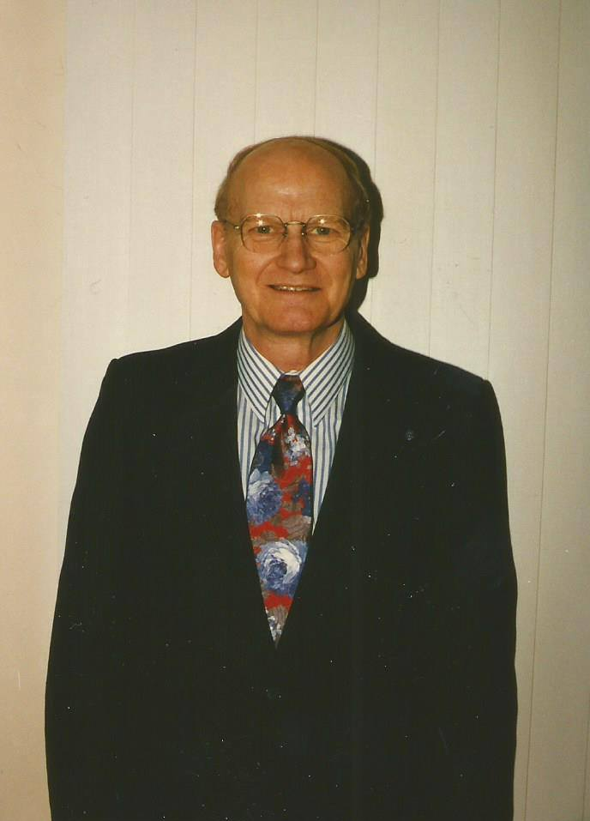
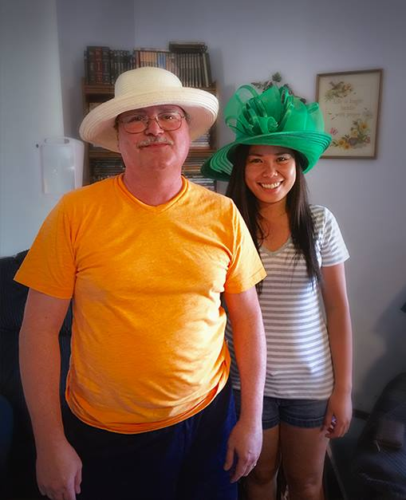
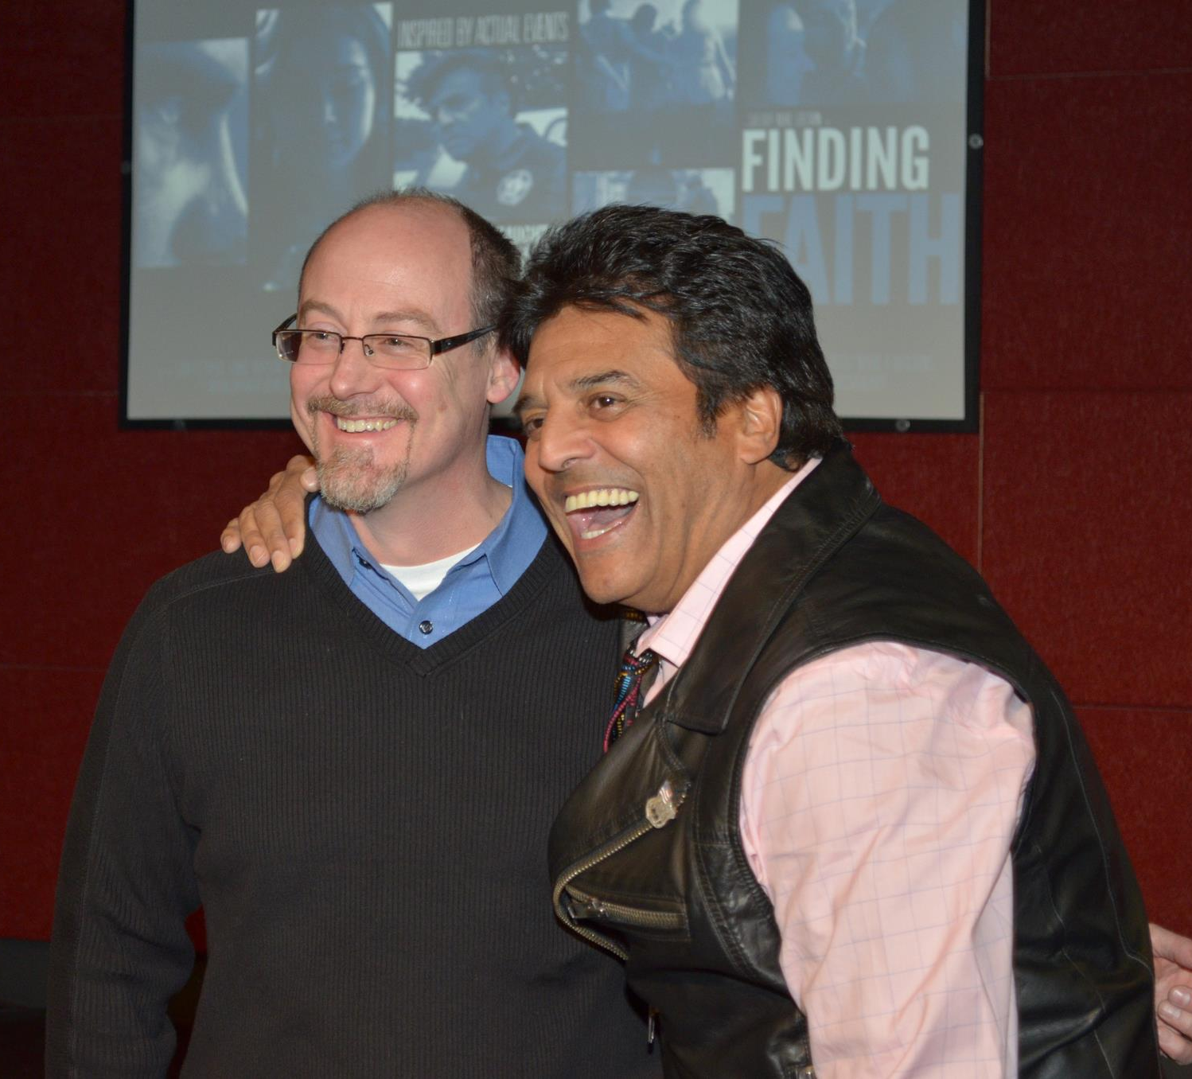
R. Kenyon Haring
1928-2018
Tom Haring
Tim Haring
Dan
Haring

Slide 3
Matthew 4:12-22 ESV
12 Now when he heard that John had been arrested, he withdrew into Galilee.
13 And leaving Nazareth he went and lived in Capernaum by the sea, in the territory of Zebulun and Naphtali,
14 so that what was spoken by the prophet Isaiah might be fulfilled:
15 “The land of Zebulun and the land of Naphtali,
the way of the sea, beyond the Jordan, Galilee of the Gentiles—
16 the people dwelling in darkness
have seen a great light,
and for those dwelling in the region and shadow of death,
on them a light has dawned.”

Slide 4
Matthew 4:12-22 ESV
17 From that time Jesus began to preach, saying, “Repent, for the kingdom of heaven is at hand.”
18 While walking by the Sea of Galilee, he saw two brothers, Simon (who is called Peter) and Andrew his brother, casting a net into the sea, for they were fishermen.
19 And he said to them, “Follow me, and I will make you fishers of men.”
20 Immediately they left their nets and followed him.
21 And going on from there he saw two other brothers, James the son of Zebedee and John his brother, in the boat with Zebedee their father, mending their nets, and he called them. 22 Immediately they left the boat and their father and followed him.

Slide 6
Jesus calls us to follow Him and we Come
(Matthew 4:18-22)

Slide 7
Jesus’ call to follow Him comes to unlikely people
(Matthew 4:18)

Slide 8
Following Jesus often involves uncertainty and sacrifice
(Matthew 4:20,22)

Slide 9
If you are not fishing for men and women, you are not following
(Matthew 4:19)

