Slide 2
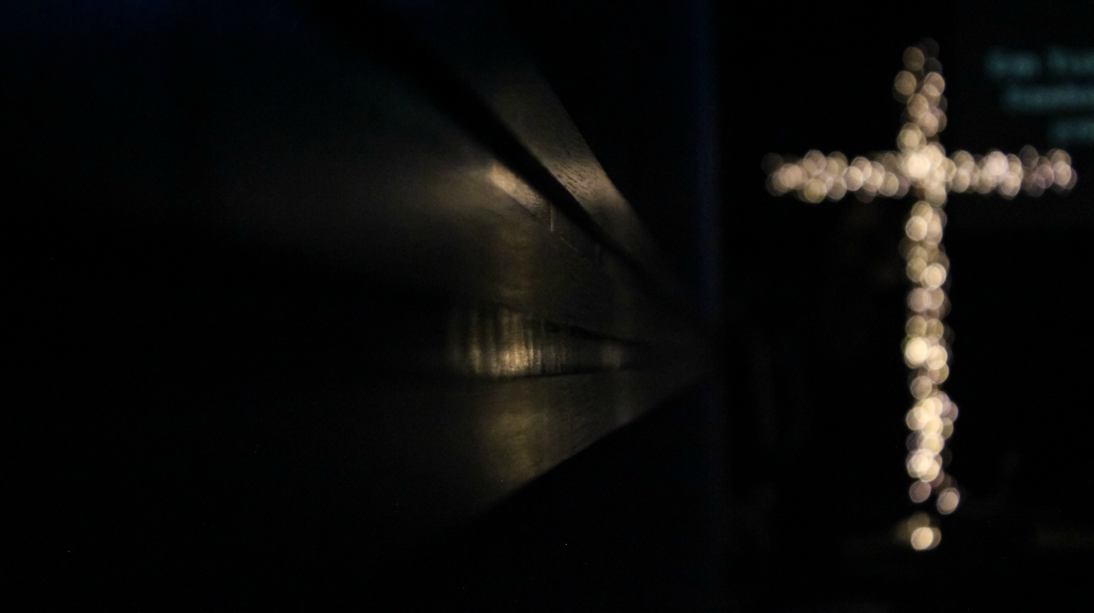
God’s Christmas Tree

Slide 3
God’s Christmas Tree – The Cross
Acts 5:30 ESV
The God of our fathers raised Jesus, whom you killed by hanging him on a tree.
1 Peter 2:24 ESV
He himself bore our sins in his body on the tree, that we might die to sin and live to righteousness. By his wounds you have been healed.

Slide 4
Romans 5:1-8 NLT
1 Therefore, since we have been made right in God’s sight by faith, we have peace with God because of what Jesus Christ our Lord has done for us.
2 Because of our faith, Christ has brought us into this place of undeserved privilege where we now stand, and we confidently and joyfully look forward to sharing God’s glory.
3 We can rejoice, too, when we run into problems and trials, for we know that they help us develop endurance.

Slide 5
Romans 5:1-8 NLT
4 And endurance develops strength of character, and character strengthens our confident hope of salvation.
5 And this hope will not lead to disappointment. For we know how dearly God loves us, because he has given us the Holy Spirit to fill our hearts with his love.
6 When we were utterly helpless, Christ came at just the right time and died for us sinners.

Slide 6
Romans 5:1-8 NLT
7 Now, most people would not be willing to die for an upright person, though someone might perhaps be willing to die for a person who is especially good.
8 But God showed his great love for us by sending Christ to die for us while we were still sinners.

Slide 7
Romans 5:1 Therefore, since we have been made right in God’s sight by faith, we have peace with God because of what Jesus Christ our Lord has done for us.

Slide 8
Romans 5:2 Because of our faith, Christ has brought us into this place of undeserved privilege where we now stand…

Slide 9
Romans 5:2 ….and we confidently and joyfully look forward to sharing God’s glory.

Slide 10
Romans 5:5 And this hope will not lead to disappointment. For we know how dearly God loves us, because he has given us the Holy Spirit to fill our hearts with his love.

Slide 11
God’s Christmas Tree

