Slide 2
Isaiah 9:1-7 ESV
1 But there will be no gloom for her who was in anguish. In the former time he brought into contempt the land of Zebulun and the land of Naphtali, but in the latter time he has made glorious the way of the sea, the land beyond the Jordan, Galilee of the nations.
2 The people who walked in darkness have seen a great light;
those who dwelt in a land of deep darkness, on them has light shone.
3 You have multiplied the nation; you have increased its joy;
they rejoice before you as with joy at the harvest, as they are glad when they divide the spoil.

Slide 3
Isaiah 9:1-7 ESV
4 For the yoke of his burden, and the staff for his shoulder, the rod of his oppressor, you have broken as on the day of Midian.
5 For every boot of the tramping warrior in battle tumult and every garment rolled in blood will be burned as fuel for the fire.
6 For to us a child is born, to us a son is given; and the government shall be upon his shoulder, and his name shall be called Wonderful Counselor, Mighty God, Everlasting Father, Prince of Peace.

Slide 4
Isaiah 9:1-7 ESV
7 Of the increase of his government and of peace there will be no end, on the throne of David and over his kingdom, to establish it and to uphold it with justice and with righteousness from this time forth and forevermore. The zeal of the Lord of hosts will do this.

Slide 5
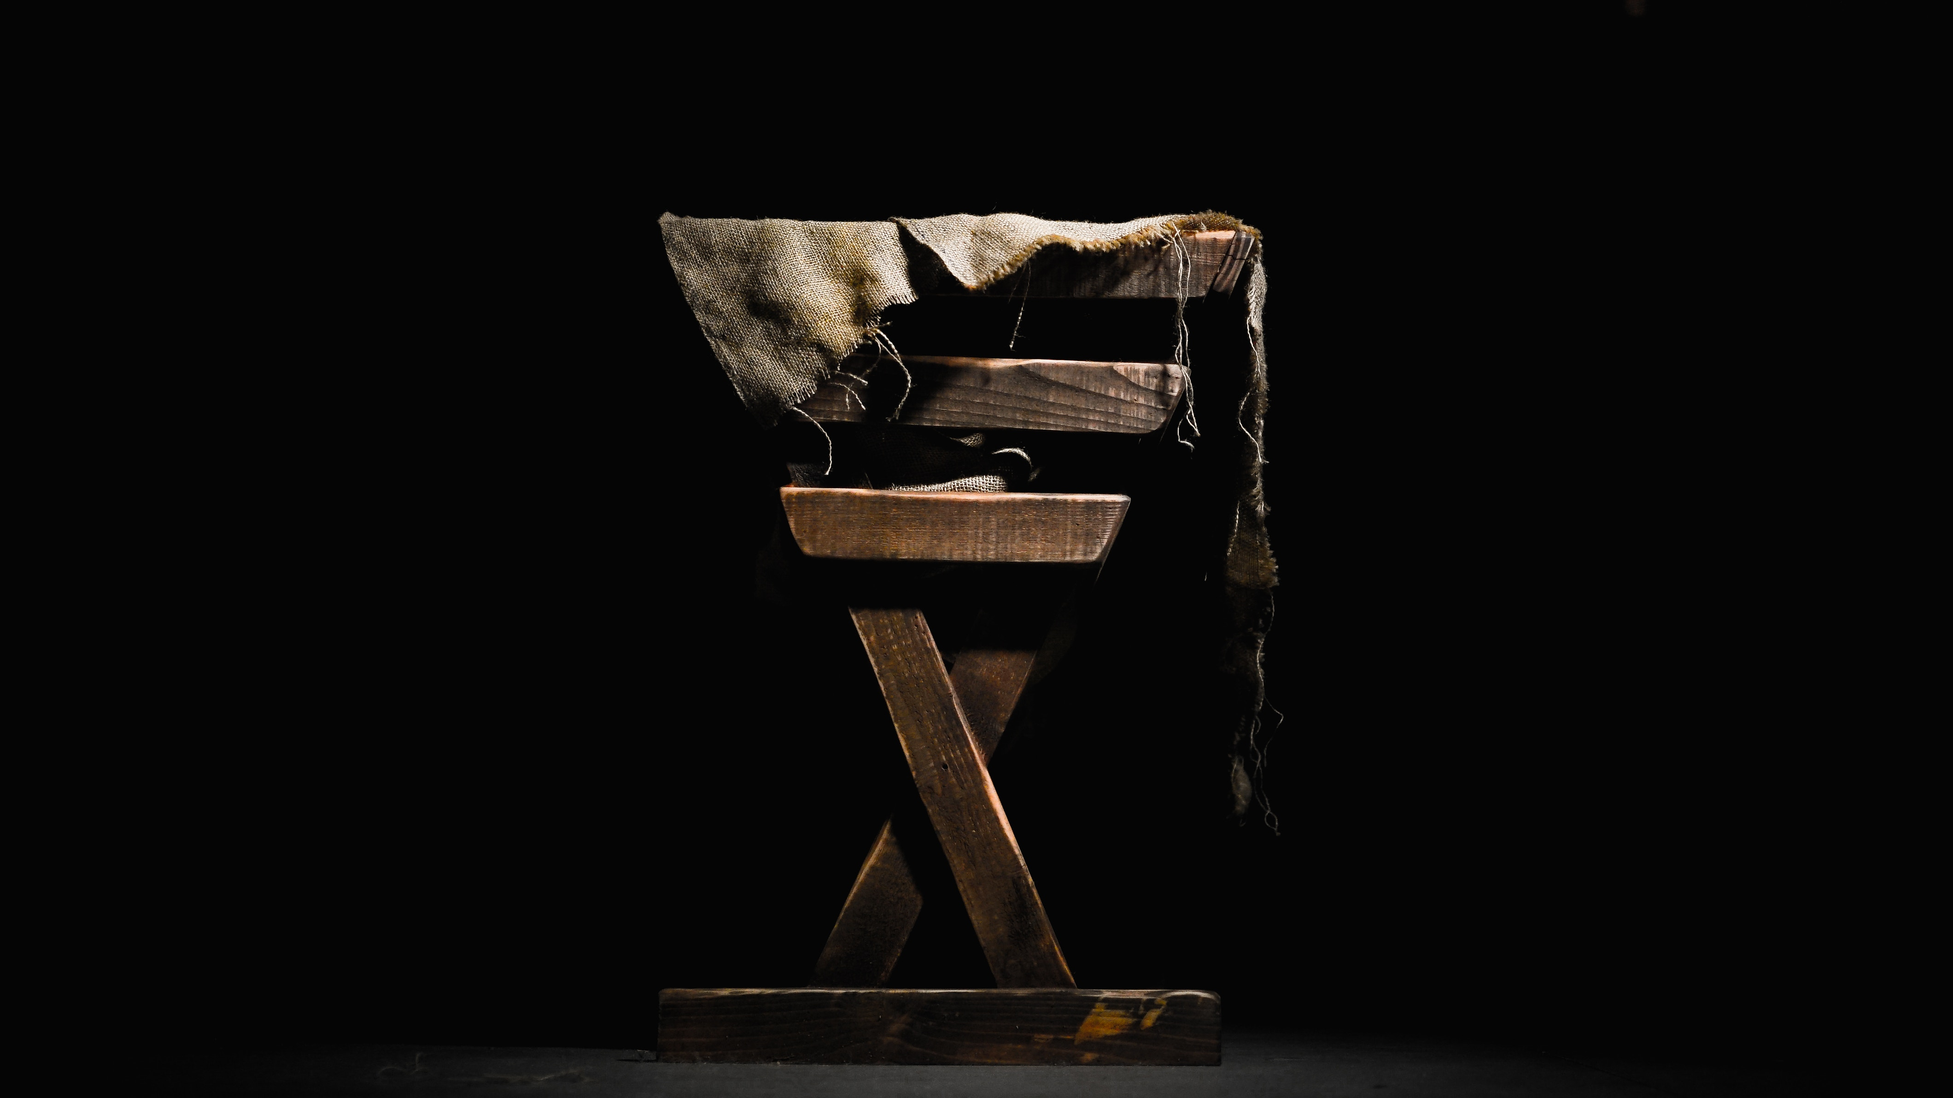
Jesus: Wonderful Counselor
* Jesus knows us better than we know ourselves
(John 2:25; Colossians 2:2-3)
* Jesus understands our needs
(Hebrews 4:15-16)
* We can trust His counsel
(Proverbs 3:5-6)

Slide 6
Jesus: Mighty God
* Jesus alone can deliver us from the power and penalty of sin
(Romans 6:5-14)
* Jesus helps us live the Christian life
(John 16:7; Matthew 28:20; 1 Peter 5:7; Ephesians 6:10)

