Slide 2
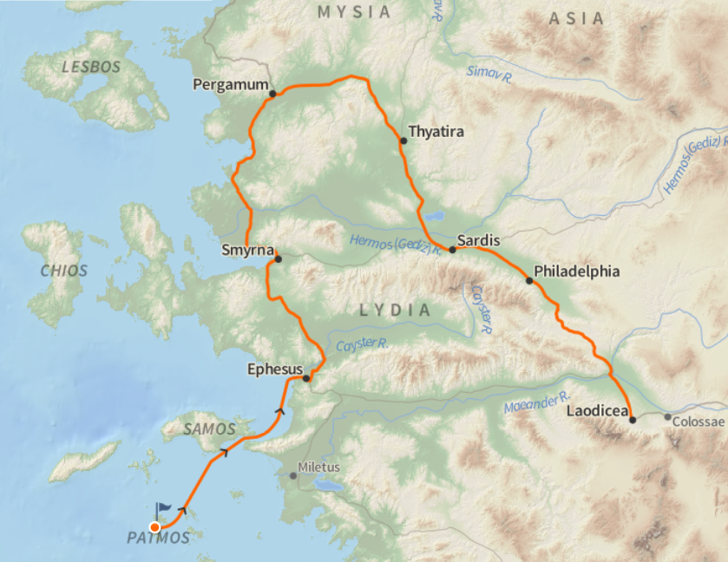
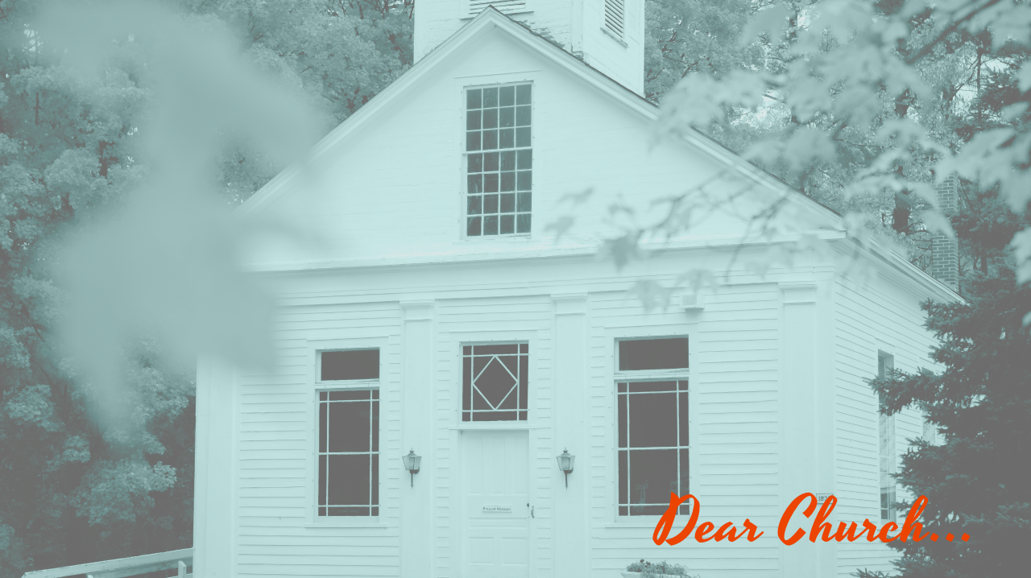
The Seven Churches
in Revelation chapters 2 and 3
These are within the boarders of modern day Turkey

Slide 3
Revelation 2:1-7 (English Standard Version – ESV)
1“To the angel of the church in Ephesus write: ‘The words of him who holds the seven stars in his right hand, who walks among the seven golden lampstands.
2 “‘I know your works, your toil and your patient endurance, and how you cannot bear with those who are evil, but have tested those who call themselves apostles and are not, and found them to be false.
3 I know you are enduring patiently and bearing up for my name's sake, and you have not grown weary.
4 But I have this against you, that you have abandoned the love you had at first.

Slide 4
Revelation 2:1-7 (English Standard Version – ESV)
5 Remember therefore from where you have fallen; repent, and do the works you did at first. If not, I will come to you and remove your lampstand from its place, unless you repent.
6 Yet this you have: you hate the works of the Nicolaitans, which I also hate.
7 He who has an ear, let him hear what the Spirit says to the churches. To the one who conquers I will grant to eat of the tree of life, which is in the paradise of God.’

Slide 5
What’s Good about the Church @ Ephesus? (vss 1-3,6)
* They work hard (vs 2)
* They persevere in tough times (vs 2,3)
* They don’t tolerant evil in the church (vs 2)
* They are spiritually discerning (vs 2)
* They would not compromise with the culture (vs 6)

Slide 6
What’s Wrong with the Church @ Ephesus? (vs 4)
* They Have Lost the Love They had at First

Slide 7
What’s the Remedy for the Church @ Ephesus? (vss 5,7)
* Remember, Repent, Repeat

