Slide 2
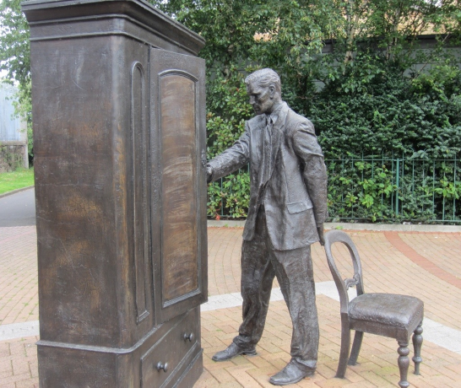
* C.S. Lewis looking into the wardrobe – a reminder to view life from the perspective of God’s sovereignty

Slide 3
Psalm 127:1-5 (English Standard Version – ESV)
1 Unless the Lord builds the house,
those who build it labor in vain.
Unless the Lord watches over the city,
the watchman stays awake in vain.
2 It is in vain that you rise up early
and go late to rest,
eating the bread of anxious toil;
for he gives to his beloved sleep.

Slide 4
Psalm 127:1-5 (English Standard Version – ESV)
3 Behold, children are a heritage from the Lord,
the fruit of the womb a reward.
4 Like arrows in the hand of a warrior
are the children of one's youth.
5 Blessed is the man
who fills his quiver with them!
He shall not be put to shame
when he speaks with his enemies in the gate.

Slide 5
* A satisfying life and having an eternal impact start with recognizing every good thing comes from God
(Psalm 127:1; James 1:17)

Slide 6
* When we do our part and trust God,
we can rest in His sovereign care
(Psalm 127:2; Proverbs 10:4,22;
Philippians 2:12,13)

Slide 7
* Children are just one of the many blessings that God gives us
(Psalm 127:3-5)

