Slide 2
Psalm 100:1-5 (English Standard Version – ESV)
1 Make a joyful noise to the Lord, all the earth!
2 Serve the Lord with gladness!
Come into his presence with singing!
3 Know that the Lord, he is God!
It is he who made us, and we are his;
we are his people, and the sheep of his pasture.

Slide 3
Psalm 100:1-5 (English Standard Version – ESV)
4 Enter his gates with thanksgiving,
and his courts with praise!
Give thanks to him; bless his name!
5 For the Lord is good;
his steadfast love endures forever,
and his faithfulness to all generations.

Slide 4
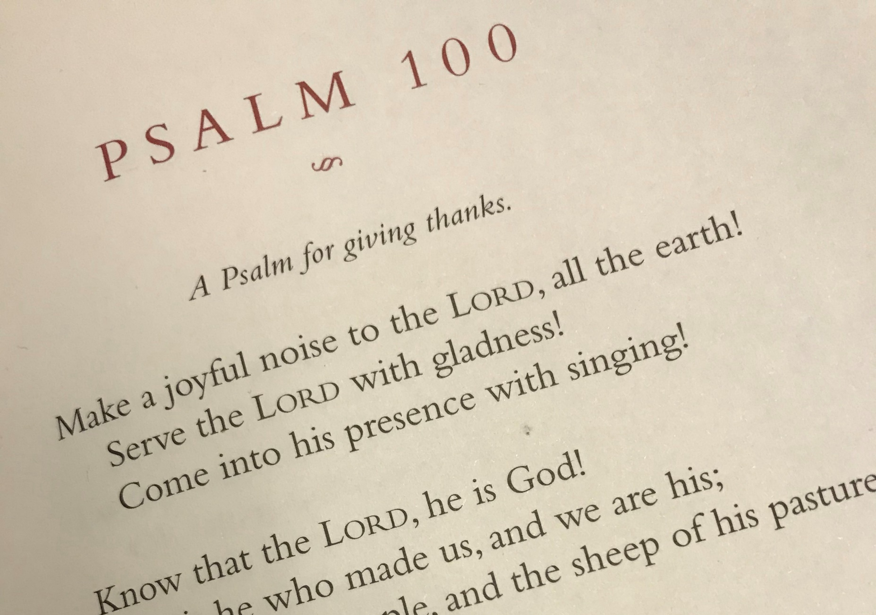

Slide 5
Ways to Give Thanks

Slide 6
Shouting

Slide 7
Serving

Slide 8
Singing

Slide 9
What We Know about God Evokes Praise and Thanksgiving

Slide 10
Psalm 100:1-5 (English Standard Version – ESV)
1 Make a joyful noise to the Lord, all the earth!
2 Serve the Lord with gladness!
Come into his presence with singing!
3 Know that the Lord, he is God!
It is he who made us, and we are his;
we are his people, and the sheep of his pasture.
4 Enter his gates with thanksgiving,
and his courts with praise!
Give thanks to him; bless his name!
5 For the Lord is good;
his steadfast love endures forever,
and his faithfulness to all generations.
Red = Heart / Feeling
Blue = Head / Knowing

Slide 11
“Worship must be vital and real in the heart, and worship must rest on a true perception of God. There must be spirit and there must be truth. . . . Truth without emotion produces dead orthodoxy and a church full (or half-full) of artificial admirers . . . . On the other hand, emotion without truth produces empty frenzy and cultivates shallow people who refuse the discipline of rigorous thought. But true worship comes from people who are deeply emotional and who love deep and sound doctrine. Strong affections for God rooted in truth are the bone and marrow of biblical worship.”
Desiring God pages 81–82
.

Slide 12
“Worship is grasping a truth about God and then letting that truth strike you in the center of your being. It thrills you, comforts you. That's when the truth has moved from left to right brain-from mind to heart. On the spot, it will change the way you feel. And from that moment on it will change the way you act. The whole brain, the whole person is affected.”
Tim Keller
.

Slide 13
He alone is God
and we are His

Slide 14
He is good, loving, and faithful

Slide 15
“What if I’m not feeling it?”

Slide 16
Don’t Settle for the Fog

Slide 17
Keep Seeking God, Trusting His Promises and Wait on Him

