Slide 1
The Full Armor of God
Partial
Ephesians 6:14; 18
Notes:
Good morning. This week is part two of a series from Nick Higgins and I…I just need to confess, his expectations of me are a bit over stated, as I don’t intend to cover the full armour of God this week, but just part of it…so lets fix that….

Slide 2
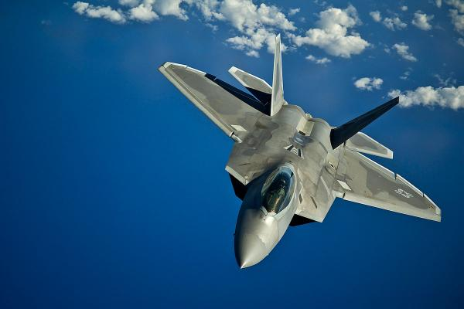
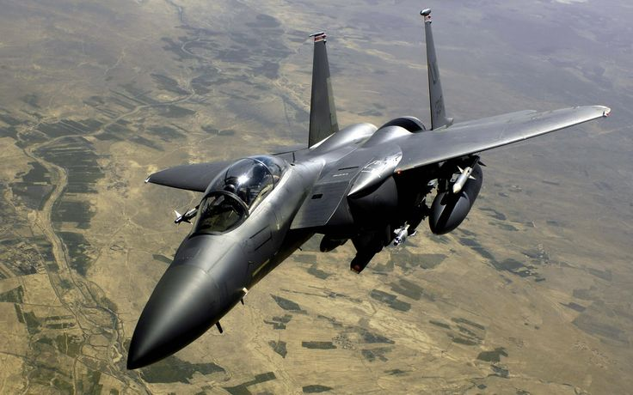
Notes:
Last week Nick Higgins talked about maintinaing “air superiority against the true enemy of us, Satan, the Devil, the Angel of light, or possibly the guy who invented that plastic packaging that is used in so many retail packages…cant use a knife, scissors, blow torch…but you can see what you bought!
If you missed last week, I’d encourage you to go back and listen to the message that Nick offered. HE started off our series in Ephesians 6, reviewing vs 10-13. Nick gave us recon and capability report of who we are fighting with…he was not implying “the devil made me do it” is reasonable assertion of our sin lives. Satan is a liar. He’s an influencer. But he’s no greater than us…who can also influence and lie. He’s created by God so he’s a welter weight taking a swing at a super heavy weight by bothering us…and he is competing with Christians to win the hearts of our friends and family. His attacks aren’t aimed to destroy you but to make us ineffective in reaching our friends with the gospel. That is why vs 13 ends with “stand firm”
So lets open with prayer and jump in.
Prayer
So last week, Nick shared about his career and showed these really cool planes…I want to start out talking about ….

Slide 3
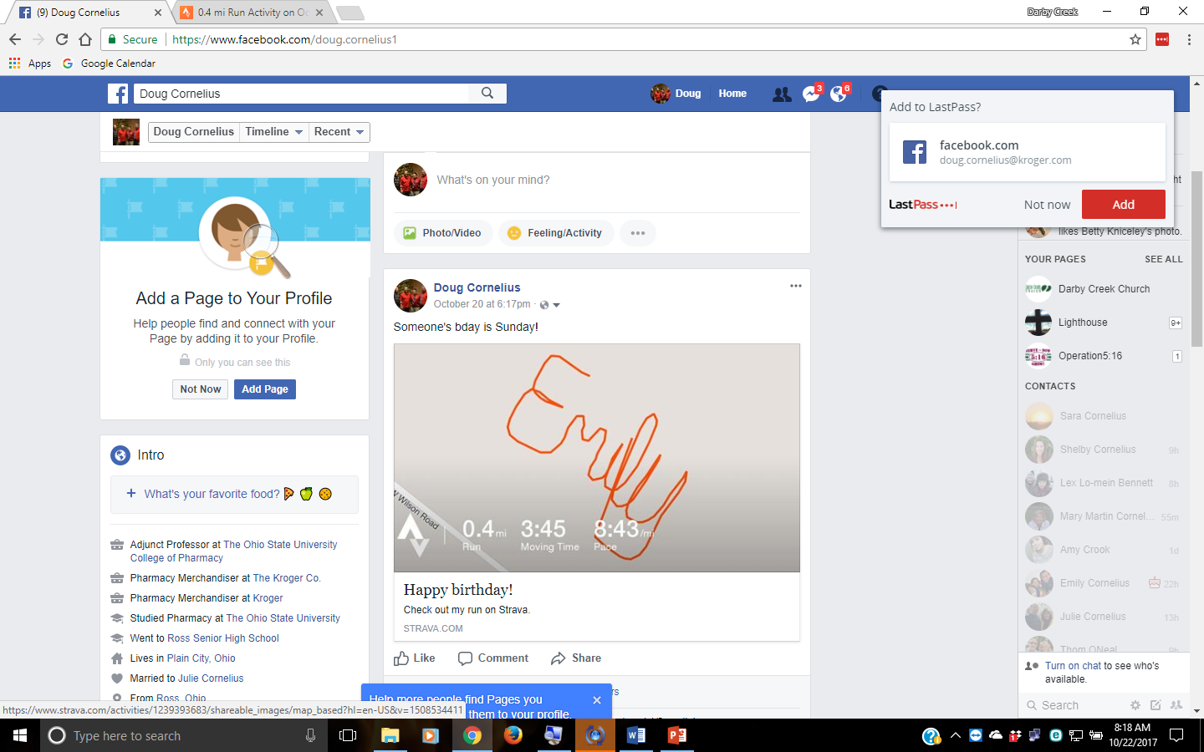

Slide 4
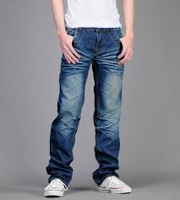
How do we know truth?
-Why stand? James 4:7b
-The belt is THE TRUTH
-found in Bible(WORD, not worLd)
John 18:37-38a
-exposed by science
Romans 1:18-20 ; Genesis 1:14
-exposed by the Holy Spirit
John 16:13; Philippians 4:8-9
Notes:
SO I’ve been in my career a little longer than Nick has been in his career (I help sell food and drugs to people) And for most of my career, I’ve been dress pants, shirt and tie…Then a couple of years ago ties went away except for meetings and store visits…then ties went away, but required a jacket at times….and now jeans are becoming more of a requirement to remove barriers some how.
But, run of the mill Kohl’s jeans don’t cut it…as a mature man of my stature, I should wear jeans that represent quality and taste…and I must admit, higher end jeans do feel good.
So I got a couple of pairs of the new world jeans, and simultaneously was losing weight…and, well, I got to wear a belt. Or I’m pulling my pants up all the time. Without the belt, I can’t focus on presentations, conversations, move quickly while carrying items…I become less effective. So that’s where we jump in this morning, standing firm with the belt of truth.
You are welcomed to look at all sorts of sites about the belt of truth to learn about the origins and purpose of the warrior’s belt, but I don’t want to spend time on history today…in fact I’m pretty sure you can look back in our old messages on the analogies of the WHOLE armor of God…today I just am touching on the partial armor of God
It is important that the war is explained to the Ephesians AFTER Paul writes about how we ought to live with other people. The breakdown of civilization is ignoring the truth, misapplication of the truth, or making a new truth.
Why take a stand? Make the devil flee. He is wanting to influence you to make you ineffective in reaching others for Christ…you got to take a stand…and reist him
The belt s the belt of truth…made up of, re[presenting truth In John 18:37-38 we read this interaction between Jesus and Pilate:
For this reason, I say truth is more than the word of God, but the word of God is truth. It’s understanding the things of God. It’s living a life that emulates those things…either your with Jesus or youre not.

Slide 5
-Belts surround us
-John 17:16-17 Real truth
stands on it’s own
-Truth isn’t knowledge. It’s life –changing
-Ephesians 4:25-27
-Substitutes can be more stylish
-2 Timothy 4:3-4
-BTW, God’s not dead, neither are His
people
Notes:
Yeah…belts surround us. They are close to our center of balance. They can pull pants up and shirts down…and this is God’s belt Jesus, praying for his followers said in John 17:17.
Not knowledge, life changing
Substitues can be more stylish, but they don’t surround us and you can’t really hang swords and opther things on them
Ata pastor’s conference, John Piper offered news….True Christianity is growing, popularity is waning, in spite of what Satan would have us believe:
only 45 percent of those raised in the Mainline Protestant tradition remain in Mainline churches. These are people who once identified themselves as affiliated with the mainline churches, which gave inflated numbers of Christian Protestant strength, but who believed and practiced very little true Christianity. Stetzer adds, “If Mainline Protestantism continues its trajectory, it is only a couple of generations from virtual extinction.”
But, of course, there are nominal Christians in every church and denomination. And increasingly those who used to check “affiliated” on the surveys are now checking “none” — no affiliation. Here are Stetzer’s conclusions from the most recent surveys:
Americans whose Christianity was nominal — in name only — are casting aside the name. They are now aligning publicly with what they’ve actually not believed all along.
The percentage of convictional Christians remains rather steady, but because the nominal Christians now are unaffiliated the overall percentage of self-identified Christians is decline. This overall decline is what Pew shows — and I expect it to accelerate. What we see from Pew is not the death-knell of Christianity, but another indication that Christianity in America is being refined.
From 2007 to 2014, the number of evangelicals in America rose from 59.8 million to 62.2 million. Christianity isn’t dying and no research says it is; the statistics about Christians in America are simply starting to show a clearer picture of what American Christianity is becoming — less nominal, more defined, and more outside of the mainstream of American culture. The cultural cost of calling yourself “Christian” is starting to outweigh the cultural benefit, so those who do not identify as a “Christian” according to their convictions are starting to identify as “nones” because it’s more culturally savvy.
Christianity is losing, and will continue to lose, its home field advantage; no one can (or should) deny this. However, the numerical decline of self-identified American Christianity is more of a purifying bloodletting than it is an arrow to the heart of the church. So if you picture a continuum with the mere absence of cultural benefits for Christians on one end, and the aggressive persecution of Christians on the other end, Christianity in America is now on that continuum and is moving from indifference to derision to exclusion to hostility.
What’s exciting is that millennials are seemingly less superficial as their needs are met. We see that as more companies start defining “purpose” and “mission” vs “value” and “experience.” They are less “religious,” but they are also less interested in non-religious institutions. They ARE very interested in truth, purpose, and mission, and what is greater than that of the mission, truth, and purpose from Jesus Christ…who incidently was also antireligious….surround yourself with truth
Incidently, when someone asks you about this that or the other, how do you form your answer? What does God’s word, creation, and Holy spirit tell you about this that and the other?

Slide 6
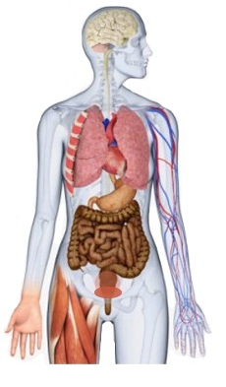
-Righteousness is what people see, experience
-Roman 13:13-14
-Not what is imputed, but representative of
God
-Isaiah 59:16-18
-Not self-righteousness
-Romans 3:10
-Philippians 3:3-9
Notes:
Adter the belt, of truth comes the breastplat of righteousness.. It’s what friends and foe see, as it is so big, covering vital organs. This righteouseness is not the righteousness described in 1 Coritnthians 1:30…imputed righteouseness that gets us into heaven…but the rightness of God described in Isaiah 59:16-18
So, we need to live in a way that represents a God-designed, holy lifestyle. Knowing truth is key. To live that way we protect the heart and our gut, with the armor of God, not self-righteouseness Philippians:
Circumcised-Israelite, God’s chosen people
Benjamanite-Joseph’s favorite brother; son of Jacobs favored wife
Pharisee-highly educated, legal mind

Slide 7
-Protection for what we “miss”
-The Heart – thoughts, value
-Proverbs 23:12,15,17,19,20
-Jeremiah 17:9
-The gut – feelings, emotions
-Ephesians 4:14-15
-Ephesians 4:26-32
Protects thoughts and feelings
Notes:
For a soldier, the breastplate, body armor, whatever isn’t so much to protect you from the foe you are engaged with, but from that unseen arrow, dart, bullet. Your righteouseness protects your reputation and that of your savior
Heart represents how we think, apply effort,
Gut-feelings, emotions
NOTE “TRUTH”

Slide 8
¹⁵ and having shod your feet with the preparation of the gospel of peace; ¹⁶ in addition to all, taking up the shield of faith with which you will be able to extinguish all the flaming arrows of the evil one. ¹⁷ And take the helmet of salvation, and the sword of the Spirit, which is the word of God.
REALLY IMPORTANT,
But later

Slide 9
¹⁸ With all prayer and petition pray at all times in the Spirit, and with this in view, be on the alert with all perseverance and petition for all the saints, ¹⁹ and pray on my behalf, that utterance may be given to me in the opening of my mouth, to make known with boldness the mystery of the gospel, ²⁰ for which I am an ambassador in chains; that in proclaiming it I may speak boldly, as I ought to speak.
Connection with HQ
Notes:
Mark 9 17-29 17A man in the crowd answered, “Teacher, I brought you my son, who is possessed by a spirit that has robbed him of speech. 18Whenever it seizes him, it throws him to the ground. He foams at the mouth, gnashes his teeth and becomes rigid. I asked your disciples to drive out the spirit, but they could not.”
19 “You unbelieving generation,”Jesus replied, “how long shall I stay with you? How long shall I put up with you? Bring the boy to me.”
20So they brought him. When the spirit saw Jesus, it immediately threw the boy into a convulsion. He fell to the ground and rolled around, foaming at the mouth.
21Jesus asked the boy’s father, “How long has he been like this?”
“From childhood,” he answered. 22“It has often thrown him into fire or water to kill him. But if you can do anything, take pity on us and help us.”
23 “ ‘If you can’?”said Jesus. “Everything is possible for one who believes.”
24Immediately the boy’s father exclaimed, “I do believe; help me overcome my unbelief!”
25When Jesus saw that a crowd was running to the scene, he rebuked the impure spirit. “You deaf and mute spirit,”he said, “I command you, come out of him and never enter him again.”
26The spirit shrieked, convulsed him violently and came out. The boy looked so much like a corpse that many said, “He’s dead.” 27But Jesus took him by the hand and lifted him to his feet, and he stood up.
28After Jesus had gone indoors, his disciples asked him privately, “Why couldn’t we drive it out?”
29He replied, “This kind can come out only by prayer.

Slide 10
Stand Firm in the Truth
Great Prayers
“Lord, the God of heaven, the great and awesome God, who keeps his covenant of love with those who love him and keep his commandments, ⁶ let your ear be attentive and your eyes open to hear the prayer your servant is praying before you day and night for your servants, the people of Israel. I confess the sins we Israelites, including myself and my father’s family, have committed against you.⁷ We have acted very wickedly toward you. We have not obeyed the commands, decrees and laws you gave your servant Moses.
⁸ “Remember the instruction you gave your servant Moses, saying, ‘If you are unfaithful, I will scatter you among the nations, ⁹ but if you return to me and obey my commands, then even if your exiled people are at the farthest horizon, I will gather them from there and bring them to the place I have chosen as a dwelling for my Name.’
¹⁰ “They are your servants and your people, whom you redeemed by your great strength and your mighty hand. ¹¹ Lord, let your ear be attentive to the prayer of this your servant and to the prayer of your servants who delight in revering your name. Give your servant success today by granting him favor in the presence of this man.”
Notes:
Nehemiah 1-2:9

Slide 11
Stand Firm in the Truth
Great Prayers
Jabez cried out to the God of Israel, “Oh, that you would bless me and enlarge my territory! Let your hand be with me, and keep me from harm so that I will be free from pain.” And God granted his request.
Lord, how many are my foes! How many rise up against me! Many are saying of me, “God will not deliver him.” But you, Lord, are a shield around me, my glory, the One who lifts my head high. I call out to the Lord, and he answers me from his holy mountain.
I lie down and sleep; I wake again, because the Lord sustains me. I will not fear though tens of thousands assail me on every side. Arise, Lord! Deliver me, my God! Strike all my enemies on the jaw; break the teeth of the wicked. From the Lord comes deliverance.May your blessing be on your people.
My heart rejoices in the Lord; in the Lord my horn is lifted high. My mouth boasts over my enemies, for I delight in your deliverance. “There is no one holy like the Lord; there is no one besides you; there is no Rock like our God.
Notes:
Jabez
Davis
Hannah

Slide 12
Stand Firm in the Truth
Great Prayers
Create in me a pure heart, O God,and renew a steadfast spirit within me. Do not cast me from your presence or take your Holy Spirit from me.
…give attention to your servant’s prayer and his plea for mercy, Lord my God. Hear the cry and the prayer that your servant is praying in your presence this day. May your eyes be open toward this temple night and day, this place of which you said, ‘My Name shall be there,’ so that you will hear the prayer your servant prays toward this place. Hear the supplication of your servant and of your people Israel when they pray toward this place. Hear from heaven, your dwelling place, and when you hear, forgive.
I will remain in the world no longer, but they are still in the world,and I am coming to you. Holy Father, protect them by the power of^{[a]}your name, the name you gave me, so that they may be one as we are one.
Notes:
David
Solomon
Jesus

Slide 13
Stand Firm in the Truth
Great Prayers
I have not stopped giving thanks for you, remembering you in my prayers. I keep asking that the God of our Lord Jesus Christ, the glorious Father, may give you the Spirit^{[a]} of wisdom and revelation, so that you may know him better. I pray that the eyes of your heart may be enlightened in order that you may know the hope to which he has called you, the riches of his glorious inheritance in his holy people, and his incomparably great power for us who believe
I pray that out of his glorious riches he may strengthen you with power through his Spirit in your inner being, so that Christ may dwell in your hearts through faith. And I pray that you, being rooted and established in love, may have power, together with all the Lord’s holy people, to grasp how wide and long and high and deep is the love of Christ, and to know this love that surpasses knowledge—that you may be filled to the measure of all the fullness of God.
²⁰ Now to him who is able to do immeasurably more than all we ask or imagine, according to his power that is at work within us,
We continually ask God to fill you with the knowledge of his will through all the wisdom and understanding that the Spirit gives, so that you may live a life worthy of the Lord and please him in every way: bearing fruit in every good work, growing in the knowledge of God, being strengthened with all power according to his glorious might so that you may have great endurance and patience
Notes:
Paul
Paul
Story from Ironside about church who gave up corporate prayer as a challeneg

Slide 14
Stand Firm in the Truth
Truth Righteousness Prayer
Seek it
Test it
Put it on
Live it
Just
Do
It
James 5:16 Therefore confess your sins to each other and pray for each other so that you may be healed. The prayer of a righteous person is powerful and effective.

