Slide 1
Stand Firm in the Truth
Ephesians 6:10-13

Slide 2
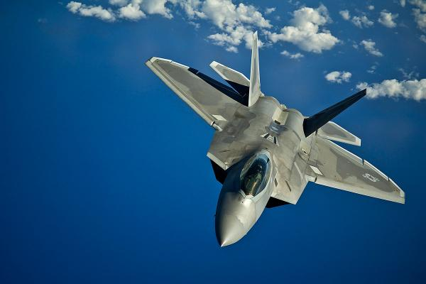
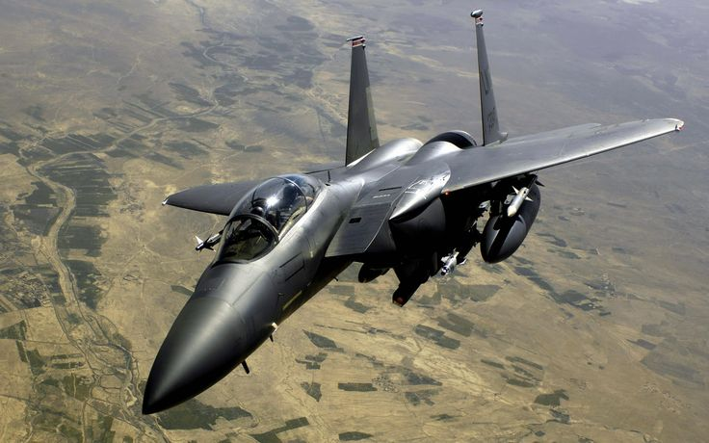

Slide 3
¹⁰ Finally, be strong in the Lord and in the strength of His might. ¹¹ Put on the full armor of God, so that you will be able to stand firm against the schemes of the devil. ¹² For our struggle is not against flesh and blood, but against the rulers, against the powers, against the world forces of this darkness, against the spiritual forces of wickedness in the heavenly places. ¹³ Therefore, take up the full armor of God, so that you will be able to resist in the evil day, and having done everything, to stand firm.

Slide 4
¹⁴ Stand firm therefore, having girded your loins with truth, and having put on the breastplate of righteousness, ¹⁵ and having shod your feet with the preparation of the gospel of peace; ¹⁶ in addition to all, taking up the shield of faith with which you will be able to extinguish all the flaming arrows of the evil one. ¹⁷ And take the helmet of salvation, and the sword of the Spirit, which is the word of God.

Slide 5
¹⁸ With all prayer and petition pray at all times in the Spirit, and with this in view, be on the alert with all perseverance and petition for all the saints, ¹⁹ and pray on my behalf, that utterance may be given to me in the opening of my mouth, to make known with boldness the mystery of the gospel, ²⁰ for which I am an ambassador in chains; that in proclaiming it I may speak boldly, as I ought to speak.

Slide 6
Stand Firm in the Truth
Focus on the Lord and in the strength of His might
Ephesians 6:10

Slide 7
Stand Firm in the Truth
Be aware that we have an enemy
Ephesians 6:11-12

Slide 8
Stand Firm in the Truth
Know and believe in the Truth
Ephesians 6:13

Slide 9
Stand Firm in the Truth
Answers for truth are not found in the world,
they are found in the Word!

