Slide 2
Psalm 1:1-6 (English Standard Version – ESV)
1 Blessed is the man
who walks not in the counsel of the wicked,
nor stands in the way of sinners,
nor sits in the seat of scoffers;
2 but his delight is in the law of the Lord,
and on his law he meditates day and night.
3 He is like a tree
planted by streams of water that yields its fruit in its season,
and its leaf does not wither. In all that he does, he prospers.

Slide 3
Psalm 1:1-6 (English Standard Version – ESV)
4 The wicked are not so,
but are like chaff that the wind drives away.
5 Therefore the wicked will not stand in the judgment,
nor sinners in the congregation of the righteous;
6 for the Lord knows the way of the righteous,
but the way of the wicked will perish.

Slide 4
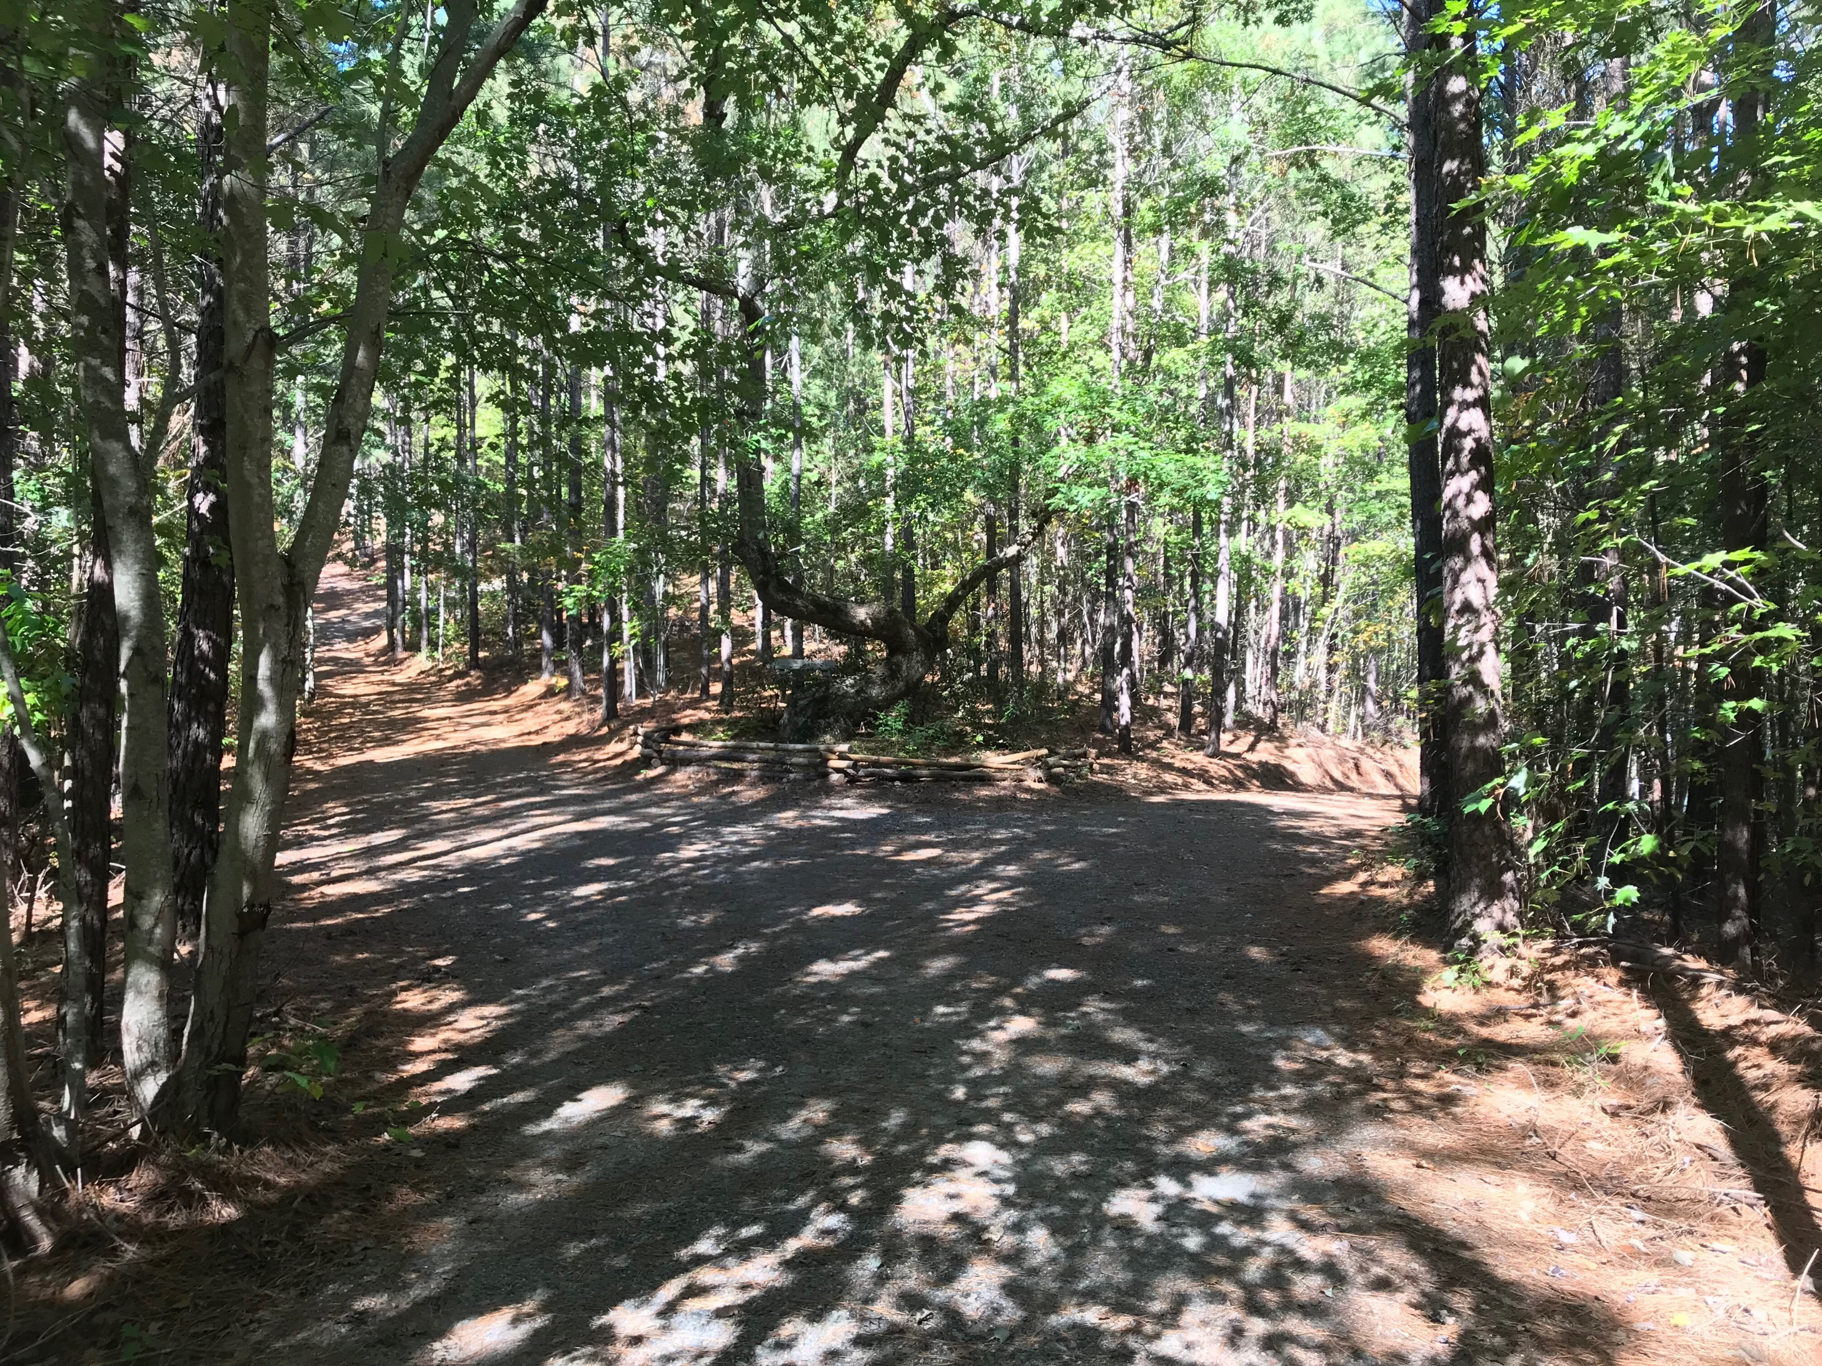
Two Ways to Live

Slide 5
The Godly Person is Distinct from the World

Slide 6
The Godly Person is Drenched with the Word

Slide 7
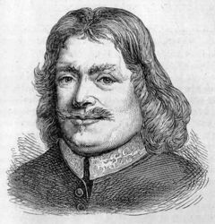
Charles Spurgeon once remarked about John Bunyan, “Why, this man is a living Bible! Prick him anywhere; his blood is Bibline, the very essence of the Bible flows from him. He cannot speak without quoting a text, for his very soul is full of the Word of God.”

Slide 8
He is Like a Tree
Planted by Streams of Water

Slide 9
The Ungodly Person is Eternally Condemned

