Slide 1
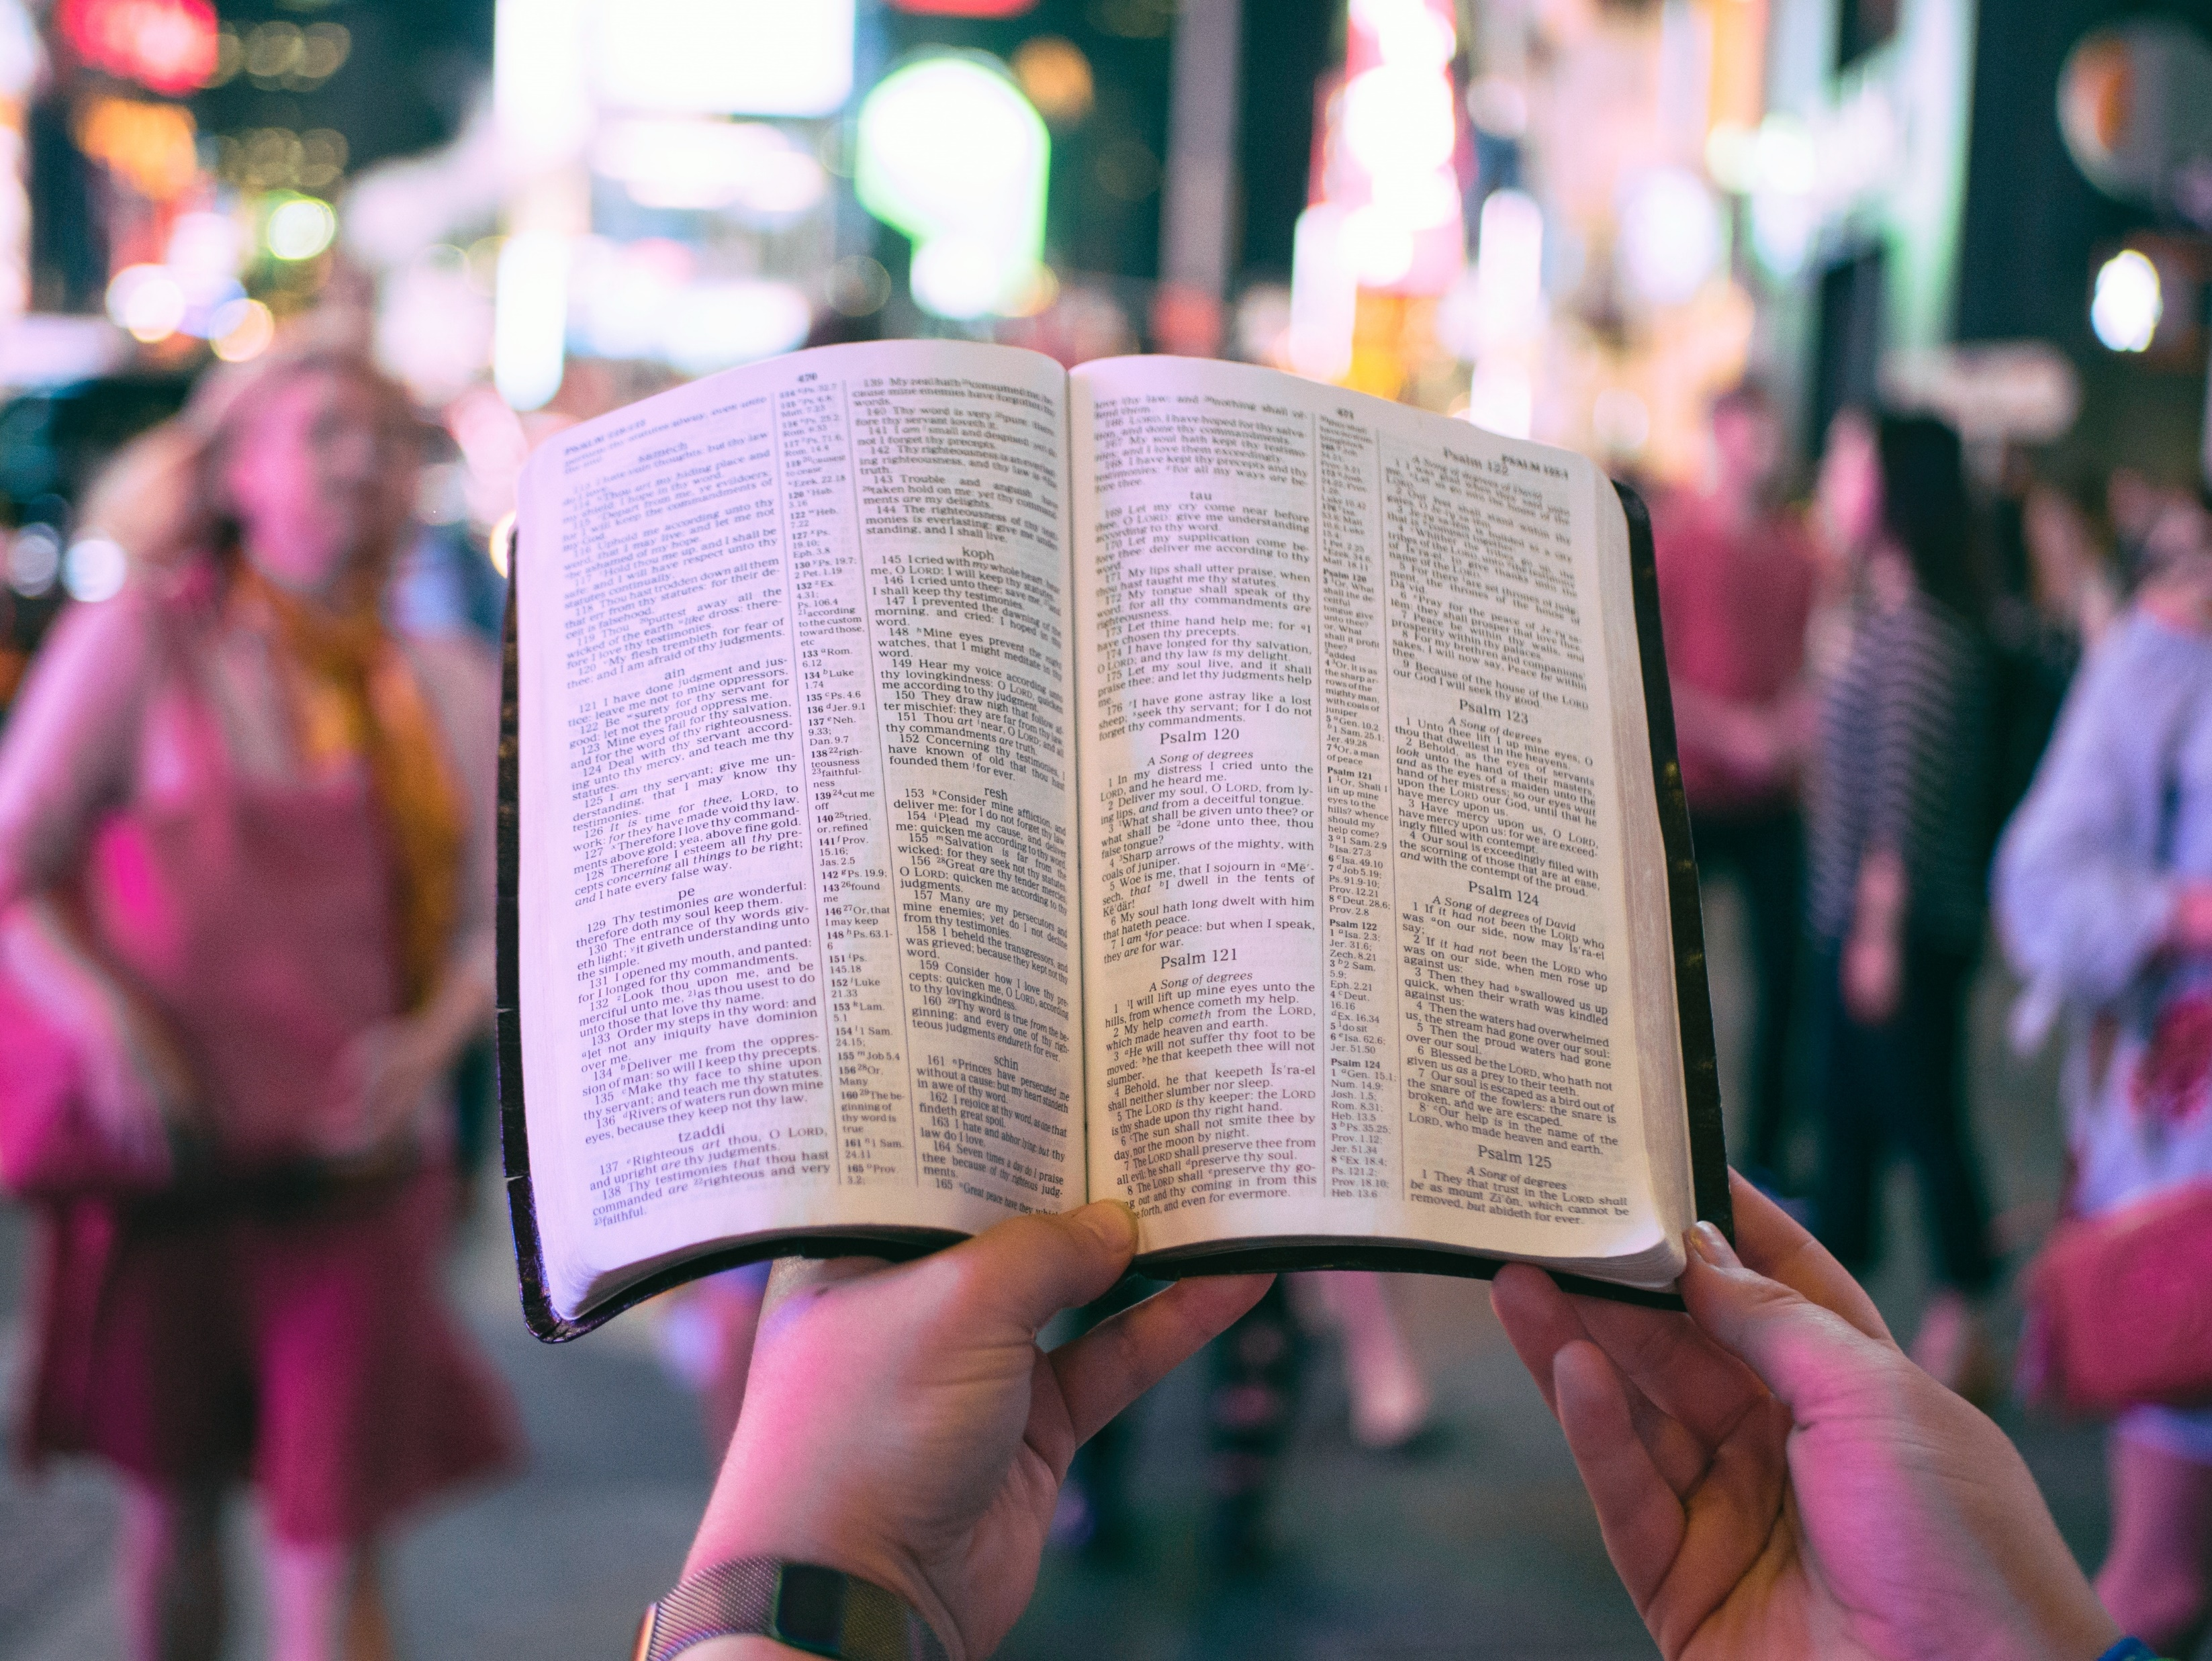
God’s Word
2 Timothy 3:14-17

Slide 2
2 Timothy 3:14-17 (English Standard Version)
14 But as for you, continue in what you have learned and have firmly believed, knowing from whom you learned it
15 and how from childhood you have been acquainted with the sacred writings, which are able to make you wise for salvation through faith in Christ Jesus.
16 All Scripture is breathed out by God and profitable for teaching, for reproof, for correction, and for training in righteousness,
17 that the man of God may be complete, equipped for every good work.

Slide 3
The Bible is God’s authoritative word over all people.
2 Timothy 3:16a

Slide 4
The regular intake and application of God’s Word enables us to do what God calls us to do
2 Timothy 3:16b-17

Slide 5
S.P.A.C.E.P.E.T.S.
Is there a SIN to confess? Does God’s Word make you aware of something you need to make right with God?
Is there a PROMISE to claim? There are more than 7,000 promises in God’s Word. Ask yourself if the passage you’ve read contains a universal promise. Ask whether you’ve met all the conditions of the promise. Every promise has a premise!
Is there an ATTITUDE to change? Is there something you need to think about differently? Do you need to work on a negative attitude, worry, guilt, fear, loneliness, bitterness, pride, apathy, or ego?

Slide 6
S.P.A.C.E.P.E.T.S.
Is there a COMMAND to obey? Is there a command you need to obey, no matter how you feel?
Is there an EXAMPLE to follow? Are there positive examples to follow or negative examples to avoid?
Is there a PRAYER to pray? Paul, David, Solomon, Elijah, and Isaiah, among others, pray in the Bible. You can use their prayers and know that they’ll be answered because they’re in the Bible and in God’s will.

Slide 7
S.P.A.C.E.P.E.T.S.
Is there an ERROR to avoid? It’s wise to learn from experience, and it’s even wiser to learn from the experience of others! We don’t have time to make all the mistakes ourselves. So what can you learn from the mistakes of those in Scripture?
Is there a TRUTH to believe? Often, we’ll read something in Scripture that we can’t do anything about. We simply have to believe what it says about God the Father, Jesus, the Holy Spirit, the past, the future, Heaven, Hell, or other topics in the Bible.

Slide 8
S.P.A.C.E.P.E.T.S.
Is there SOMETHING for which to praise God? You can always find something in a passage you can be grateful to God for, like something God has done or protected you from.

Slide 9
God’s Word
2 Timothy 3:14-17

