Slide 1
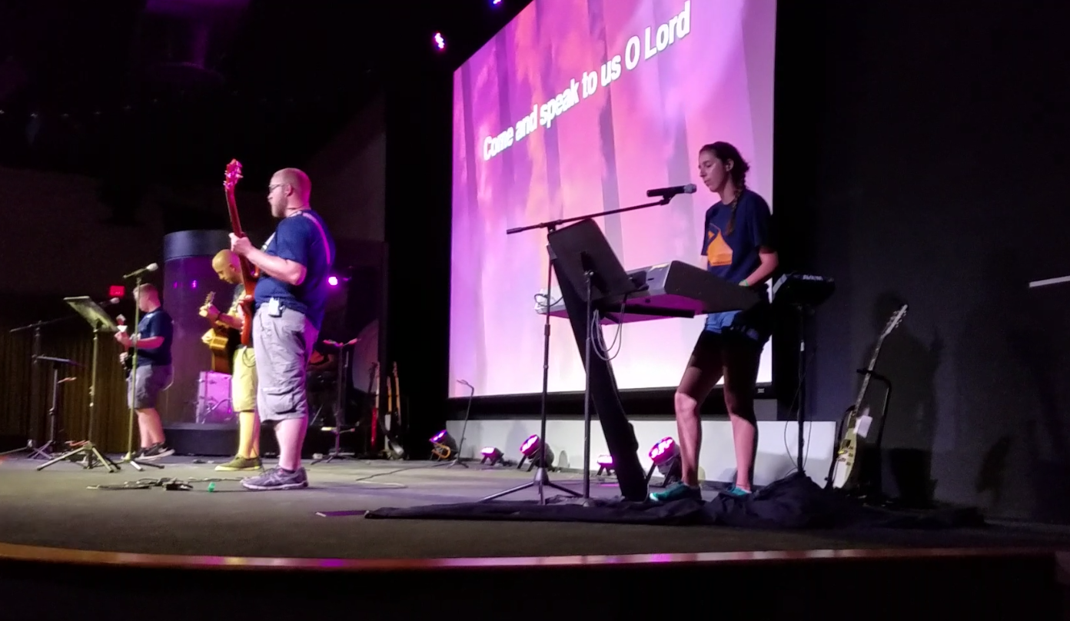
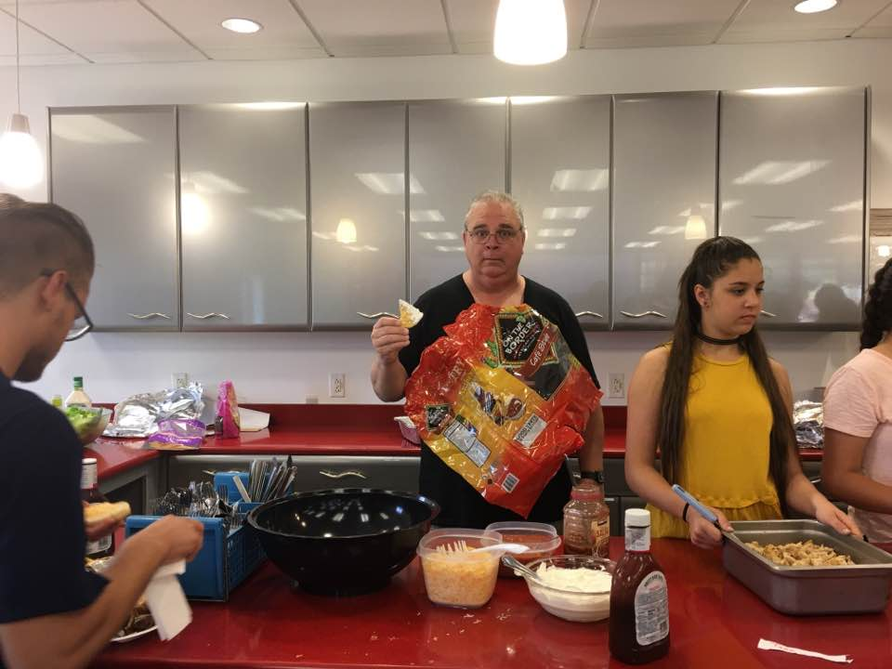
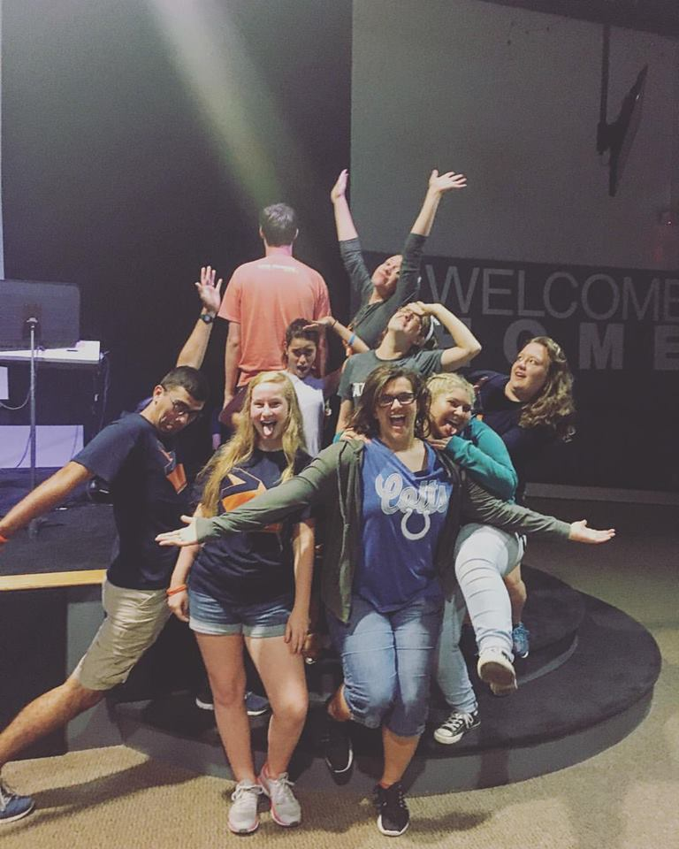
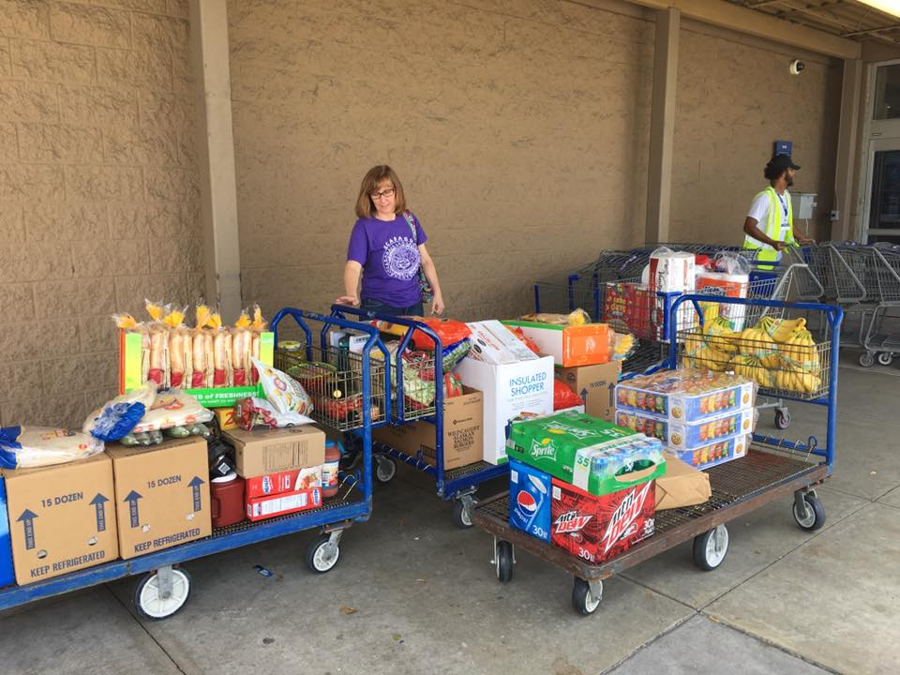
The Rock – Miami, FL
Awaken – Jacksonville, Fl
Vintage – St.Petersburg, FL
Oakridge – Clarksville, MD
Pneuma – Wilmington, NC
Howell CC – Howell, NJ
Darby Creek – Galloway, OH
Ablaze – Blacksburg, VA

Slide 2
Are you ready for church growth and spreading the gospel?
Do you trust the Bible?

Slide 3
By this all people will know that you are my disciples, if you have love for one another.
-Jesus, (John 13:35)

Slide 4
They profess to know God, but they deny him by their works. They are detestable, disobedient, unfit for any good work. Titus 1: 16

Slide 5
That the word of God may not be reviled; having nothing evil to say about us.
Older men
Older women
Young women
Younger men

Slide 6
Older men
Sober-minded/Temperate
Dignified/worthy of respect
Self controlled
Sound in faith
Sound in love
Sound in endurance

Slide 7
Older women
Reverant
Teach what is good
Train young women

Slide 8
Young Women
Love husbands and children
Be Self controlled
Be Pure
Working at home
Kindness
Submissive to their OWN husband

Slide 9
Younger men
Self controlled
Model of good works
Have integrity & Dignity
Sound in speech

Slide 10
Not about limitations, but purpose
For the grace of God has appeared, bringing salvation for all people,¹² training us to renounce ungodliness and worldly passions, and to live self-controlled, upright, and godly lives in the present age, ¹³ waiting for our blessed hope, the appearing of the glory of our great God and Savior Jesus Christ, ¹⁴ who gave himself for us to redeem us from all lawlessness and to purify for himself a people for his own possession who are zealous for good works.¹⁵ Declare these things; exhort and rebuke with all authority. Let no one disregard you.

Slide 11
Who do you know?
What do you do?
What do you talk about?

Slide 12
I want you to insist on these things, so that those who have believed in God may be careful to devote themselves to good works.

