Slide 1
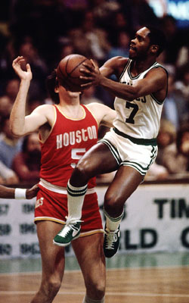
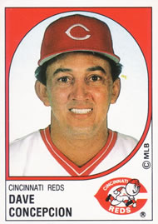
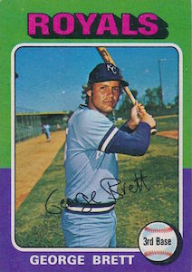

Slide 2
Timothy: Shaped by God’s Grace
2 Timothy 1:1-7

Slide 3
2 Timothy 1:1-7 (English Standard Version)
1 Paul, an apostle of Christ Jesus by the will of God according to the promise of the life that is in Christ Jesus,
2 To Timothy, my beloved child: Grace, mercy, and peace from God the Father and Christ Jesus our Lord.
3 I thank God whom I serve, as did my ancestors, with a clear conscience, as I remember you constantly in my prayers night and day.
4 As I remember your tears, I long to see you, that I may be filled with joy.

Slide 4
2 Timothy 1:1-7 (English Standard Version)
5 I am reminded of your sincere faith, a faith that dwelt first in your grandmother Lois and your mother Eunice and now, I am sure, dwells in you as well.
6 For this reason I remind you to fan into flame the gift of God, which is in you through the laying on of my hands,
7 for God gave us a spirit not of fear but of power and love and self-control.

Slide 5
Timothy: Shaped by God’s Grace
2 Timothy 1:1-7

Slide 6
Influences God Used to Shape
Timothy’s Life and Ministry
1. A Godly Mother and Grandmother
2 Timothy 1:5

Slide 7
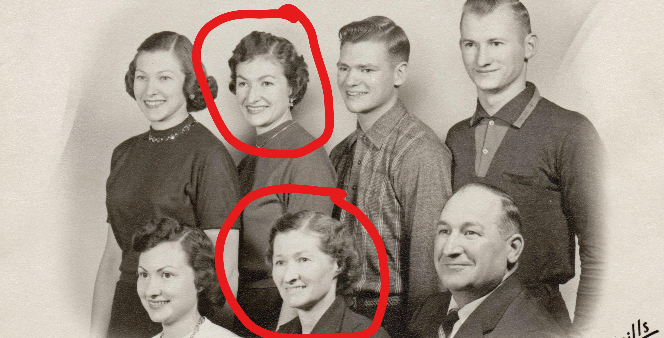

Slide 8
Influences God Used to Shape
Timothy’s Life and Ministry
2. Paul, his Spiritual Mentor
2 Timothy 1:2-4

Slide 9
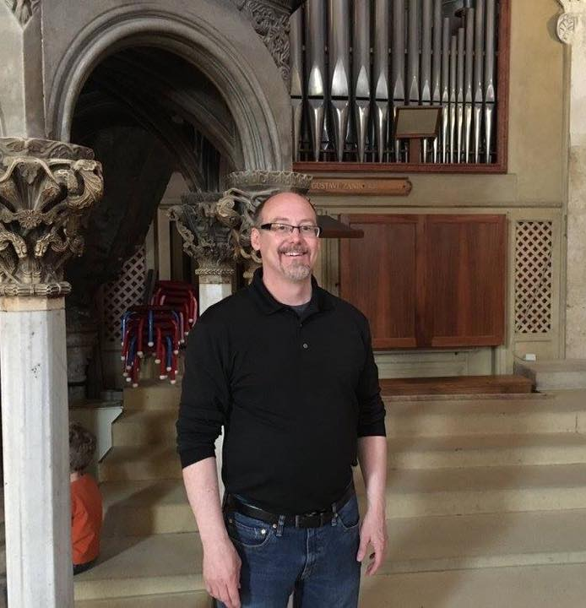
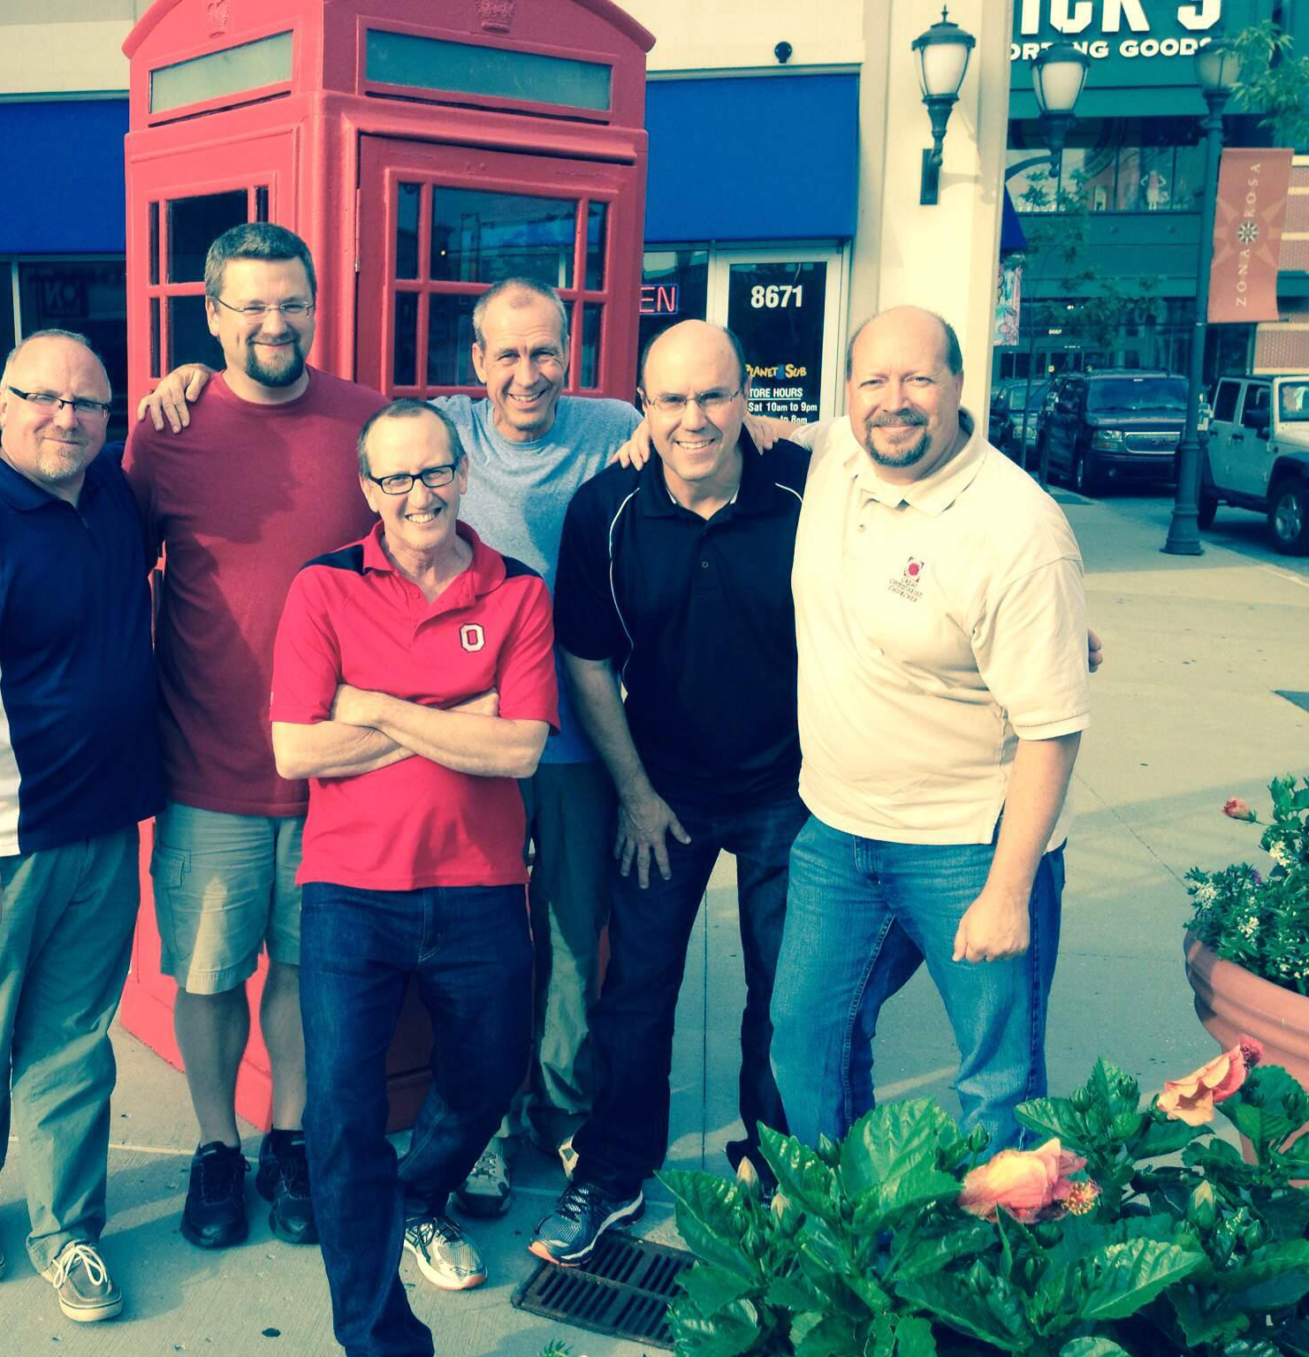

Slide 10
Influences God Used to Shape
Timothy’s Life and Ministry
3. The Spirit and his Spiritual Gifts
2 Timothy 1:6-7

Slide 11
Timothy: Shaped by God’s Grace
2 Timothy 1:1-7

